Slide 1
LECTURE 04
Gaussian Beams & Beam Optics
Complex q-Parameter · ABCD Kogelnik Law · Focused Beam Worked Example
Linear Optics Course · All formulas typeset with LaTeX

Slide 2
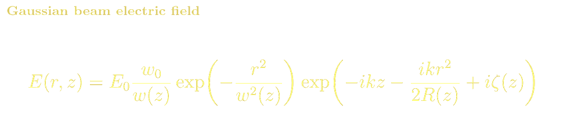
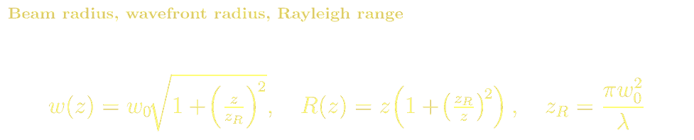
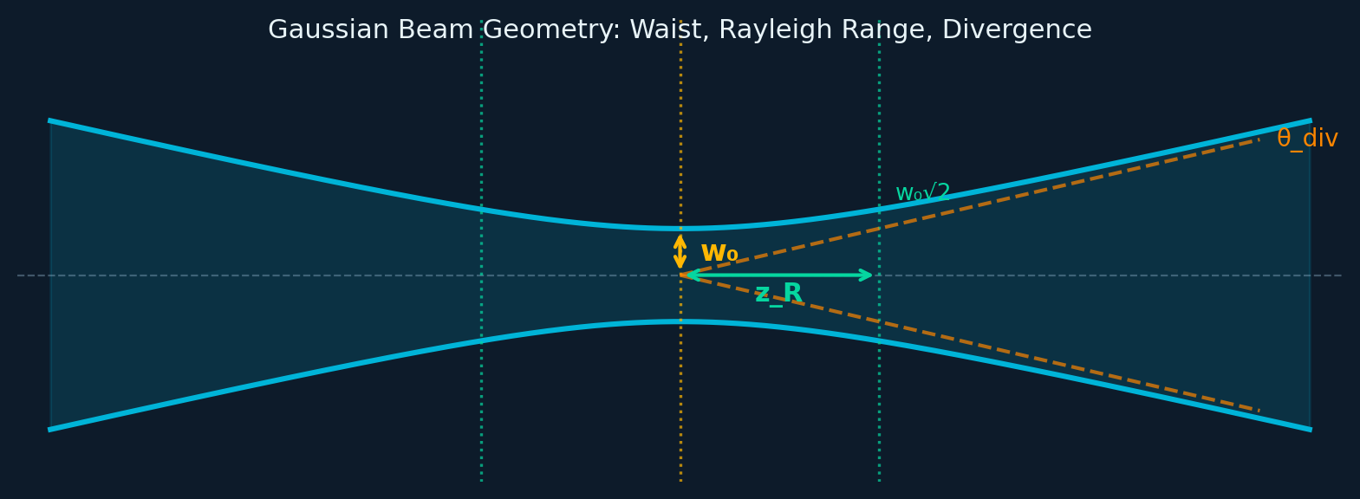
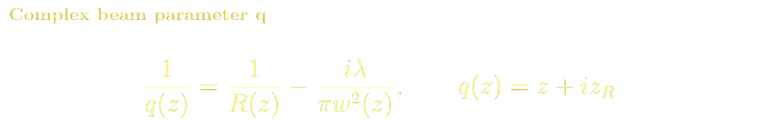
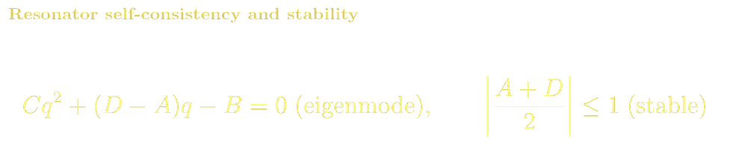
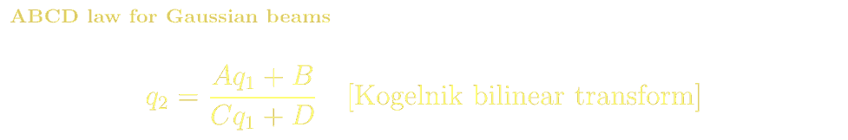
GAUSSIAN BEAMS
Gaussian Beam: Field, Parameters & Geometry
Resonator Self-Consistency

Slide 3
GAUSSIAN BEAMS
Complex q-Parameter & ABCD Kogelnik Transform
The q-parameter ABCD law (Kogelnik bilinear transform) is the same 2×2 matrix as in geometric ray optics — unifying ray and wave treatments of paraxial beams:
Free space (d)
Thin lens (f)
Resonator eigenmode
M=[1,d;0,1]
q₂=q₁+d
(beam expands)
M=[1,0;−1/f,1]
1/q₂=1/q₁−1/f
(curvature shift)
M=[A,B;C,D]
Cq²+(D−A)q−B=0
(stable mode)

Slide 4
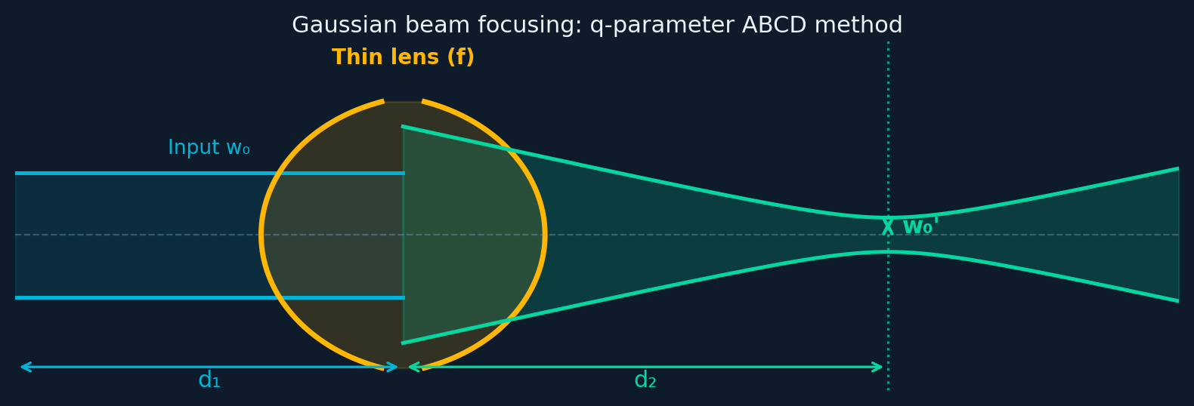
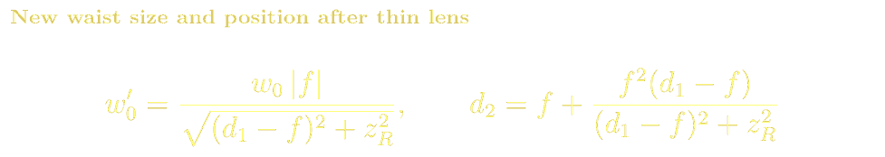
GAUSSIAN BEAMS
Worked Example: Focusing a Gaussian Beam with a Thin Lens
A Gaussian beam (waist w₀ at z=0) propagates to a thin lens at z=d₁, then focuses to waist w₀' at d₂ beyond the lens. We use the q-parameter ABCD method:
Numerical Example & Special Cases
λ=1064nm, w₀=1mm, d₁=500mm, f=200mm
z_R = πw₀²/λ = π×1²/0.001064 = 2953 mm
d₁−f = 500−200 = 300 mm
w₀' = 1×200/√(300²+2953²) = 200/2966 ≈ 0.0674 mm
New z_R' = π(0.0674)²/0.001064 ≈ 13.4 mm
Special: d₁=f → w₀'=fλ/(πw₀): lens Fourier-transforms beam!
Special: z_R>>f → w₀'≈fλ/(πw₀): diffraction limit
Key Physical Insights
Focusing tighter requires larger input beam w₀
Diffraction limit: w₀'=fλ/(πw₀) — cannot beat λ/NA
M² factor: real beams w₀'θ=M²λ/π, M²=1 ideal Gaussian

Slide 5
GAUSSIAN BEAMS · REFERENCES
Gaussian Beams: References, Problems & Projects
BSc References & Reading
MSc / Advanced References
Saleh & Teich, Fundamentals of Photonics Ch. 3: Gaussian beam optics — clear and complete.
Hecht, Optics Ch. 5.6: beam optics and coherence.
Svelto, Principles of Lasers Ch. 4: Gaussian modes in laser cavities.
Siegman, Lasers Ch. 16–20: definitive Gaussian beams, ABCD, and resonators.
Kogelnik & Li (1966) Proc. IEEE 54, 1312: original ABCD Gaussian beam paper.
ISO 11146: Laser beam characterisation (M² measurement standard).
Problem Sets & Projects
[BSc] HeNe laser (λ=633nm), w₀=0.5mm. Calculate beam radius and R(z) at z=1m and z=10m.
[BSc] Using q-parameter: propagate Gaussian through 2m free space then 50mm lens. Find new waist.
[MSc] Design beam expander (two lenses) expanding 0.5mm waist to 5mm, minimum total length.
[MSc] Show that a lens at z=z_R maximises the focal spot area. What is the optimal position for minimum spot?
[Project: BSc] Measure M² of a diode laser using CCD camera + Python. Compare with diffraction-limited prediction.
[Project: MSc] Simulate resonator modes using round-trip q-parameter self-consistency. Plot mode size vs. mirror radius.

