Slide 1
LECTURE 05
Fourier Optics
Linear Superposition · Spatial Frequencies · Eigenmodes · Transfer Functions · Rainbow
Linear Optics Course · All formulas typeset with LaTeX

Slide 2
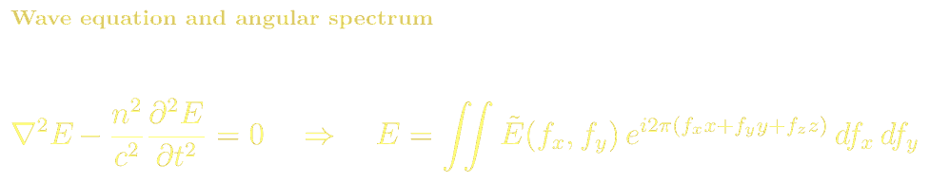
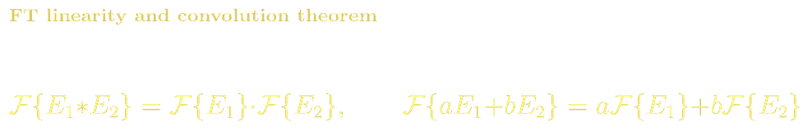
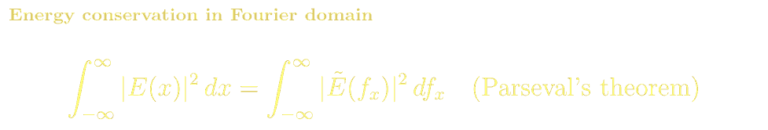
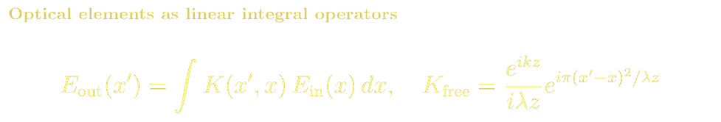
FOURIER OPTICS
Wave Equation Linearity & Angular Spectrum
The wave equation is linear: if E₁ and E₂ are solutions, so is aE₁+bE₂. The general solution is a superposition of plane waves — the angular spectrum:
Optical Components as Linear Integral Operators

Slide 3
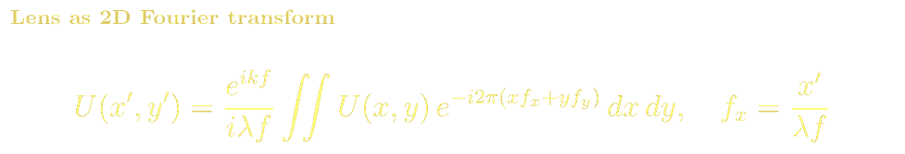
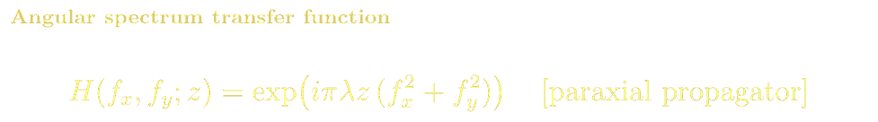
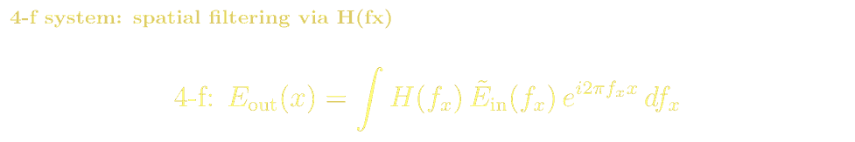
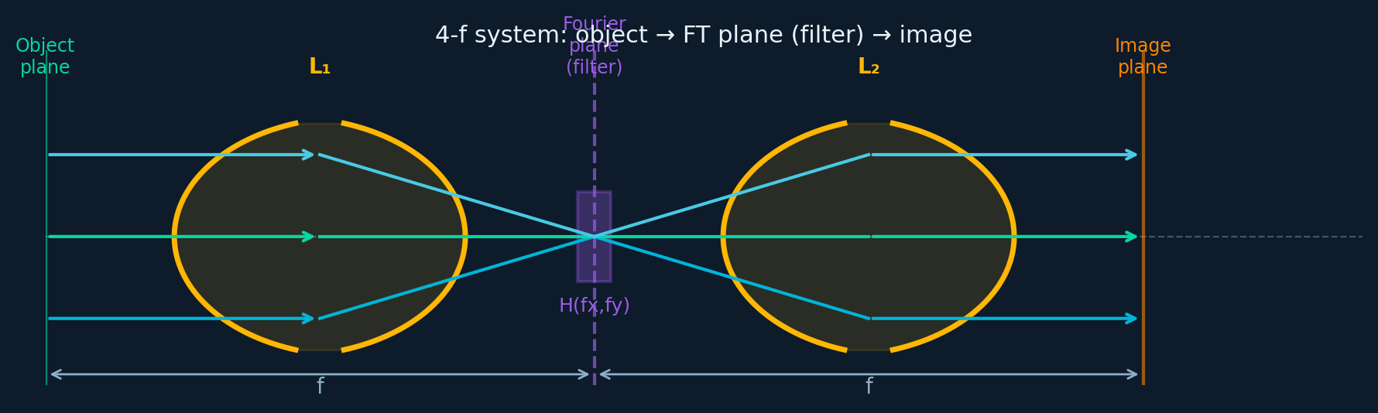
FOURIER OPTICS
The Lens as a Fourier Transform Operator
4-f Imaging System
Angular Spectrum H(f,z)
Object→FT plane (spatial filter H(fx))→image. Low-pass, high-pass, notch, phase-contrast, matched filter.
H=exp(iπλz(fx²+fy²)) paraxial. Evanescent for |f|>1/λ. Free-space propagation = phase filter.

Slide 4
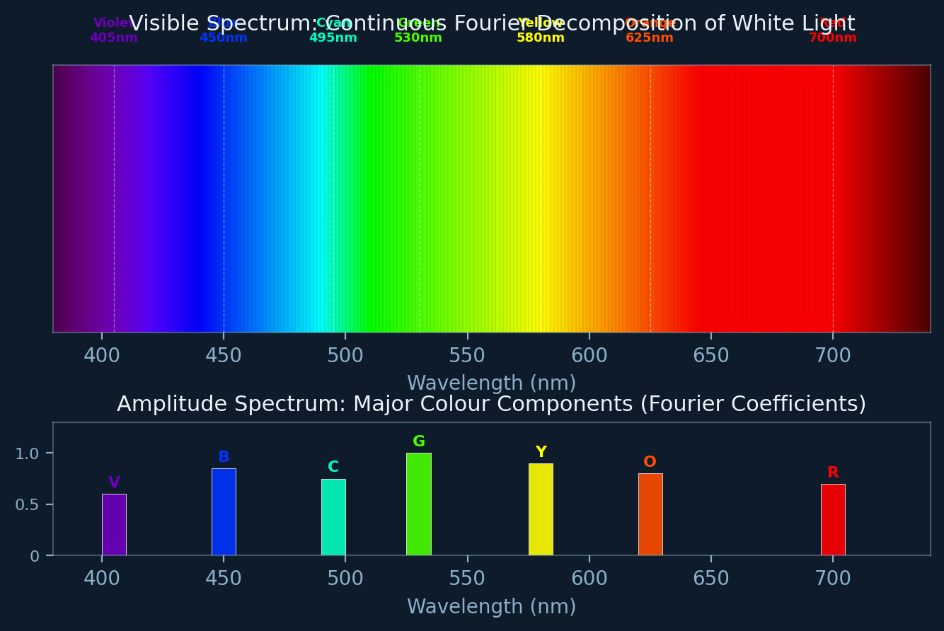
FOURIER OPTICS
The Rainbow: White Light as a Fourier Superposition
White light is an equal superposition of all visible wavelengths (380–740 nm). A prism or grating performs an optical Fourier transform, separating the eigenmodes by spatial frequency:
Top: continuous rainbow — all Fourier eigenmodes present. Bottom: amplitude spectrum showing major colour components as Fourier coefficients. Green (530nm) has highest spectral weight in white light.

Slide 5
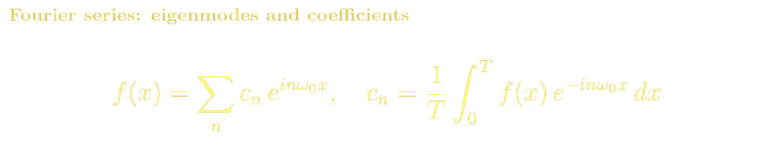
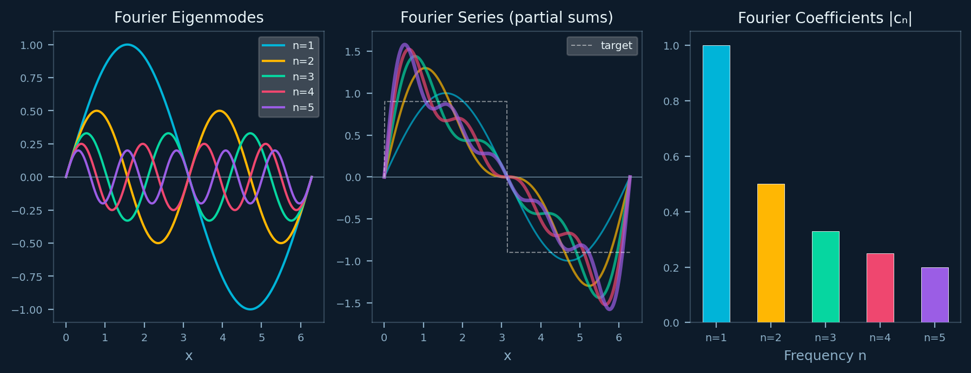
FOURIER OPTICS
Fourier Eigenmodes: Plane Waves as Basis Functions
The Fourier series expresses any periodic function as a sum of sinusoidal eigenmodes. In optics, these eigenmodes are plane waves — the natural solutions of the linear wave equation:
Eigenmodes & Fourier Series
Rainbow & White Light
Plane waves are eigenfunctions of any translation-invariant optical system
FT decomposes any field into eigenmodes; IFT reconstructs
Fourier series cₙ=(1/L)∫E(x)e^{-i2πnx/L}dx
Prism = optical Fourier analyser: disperses eigenmodes by frequency f=1/λ
Each colour = one eigenmode at spatial frequency fₙ=1/λₙ
Recombine all → white light (Newton's prism experiment, 1672)

Slide 6
FOURIER OPTICS · REFERENCES
Fourier Optics: References, Problems & Projects
BSc References & Reading
MSc / Advanced References
Hecht, Optics Ch. 11: Fourier methods in optics — accessible introduction.
Saleh & Teich Ch. 4: Fourier optics — wave optics and spatial filtering.
Gaskill, Linear Systems, Fourier Transforms, and Optics (1978) — Wiley: classic systems approach.
Goodman, Introduction to Fourier Optics, 4th ed. (2017) — definitive graduate reference.
Voelz, Computational Fourier Optics (SPIE 2011): numerical implementation with MATLAB/Python.
Goodman, Statistical Optics (2015): coherence and Fourier methods in speckle and imaging.
Problem Sets & Projects
[BSc] Show Fraunhofer pattern of a rectangular aperture (a×b) is a sinc² pattern. Find first zero positions.
[BSc] In a 4-f system (f=100mm), design a filter removing spatial frequencies above 100 cyc/mm. What aperture diameter?
[MSc] Derive coherent transfer function (CTF) and compare with incoherent OTF.
[MSc] Implement angular spectrum propagation method in Python/NumPy. Propagate a Gaussian beam and compare with analytical result.
[Project: MSc] Simulate a phase-contrast microscope using Fourier optics. Show π/2 phase ring converts phase objects to amplitude contrast.

