Slide 1
LECTURE 06
Diffraction Integrals
Maxwell → Kirchhoff → Fresnel → Circular Aperture Rings → Collins Integral
Linear Optics Course · All formulas typeset with LaTeX

Slide 2
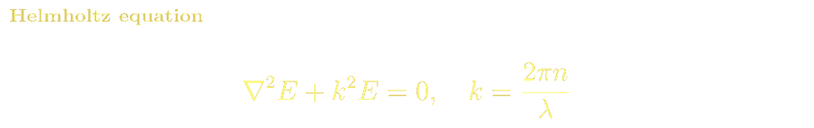
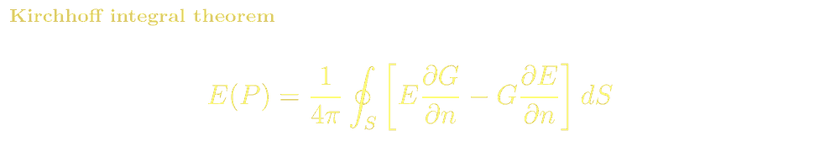
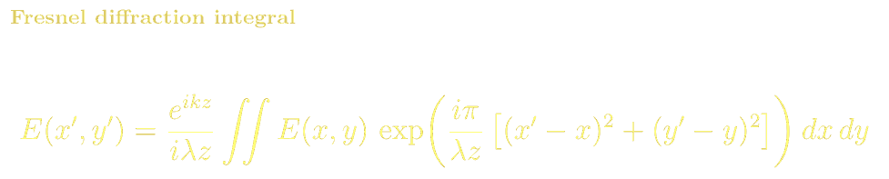
DIFFRACTION
From Maxwell's Equations to Scalar Diffraction
Starting from Maxwell's equations in a source-free region, the field satisfies the Helmholtz equation. Green's theorem + free-space Green's function yields the Kirchhoff integral:
Kirchhoff boundary conditions: field=0 on opaque screen; field=unperturbed incident field in the aperture. This converts the surface integral to an aperture integral — the Huygens-Fresnel principle:

Slide 3
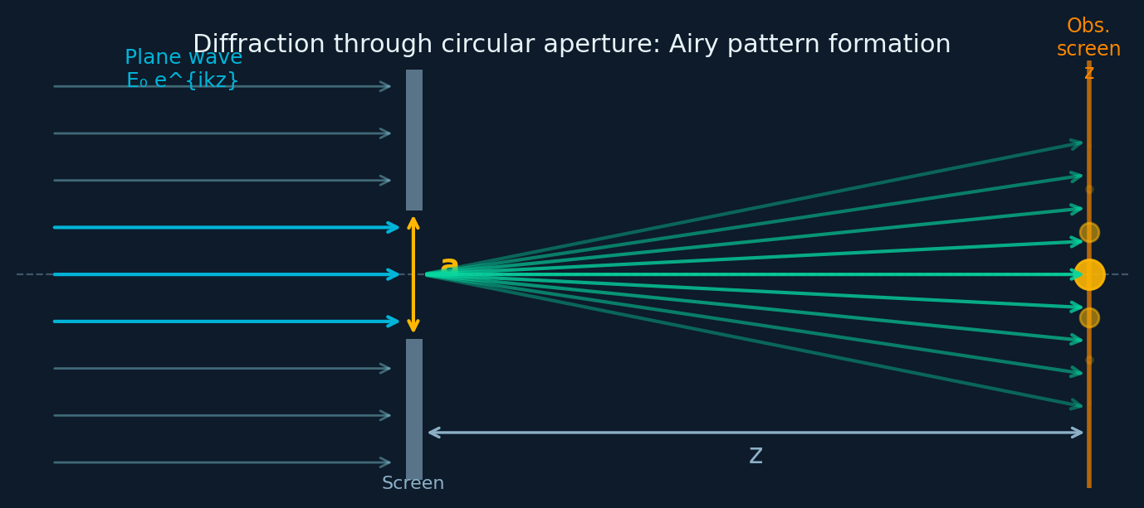
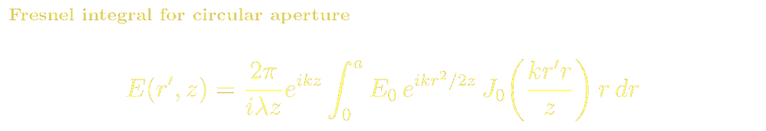
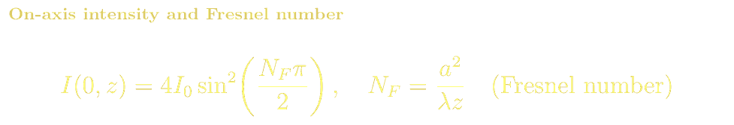
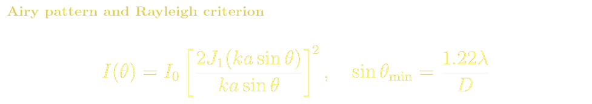
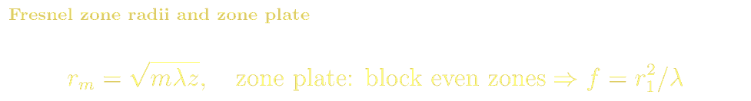
DIFFRACTION
Circular Aperture: Diffraction Rings from the Mathematics
A plane wave strikes a flat metal screen with a circular hole of radius a. The Fresnel integral reduces to a Bessel function, giving on-axis oscillations controlled by the Fresnel number N_F:
Physical Interpretation
Each point in the aperture is a secondary Huygens source (Huygens-Kirchhoff)
Phase of each secondary wavelet depends on its distance to the observation point
Fresnel zones: alternating zones contribute constructive/destructive amplitudes
Increasing z: N_F decreases, pattern transitions from Fresnel to Fraunhofer
N_F=1: aperture equals one Fresnel zone — maximum on-axis intensity
Zone plate: block even zones → constructive interference → focus

Slide 4
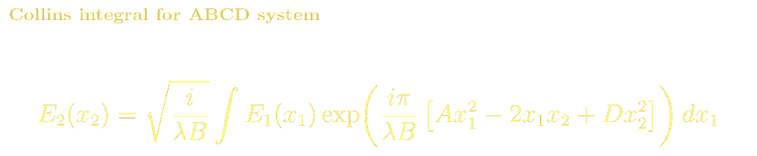
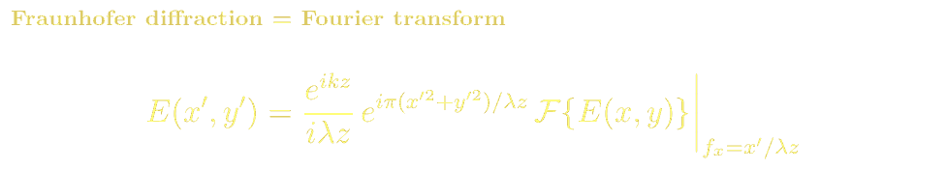
DIFFRACTION
Collins Integral & Near-to-Far-Field Transition
The Collins integral generalises Fresnel diffraction to any ABCD system — free space, lenses, and resonator passes all use the same kernel with respective ABCD elements.
Near field (N_F >> 1) Fresnel diffraction. Geometrical shadow with fringes. On-axis intensity oscillates with z.
Transition (N_F ~ 1) Rich interference structure. Aperture approximately equals beam-waist.
Far field (N_F << 1) Fraunhofer diffraction. Pattern = |FT of aperture|². Airy disk for circular aperture.
ABCD generalisation Collins (1970): replace λz with λB — covers all paraxial systems.

Slide 5
DIFFRACTION · REFERENCES
Diffraction Integrals: References, Problems & Projects
BSc References & Reading
MSc / Advanced References
Hecht, Optics Ch. 10: diffraction — Kirchhoff, Fresnel, Fraunhofer with worked examples.
Born & Wolf Ch. 8: Fresnel-Kirchhoff diffraction theory — rigorous derivation from Maxwell.
Saleh & Teich Ch. 4.3: Fresnel and Fraunhofer diffraction and relation to ABCD.
Goodman, Introduction to Fourier Optics Ch. 3–5: scalar diffraction theory in depth.
Born & Wolf Ch. 9: diffraction from apertures, Babinet's principle, vector theory.
Lalor (1968) J. Opt. Soc. Am 58, 1235: angular spectrum rigorous derivation.
Problem Sets & Projects
[BSc] Compute on-axis intensity I(0,z) for circular aperture a=1mm, λ=633nm, z=1mm to 10m. At what distances is I maximum?
[BSc] Show that blocking every other Fresnel zone (zone plate) creates a focusing element. What is the focal length?
[MSc] Evaluate the Fresnel diffraction integral numerically for a rectangular slit using the FFT angular-spectrum method. Compare with analytical result.
[MSc] Derive the Collins integral from Huygens-Fresnel by substituting the ABCD system matrix. What conditions on B make this valid?
[Project: MSc] Simulate diffraction of a Gaussian beam through an obstacle (Babinet) using angular spectrum method. Compare with Kirchhoff theory.

