Slide 1
LECTURE 07
Mueller Calculus & Stokes Formalism
Partial Polarization · Stokes Vectors · Mueller Matrices · Poincaré Sphere · Polarimetry
Linear Optics Course · All formulas typeset with LaTeX

Slide 2
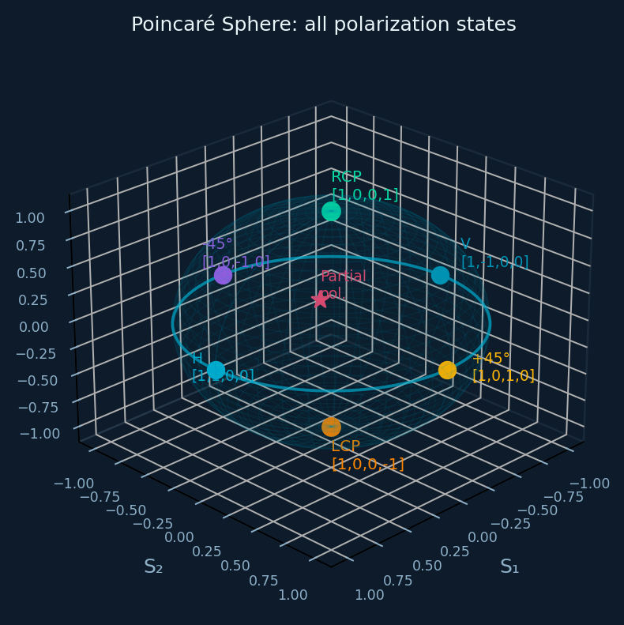
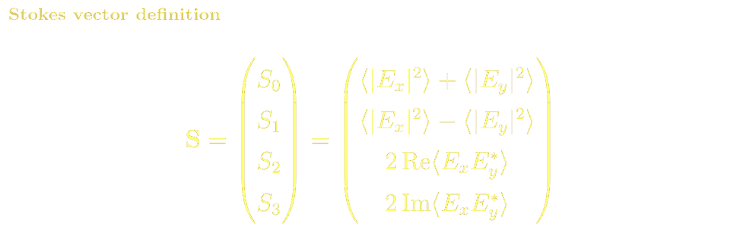
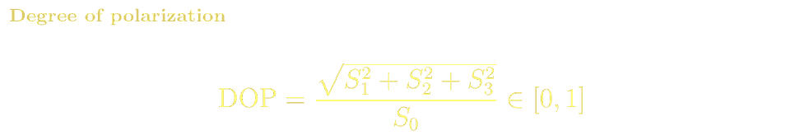
MUELLER CALCULUS
Stokes Parameters: Describing Partially Polarized Light
Jones vectors describe only fully coherent, fully polarized light. Stokes parameters S₀–S₃ are real, time-averaged intensity differences — they describe any polarization state:
H linear
V linear
+45° linear
[1, 1, 0, 0]ᵀ
[1, −1, 0, 0]ᵀ
[1, 0, 1, 0]ᵀ
RCP
LCP
Unpolarized
[1, 0, 0, 1]ᵀ
[1, 0, 0, −1]ᵀ
[1, 0, 0, 0]ᵀ

Slide 3
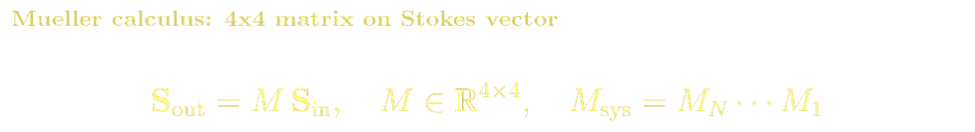
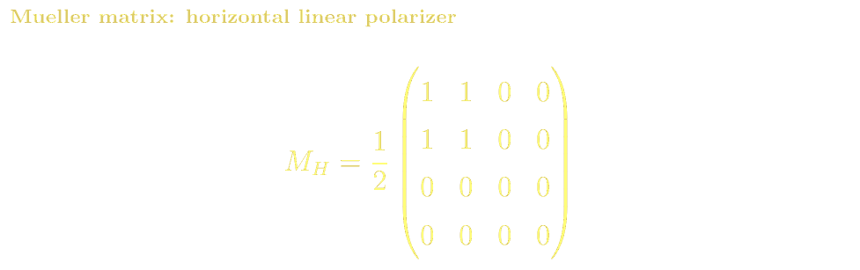
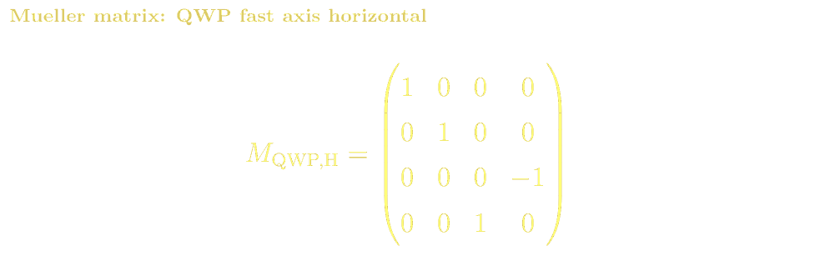
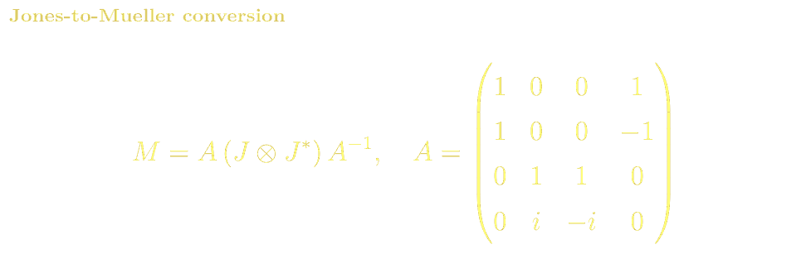
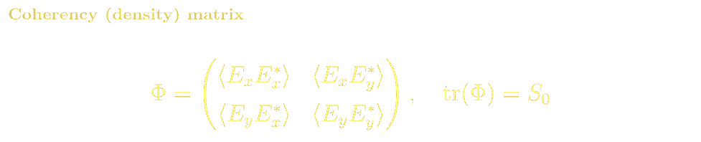
MUELLER CALCULUS
Mueller Matrices & Component Examples
Mueller vs Jones Comparison
Jones
Mueller
Fully polarized only
Any DOP (0 to 1)
8 real parameters
16 real parameters
No depolarization
Depolarization natural
Phase-sensitive
Intensity averages only

Slide 4
MUELLER CALCULUS
Mueller Matrix: Polarizer and Wave Plate
The Mueller matrix acts on the 4-component Stokes vector. Here are the matrices for the key polarization elements:
Horizontal Linear Polarizer
QWP (fast axis horizontal)
Jones → Mueller Conversion

Slide 5
MUELLER CALCULUS · REFERENCES
Mueller Calculus: References, Problems & Projects
BSc References & Reading
MSc / Advanced References
Hecht, Optics Ch. 8.12: Stokes parameters and degree of polarization.
Saleh & Teich Ch. 6.6: Mueller matrices and Stokes vectors.
Pedrotti Ch. 16: partial polarization and Mueller calculus.
Chipman, Handbook of Optics Vol. II Ch. 22–27 — most comprehensive Mueller/Jones reference.
Azzam & Bashara, Ellipsometry and Polarized Light (1977): Mueller and coherency matrices.
Gil & Ossikovski, Polarized Light, Fundamentals and Applications (2016) — Cambridge UP.
Cloude (1986) Optik 75, 26: eigenvalue decomposition of Mueller matrices.
Problem Sets & Projects
[BSc] Compute Stokes vector for +45° linear light through QWP (fast axis horizontal). What polarization results?
[BSc] Verify that Mueller matrix for H polarizer satisfies M²=M (idempotent). What does this mean physically?
[BSc] Show that for a non-depolarizing element, det(M) = (det J)² where J is the Jones matrix.
[MSc] Design a Stokes polarimeter using 4 intensity measurements. Write the measurement matrix and show it can be inverted.
[MSc] Decompose a general Mueller matrix using the Lu-Chipman polar decomposition into depolarizer, retarder, and diattenuator.
[Project: MSc] Implement Mueller matrix spectropolarimeter simulation in Python. Model polarimetric properties of a cholesteric liquid crystal layer.

