Slide 1
Ψ
QUANTUM MECHANICS — BRA–KET NOTATION
L01
Why Dirac Notation? States as Rays & Superposition
Sakurai ↔ Dirac Dual-Track — Lecture 1
HS
BegUG
AdvUG
MSc
PhD
90-minute lecture · Dirac + Sakurai Dual-Track
QM: Bra–Ket Notation — L01
L01

Slide 2
L01 — Lecture Overview
L01
Why Dirac Notation? States as Rays & Superposition
90-MIN PACING
CORE LEARNING OUTCOMES
0–15 min: Motivation — representations vs abstract states
15–45 min: Kets as vectors, rays, normalization, global phase
45–70 min: Bras (informal), amplitudes, Born rule preview
70–90 min: Notation dictionary: ket ↔ column vector ↔ wavefunction
• Understand state as equivalence class |ψ⟩ ~ e^{iθ}|ψ⟩
• Interpret amplitudes and Born-rule probabilities P(a) = |⟨a|ψ⟩|²
• Learn the notation dictionary in a discrete basis
• Connect Sakurai (physical) and Dirac (abstract) perspectives
HS
BegUG
AdvUG
MSc
PhD
Complex numbers; |z|² as probability; vector addition & interference
Normalization ⟨ψ|ψ⟩=1; orthogonality; components cₙ = ⟨n|ψ⟩
Cauchy–Schwarz; triangle inequality; metric viewpoint on states
Rays & projective Hilbert space P(H); Wigner theorem preview
Precise Hilbert-space statements; separability; rays as points in P(H)
ASSESSMENT BUNDLE
Set A: Normalize |ψ⟩ = (1+i)|1⟩ + 2|2⟩ · Find P(1) and P(2) for |ψ⟩ = (1/√5)(|1⟩ + 2i|2⟩)
Set B: Prove Cauchy-Schwarz: |⟨φ|ψ⟩|² ≤ ⟨φ|φ⟩⟨ψ|ψ⟩ [Hint: ||φ⟩ - λ|ψ⟩||² ≥ 0] · Prove triangle inequality: ||φ+ψ|| ≤ ||φ|| + ||ψ|| [Hint: square; use C-S]
QM: Bra–Ket Notation — L01
L01 · Overview

Slide 3
L01 — Why Dirac Notation? States as Rays & Superposition
L01
Sakurai ↔ Dirac Dual-Track — Lecture 1
SAKURAI TRACK: Operational Starting Point
DIRAC TRACK: Abstract Axioms
• Preparation procedures → stable frequencies
• Measurement outcomes encode state statistics
• State encodes probabilities, not properties
• Interference motivates complex amplitudes
• P = |A₁ + A₂|² — phase controls cross term
• Quantum state is a ray in Hilbert space H
• |ψ⟩ ~ e^{iθ}|ψ⟩ — global phase unobservable
• Completeness: Σₙ |n⟩⟨n| = Î
• Components: cₙ = ⟨n|ψ⟩
• Probability: P(aᵢ) = |⟨aᵢ|ψ⟩|²
SYNTHESIS DICTIONARY
Physical preparation
Measurement outcome
Probability amplitude
Probability
⟷
⟷
⟷
⟷
Ket |ψ⟩
Basis ket |aᵢ⟩
Inner product ⟨aᵢ|ψ⟩
|⟨aᵢ|ψ⟩|²
QM: Bra–Ket Notation — L01
L01 · Content

Slide 4
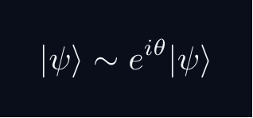
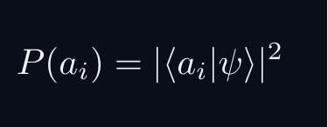
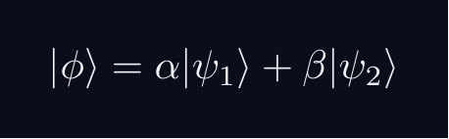
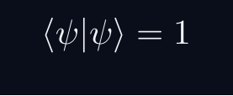
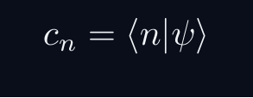
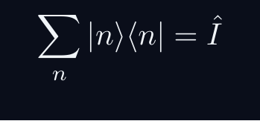

L01 — Key Formulas
L01
Pre-rendered formula reference
ray equiv
born rule
superposition
normalization
component
completeness
interference
QM: Bra–Ket Notation — L01
L01 · Formulas

Slide 5
L01 — Common Pitfalls & Historical Notes
L01
⚠ COMMON PITFALLS
HISTORICAL ANCHORS
• Confusing |ψ⟩ (abstract) with a column vector (representation-dependent)
• Forgetting complex conjugation when ket → bra: ⟨ψ| = Σ cₙ* ⟨n|
• Treating phase difference as extra probability — phase only affects interference
• Assuming normalization is automatic — always check ⟨ψ|ψ⟩ = 1
• Born (1926) — probability interpretation of ψ
• Dirac (1927–30) — amplitude formalism, bra-ket notation
• von Neumann (1932) — Hilbert-space axiomatics
• Wigner — symmetry principles (preview for later lectures)
PROBLEM SET A — Simple
PROBLEM SET B — Complex
A1. Normalize |ψ⟩ = (1+i)|1⟩ + 2|2⟩
A2. Find P(1) and P(2) for |ψ⟩ = (1/√5)(|1⟩ + 2i|2⟩)
A3. If |φ⟩ = α|1⟩ + β|2⟩, find conditions for |φ⟩ ⊥ |ψ⟩
A4. Verify Σₙ |cₙ|² = 1 for a given normalized state
A5. Compute ⟨ψ|φ⟩ for two given 3-component states
A6. Show |ψ⟩ and e^{iπ/3}|ψ⟩ give identical probabilities
B1. Prove Cauchy-Schwarz: |⟨φ|ψ⟩|² ≤ ⟨φ|φ⟩⟨ψ|ψ⟩ [Hint: ||φ⟩ - λ|ψ⟩||² ≥ 0]
B2. Prove triangle inequality: ||φ+ψ|| ≤ ||φ|| + ||ψ|| [Hint: square; use C-S]
B3. Show unitary basis change preserves Σ|cₙ|² [Hint: U†U = I]
B4. (MSc+) Interpret physical states as points in P(H)
QM: Bra–Ket Notation — L01
L01 · Problems

