Slide 1
L01
Deep Concept Slides
Why Dirac Notation? States as Rays & Superposition
One slide per core concept · Full LaTeX derivation · 2D/3D geometric diagram
HS
BegUG
AdvUG
MSc
PhD
14 concept slides
QM: Bra-Ket Notation — L01 Concepts
L01

Slide 2
HS
High School
1. Complex Numbers as Arrows
2. Magnitude Squared as Probability
3. Superposition and Interference
4. Phase Dependence of Probability
QM: L01 — High School
L01

Slide 3
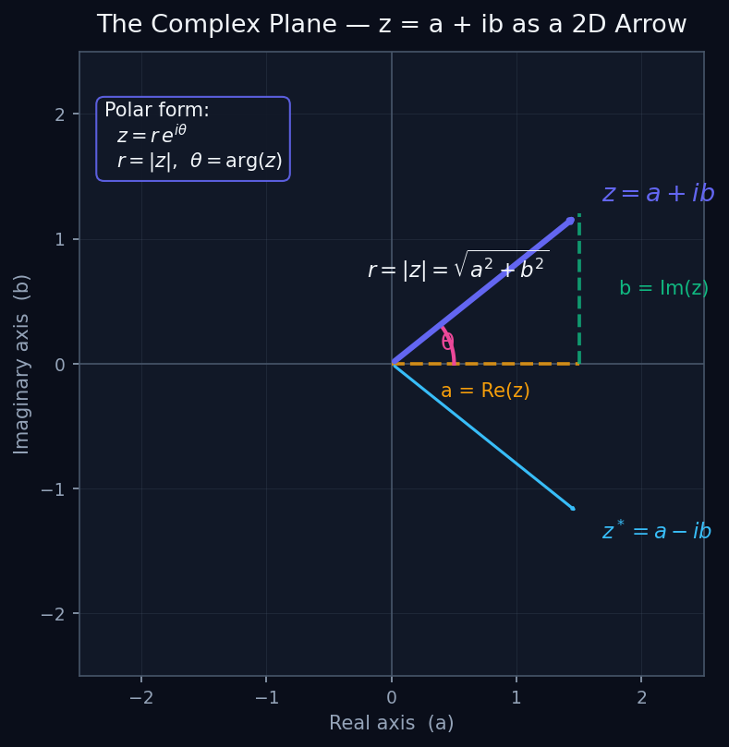
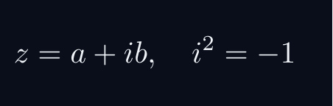
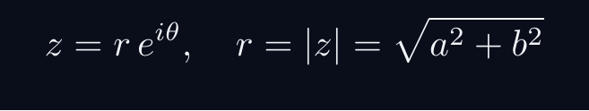

L01 — HS: Complex Numbers as Arrows
L01
The complex plane — z = a+ib as a 2D vector
COMPLEX NUMBERS AS ARROWS
WHAT IS A COMPLEX NUMBER?
A complex number z = a + ib is a 2D vector in a plane.
The plane has two axes: real (a) and imaginary (b).
POLAR FORM
r is the length (magnitude). θ is the angle (phase).
KEY IDENTITY
The squared magnitude is always real and non-negative.
WHY THIS MATTERS FOR QM
Quantum amplitudes ARE complex numbers. The probability is their squared magnitude.
QM: L01 — HS · Complex Numbers as Arrows
L01 · HS

Slide 4
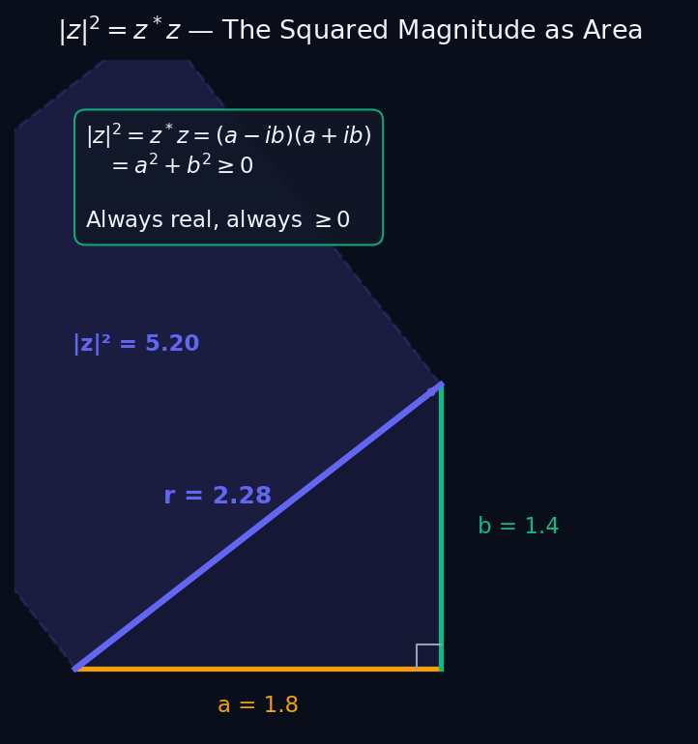
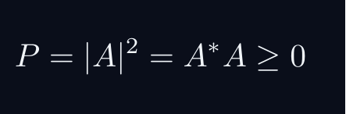
L01 — HS: Magnitude Squared as Probability
L01
P = |A|² — squaring gives a valid probability
MAGNITUDE SQUARED AS PROBABILITY
THE BORN RULE (HIGH SCHOOL VERSION)
A quantum amplitude A is a complex number describing a process.
Why must we SQUARE? Two reasons:
REASON 1 — POSITIVITY
Probabilities must be ≥ 0. Complex numbers can be negative or imaginary. Squaring always gives a non-negative real number.
REASON 2 — INTERFERENCE
If we used |A| instead of |A|², the interference term would look different. Only |A|² gives the correct two-slit experiment result.
GEOMETRIC PICTURE
The diagram shows: |z|² = (squared length) = the area of the square on the hypotenuse. It is always the sum of the squares of the sides.
QM: L01 — HS · Magnitude Squared as Probability
L01 · HS

Slide 5
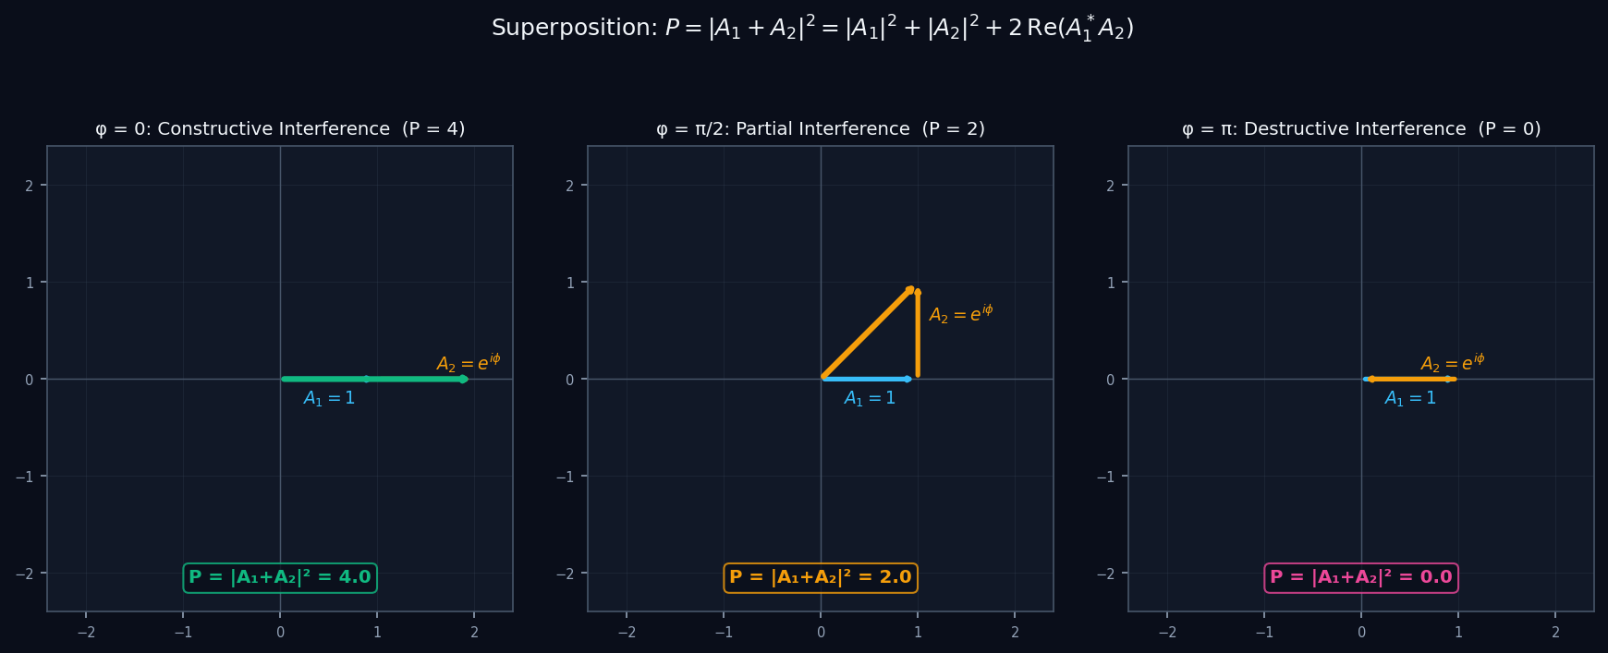
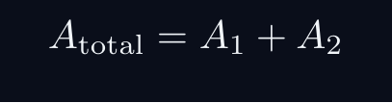

L01 — HS: Superposition and Interference
L01
Adding amplitude arrows — constructive vs destructive
SUPERPOSITION AND INTERFERENCE
SUPERPOSITION = ARROW ADDITION
When two processes can both contribute to an outcome, we ADD their amplitudes (not their probabilities).
THE INTERFERENCE TERM
The extra term 2Re(A₁*A₂) is interference. It can be positive (constructive) or negative (destructive).
PHASE CONTROLS THE SIGN
φ = 0: arrows align → P = 4 (maximum, constructive).
φ = π: arrows cancel → P = 0 (minimum, destructive).
φ = π/2: perpendicular → P = 2 (no interference).
QM: L01 — HS · Superposition and Interference
L01 · HS

Slide 6
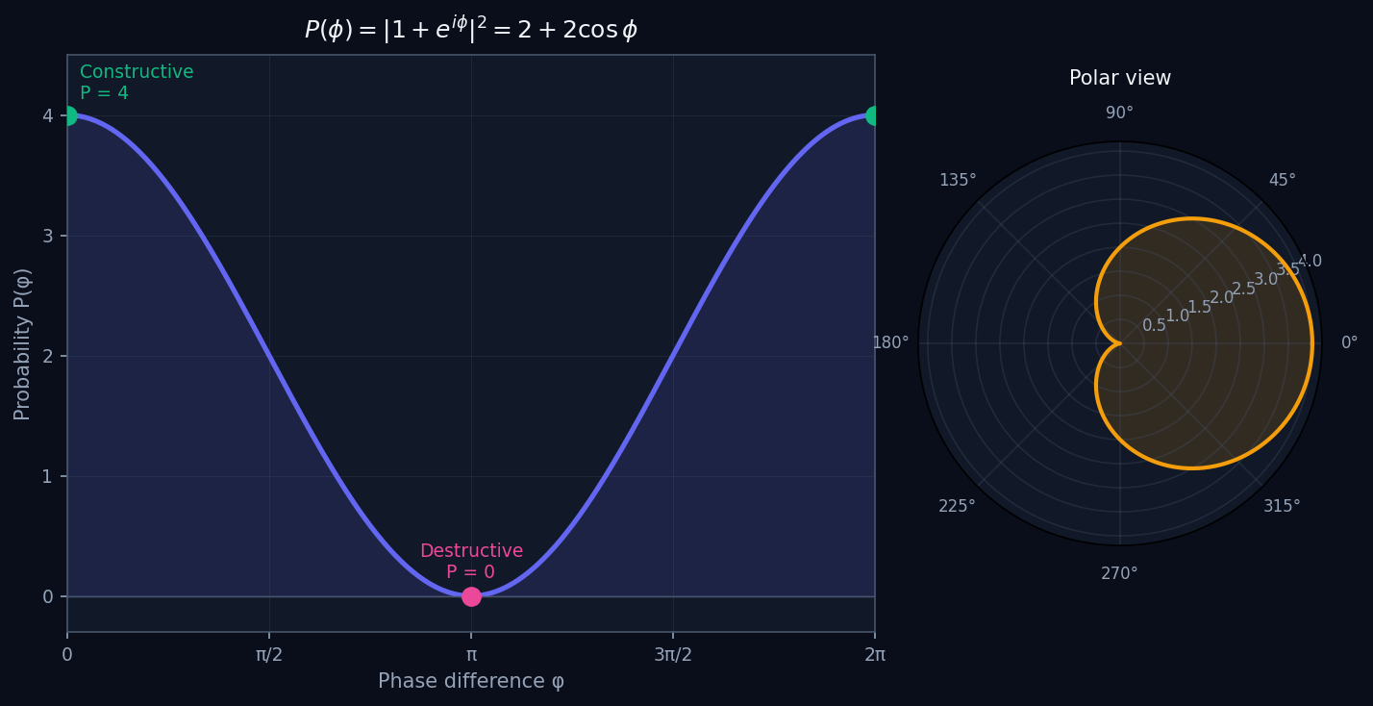
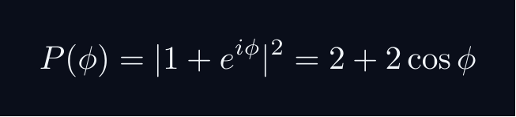
L01 — HS: Phase Dependence of Probability
L01
P(φ) = 2 + 2cosφ — the interference pattern
PHASE DEPENDENCE OF PROBABILITY
A COMPLETE INTERFERENCE PATTERN
Let A₁ = 1 and A₂ = e^{iφ}. As we vary the relative phase φ:
READING THE GRAPH
Maximum P = 4 at φ = 0, 2π (constructive). Minimum P = 0 at φ = π (destructive). The oscillation between 0 and 4 is a hallmark of wave-like behaviour.
KEY INSIGHT
If we had used probabilities directly (not amplitudes), we would get P = P₁ + P₂ = 2, always. NO interference. The interference pattern PROVES we must add amplitudes first.
TWO-SLIT ANALOGY
This is exactly the pattern seen in the double-slit experiment — bright and dark bands as the phase difference varies across the screen.
QM: L01 — HS · Phase Dependence of Probability
L01 · HS

Slide 7
BegUG
Beginning Undergraduate
1. Basis Vectors and State Decomposition
2. Normalisation and the Unit Sphere
3. The Inner Product as Projection
QM: L01 — Beginning Undergraduate
L01

Slide 8
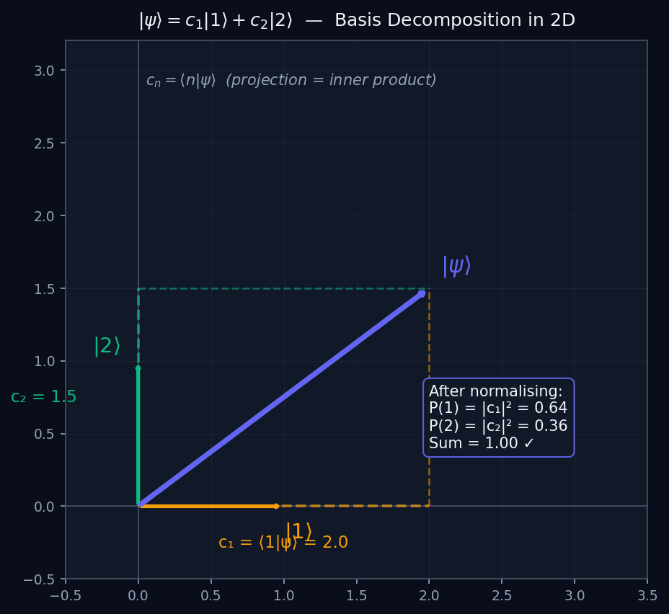
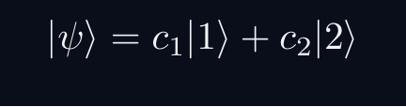
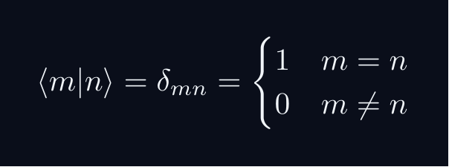
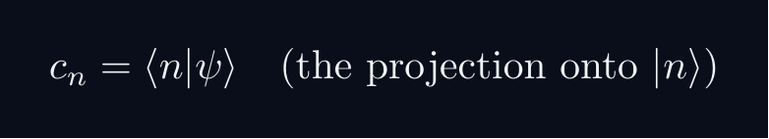
L01 — BegUG: Basis Vectors and State Decomposition
L01
|ψ⟩ = c₁|1⟩ + c₂|2⟩ — expanding in a basis
BASIS VECTORS AND STATE DECOMPOSITION
THE HILBERT SPACE AS A VECTOR SPACE
A quantum state |ψ⟩ lives in a vector space, just like a 2D or 3D arrow.
ORTHONORMAL BASIS
The basis vectors |1⟩ and |2⟩ play the role of x̂ and ŷ in 2D space:
COMPONENTS ARE INNER PRODUCTS
This is the key identity. Just like a 2D dot product gives the component along each axis.
DIAGRAM
The diagram shows |ψ⟩ decomposed along |1⟩ (x-axis) and |2⟩ (y-axis) with dashed projection lines, exactly as in 2D vector geometry.
QM: L01 — BegUG · Basis Vectors and State Decomposition
L01 · BegUG

Slide 9
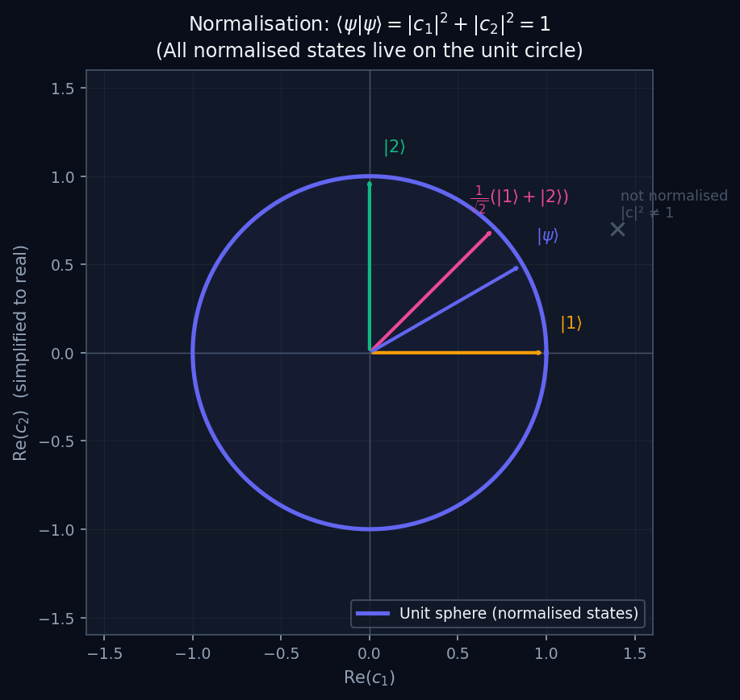
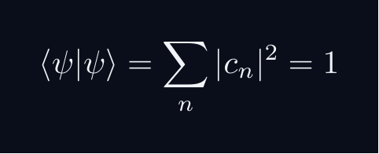
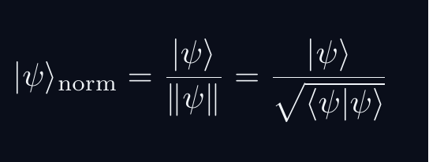
L01 — BegUG: Normalisation and the Unit Sphere
L01
⟨ψ|ψ⟩ = 1 — all states live on the unit sphere
NORMALISATION AND THE UNIT SPHERE
WHY NORMALISATION?
Total probability must equal 1. This forces:
GEOMETRIC MEANING
In 2D (real amplitudes): normalised states lie exactly on the unit circle. In 2D complex (a qubit): they lie on the Bloch sphere.
HOW TO NORMALISE
Given any |ψ⟩ ≠ 0, divide by its norm:
DIAGRAM
All normalised states sit on the circle. Non-normalised states sit outside. Physical states must be on the circle — normalisation is a physical constraint, not just a convention.
QM: L01 — BegUG · Normalisation and the Unit Sphere
L01 · BegUG

Slide 10
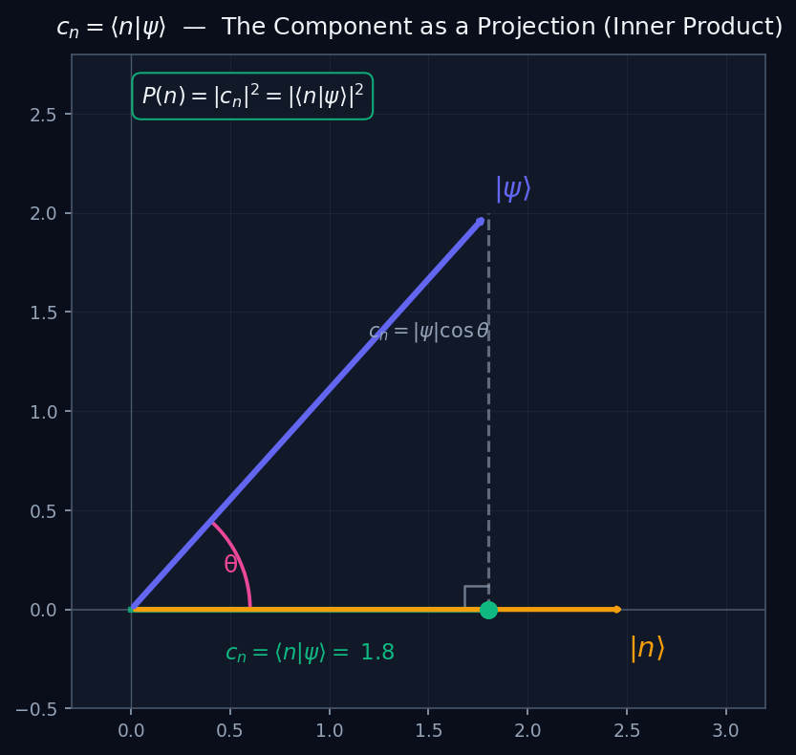
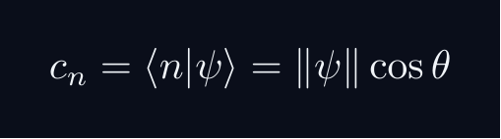
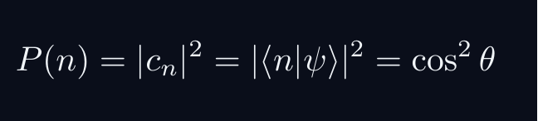
L01 — BegUG: The Inner Product as Projection
L01
c_n = ⟨n|ψ⟩ — the component IS the projection
THE INNER PRODUCT AS PROJECTION
INNER PRODUCT = OVERLAP
The inner product ⟨φ|ψ⟩ measures how much |ψ⟩ overlaps with |φ⟩. Geometrically: it is the projection (shadow) of |ψ⟩ onto the direction of |φ⟩.
THE COMPONENT FORMULA
where θ is the angle between |ψ⟩ and the basis vector |n⟩.
BORN RULE FROM PROJECTION
(for normalised states). The probability is the SQUARED projection — the squared shadow length.
KEY INSIGHT
The diagram shows the projection construction. This is identical to decomposing a 2D vector along a coordinate axis. The only new feature in QM: the components are complex numbers.
QM: L01 — BegUG · The Inner Product as Projection
L01 · BegUG

Slide 11
AdvUG
Advanced Undergraduate
1. Cauchy-Schwarz and the Geometry of Overlap
2. Triangle Inequality
3. The Fubini-Study Metric on Rays
QM: L01 — Advanced Undergraduate
L01

Slide 12
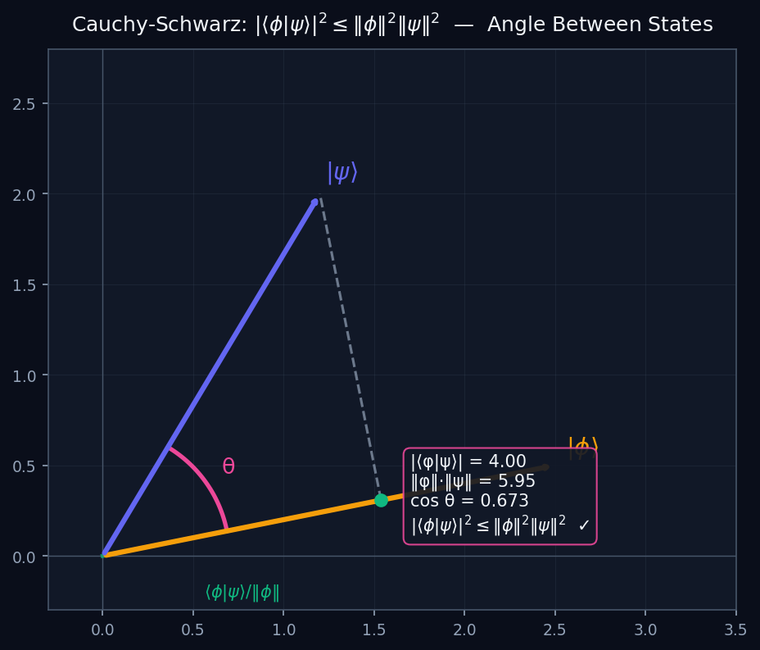


L01 — AdvUG: Cauchy-Schwarz and the Geometry of Overlap
L01
|⟨φ|ψ⟩|² ≤ ‖φ‖²‖ψ‖² — why probabilities are bounded
CAUCHY-SCHWARZ AND THE GEOMETRY OF OVERLAP
THE CAUCHY-SCHWARZ INEQUALITY
For normalised states this gives |⟨φ|ψ⟩|² ≤ 1 — transition probabilities are always bounded by 1.
PROOF IDEA (MINIMISATION)
For any complex λ, define f(λ) = ‖|φ⟩ − λ|ψ⟩‖² ≥ 0.
Choose λ = ⟨ψ|φ⟩/‖ψ‖² to minimise f → the inequality falls out.
GEOMETRIC MEANING
The diagram shows two vectors. |⟨φ|ψ⟩| = ‖φ‖‖ψ‖|cosθ| ≤ ‖φ‖‖ψ‖ because |cosθ| ≤ 1. C-S is just the statement that the absolute cosine of an angle is ≤ 1.
QM: L01 — AdvUG · Cauchy-Schwarz and the Geometry of Overlap
L01 · AdvUG

Slide 13
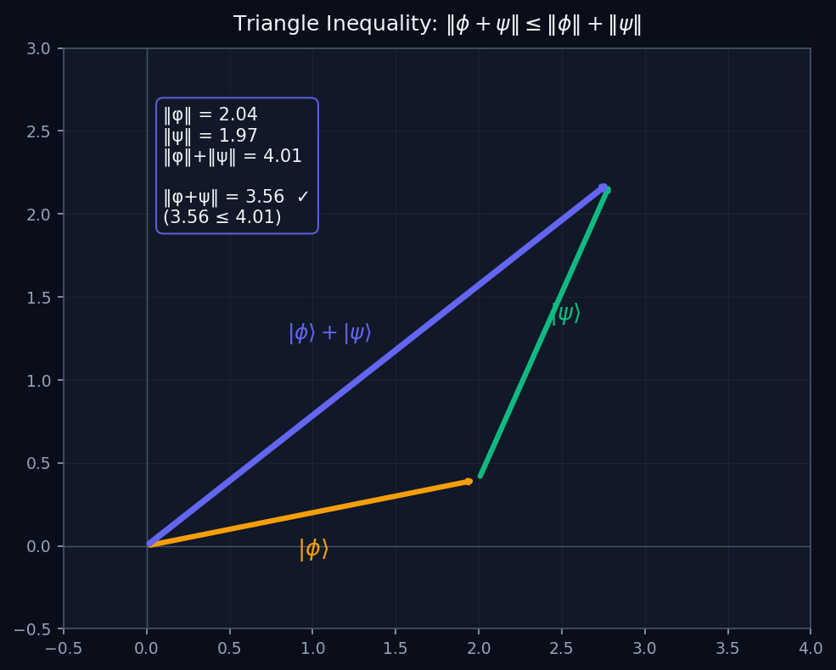
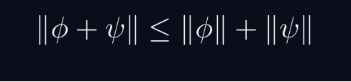

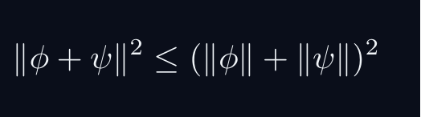
L01 — AdvUG: Triangle Inequality
L01
‖φ+ψ‖ ≤ ‖φ‖+‖ψ‖ — the norm behaves like geometric length
TRIANGLE INEQUALITY
THE TRIANGLE INEQUALITY
The length of the sum is at most the sum of the lengths. This is exactly the triangle inequality from Euclidean geometry.
PROOF
Square both sides (both sides ≥ 0):
Use Re⟨φ|ψ⟩ ≤ |⟨φ|ψ⟩| ≤ ‖φ‖‖ψ‖ (by C-S):
Taking square roots gives the result.
WHY IT MATTERS
The triangle inequality makes ‖·‖ a proper norm, and (ℋ, ‖·‖) a metric space. Limits, continuity, and convergence all rely on this.
QM: L01 — AdvUG · Triangle Inequality
L01 · AdvUG

Slide 14
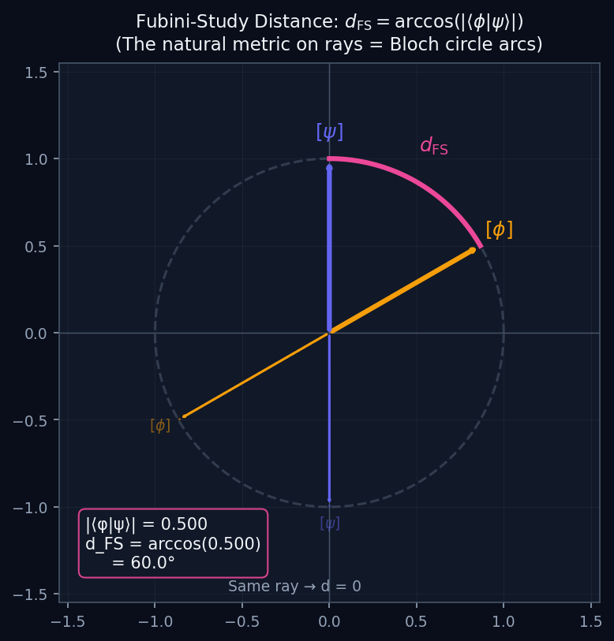
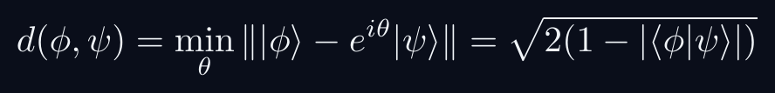
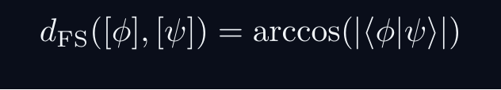
L01 — AdvUG: The Fubini-Study Metric on Rays
L01
d_FS = arccos|⟨φ|ψ⟩| — the physical distance between states
THE FUBINI-STUDY METRIC ON RAYS
WHY ‖φ−ψ‖ IS NOT THE RIGHT DISTANCE
Physical states are rays — |ψ⟩ and e^{iθ}|ψ⟩ are the same state. But ‖|ψ⟩ − e^{iθ}|ψ⟩‖ depends on θ. So ‖φ−ψ‖ is NOT phase-invariant.
THE CORRECT DISTANCE
FUBINI-STUDY METRIC
This is the angle between rays — invariant under global phase. On the Bloch circle (diagram), it is the arc length between two points.
SPECIAL VALUES
d_FS = 0 iff same ray (same physical state). d_FS = π/2 iff orthogonal states (mutually exclusive outcomes). d_FS = π/2 is the maximum distinguishability.
QM: L01 — AdvUG · The Fubini-Study Metric on Rays
L01 · AdvUG

Slide 15
MSc
Master's Level
1. Projective Hilbert Space
2. The Bloch Sphere
QM: L01 — Master's Level
L01

Slide 16
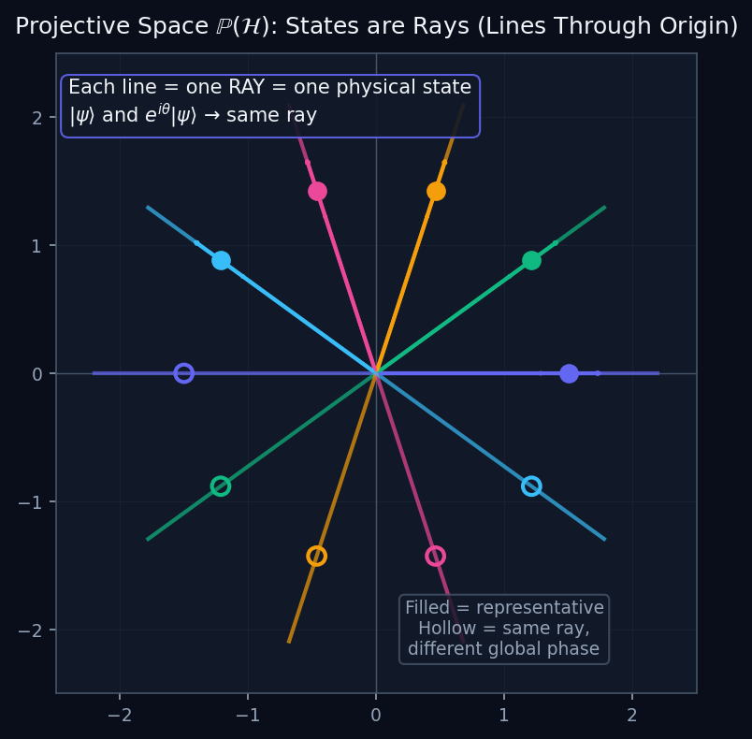
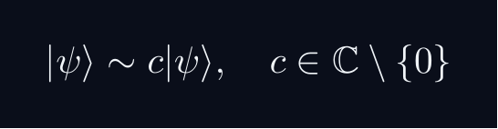
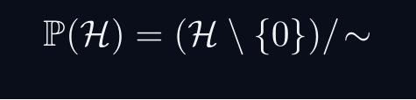
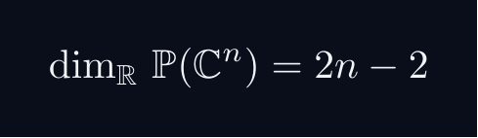
L01 — MSc: Projective Hilbert Space
L01
ℙ(ℋ) — states as lines through the origin
PROJECTIVE HILBERT SPACE
RAYS = EQUIVALENCE CLASSES
Two vectors represent the same physical state if they differ by a non-zero complex scalar:
A ray [ψ] is the equivalence class — a one-dimensional complex subspace.
PROJECTIVE HILBERT SPACE
Each point of ℙ(ℋ) is a ray — a physical pure state.
DIAGRAM
The diagram shows ℝ² (or ℂ²). Each line through the origin is one ray — one physical state. Points on the same line (same colour) differ only by phase or scale.
DIMENSION
For a qubit (n=2): dim = 2 real dimensions → the Bloch sphere S².
QM: L01 — MSc · Projective Hilbert Space
L01 · MSc

Slide 17
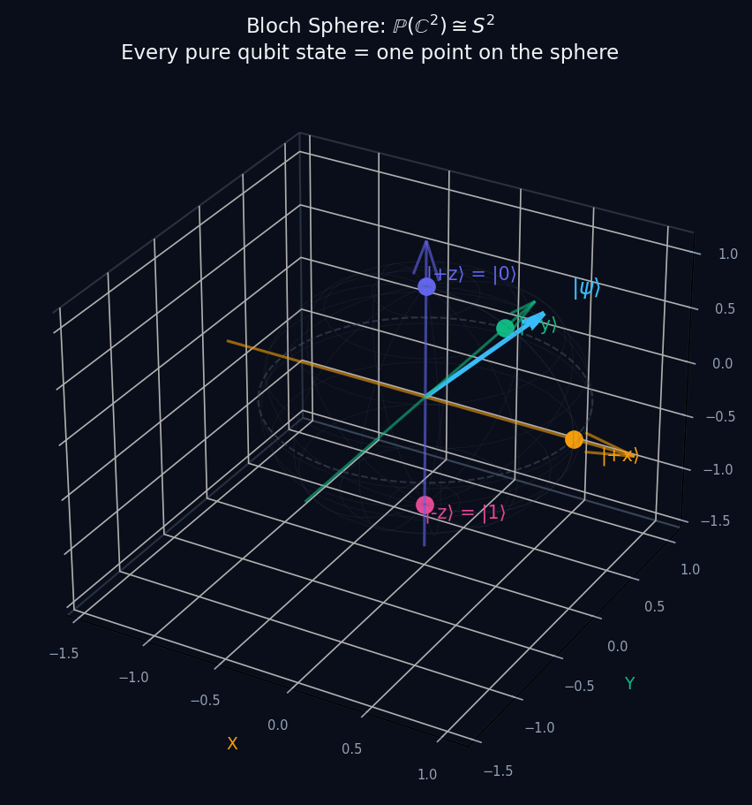
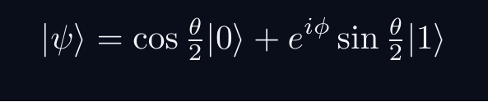
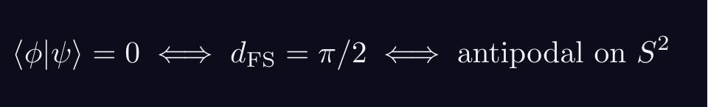
L01 — MSc: The Bloch Sphere
L01
ℙ(ℂ²) ≅ S² — every qubit state is a point on a 3-sphere
THE BLOCH SPHERE
QUBIT STATES AS SPHERE POINTS
Any normalised qubit state can be written:
Two real parameters (θ,φ) label a point on S² — the Bloch sphere.
KEY STATES
|0⟩ and |1⟩ are the North and South poles.
Superpositions (|0⟩+|1⟩)/√2 live on the equator.
ANTIPODAL POINTS = ORTHOGONAL STATES
FUBINI-STUDY ON THE SPHERE
The Fubini-Study metric on ℙ(ℂ²) is exactly the round metric on S² (up to a factor). The geodesics are great circle arcs.
QM: L01 — MSc · The Bloch Sphere
L01 · MSc

Slide 18
PhD
PhD Level
1. Completeness and Cauchy Sequences
2. Hermitian vs Self-Adjoint Operators
QM: L01 — PhD Level
L01

Slide 19
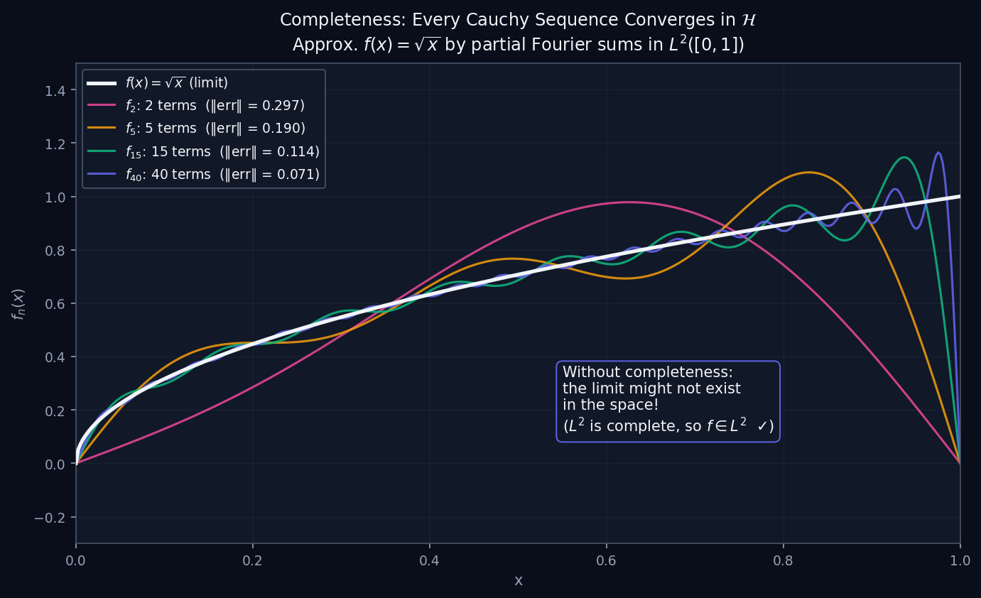
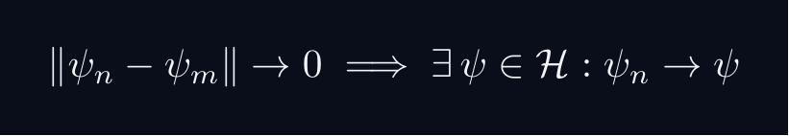
L01 — PhD: Completeness and Cauchy Sequences
L01
Why ℋ must be complete — limits must stay in the space
COMPLETENESS AND CAUCHY SEQUENCES
THE COMPLETENESS AXIOM
A Hilbert space ℋ must be COMPLETE: every Cauchy sequence converges in ℋ.
WHY PHYSICISTS NEED THIS
In QM we constantly take limits: Fourier series, perturbation theory, time evolution, spectral expansions. If ℋ were not complete, these limits might not exist in the space.
THE DIAGRAM
The diagram shows partial Fourier sums approximating √x in L²([0,1]). Each partial sum is in L², and their L²-norm distance shrinks (Cauchy sequence). The limit f(x) = √x is also in L² because L² is complete.
CONTRAST: NON-COMPLETE SPACE
The rationals ℚ are NOT complete: the sequence 1, 1.4, 1.41, 1.414, … is Cauchy in ℚ but converges to √2 ∉ ℚ. Physics needs ℝ or ℂ, not ℚ.
QM: L01 — PhD · Completeness and Cauchy Sequences
L01 · PhD

Slide 20
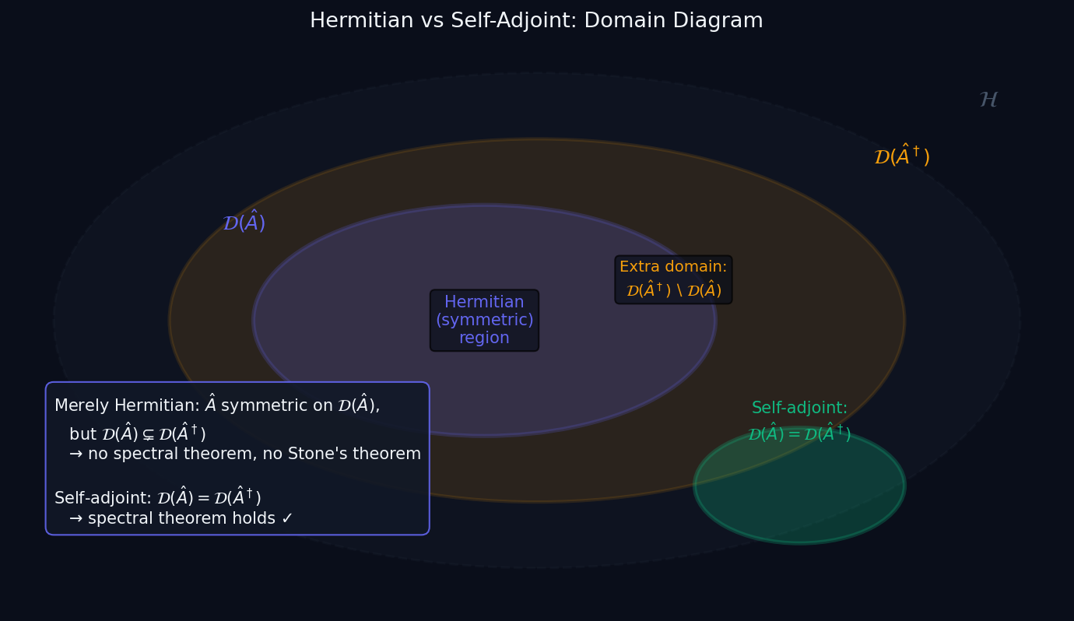
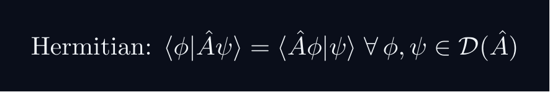
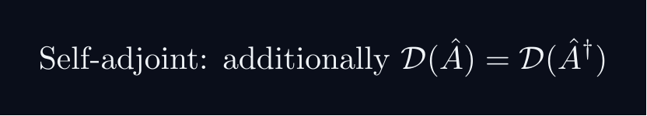
L01 — PhD: Hermitian vs Self-Adjoint Operators
L01
Domain subtlety — why this distinction is physical
HERMITIAN VS SELF-ADJOINT OPERATORS
THE DISTINCTION
For bounded operators on a finite-dimensional space, Hermitian = self-adjoint. For UNBOUNDED operators (p̂, x̂), these are different:
PHYSICAL CONSEQUENCE
The spectral theorem (real eigenvalues, complete eigenbasis) REQUIRES self-adjointness, not just Hermitian symmetry. Physical observables must be self-adjoint.
EXAMPLE: p̂ on [0,1]
p̂ = -iℏd/dx on C^∞_c(0,1) is Hermitian but NOT self-adjoint. Each boundary condition ψ(1) = e^{iθ}ψ(0) gives a different self-adjoint extension, with a different spectrum.
DIAGRAM
The domain diagram shows 𝒟(Â) ⊊ 𝒟(Â†). The self-adjoint case (green) has equal domains.
QM: L01 — PhD · Hermitian vs Self-Adjoint Operators
L01 · PhD

