Slide 1
Ψ
QUANTUM MECHANICS — BRA–KET NOTATION
L02
Bras, Dual Space & Inner Product Structure
Duality, conjugate linearity, Riesz representation
HS
BegUG
AdvUG
MSc
PhD
90-minute lecture · Dirac + Sakurai Dual-Track
QM: Bra–Ket Notation — L02
L02

Slide 2
L02 — Lecture Overview
L02
Bras, Dual Space & Inner Product Structure
90-MIN PACING
CORE LEARNING OUTCOMES
0–20 min: Define bras as linear functionals on H
20–50 min: Conjugate linearity; inner product axioms
50–70 min: Probability amplitude ⟨φ|ψ⟩ and Born rule
70–90 min: Orthonormal basis; Gram–Schmidt sketch
• Define bra ⟨ψ| as element of dual space H*
• Master conjugate linearity: (a⟨φ₁|+b⟨φ₂|)|ψ⟩ = a*⟨φ₁|ψ⟩ + b*⟨φ₂|ψ⟩
• Derive Born-rule probability from inner product structure
• State Riesz representation theorem (intuition)
HS
BegUG
AdvUG
MSc
PhD
Conjugation rules; dot-product analogy for real vectors
Orthonormal bases; Gram–Schmidt procedure
Riesz representation theorem intuition; proofs
Anti-linear maps; adjoint rigorously defined; continuity
Bounded vs unbounded functionals; Banach space context
ASSESSMENT BUNDLE
Set A: Compute ⟨φ|ψ⟩ for |φ⟩ = (1/√2)(|1⟩-i|2⟩), |ψ⟩ = (1/√5)(|1⟩+2i|2⟩) · Verify conjugate symmetry for the above pair
Set B: Prove that inner product positive-definiteness implies norm > 0 for |ψ⟩ ≠ 0 · Prove Gram–Schmidt produces orthonormal vectors
QM: Bra–Ket Notation — L02
L02 · Overview

Slide 3
L02 — Bras, Dual Space & Inner Product Structure
L02
Duality, conjugate linearity, Riesz representation
CORE CONTENT
OUTCOMES & APPLICATIONS
• Define bra ⟨ψ| as element of dual space H*
• Master conjugate linearity: (a⟨φ₁|+b⟨φ₂|)|ψ⟩ = a*⟨φ₁|ψ⟩ + b*⟨φ₂|ψ⟩
• Derive Born-rule probability from inner product structure
• State Riesz representation theorem (intuition)
QM: Bra–Ket Notation — L02
L02 · Content

Slide 4
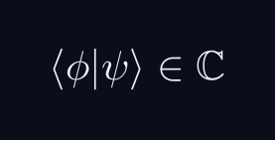
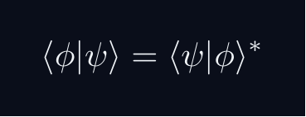

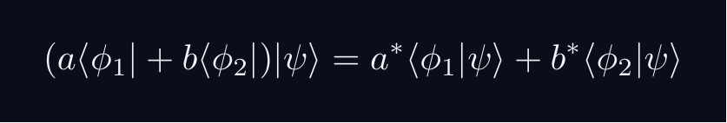
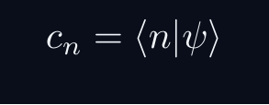
L02 — Key Formulas
L02
Pre-rendered formula reference
inner product
conj symmetry
linearity ket
conj lin bra
component via ip
QM: Bra–Ket Notation — L02
L02 · Formulas

Slide 5
L02 — Common Pitfalls & Historical Notes
L02
⚠ COMMON PITFALLS
HISTORICAL ANCHORS
• Forgetting that bra is antilinear: bra of (a|ψ⟩) is a*⟨ψ|
• Treating ⟨φ|ψ⟩ as symmetric — it is conjugate symmetric
• Confusing row vector (bra in a basis) with abstract dual vector
• Hilbert (1900s) — inner product spaces formalized
• Riesz (1907) — representation theorem for bounded functionals
• Dirac (1930) — bra as dual vector, bracket notation
PROBLEM SET A — Simple
PROBLEM SET B — Complex
A1. Compute ⟨φ|ψ⟩ for |φ⟩ = (1/√2)(|1⟩-i|2⟩), |ψ⟩ = (1/√5)(|1⟩+2i|2⟩)
A2. Verify conjugate symmetry for the above pair
A3. Apply Gram–Schmidt to {|1⟩+|2⟩, |1⟩-|2⟩} to get an ONB
A4. Compute the norm of |ψ⟩ = 3|1⟩ - 4i|2⟩ + 2|3⟩
B1. Prove that inner product positive-definiteness implies norm > 0 for |ψ⟩ ≠ 0
B2. Prove Gram–Schmidt produces orthonormal vectors
B3. Show the dual-space map |ψ⟩ ↦ ⟨ψ| is antilinear
QM: Bra–Ket Notation — L02
L02 · Problems

