Slide 1
Ψ
QUANTUM MECHANICS — BRA–KET NOTATION
L03
Linear Operators: Adjoint, Hermitian & Unitary
Operator algebra, observables and symmetries
HS
BegUG
AdvUG
MSc
PhD
90-minute lecture · Dirac + Sakurai Dual-Track
QM: Bra–Ket Notation — L03
L03

Slide 2
L03 — Lecture Overview
L03
Linear Operators: Adjoint, Hermitian & Unitary
90-MIN PACING
CORE LEARNING OUTCOMES
0–20 min: Operators as maps H→H; matrix elements ⟨φ|Â|ψ⟩
20–50 min: Adjoint Â†; Hermitian observables; unitary symmetries
50–70 min: Expectation values; operator algebra
70–90 min: Commutators preview; spectral theorem motivation
• Compute matrix elements ⟨φ|Â|ψ⟩ in any basis
• Define adjoint via ⟨φ|Â|ψ⟩ = ⟨Â†φ|ψ⟩
• Characterize Hermitian (Â=Â†) and unitary (Û†Û=Î) operators
• Prove expectation value of Hermitian operator is real
HS
BegUG
AdvUG
MSc
PhD
Matrices as machines on vectors; 2×2 examples
Eigenvalues basics; expectation value ⟨Â⟩ = ⟨ψ|Â|ψ⟩
Hermitian ⇒ real expectation; unitary preserves inner product
Spectral theorem preview; commutators; normal operators
Domains of unbounded operators; self-adjoint vs merely Hermitian
ASSESSMENT BUNDLE
Set A: Find Â† if Â = [[1+i, 2], [3, 4-i]] in matrix representation · Verify Hermiticity of σₓ, σᵧ, σᵤ (Pauli matrices)
Set B: Prove: if Â = Â† then ⟨ψ|Â|ψ⟩ ∈ ℝ for all |ψ⟩ · Prove: if Û is unitary then ⟨Ûφ|Ûψ⟩ = ⟨φ|ψ⟩
QM: Bra–Ket Notation — L03
L03 · Overview

Slide 3
L03 — Linear Operators: Adjoint, Hermitian & Unitary
L03
Operator algebra, observables and symmetries
CORE CONTENT
OUTCOMES & APPLICATIONS
• Compute matrix elements ⟨φ|Â|ψ⟩ in any basis
• Define adjoint via ⟨φ|Â|ψ⟩ = ⟨Â†φ|ψ⟩
• Characterize Hermitian (Â=Â†) and unitary (Û†Û=Î) operators
• Prove expectation value of Hermitian operator is real
QM: Bra–Ket Notation — L03
L03 · Content

Slide 4
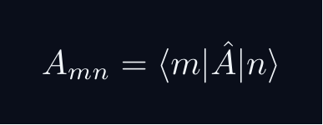
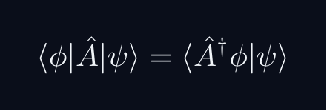


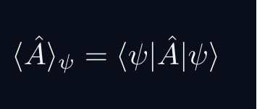
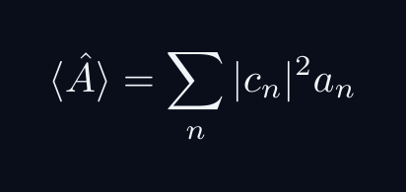
L03 — Key Formulas
L03
Pre-rendered formula reference
matrix element
adjoint def
hermitian
unitary
expectation
exp eigenbasis
QM: Bra–Ket Notation — L03
L03 · Formulas

Slide 5
L03 — Common Pitfalls & Historical Notes
L03
⚠ COMMON PITFALLS
HISTORICAL ANCHORS
• Confusing adjoint with transpose — must take complex conjugate too
• Assuming Hermitian implies bounded — position/momentum are unbounded
• Using Û† = Û⁻¹ blindly without checking domain
• Heisenberg (1925) — matrix mechanics; operators as physical quantities
• Born & Jordan (1925) — canonical commutation relations
• von Neumann (1927) — operator algebra on Hilbert space
PROBLEM SET A — Simple
PROBLEM SET B — Complex
A1. Find Â† if Â = [[1+i, 2], [3, 4-i]] in matrix representation
A2. Verify Hermiticity of σₓ, σᵧ, σᵤ (Pauli matrices)
A3. Compute ⟨σᵤ⟩ for |+⟩ = (1/√2)(|↑⟩+|↓⟩)
A4. Show UU† = I for U = (1/√2)[[1,1],[1,-1]] (Hadamard)
B1. Prove: if Â = Â† then ⟨ψ|Â|ψ⟩ ∈ ℝ for all |ψ⟩
B2. Prove: if Û is unitary then ⟨Ûφ|Ûψ⟩ = ⟨φ|ψ⟩
B3. Show [Â,B̂] = iĈ with Â,B̂ Hermitian implies Ĉ is Hermitian
QM: Bra–Ket Notation — L03
L03 · Problems

