Slide 1
Ψ
QUANTUM MECHANICS — BRA–KET NOTATION
L04
Eigenkets, Projectors & Spectral Decomposition
Measurement postulate, projectors, post-measurement state
HS
BegUG
AdvUG
MSc
PhD
90-minute lecture · Dirac + Sakurai Dual-Track
QM: Bra–Ket Notation — L04
L04

Slide 2
L04 — Lecture Overview
L04
Eigenkets, Projectors & Spectral Decomposition
90-MIN PACING
CORE LEARNING OUTCOMES
0–20 min: Eigenvalue equation Â|a⟩ = a|a⟩
20–50 min: Projectors P̂ₐ = |a⟩⟨a|; idempotency and completeness
50–75 min: Spectral decomposition Â = Σₐ a|a⟩⟨a|
75–90 min: Measurement postulate; post-measurement state update
• Use eigenkets to compute measurement probabilities P(a) = |⟨a|ψ⟩|²
• Construct and verify projectors P̂ₐ² = P̂ₐ, P̂ₐ† = P̂ₐ
• Write spectral decomposition for any discrete observable
• State the measurement postulate (Sakurai formulation)
HS
BegUG
AdvUG
MSc
PhD
Filters and outcomes intuition — Stern–Gerlach analogy
Compute P(a) = |⟨a|ψ⟩|² via projectors for simple cases
Degeneracy; resolution of identity in eigenbasis
Projection postulate subtleties; Lüders rule
Spectral measures; PVMs and POVMs preview; measurement models
ASSESSMENT BUNDLE
Set A: Find eigenkets and eigenvalues of σᵤ = [[1,0],[0,-1]] · Construct projectors P̂₊ and P̂₋; verify P̂₊ + P̂₋ = Î
Set B: Prove P̂ₐP̂_b = δ_{ab}P̂ₐ for distinct eigenvalues · Show Σₐ P̂ₐ = Î using completeness of eigenbasis
QM: Bra–Ket Notation — L04
L04 · Overview

Slide 3
L04 — Eigenkets, Projectors & Spectral Decomposition
L04
Measurement postulate, projectors, post-measurement state
CORE CONTENT
OUTCOMES & APPLICATIONS
• Use eigenkets to compute measurement probabilities P(a) = |⟨a|ψ⟩|²
• Construct and verify projectors P̂ₐ² = P̂ₐ, P̂ₐ† = P̂ₐ
• Write spectral decomposition for any discrete observable
• State the measurement postulate (Sakurai formulation)
QM: Bra–Ket Notation — L04
L04 · Content

Slide 4
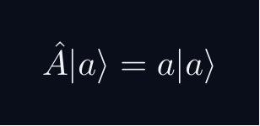
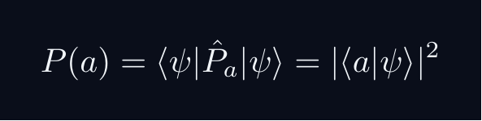
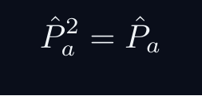
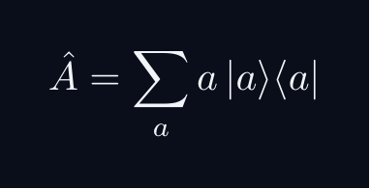
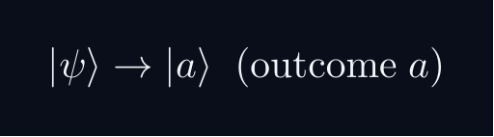
L04 — Key Formulas
L04
Pre-rendered formula reference
eigenvalue eq
projector
idempotent
spectral decomp
prob projector
post meas
QM: Bra–Ket Notation — L04
L04 · Formulas

Slide 5
L04 — Common Pitfalls & Historical Notes
L04
⚠ COMMON PITFALLS
HISTORICAL ANCHORS
• Mixing up projector P̂ₐ (idempotent) with general operator
• Forgetting to normalize post-measurement state in degenerate case
• Applying spectral theorem to non-Hermitian operators
• Dirac (1930) — transformation theory, eigenvalues as measurement outcomes
• von Neumann (1932) — projection postulate, wave-function collapse
• Lüders (1951) — generalization of projection postulate
PROBLEM SET A — Simple
PROBLEM SET B — Complex
A1. Find eigenkets and eigenvalues of σᵤ = [[1,0],[0,-1]]
A2. Construct projectors P̂₊ and P̂₋; verify P̂₊ + P̂₋ = Î
A3. Compute P(+) for |ψ⟩ = (3/5)|+⟩ + (4/5)|-⟩
A4. Verify P̂ₐ² = P̂ₐ for any rank-1 projector
B1. Prove P̂ₐP̂_b = δ_{ab}P̂ₐ for distinct eigenvalues
B2. Show Σₐ P̂ₐ = Î using completeness of eigenbasis
B3. Derive the spectral theorem for a 2×2 Hermitian matrix from scratch
QM: Bra–Ket Notation — L04
L04 · Problems

