Slide 1
Ψ
QUANTUM MECHANICS — BRA–KET NOTATION
L05
Completeness, Change of Basis & Matrix Mechanics
Identity insertion, basis transforms, matrix representation
HS
BegUG
AdvUG
MSc
PhD
90-minute lecture · Dirac + Sakurai Dual-Track
QM: Bra–Ket Notation — L05
L05

Slide 2
L05 — Lecture Overview
L05
Completeness, Change of Basis & Matrix Mechanics
90-MIN PACING
CORE LEARNING OUTCOMES
0–20 min: Resolution of identity; inserting 1
20–50 min: Basis expansion and change of representation
50–75 min: Matrix multiplication as inserted identities
75–90 min: Coordinate transforms; unitary basis changes
• Use Σₙ|n⟩⟨n|=Î to evaluate any bracket by inserting identity
• Transform between bases using unitary matrices
• Derive matrix multiplication from operator composition
• Express operator matrix elements Aₘₙ = ⟨m|Â|n⟩
HS
BegUG
AdvUG
MSc
PhD
Coordinate systems analogy; 2D rotation
Compute Aₘₙ and transform vectors between bases
Abstract operator and matrix representation equivalence
Similarity vs unitary equivalence; trace & spectrum invariants
Representation theory framing; direct integrals preview
ASSESSMENT BUNDLE
Set A: Compute ⟨φ|Â|ψ⟩ by inserting identity in the σᵤ eigenbasis · Express |ψ⟩ = |+⟩ in the σₓ eigenbasis {|x+⟩, |x-⟩}
Set B: Prove Tr(Â) is basis-independent using insert-identity twice · Show that unitary equivalence preserves eigenvalues
QM: Bra–Ket Notation — L05
L05 · Overview

Slide 3
L05 — Completeness, Change of Basis & Matrix Mechanics
L05
Identity insertion, basis transforms, matrix representation
CORE CONTENT
OUTCOMES & APPLICATIONS
• Use Σₙ|n⟩⟨n|=Î to evaluate any bracket by inserting identity
• Transform between bases using unitary matrices
• Derive matrix multiplication from operator composition
• Express operator matrix elements Aₘₙ = ⟨m|Â|n⟩
QM: Bra–Ket Notation — L05
L05 · Content

Slide 4
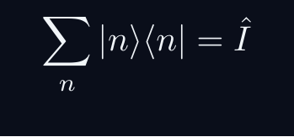
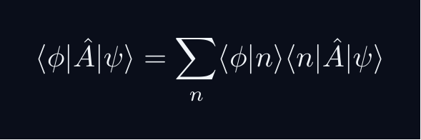
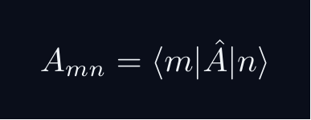
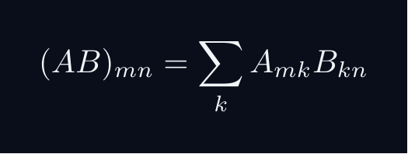

L05 — Key Formulas
L05
Pre-rendered formula reference
completeness
insert identity
matrix elem
matrix mult
unitary change
QM: Bra–Ket Notation — L05
L05 · Formulas

Slide 5
L05 — Common Pitfalls & Historical Notes
L05
⚠ COMMON PITFALLS
HISTORICAL ANCHORS
• Inserting identity in wrong basis for the operator
• Confusing similarity transform with unitary equivalence
• Forgetting that Tr(Â) and spectrum are basis-independent
• Heisenberg (1925) — matrix mechanics formulation
• Schrödinger (1926) — wave mechanics (different representation)
• Dirac (1930) — showed both are representations of same abstract theory
PROBLEM SET A — Simple
PROBLEM SET B — Complex
A1. Compute ⟨φ|Â|ψ⟩ by inserting identity in the σᵤ eigenbasis
A2. Express |ψ⟩ = |+⟩ in the σₓ eigenbasis {|x+⟩, |x-⟩}
A3. Verify (Â·B̂)ₘₙ = Σₖ AₘₖBₖₙ for 2×2 matrices
B1. Prove Tr(Â) is basis-independent using insert-identity twice
B2. Show that unitary equivalence preserves eigenvalues
B3. Prove the determinant is basis-independent
QM: Bra–Ket Notation — L05
L05 · Problems

