Slide 1
Ψ
QUANTUM MECHANICS — BRA–KET NOTATION
L06
Continuous Bases: |x⟩, |p⟩ & Delta Functions
Position/momentum bases, wavefunctions, Fourier connection
HS
BegUG
AdvUG
MSc
PhD
90-minute lecture · Dirac + Sakurai Dual-Track
QM: Bra–Ket Notation — L06
L06

Slide 2
L06 — Lecture Overview
L06
Continuous Bases: |x⟩, |p⟩ & Delta Functions
90-MIN PACING
CORE LEARNING OUTCOMES
0–20 min: Continuous completeness ∫|x⟩⟨x|dx = Î
20–50 min: Wavefunction as ψ(x) = ⟨x|ψ⟩
50–75 min: Momentum basis; ⟨x|p⟩ = e^{ipx/ℏ}/√(2πℏ)
75–90 min: Fourier connection; delta function identities
• Understand ⟨x|x'⟩ = δ(x−x') as continuous orthonormality
• Derive wavefunction ψ(x) as projection onto position basis
• Connect Fourier transform to ⟨x|p⟩ inner product
• Handle Dirac delta distributions carefully
HS
BegUG
AdvUG
MSc
PhD
What a continuum of outcomes means physically
Basic integrals; qualitative delta function properties
Careful delta manipulations; normalization conventions
Distribution theory viewpoint; generalized eigenvectors
Rigged Hilbert spaces motivation; Gel'fand triple preview
ASSESSMENT BUNDLE
Set A: Show ∫|x⟩⟨x|dx=Î implies ⟨φ|ψ⟩ = ∫φ*(x)ψ(x)dx · Verify ψ̃(p) = ⟨p|ψ⟩ is the Fourier transform of ψ(x)
Set B: Derive ψ(x) as Fourier transform of φ(p) from ⟨x|p⟩ kernel · Prove Parseval–Plancherel: ∫|ψ|² dx = ∫|φ|² dp from completeness
QM: Bra–Ket Notation — L06
L06 · Overview

Slide 3
L06 — Continuous Bases: |x⟩, |p⟩ & Delta Functions
L06
Position/momentum bases, wavefunctions, Fourier connection
CORE CONTENT
OUTCOMES & APPLICATIONS
• Understand ⟨x|x'⟩ = δ(x−x') as continuous orthonormality
• Derive wavefunction ψ(x) as projection onto position basis
• Connect Fourier transform to ⟨x|p⟩ inner product
• Handle Dirac delta distributions carefully
QM: Bra–Ket Notation — L06
L06 · Content

Slide 4
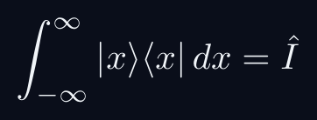
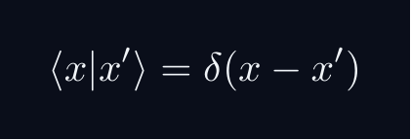
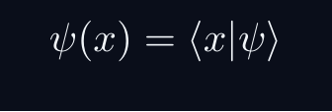
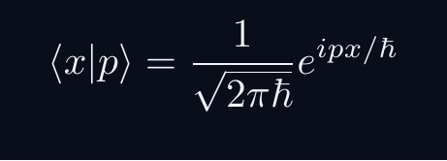
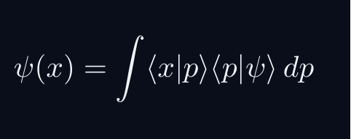
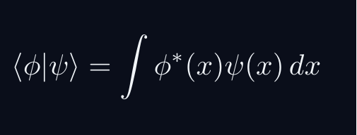
L06 — Key Formulas
L06
Pre-rendered formula reference
cont completeness
position ortho
wavefunction
momentum kernel
fourier via bk
ip as integral
QM: Bra–Ket Notation — L06
L06 · Formulas

Slide 5
L06 — Common Pitfalls & Historical Notes
L06
⚠ COMMON PITFALLS
HISTORICAL ANCHORS
• Treating δ(x−x') as a regular function — it is a distribution
• Wrong normalization: ⟨x|x'⟩ uses δ not Kronecker δ
• Confusing momentum eigenstate normalization conventions (ℏ vs 1)
• Schrödinger (1926) — wave mechanics and ψ(x)
• Dirac (1927) — δ-function introduced (informally)
• Schwartz (1950s) — distribution theory: rigorous foundation for δ
PROBLEM SET A — Simple
PROBLEM SET B — Complex
A1. Show ∫|x⟩⟨x|dx=Î implies ⟨φ|ψ⟩ = ∫φ*(x)ψ(x)dx
A2. Verify ψ̃(p) = ⟨p|ψ⟩ is the Fourier transform of ψ(x)
A3. Compute ⟨x|p̂|ψ⟩ using ⟨x|p̂|p⟩ = p⟨x|p⟩
B1. Derive ψ(x) as Fourier transform of φ(p) from ⟨x|p⟩ kernel
B2. Prove Parseval–Plancherel: ∫|ψ|² dx = ∫|φ|² dp from completeness
B3. Show x̂ in p-representation acts as iℏ∂/∂p
QM: Bra–Ket Notation — L06
L06 · Problems

