Slide 1
Ψ
QUANTUM MECHANICS — BRA–KET NOTATION
L07
Measurement Theory: Postulates, Compatibility & Uncertainty
Commutators, Robertson inequality, compatible observables
HS
BegUG
AdvUG
MSc
PhD
90-minute lecture · Dirac + Sakurai Dual-Track
QM: Bra–Ket Notation — L07
L07

Slide 2
L07 — Lecture Overview
L07
Measurement Theory: Postulates, Compatibility & Uncertainty
90-MIN PACING
CORE LEARNING OUTCOMES
0–20 min: Compatible observables and commutators [Â,B̂]
20–50 min: Uncertainty relation derivation (Robertson inequality)
50–75 min: Measurement update; expectation values
75–90 min: POVM preview; state tomography mention
• Define compatible observables: [Â,B̂]=0 ⟺ common eigenbasis
• Derive Robertson–Schrödinger uncertainty inequality
• Compute variances and uncertainty products
• Distinguish measurement uncertainty from instrumental imprecision
HS
BegUG
AdvUG
MSc
PhD
Uncertainty as statistical spread, not instrument error
Compute variances; simple commutators [x̂,p̂]=iℏ
Derive Robertson inequality from Cauchy–Schwarz
POVMs, operational view; state tomography preview
Measurement models (von Neumann coupling), disturbance, contextuality
ASSESSMENT BUNDLE
Set A: Compute [σₓ, σᵧ] and verify = 2iσᵤ · Find ΔSₓ and ΔSᵧ for |+z⟩; verify Robertson bound
Set B: Derive Robertson inequality using Cauchy–Schwarz on ΔÂ and ΔB̂ · Prove: [Â,B̂]=0 ⇒ simultaneous eigenbasis exists (for finite-dim)
QM: Bra–Ket Notation — L07
L07 · Overview

Slide 3
L07 — Measurement Theory: Postulates, Compatibility & Uncertainty
L07
Commutators, Robertson inequality, compatible observables
CORE CONTENT
OUTCOMES & APPLICATIONS
• Define compatible observables: [Â,B̂]=0 ⟺ common eigenbasis
• Derive Robertson–Schrödinger uncertainty inequality
• Compute variances and uncertainty products
• Distinguish measurement uncertainty from instrumental imprecision
QM: Bra–Ket Notation — L07
L07 · Content

Slide 4
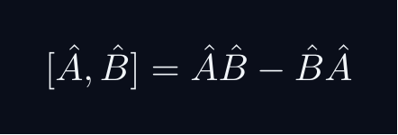
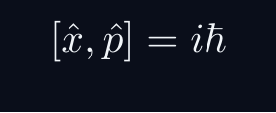
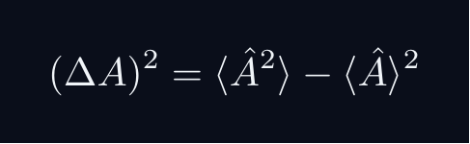
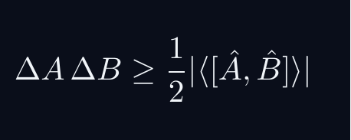
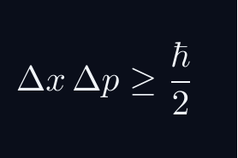
L07 — Key Formulas
L07
Pre-rendered formula reference
commutator
canonical CR
variance
robertson
heisenberg ur
QM: Bra–Ket Notation — L07
L07 · Formulas

Slide 5
L07 — Common Pitfalls & Historical Notes
L07
⚠ COMMON PITFALLS
HISTORICAL ANCHORS
• Confusing measurement uncertainty (quantum) with experimental error
• [x̂,p̂]=iℏ — do not drop the iℏ or reverse the sign
• Assuming compatible means 'commuting matrices' without checking domain
• Heisenberg (1927) — uncertainty principle (heuristic)
• Robertson (1929) — general algebraic uncertainty relation
• Schrödinger (1930) — tighter form (Robertson–Schrödinger)
PROBLEM SET A — Simple
PROBLEM SET B — Complex
A1. Compute [σₓ, σᵧ] and verify = 2iσᵤ
A2. Find ΔSₓ and ΔSᵧ for |+z⟩; verify Robertson bound
A3. Compute variance of σᵤ in state |+x⟩
B1. Derive Robertson inequality using Cauchy–Schwarz on ΔÂ and ΔB̂
B2. Prove: [Â,B̂]=0 ⇒ simultaneous eigenbasis exists (for finite-dim)
B3. Show [Â,B̂] = iĈ with Ĉ Hermitian ⇒ uncertainty product ≥ |⟨Ĉ⟩|/2
QM: Bra–Ket Notation — L07
L07 · Problems

