Slide 1
Ψ
QUANTUM MECHANICS — BRA–KET NOTATION
L08
Time Evolution & Pictures of Quantum Mechanics
Unitary evolution, Schrödinger/Heisenberg pictures, constants of motion
HS
BegUG
AdvUG
MSc
PhD
90-minute lecture · Dirac + Sakurai Dual-Track
QM: Bra–Ket Notation — L08
L08

Slide 2
L08 — Lecture Overview
L08
Time Evolution & Pictures of Quantum Mechanics
90-MIN PACING
CORE LEARNING OUTCOMES
0–20 min: Unitary evolution Û(t) = e^{−iĤt/ℏ}
20–45 min: Schrödinger picture: states evolve, operators fixed
45–70 min: Heisenberg picture: operators evolve
70–90 min: Constants of motion; [Â,Ĥ]=0 ⟺ conserved
• Derive Û(t) from unitarity and time-translation invariance
• Work fluently in both Schrödinger and Heisenberg pictures
• Derive Heisenberg equation of motion dÂ_H/dt
• Identify constants of motion via [Â,Ĥ]=0
HS
BegUG
AdvUG
MSc
PhD
Exponential as repeated tiny evolution steps
Differentiate ⟨Â⟩ with time; simple Hamiltonians
Heisenberg EOM; Ehrenfest's theorem
Time-ordering; interaction picture preview
Stone's theorem; one-parameter unitary groups; domain issues
ASSESSMENT BUNDLE
Set A: Show Û†Û = Î if Ĥ is Hermitian · Prove d/dt ⟨ψ(t)|ψ(t)⟩ = 0 under unitary evolution
Set B: Derive Heisenberg EOM from d/dt⟨Â⟩ = d/dt⟨ψ|Â|ψ⟩ · Prove Ehrenfest: d⟨x̂⟩/dt = ⟨p̂⟩/m from Ĥ = p̂²/2m + V(x̂)
QM: Bra–Ket Notation — L08
L08 · Overview

Slide 3
L08 — Time Evolution & Pictures of Quantum Mechanics
L08
Unitary evolution, Schrödinger/Heisenberg pictures, constants of motion
CORE CONTENT
OUTCOMES & APPLICATIONS
• Derive Û(t) from unitarity and time-translation invariance
• Work fluently in both Schrödinger and Heisenberg pictures
• Derive Heisenberg equation of motion dÂ_H/dt
• Identify constants of motion via [Â,Ĥ]=0
QM: Bra–Ket Notation — L08
L08 · Content

Slide 4
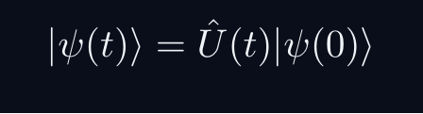

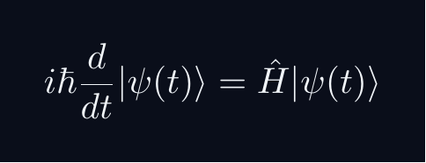
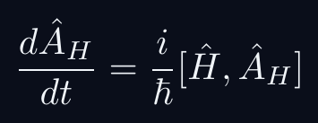
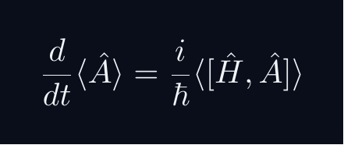
L08 — Key Formulas
L08
Pre-rendered formula reference
time evolution
unitary exp
schrodinger eq
heisenberg eom
ehrenfest
QM: Bra–Ket Notation — L08
L08 · Formulas

Slide 5
L08 — Common Pitfalls & Historical Notes
L08
⚠ COMMON PITFALLS
HISTORICAL ANCHORS
• Forgetting sign: dÂ_H/dt = (i/ℏ)[Ĥ,Â_H], not [Â_H,Ĥ]
• Mixing Schrödinger and Heisenberg pictures in same equation
• Assuming e^{Â+B̂} = e^Â·e^{B̂} — only true if [Â,B̂]=0
• Schrödinger (1926) — wave equation, Schrödinger picture
• Heisenberg (1925) — matrix mechanics, Heisenberg picture
• Dirac (1927) — interaction picture; both pictures equivalent
PROBLEM SET A — Simple
PROBLEM SET B — Complex
A1. Show Û†Û = Î if Ĥ is Hermitian
A2. Prove d/dt ⟨ψ(t)|ψ(t)⟩ = 0 under unitary evolution
A3. Compute |ψ(t)⟩ for two-level system Ĥ = ω₀σᵤ/2
B1. Derive Heisenberg EOM from d/dt⟨Â⟩ = d/dt⟨ψ|Â|ψ⟩
B2. Prove Ehrenfest: d⟨x̂⟩/dt = ⟨p̂⟩/m from Ĥ = p̂²/2m + V(x̂)
B3. Show [Â,Ĥ]=0 ⇒ ⟨Â⟩ constant in time in Schrödinger picture
QM: Bra–Ket Notation — L08
L08 · Problems

