Slide 1
Ψ
QUANTUM MECHANICS — BRA–KET NOTATION
L09
Tensor Products: Composite Systems & Entanglement
Product vs entangled states, Schmidt decomposition
HS
BegUG
AdvUG
MSc
PhD
90-minute lecture · Dirac + Sakurai Dual-Track
QM: Bra–Ket Notation — L09
L09

Slide 2
L09 — Lecture Overview
L09
Tensor Products: Composite Systems & Entanglement
90-MIN PACING
CORE LEARNING OUTCOMES
0–20 min: Tensor product space H_A ⊗ H_B
20–50 min: Product vs entangled states; operator action
50–75 min: Entanglement criterion; Schmidt decomposition
75–90 min: Partial measurement; reduced state preview
• Construct product states |i⟩_A ⊗ |j⟩_B and general bipartite states
• Identify entanglement by failure of coefficient factorization
• Apply Schmidt decomposition to find Schmidt rank
• Preview partial trace as reduced description of a subsystem
HS
BegUG
AdvUG
MSc
PhD
Two systems = bigger space — classical analogy & beyond
Compute product basis components; ⊗ of matrices
Schmidt decomposition (intro); maximally entangled states
Partial trace lightly; entanglement entropy preview
Entanglement measures, operational tasks, reading prompts
ASSESSMENT BUNDLE
Set A: Construct the 4-dim basis for two spin-1/2 particles · Show |Φ+⟩ = (1/√2)(|00⟩+|11⟩) is entangled
Set B: Find Schmidt decomposition of |Ψ⟩ = (|00⟩+|01⟩+|10⟩-|11⟩)/2 · Prove (⟨φ|⊗⟨χ|)(|ψ⟩⊗|η⟩) = ⟨φ|ψ⟩⟨χ|η⟩ from bilinearity
QM: Bra–Ket Notation — L09
L09 · Overview

Slide 3
L09 — Tensor Products: Composite Systems & Entanglement
L09
Product vs entangled states, Schmidt decomposition
CORE CONTENT
OUTCOMES & APPLICATIONS
• Construct product states |i⟩_A ⊗ |j⟩_B and general bipartite states
• Identify entanglement by failure of coefficient factorization
• Apply Schmidt decomposition to find Schmidt rank
• Preview partial trace as reduced description of a subsystem
QM: Bra–Ket Notation — L09
L09 · Content

Slide 4
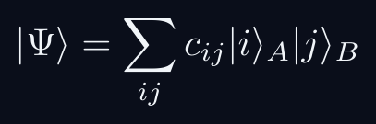
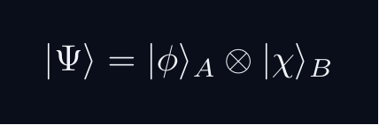
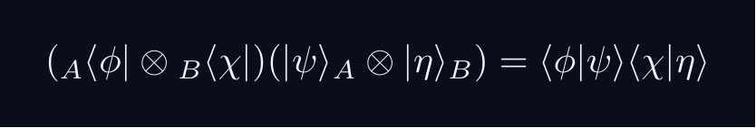
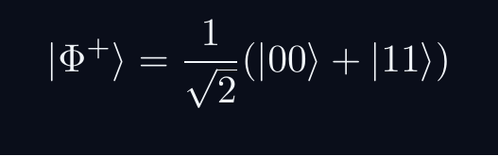
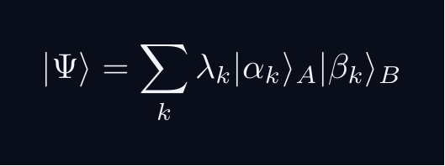
L09 — Key Formulas
L09
Pre-rendered formula reference
tensor product
product state
ip factorizes
bell state
schmidt
QM: Bra–Ket Notation — L09
L09 · Formulas

Slide 5
L09 — Common Pitfalls & Historical Notes
L09
⚠ COMMON PITFALLS
HISTORICAL ANCHORS
• Assuming all bipartite states are product states
• Forgetting that dim(H_A ⊗ H_B) = dim(H_A) × dim(H_B)
• Confusing Schmidt rank 1 (separable) with full Schmidt decomposition
• Schrödinger (1935) — 'entanglement' (Verschränkung) coined
• Einstein, Podolsky, Rosen (1935) — EPR paradox
• Bell (1964) — Bell inequalities; experimental tests
PROBLEM SET A — Simple
PROBLEM SET B — Complex
A1. Construct the 4-dim basis for two spin-1/2 particles
A2. Show |Φ+⟩ = (1/√2)(|00⟩+|11⟩) is entangled
A3. Compute (σₓ⊗Î)|Φ+⟩
B1. Find Schmidt decomposition of |Ψ⟩ = (|00⟩+|01⟩+|10⟩-|11⟩)/2
B2. Prove (⟨φ|⊗⟨χ|)(|ψ⟩⊗|η⟩) = ⟨φ|ψ⟩⟨χ|η⟩ from bilinearity
B3. Show separability ⟺ Schmidt rank = 1
QM: Bra–Ket Notation — L09
L09 · Problems

