Slide 1
Ψ
QUANTUM MECHANICS — BRA–KET NOTATION
L10
Spin & Finite-Dimensional Hilbert Spaces (SU(2))
Spin-1/2, Pauli matrices, rotation operators, Bloch sphere
HS
BegUG
AdvUG
MSc
PhD
90-minute lecture · Dirac + Sakurai Dual-Track
QM: Bra–Ket Notation — L10
L10

Slide 2
L10 — Lecture Overview
L10
Spin & Finite-Dimensional Hilbert Spaces (SU(2))
90-MIN PACING
CORE LEARNING OUTCOMES
0–20 min: Spin-1/2 as 2D Hilbert space; |+⟩, |−⟩ basis
20–50 min: Pauli matrices; spin operators Sₓ, Sᵧ, Sᵤ
50–75 min: Rotation operators U(θ,n̂) = e^{−iθσ·n̂/2}
75–90 min: Angular momentum algebra; SU(2)/SO(3) link
• Work with spin-1/2 as prototype finite-dimensional QM
• Compute eigenkets and probabilities for all spin components
• Apply rotation operators U(θ,n̂) = e^{−iθσ·n̂/2}
• Connect SU(2) group to physical rotations SO(3)
HS
BegUG
AdvUG
MSc
PhD
Two-state systems as qubits — conceptual motivation
Compute spin measurement probabilities; Stern–Gerlach
Rotation operators; verify [σᵢ,σⱼ] = 2iεᵢⱼₖσₖ
Representation theory; angular momentum J+, J−
SU(2) vs SO(3), projective representations, Wigner theorem
ASSESSMENT BUNDLE
Set A: Find eigenkets of σₓ in terms of |+z⟩ and |−z⟩ · Compute P(+x) for state |+z⟩
Set B: Prove [σᵢ,σⱼ] = 2iεᵢⱼₖσₖ for all pairs · Derive U(θ,ẑ) = e^{−iθσᵤ/2} explicitly
QM: Bra–Ket Notation — L10
L10 · Overview

Slide 3
L10 — Spin & Finite-Dimensional Hilbert Spaces (SU(2))
L10
Spin-1/2, Pauli matrices, rotation operators, Bloch sphere
CORE CONTENT
OUTCOMES & APPLICATIONS
• Work with spin-1/2 as prototype finite-dimensional QM
• Compute eigenkets and probabilities for all spin components
• Apply rotation operators U(θ,n̂) = e^{−iθσ·n̂/2}
• Connect SU(2) group to physical rotations SO(3)
QM: Bra–Ket Notation — L10
L10 · Content

Slide 4
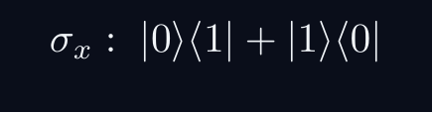
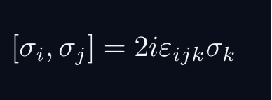
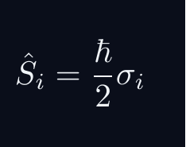
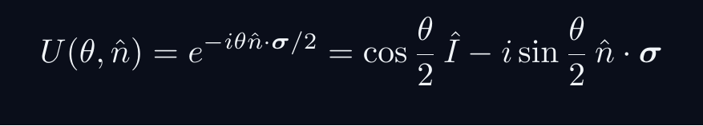
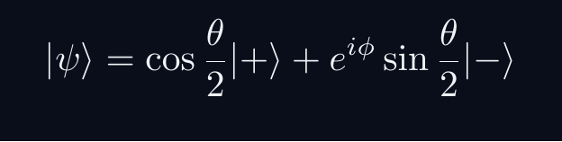
L10 — Key Formulas
L10
Pre-rendered formula reference
pauli x
pauli commutator
spin op
rotation op
bloch state
QM: Bra–Ket Notation — L10
L10 · Formulas

Slide 5
L10 — Common Pitfalls & Historical Notes
L10
⚠ COMMON PITFALLS
HISTORICAL ANCHORS
• Off-by-2 in rotation: SU(2) element for 2π rotation is −Î, not +Î
• Confusing σᵢ (dimensionless) with Sᵢ = ℏσᵢ/2
• Bloch sphere θ is polar angle (0 to π), not azimuthal
• Goudsmit & Uhlenbeck (1925) — spin hypothesis
• Pauli (1927) — Pauli matrices; spin-1/2 formalism
• Cartan (1913) / Weyl (1925) — SU(2) representation theory
PROBLEM SET A — Simple
PROBLEM SET B — Complex
A1. Find eigenkets of σₓ in terms of |+z⟩ and |−z⟩
A2. Compute P(+x) for state |+z⟩
A3. Apply U(π,ẑ) to |+z⟩; interpret physically
B1. Prove [σᵢ,σⱼ] = 2iεᵢⱼₖσₖ for all pairs
B2. Derive U(θ,ẑ) = e^{−iθσᵤ/2} explicitly
B3. Show a 4π rotation returns to original state; show 2π gives −|ψ⟩
QM: Bra–Ket Notation — L10
L10 · Problems

