Slide 1
Ψ
QUANTUM MECHANICS — BRA–KET NOTATION
L11
Density Operators, Mixed States & Partial Trace
ρ, Tr(ρA), Bloch sphere, open quantum systems preview
HS
BegUG
AdvUG
MSc
PhD
90-minute lecture · Dirac + Sakurai Dual-Track
QM: Bra–Ket Notation — L11
L11

Slide 2
L11 — Lecture Overview
L11
Density Operators, Mixed States & Partial Trace
90-MIN PACING
CORE LEARNING OUTCOMES
0–20 min: Pure vs mixed states; ρ = Σᵢ pᵢ|ψᵢ⟩⟨ψᵢ|
20–50 min: ⟨Â⟩ = Tr(ρÂ); properties of ρ
50–75 min: Partial trace; reduced density matrices
75–90 min: Bloch sphere for spin-1/2; purity Tr(ρ²)
• Construct density operator for ensembles and reduced states
• Compute expectation values via Tr(ρÂ)
• Apply partial trace to obtain subsystem density matrix
• Distinguish pure (Tr(ρ²)=1) from mixed (Tr(ρ²)<1) states
HS
BegUG
AdvUG
MSc
PhD
Classical ignorance vs quantum spread — conceptual distinction
Compute trace in matrix form; verify ρ properties
Pure vs mixed; Bloch vector parameterization of ρ
Kraus operators; CPTP maps preview; quantum channels
Open systems, master equations; quantum error correction preview
ASSESSMENT BUNDLE
Set A: Write ρ for the equal-weight mixture of |+z⟩ and |−z⟩; compute Tr(ρ²) · Compute ⟨σᵤ⟩ = Tr(ρσᵤ) for a given 2×2 ρ
Set B: Compute ρ_A = Tr_B(|Φ+⟩⟨Φ+|) for a Bell state; interpret purity · Show that reduced state of any pure entangled state is mixed
QM: Bra–Ket Notation — L11
L11 · Overview

Slide 3
L11 — Density Operators, Mixed States & Partial Trace
L11
ρ, Tr(ρA), Bloch sphere, open quantum systems preview
CORE CONTENT
OUTCOMES & APPLICATIONS
• Construct density operator for ensembles and reduced states
• Compute expectation values via Tr(ρÂ)
• Apply partial trace to obtain subsystem density matrix
• Distinguish pure (Tr(ρ²)=1) from mixed (Tr(ρ²)<1) states
QM: Bra–Ket Notation — L11
L11 · Content

Slide 4
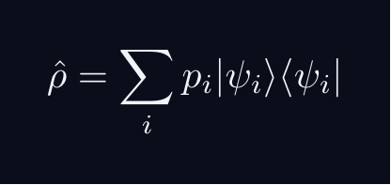
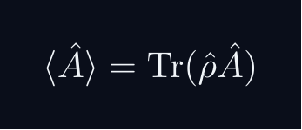
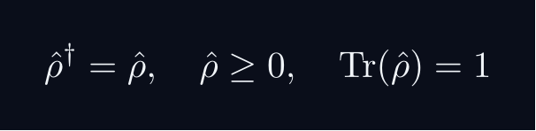

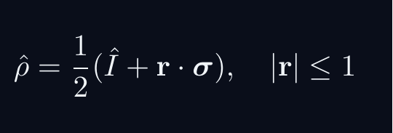
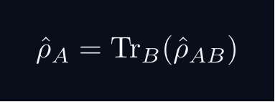
L11 — Key Formulas
L11
Pre-rendered formula reference
density op
expectation rho
rho properties
purity
bloch rho
partial trace
QM: Bra–Ket Notation — L11
L11 · Formulas

Slide 5
L11 — Common Pitfalls & Historical Notes
L11
⚠ COMMON PITFALLS
HISTORICAL ANCHORS
• Confusion between statistical mixture and quantum superposition
• Trace of a product ≠ product of traces in general
• Partial trace order matters: Tr_B ≠ Tr_A in general
• von Neumann (1927) — density matrix formalism
• Landau (1927) — density matrix for subsystems (independently)
• Kraus (1971) — operator-sum (Kraus) representation of channels
PROBLEM SET A — Simple
PROBLEM SET B — Complex
A1. Write ρ for the equal-weight mixture of |+z⟩ and |−z⟩; compute Tr(ρ²)
A2. Compute ⟨σᵤ⟩ = Tr(ρσᵤ) for a given 2×2 ρ
A3. Find Bloch vector r for ρ = (3/4)|+⟩⟨+| + (1/4)|−⟩⟨−|
B1. Compute ρ_A = Tr_B(|Φ+⟩⟨Φ+|) for a Bell state; interpret purity
B2. Show that reduced state of any pure entangled state is mixed
B3. Prove Tr(ρ²) ≤ 1 from ρ's spectral decomposition
QM: Bra–Ket Notation — L11
L11 · Problems

