Slide 1
Ψ
QUANTUM MECHANICS — BRA–KET NOTATION
L12
Rigged Hilbert Spaces & Mathematical Foundations
Distributions, self-adjointness, what Dirac notation hides
HS
BegUG
AdvUG
MSc
PhD
90-minute lecture · Dirac + Sakurai Dual-Track
QM: Bra–Ket Notation — L12
L12

Slide 2
L12 — Lecture Overview
L12
Rigged Hilbert Spaces & Mathematical Foundations
90-MIN PACING
CORE LEARNING OUTCOMES
0–20 min: Why |x⟩ is NOT in the Hilbert space
20–50 min: Distributions and test functions; Schwartz space
50–75 min: Self-adjointness vs Hermiticity revisited
75–90 min: What Dirac notation hides — safe usage rules
• Explain why ⟨x|x'⟩ = δ(x−x') requires distribution theory
• State the Gel'fand triple Φ ⊂ H ⊂ Φ'
• Distinguish self-adjoint from merely Hermitian (deficiency indices)
• Apply Dirac notation safely knowing its foundational limits
HS
BegUG
AdvUG
MSc
PhD
Idealized states — measuring infinitely precise position
Cautionary rules for delta functions in calculations
Unbounded operators (x̂, p̂); domain issues
Rigged Hilbert space triple Φ⊂H⊂Φ'; nuclear spectral theorem
Spectral theorem in full measure-theoretic form; deficiency indices
ASSESSMENT BUNDLE
Set A: Verify δ(ax) = δ(x)/|a| by integrating against test function · Show x̂ is Hermitian on C∞_c(ℝ) ⊂ L²(ℝ)
Set B: Show p̂ on [0,∞) with Dirichlet BC is Hermitian but NOT self-adjoint · Construct a self-adjoint extension of p̂ on [0,1]
QM: Bra–Ket Notation — L12
L12 · Overview

Slide 3
L12 — Rigged Hilbert Spaces & Mathematical Foundations
L12
Distributions, self-adjointness, what Dirac notation hides
CORE CONTENT
OUTCOMES & APPLICATIONS
• Explain why ⟨x|x'⟩ = δ(x−x') requires distribution theory
• State the Gel'fand triple Φ ⊂ H ⊂ Φ'
• Distinguish self-adjoint from merely Hermitian (deficiency indices)
• Apply Dirac notation safely knowing its foundational limits
QM: Bra–Ket Notation — L12
L12 · Content

Slide 4

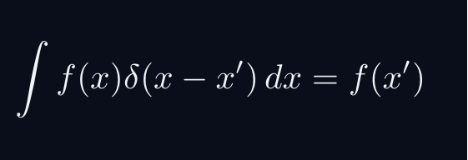
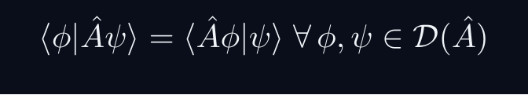
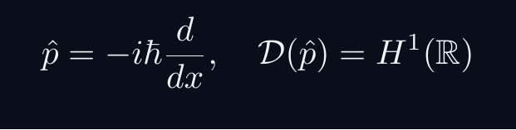
L12 — Key Formulas
L12
Pre-rendered formula reference
gelfand triple
delta def
sa condition
momentum domain
QM: Bra–Ket Notation — L12
L12 · Formulas

Slide 5
L12 — Common Pitfalls & Historical Notes
L12
⚠ COMMON PITFALLS
HISTORICAL ANCHORS
• Treating |x⟩ as a normalizable state — it is not in H
• Assuming Hermitian on a dense domain ⇒ self-adjoint automatically
• Using closure of Dirac notation without checking domain conditions
• Dirac (1930) — δ function and continuous eigenstates (informal)
• Schwartz (1950) — rigorous distribution theory
• Gel'fand & Kostyuchenko (1955) — rigged Hilbert spaces
• Bohm & Gadella (1989) — rigged Hilbert spaces in QM textbooks
PROBLEM SET A — Simple
PROBLEM SET B — Complex
A1. Verify δ(ax) = δ(x)/|a| by integrating against test function
A2. Show x̂ is Hermitian on C∞_c(ℝ) ⊂ L²(ℝ)
A3. Identify the domain of p̂ = −iℏd/dx on L²([0,1])
B1. Show p̂ on [0,∞) with Dirichlet BC is Hermitian but NOT self-adjoint
B2. Construct a self-adjoint extension of p̂ on [0,1]
B3. Explain why Gel'fand triple resolves the 'continuous eigenvector' problem
QM: Bra–Ket Notation — L12
L12 · Problems

