Slide 1
Operation Manual for imToolBox (v1.5.1)
Renliang Yuan

Slide 2
Contents
Installing the program ……p3
As stand-alone exe ……p4
Load data files ……p5
.ser/.dm3/.dm4 and other format image stack ……p5
A series of images ……p6
Image operation ……p7
Show different slice in the stack ……p7
Adjust contrast and gamma ……p8
Crop image ……p9
Basic analysis of scanning diffraction ……p10
Virtual annular dark field image ……p10
Strain analysis of scanning diffraction ……p11
Determine strain calculation method ……p12
Determine peak fitting method ……p13
Process single image or image stack ……p14
Generate strain maps ……p15
Export results ……p16

Slide 3

1. Installing the program - overview
imToolBox is developed using Matlab scripts and GUIDE for graphic user interface.
The stand-alone exe is compiled using Matlab R2016a, which can be used with a free compatible Matlab Runtime. No Matlab license required.

Slide 4
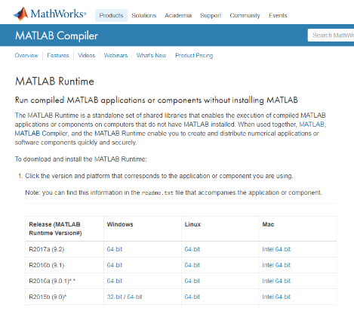
1.1 Installing the program – as stand-alone exe
Step 1: download and install Matlab Runtime
Version: R2016a (9.0.1)
Require 64-bit operating system
Link: https://www.mathworks.com/products/compiler/mcr.html
Step 2: copy ‘imToolBox.exe’ to any directory and open

Slide 5
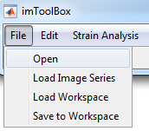
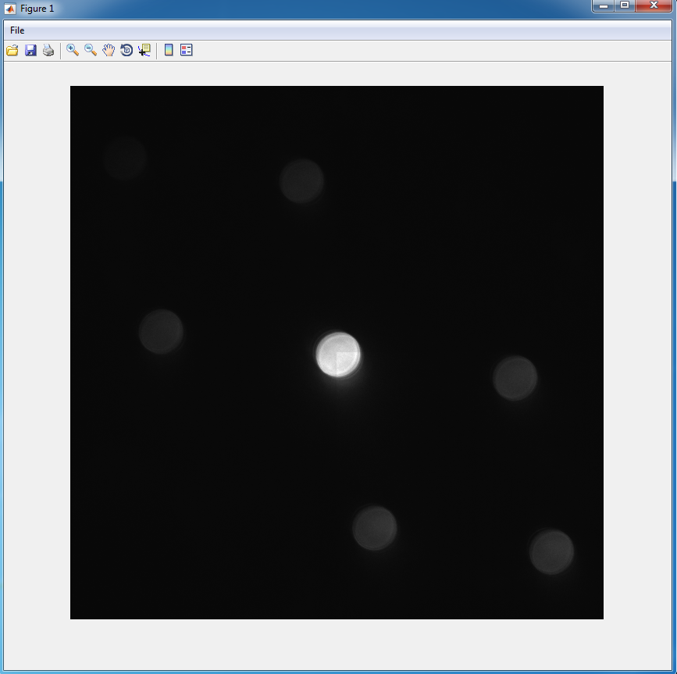
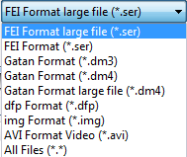
2.1 Load data files: .ser/.dm3/.dm4 and other format image stack
Menu -> File -> Open
Select data format (.ser, .dm3, .dm4, etc)
If the file size exceeds computer memory, select ‘Gatan Format large file(*.dm4)’ or ‘FEI Format large file(*.ser)’ instead
Select file and click ‘open’.
A separate window will show up with the image stack.
Note
For FEI format, .emi file which contains metadata is not needed. Only image or image stack saved in .ser file can be read directly.
Also support .dfp file generated from Zmult and .img file with 8-byte header.
Updated in v1.5

Slide 6
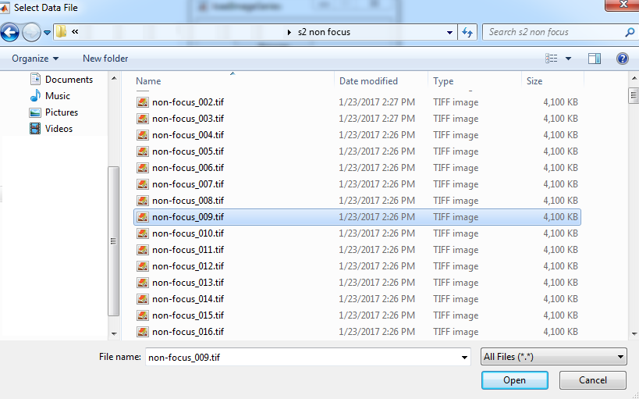
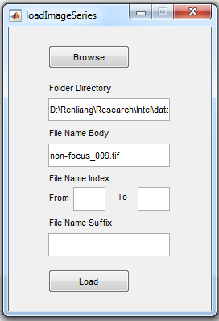
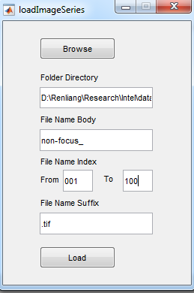
2.2 Load data files: a series of images
Menu -> File -> Load Image Series
Click ‘Browse’
Go to the data folder and select any one of the images
Modify filename body, fill in index range and filename suffix
The filename format must be ‘File Name Body’+’File Name Index’+’File Name Suffix’.
Index must be number and can have zeros in the beginning (up to 5 digits in total).
Click ‘Load’ and a separate window will show up with the image stack.

Slide 7
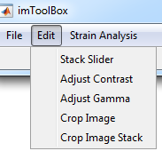
3 Image operation
3.1 Show different slice in the stack
Menu -> Edit -> Stack Slider to open
Select the window with image stack first and then select the stackSlider window.
Click ‘Update’ to link the image stack to stackSlider. (see gif on the right)
Use the slider or the textbox to select different slice of the image. Image will be updated in original figure window.
gif

Slide 8
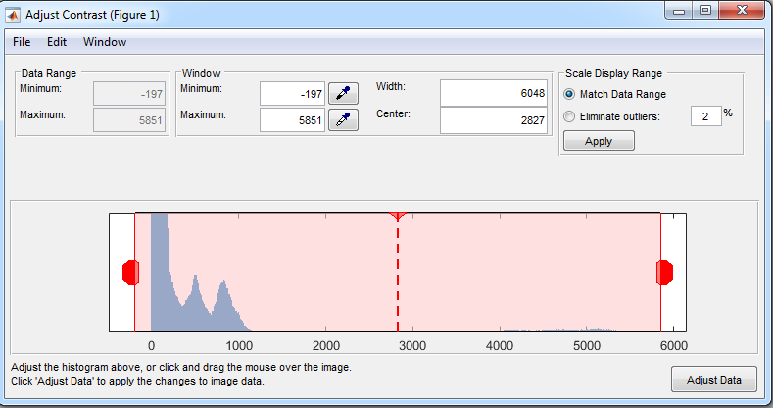
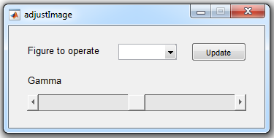
3 Image operation
3.2 Adjust contrast and gamma
Select the window with image first and then select imToolBox window.
Menu -> Edit -> Adjust Contrast / Adjust Gamma
Adjust Contrast: a new window will pop up with the histogram of the image. Drag the red rectangle to adjust contrast and brightness. The change will be reflected in image immediately. There is no need to click ‘Adjust Data’ button. Otherwise, you may not be able to restore the original display setting.
Adjust Gamma: a new window will pop up with the slider to adjust gamma. Similar to stack slider, remember to select the image window first and click ‘Update’. Slide the scroll to adjust gamma.

Slide 9
3 Image operation
3.3 Crop image
Select the window with image first and then select imToolBox window.
Menu -> Edit -> Crop Image / Crop Image Stack
The mouse will become a cross and the image window will be activated.
Click and drag a box on the region you want to crop.
Release the mouse and a new window with cropped image will show up. (see gif on the right)
When using Crop Image Stack, it will crop the same area of all the images in the stack and generate a new image stack.
gif

Slide 10
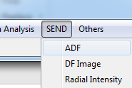
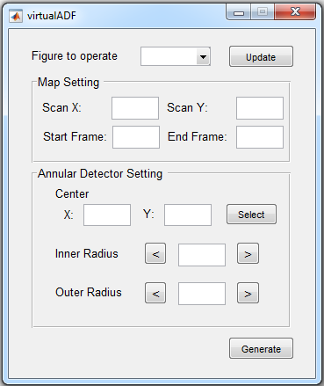
4 Basic analysis of scanning diffraction
4.1 Virtual annular dark field (VADF) image
Menu -> SEND -> ADF to open virtualADF window
Update figure to operate as shown in 3.1. It must be an image stack.
Determine the size of final VADF image by typing the pixel number of each dimension as Scan X and Scan Y.
If only part of the image stack is needed, type in the start and end frame. The start frame will be the first pixel in the VADF image.
Determine the center of VADF detector by clicking ‘Select’ button in Annular Detector Setting panel. Your mouse will become a crosshair. Single click the image where the desired center locates and press Enter. If needed, modify the numbers in X and Y coordinates to adjust position precisely.
Type in the pixel number of inner radius and outer radius of VADF detector. Use arrow buttons on left and right to decrease or increase.
Click ‘Generate’ button to generate VADF image using the settings above.
Updated in v1.5

Slide 11
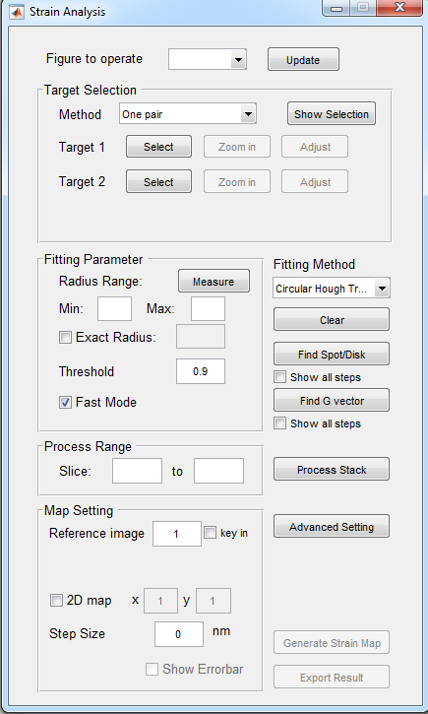
5 Strain analysis of scanning diffraction
Menu -> Strain Analysis -> Strain to open Strain Analysis window
Select the figure to operate by selecting the image window first and clicking ‘Update’. All operation below will only apply to this ‘Figure to operate’.
Updated in v1.5

Slide 12
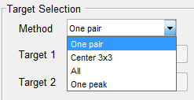
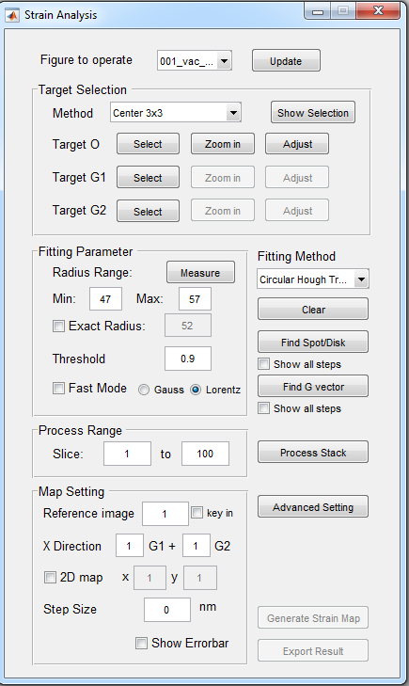
5 Strain analysis of scanning diffraction
5.1 Determine strain calculation method
There are four different modes available for strain analysis:
One pair: Calculate strain from one pair of diffraction peaks. Strain can be calculated only along one direction. Need to select 2 targets.
Center 3x3: Center beam and 8 adjacent diffraction peaks are used to calculate 2D strain tensor. Need to select 3 targets: O, reciprocal basis g1, and g2.
All: All detectable diffraction peaks are used to calculated 2D strain tensor. Need to select 3 targets: O, reciprocal basis g1, and g2.
One peak: Detect the movement of a single peak. Can be used to measure electric field. Need to select 1 target.
Select targets:
Click ‘Select’ button after ‘Target’ and drag a box around peak of interest. Adjust the box with peak at center if needed. ‘Select’ button now becomes ‘Done’ button. Click ‘Done’ when finished. Do the same for all targets.
Use ‘Zoom in’ button to show an enlarged view of the target selected, and ‘Adjust’ button to adjust the pixel value precisely.
After selecting all targets, use ‘Show Selection’ button to preview all target sub-regions for peak detection. Repeat step 1~2 if needed.
Updated in v1.5

Slide 13
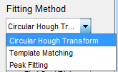
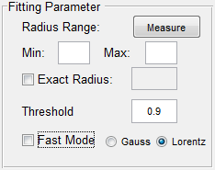
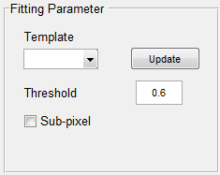
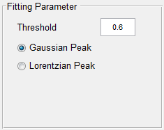
5 Strain analysis of scanning diffraction
5.2 Determine peak fitting method
There are three different methods available for peak detection:
Circular Hough Transform: Detect disk position by applying circular Hough transform to disk edge. Suitable for disk pattern.
Click ‘Measure’ button and drag a circle around the diffraction disk. Adjust size to be same as disk. Click ‘Done’ (previously ‘Measure’) button to update radius range values.
Fast Mode: Find peak position in accumulator matrix by weighted average. Recommended threshold: 0.9~0.99.
Non-fast mode: Use Gaussian or Lorentzian peak fitting to find peak position in accumulator matrix (more accurate but slower). Recommended threshold: 0.3~0.6.
Template Matching: Detect peak position by comparing with a template using normalized cross-correlation. Suitable for both spot and disk patterns.
Make a template by cropping from the original image and update template window similar to updating figure to operate.
Check ‘Sub-pixel’ to allow for sub-pixel cross-correlation.
Recommended threshold: 0.6.
Peak Fitting: Detect peak position by peak fitting. Suitable for spot pattern.
Recommended threshold: 0.3~0.6.
Updated in v1.5

Slide 14
5 Strain analysis of scanning diffraction
5.3 Process single image or image stack
Check and adjust the fitting parameter:
Set a sub-image containing only one diffraction peak as figure to operate. This sub-image can be cropped from original image or by using ‘Zoom in’ button in ‘Target Selection’ panel.
Click ‘Find Spot/Disk’ button to detect the peak position using current fitting method. Adjust parameters if fitting result is not perfect. Check ‘Show all steps’ box below to display all steps for peak detection for a detailed diagnosis.
Process single image:
With diffraction pattern as figure to operate and all targets and fitting parameters set, click ‘Find G vector’ button to calculate deformation matrix from current diffraction pattern.
Adjust parameters if errors are large and repeat step 1. Check ‘Show all steps’ box below to display fitting result of each diffraction peak used.
Process image stack:
Input the range of slice number in image stack desired to be processed.
Click ‘Process Stack’ button and wait for it to finish.
Delete any markers on figure to operate.
Updated in v1.5

Slide 15


5 Strain analysis of scanning diffraction
5.4 Generate strain maps
Set reference for strain calculation: 3 ways
Single image in the stack: input the slice number.
A continuous range of images: input the start and end slice number.
Numerical input: check ‘key in’ box and input pixel values of reciprocal vectors as reference.
Determine x direction of strain:
Input any linear combination of basis vectors G1 and G2. ex. For Si 110 pattern, G1 = 1-1-1, G2 = 1-11, then strain 110 = G1+G2, strain 001 = G1-G2.
1D profile or 2D map
Check ‘2D map’ box to set ouput as 2D maps, otherwise 1D profile is generated.
Input number of pixels in x and y dimension of the 2D map. This usually should match with scanning steps.
Step size in 1D profile
Change the axis label in 1D profile to match with experiment. If step size = 0, only number of steps will be shown in the plot.
Error bar
Check ‘Show Errorbar’ button to include errorbar in 1D profile or error maps for 2D output. These errors are estimated based on peak fitting error of each diffraction peak used to calculate strain.
Click ‘Generate Strain Map’ button to display strain profile/map.
Updated in v1.5

Slide 16
5 Strain analysis of scanning diffraction
5.4 Export results
After generating strain maps, click ‘Export Result’ button to save the strain data as txt files.
Updated in v1.5.1

