Slide 1
Parallel Web-Service Climate Model Diagnostic Analyzer
Seungwon Lee (PI)
Jonathan Jiang (Co-I)
Lei Pan (Co-I)
Chengxing Zhai (Co-I)
Joao Teixeira (Collaborator)

Slide 2
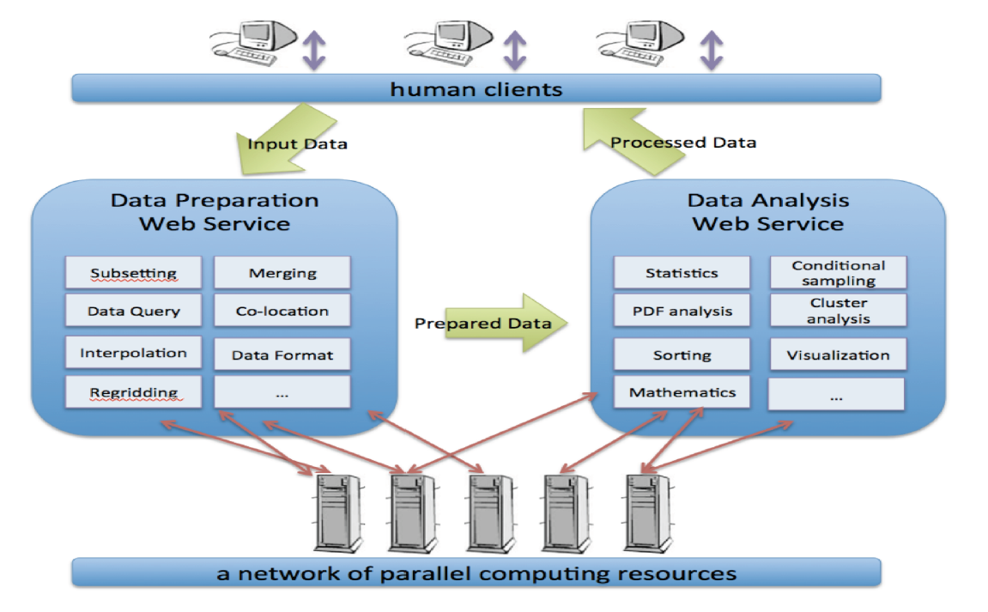
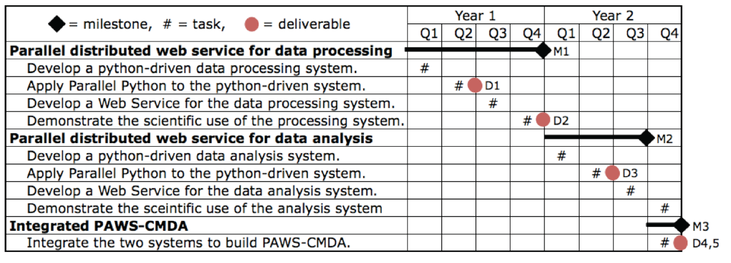
PAWS-CMDA: Parallel Web-Service Climate Model Diagnostic Analyzer PI: Seungwon Lee
Objective
Develop a parallel, distributed web-service oriented system to enable multi-aspect physics-based and phenomenon-oriented climate model performance evaluation and diagnosis through the comprehensive and synergistic us of multiple observational data, reanalysis data, and model outputs.
Significance
Scientific and technological advances in NASA’s climate and weather predictions through multivariate conditional sampling approaches and parallel and distributed web service technologies.
Functional architecture diagram for PAWS-CMDA
Approach
Develop Python-driven data preparation and analysis system. Wrap the existing data analysis tools in Python for integration into the system.
Apply Parallel Python to achieve large-scale distributed parallelism. Use Parallel Python to establish a server network, distribute sub-tasks to and retrieve results from the server network.
Build web services of the data preparation and analysis system with a dual access mode: web browsers and programs.
Task Schedules and Key Milestones
Tasks partially completed:
Developed a python-driven data processing/analysis system.
Developed a web service for the data processing system.
Tasks for next 6 months:
Add new capabilities to the data processing/analysis system.
Apply the Parallel Python where appropriate.
Co-Is/Collaborators
Lei Pan, Chengxing Zhai, Jonathan Jiang, Joao Teixeira

Slide 3
Technical Status
Describe the primary findings, technology development results, technical information and achievements, a list of technical publications, and technical status (e.g., status of elements, construction of breadboards or prototype implementations, results of tests and/or proof-of-concept demonstrations, etc).
Seungwon will write a summary of the technical status after collecting inputs from the Co-Is.

Slide 4
Adapting Existing Tools
Existing Matlab code is adapted for this project.
To meet the requirement of large scalability of PAWS-CMDA, we use GNU Octave, which is a license-free version of Matlab.
A minimal adjustment of the existing Matlab code was needed to make it executable in Octave environment.
Capabilities of the adapted Octave code:
2D ….
3D variable ….
Chengxing: More details please ….

Slide 5
Developing Python-Driven System
Wrap legacy data analysis tools for integration into the system.
Application code in GNU Octave (a free Matlab)
Use python caller code to spawn off the App. as a child process (using python subprocess)
The python caller prepares all input arguments for the child process
The python caller defines where the child process puts its results (e.g., images) using input argument
The stdout and stderr of child process are captured by the python caller at joining point (the way for the App. to communicate back to the python caller)
The legacy App. now looks like a python application

Slide 6
Building Web Services
Use Flask, an open source microframework for python apps.
Provide entry point code
Parse input arguments from client
Call aforementioned python app., passing input arguments
Get return values and pass them to client in JSON format
REST-ful style: scoping info. placed in URI and method info. conveyed in HTTP method
Example: http://cmacws.jpl.nasa.gov:8089/twoDimMap/display?model=ukmo_hadgem2-a&var=ts&start_time=199001&end_time=199512&lon1=0&lon2=100&lat1=-29&lat2=29&months=1,2,3
Define port number and location of static data
Separate app. traffic from static HTTP traffic
Use Gunicorn to provide WSGI (Web Service Gateway Interface) service (app.)
Use Tornado to provide web service (static HTTP)

Slide 7
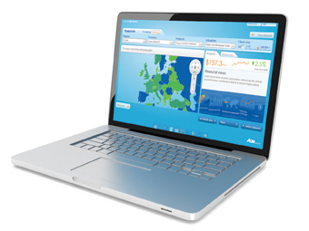


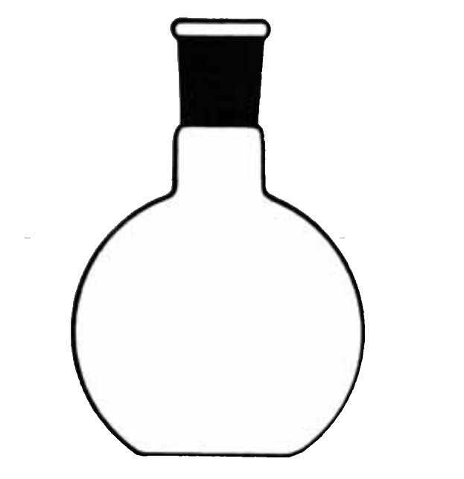



Service Diagram
client
URI
(scoping + method)
URI
of results
JSON
Octave App.

Slide 8
Service Virtualization
Use VMWare (VMPlayer)
Host OS: CentOS (Linux)
Guest OS: Ubuntu (Linux)
Open source software, python packages, etc. installed on guest OS
Services deployed to guest OS
Developers’ user accounts are on guest OS
RAID disk, with 100TB capacity, is mapped from host OS to guest OS
Host ports need to be open and forwarded to guest OS
Benefits: guest OS runs on any host OS, so moving is quick; no need to reinstall all the dependent packages again

Slide 9
Programmatic Status
This CMAC project started on October 1st, 2012.
This project total budget is $616K with $303K for year 1 and $313K for year 2.
This project has 9 tasks, 5 deliverables, and 3 milestones.
The schedule/order of the tasks is adjusted to improve the development cycle and support the new educational opportunity.
4 tasks are partially completed and 1 task is delayed.
The project cost is overrun by $16K as of the end of February.
The overrun is due to the overrun in hardware purchase and installation.
The overrun will be corrected by the gradual reduction of the labor cost through the rest of the year.

Slide 10
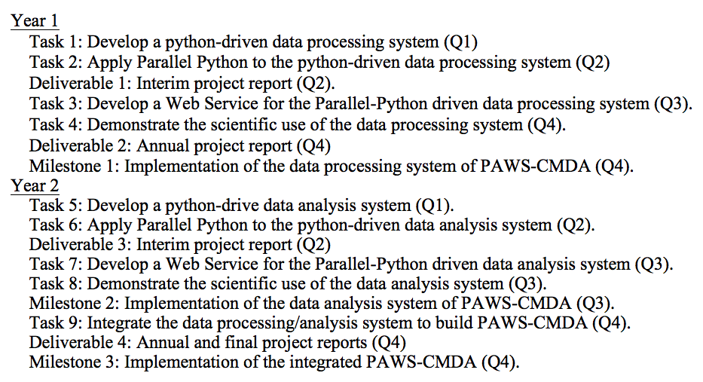
Project Schedule Planned

Slide 11
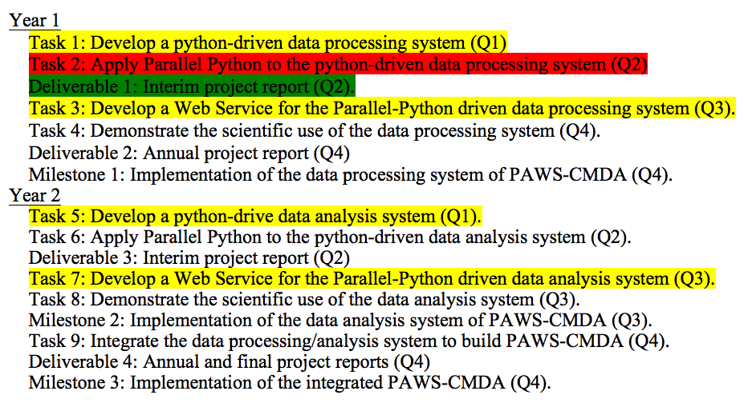
Project Schedule Status
Complete
Partially complete
Not started

Slide 12
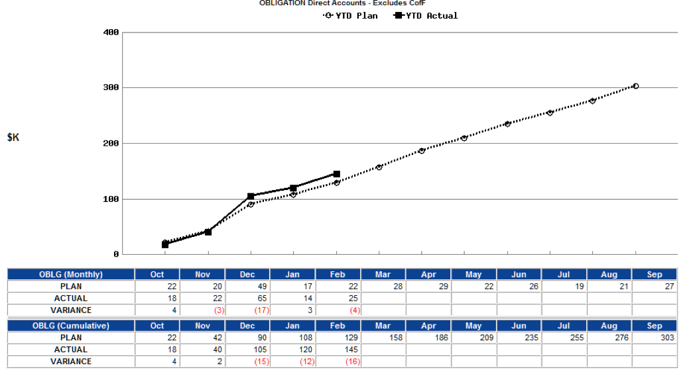
Project Cost Status
Total project budget for Year 1 is $303K.
As of the end of February, the project cost is overrun by $16K.
Overrun by $16K is due to the purchase and installation of the hardware.
While $20K was planned for the hardware purchase and installation, the actual cost was $36K.
The overrun will be corrected by the gradual reduction of the labor cost through the rest of the year.

Slide 13
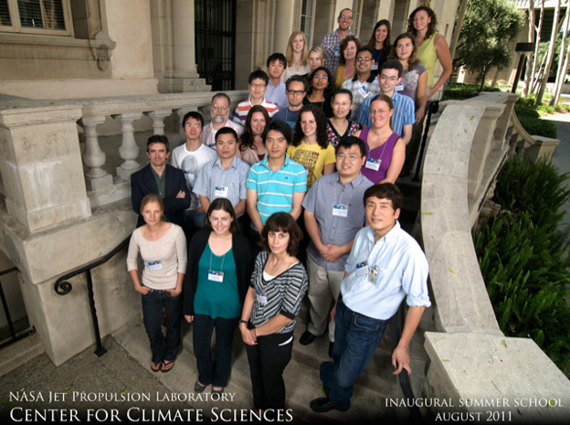
Educational and Outreach Status
Presented the planned work and current work status of this CMAC project at 2012 AGU Fall meeting in San Francisco, CA, December 2012.
This CMAC project agreed to work with CCS and make a demonstration of the tool in April, 2013. Upon a positive response, the tool will be used as an educational tool for the summer school.
Design and requirements for the education tool have been developed: the user interface should be web-browser based; the web server should support >30 simultaneous web-service requests.
Several web-services to support model-data intercomparisons are being developed: analysis and visualization of 2D/3D variable multi-annual means using Coupled Model Intercomparison Project Phase 5 (CMIP5) model outputs and Obs4MIPs datasets.
The Center for Climate Sciences (CCS) in JPL showed interest in using PAWS-CMDA as an education tool for a summer school hosted by CCS in 2013.
The summer school will bring together the next generation of climate scientists – about 30 graduate students and postdocs from around the world – to engage with premier climate scientists from JPL and elsewhere. http://climatesciences.jpl.nasa.gov/events/summer-school

Slide 14
CCS Summer School Tool & Curriculum
The CCS summer school education tool will be a web-browser based tool.
The tool will support the following functionalities:
2D variable map of annual means with spatial and temporal selection
2D variable zonal means with temporal selection
2D variable time series with spatial and temporal selection
3D variable vertical profile with spatial and temporal selection
3D variable zonal mean profiles with temporal selection
3D variable slice map with spatial, temporal and vertical level selection
The tool will be used to support the following curriculum:
Jonathan: Details about the curriculum please ….

Slide 15
Primary Findings

Slide 16
Future Work
Describe the work planned for the remainder of the project and critical issues that need to be resolved to successfully complete the remaining planned work.

Slide 17
Acronym List
PAWS-CMDA: Parallel Web-Service Climate Model Diagnostic Analyzer
CCS: The Center for Climate Sciences in JPL
CMIP5: Coupled Model Intercomparison Project Phase 5
Obs4MIPs: A pilot activity to make observational data products more accessible for climate model intercomparisons

Slide 18
Backup Slides

Slide 19
Content Guide
Include a cover page, quad chart, technical information and achievements, a list of technical publications, programmatic (including a milestone schedule and actual vs. planned costs since project inception), student pictures and involvement (including the degree they are pursuing), if applicable, and an acronym list. Acronyms should be spelled out the first time they are used. Each slide should stand on its own and contain sufficient explanation to enable future reviewers of the presentation to understand the information presented without the benefit of having participated in the review itself.
Describe the primary findings, technology development results, and technical status, e.g., status of elements, construction of breadboards or prototype implementations, results of tests and/or proof-of-concept demonstrations, etc.
Describe the work planned for the remainder of the project and critical issues that need to be resolved to successfully complete the remaining planned work.
Summarize the cost and schedule status of the project, including any schedule slippage/acceleration. A schedule milestone chart of all major task activities shall be created and maintained and shown at all reviews. A cost data sheet shall be created and maintained, showing total project costs obligated and costed, along with a graphical representation of the project cost run outs.
Report any educational and outreach components of the project, e.g., graduate degrees, educational activities; technology infusion or patents applied for or granted; journal or conference publications; presentations at professional conference, seminars and symposia; demonstrations; media exposure; and, other activities that contributed to the overall success of the research project.
An assessment of the technology readiness level of the components, sub-systems, and systems of the project.

