Slide 1


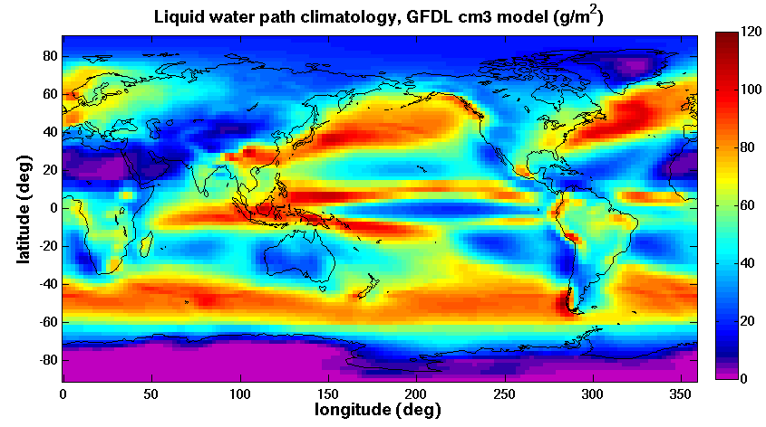
Educational Tool for Center for Climate Sciences Summer School under CMAC project “Parallel Web-Service Climate Model Diagnostic Analyzer” PI: Seungwon Lee (JPL) Co-Is: Lei Pan (JPL), Chengxing Zhai (JPL), Jonathan Jiang (JPL)
This CMAC project is developing a parallel, distributed web service oriented system that enables climate model performance evaluations and diagnoses.
The Center for Climate Sciences (CCS) in JPL is interested in using the web service system as an educational tool for a summer school to be hosted by CCS.
The summer school will bring together the next generation of climate scientists – about 30 graduate students and postdocs from around the world – to engage with premier climate scientists from JPL and elsewhere. http://climatesciences.jpl.nasa.gov/events/summer-school
This CMAC project agreed to work with CCS and make a demonstration of the tool in April, 2013. Upon a positive response, the tool will be used as an educational tool for the summer school.
Design and requirements for the educational tool are being developed: the user interface should be web-browser based; the web server should support at least 30 simultaneous web-service requests.
Web Service User Interface Example
Climate Model Climatology Web Service
Model Name | GFDL-CM3
Model Variable | Liquid Water Content
Time Range | [1980-01, 2004-12]
Latitude Range | [-90,90]degree
Longitude Range | [0,360]degree
Pressure Range | [0,1000]hPa or all
Web Service Output Example

