Slide 1


Functional Architecture Diagram
clients
workflow
MODIS
delay
MODIS delay
10 arc sec
space, time
MODIS
granules
Delay
image
ECMWF
delay
ECMWF delay
10 arc sec
services
STQ: space - time query
ECG: ECMWF delay generation
SAMI: MODIS subset, merge,
& interpolate
STQ
SAMI
ECG
RMP
MRG
RMP: map to a common grid
MRG: merge delay images
flexible mapping to
a network of servers
oscar.jpl.nasa.gov
oscar2.jpl.nasa.gov
npp.jpl.nasa.gov

Slide 2
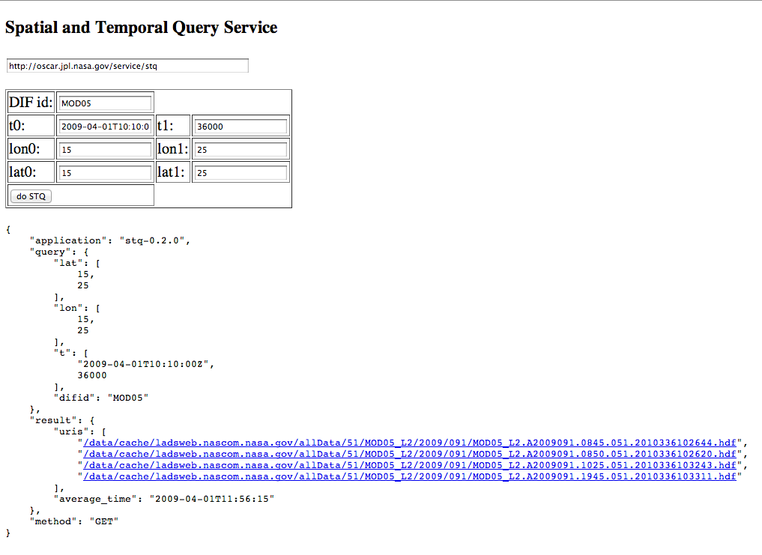

Slide 3
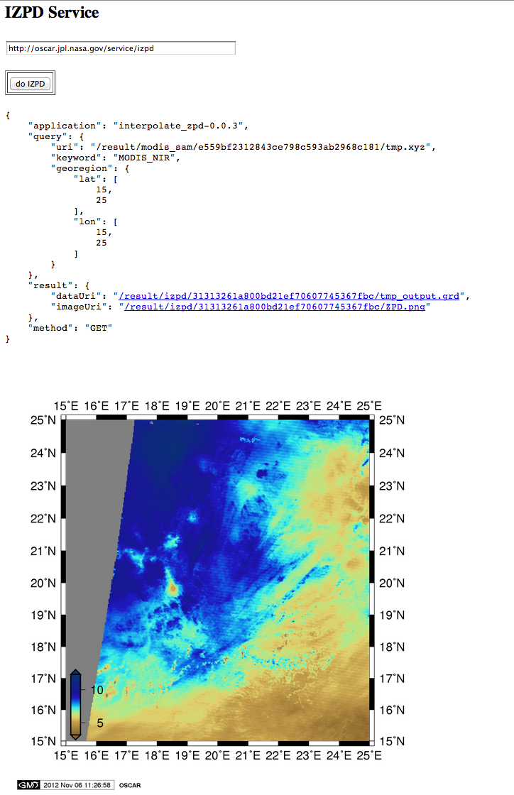

Slide 4
Human or program clients
Data flow
Space time
query
Dataset
files
Subset
data
Co-located
data
Analysis
results
Images
Services
Search
Subset
Co-locate
Analyze
Visualize
Data
preparation
Data
analysis
flexible mapping to
a network of servers
through REST and
virtualization
Parallel computing servers

