Slide 1

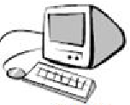

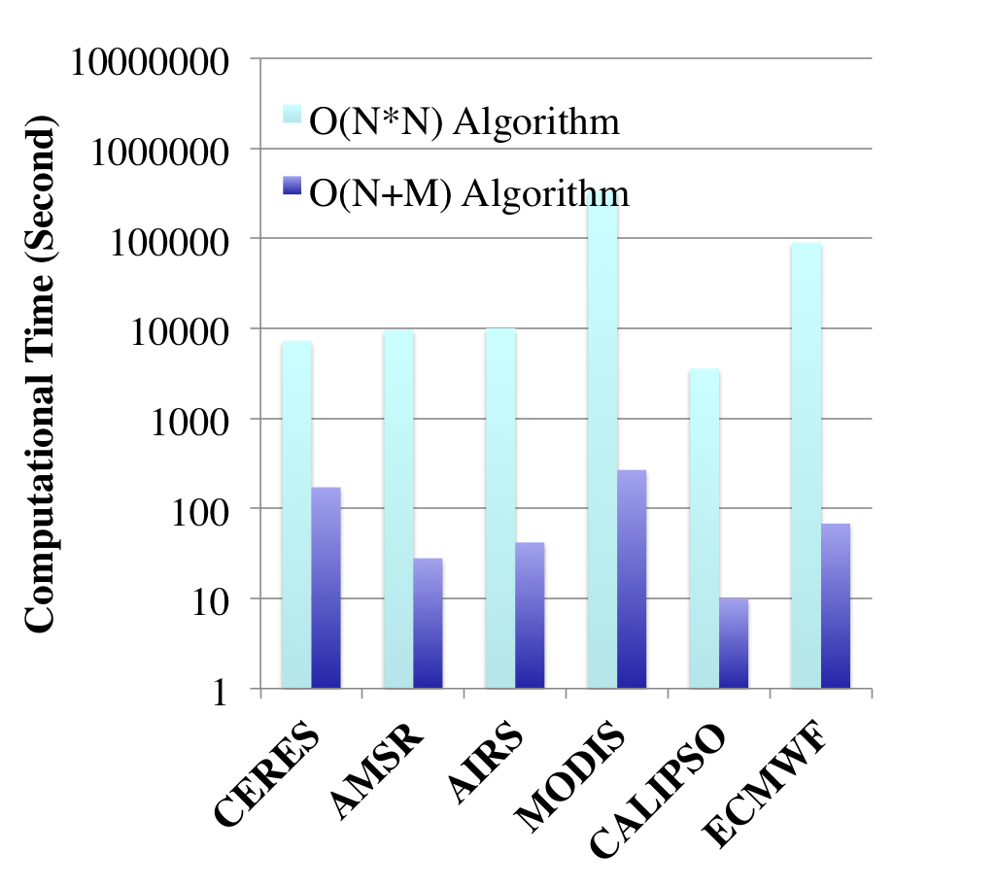
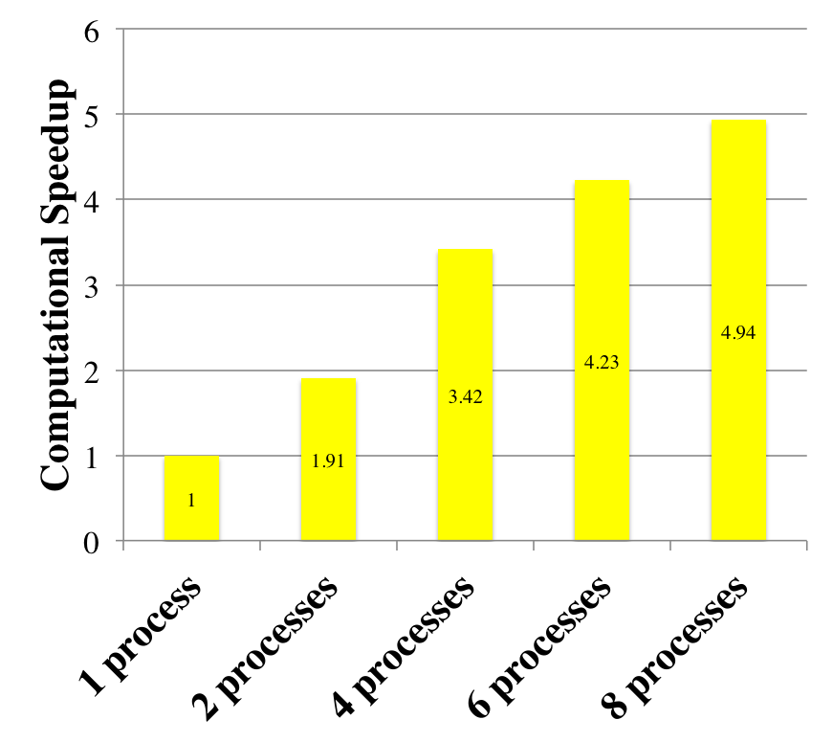
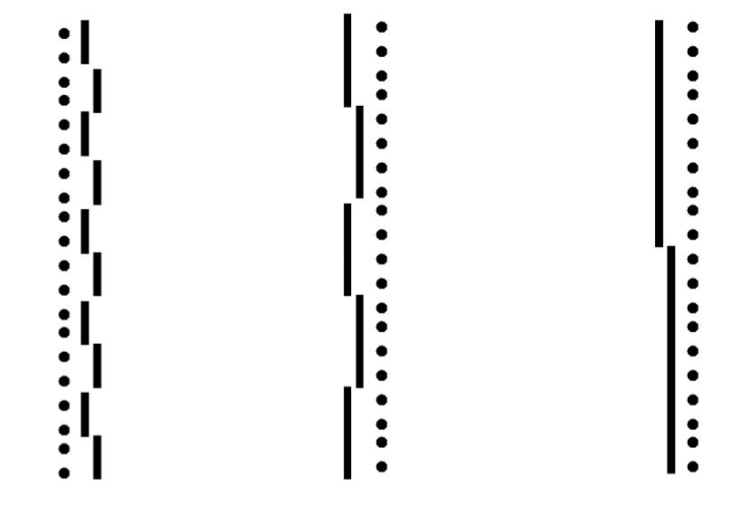
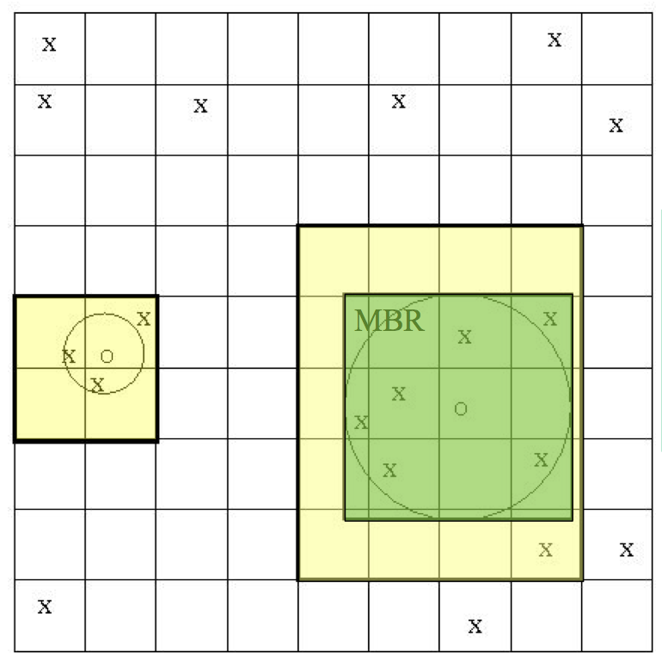
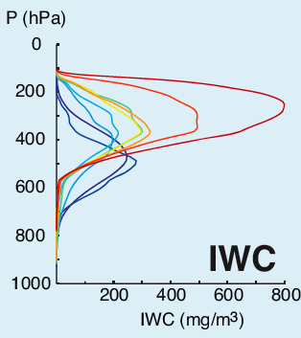
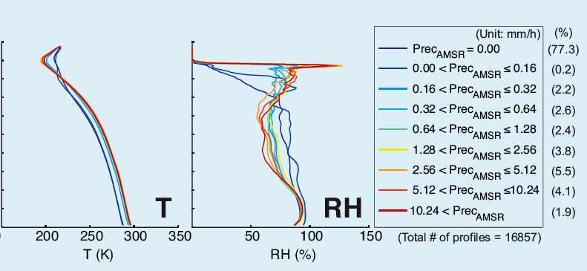
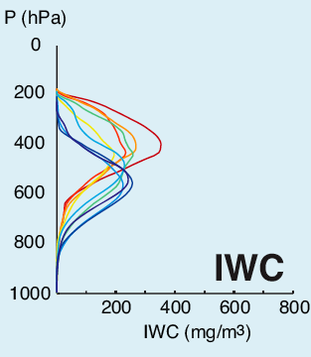
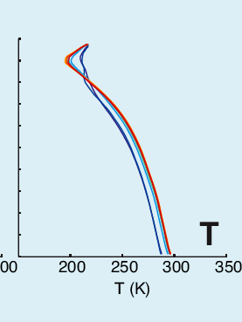
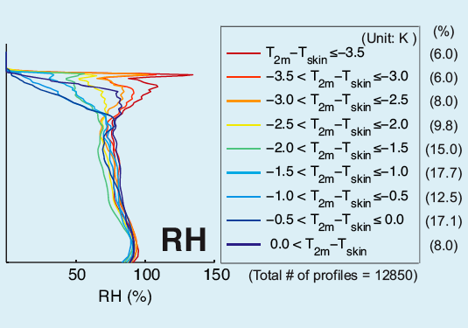
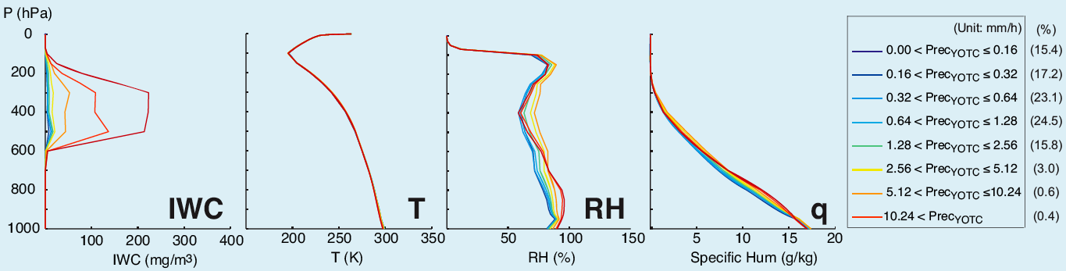
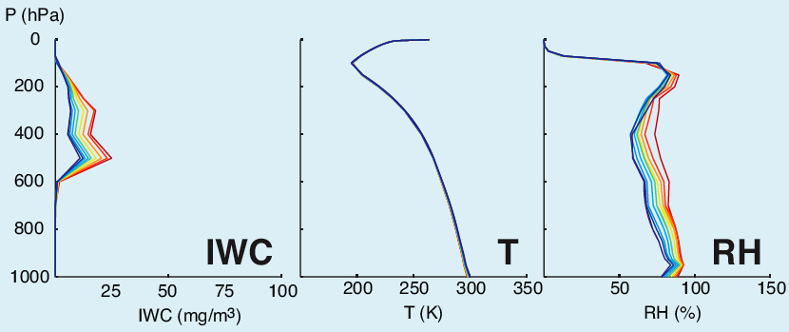
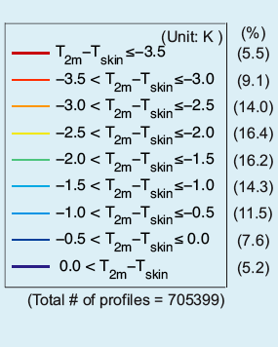
National Aeronautics and
Space Administration
Jet Propulsion Laboratory
California Institute of Technology
Pasadena, California
Software infrastructure and algorithms to facilitate co-location of observation and model data
Lei Pan*, Seungwon Lee, Gary Block, Robert Morris, Jui-lin Li, and Duane Waliser
Jet Propulsion Laboratory, California Institute of Technology, Pasadena, CA 91101
*lei.pan@jpl.nasa.gov
Background and Goal
Functional Architecture
Web Services and Virtualization
Observation data (e.g., from A-Train satellites) and model data (e.g., ECMWF) live in their own respective grid space, have different sampling characteristics, and use different formats and structures in archiving
Scientists expect synergistic usage of these datasets, e.g., to calibrate one instrument using another, or to conduct model data assimilation using observation
Co-location, which is to interpolate from a source data grid onto that of a target, provides a bridge for the above gap
To built a software tool to facilitate co-location
To make it easy to use and fast by leveraging technologies (e.g., web services, virtualization, and parallelization), and implementing efficient and scalable core algorithms
Reason for services: huge datasets from satellite and model in TBs
Open source web services solutions rich and simple: Flask (Python microframework), Gunicorn (Python WSGI server), Tornado (scalable web server)
Separate app. traffic (Gunicorn) from static HTTP traffic (Tornado)
RESTful interfaces using ROA: URI to carry “scoping info.” and HTTP to convey “method info.”
stateless, so can duplicate and deploy
Virtualization: VMWare
Human or program clients
Space time
query
Dataset
files
Data flow
Co-located
data
Analysis
results
Subset
data
Images
Services
Analyze
Visualize
Data
preparation
Search
Subset
Co-locate
Data
analysis
flexible mapping to
a network of servers
through REST and
virtualization
Parallel computing servers
Parallelization
Core Algorithm: nearest neighbor search
Colocation Performance
Prebuild lists of filename, start time, end time, and granule number for each data product.
Search target-data list (e.g. CloudSat) to get files for both target and source data for a given target time range (or granule range).
Nearest neighbor search algorithm has a linear complexity of
O((m+n)), where n is the number of target points and m the number of source points.
Overlay k by k grid on target points where k=sqrt(n).
Register each target point to a grid cell.
For each source point S, find minimum bounding rectangle (MBR) of its footprint.
  Find cells that cover MBR.
  For all target points in each cell, compare and store S for the co-location at the target point if the source footprint is the nearest neighbor of the target point.
For each target point T
X: target point
O: Source point
Data A
Data B
Data C
Data (dots) with time granule (bar). Each data product has a different time granule and start and end times. Indexing the filename and time range is needed to quickly search corresponding files for colocation.
The new colocation algorithm developed improves computational performance by 10-100 times compared to the simple O(N*N) algorithm.
The colocation algorithm is implemented for parallel computing. The parallel speedup of about 5 is achieved with 8 processes.
Scientific Use
Summary
Precipitating Deep Convection: A-Train vs. YOTC-ECMWF model forecast
A-train data offer global observational constraints for the Earth’s weather and climate models.
However, each instrument and model have a different resolution, sensitivity, and characteristics, which make the direct comparison, cross validation, and comprehensive/synergistic use of the data difficult.
We developed a scientific tool to temporally and spatially colocate the A-train data and ECMWF analysis outputs.
We demonstrated the scientific value of the colocated datasets.
Colocated datasets are being produced and will be released for public use in early 2011.
CloudSat + colocated ECMWF (Jul 2007; binned by AMSR-E precip. rate)
CloudSat + colocated ECMWF (Jul 2007; binned by EC surface stability)
YOTC-EC (Jul 2008; binned by 3hr-ave. model precipitation rate)
YOTC-EC (Jul 2008; binned by modelled surface stability)
A comprehensive A-Train-ECMWF colocated data set can be used to characterize deep convection cloud structures, properties, and its environmental context. Reasonable agreements between observations and YOTC-EC model forecast are found.
Acknowledgements: This work was performed at the Jet Propulsion Laboratory, California Institute of Technology, under contract with NASA.
Presented at AGU Fall Meeting, , San Francisco, Dec 3-7, 2012

