Slide 1


Java Workshop
Presenter:
Charles Cao, Founder of Service ECVictor Inc.
Sr. Software Development Engineer in Expedia
10+ Software development experience
Chandler Zhu, Java Tech Lead of CGI
10+ Software development experience

Slide 2
Course 1
Introduction

Slide 3

Course Description
Java Course and Career Path
  Java workshop -> JavaEE workshop -> JavaEE Developer
  Java workshop -> Automation Testing -> Automation Developer
Internship
  Java based program design
Mostly back-end
Job Interview workshop

Slide 4
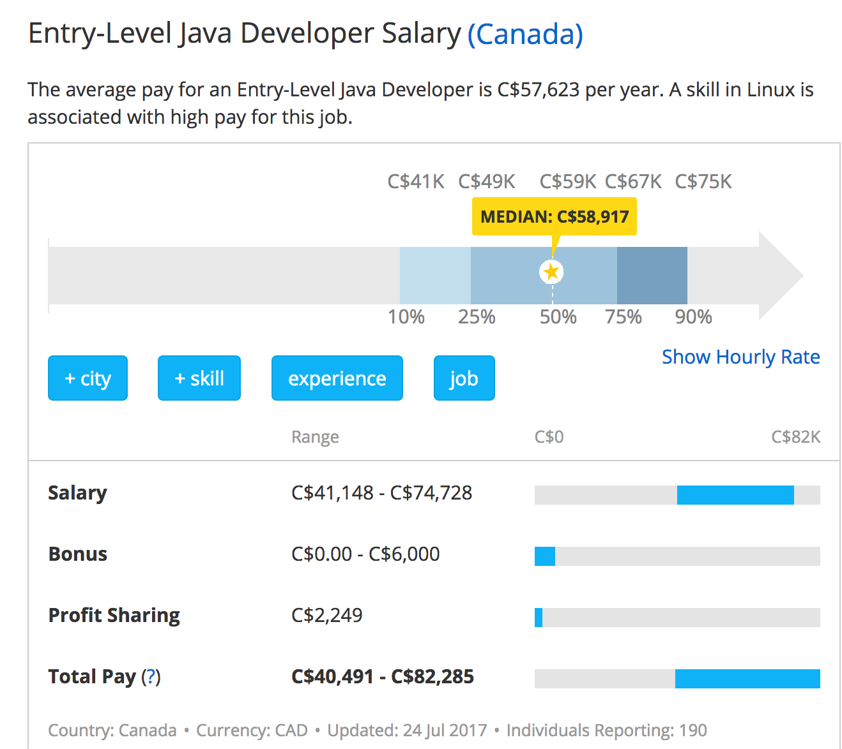
Salary Entry-Level Java Developer
http://www.payscale.com/research/CA/Job=Java_Developer/Salary/953cf2a1/Entry-Level

Slide 5

Entry-Level Quality Assurance (QA) / Test Automation Engineer
http://www.payscale.com/research/CA/Job=Test_%2f_Quality_Assurance_(QA)_Engineer_(Computer_Software)/Salary/d48da949/Entry-Level

Slide 6
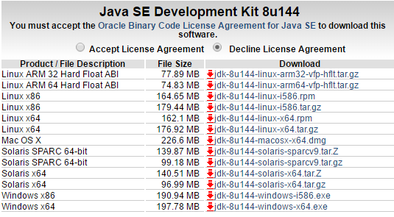
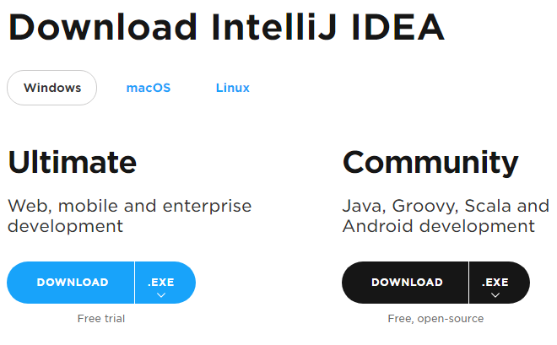
System requirements
JDK 8 from Oracle
IntelliJ as IDE

Slide 7
Java platform overview
Java is used to develop enterprise level applications for a wide range of environments, from consumer devices to heterogeneous enterprise systems.
The Java language is a C-language derivative, so its syntax rules look much like C's. For example, code blocks are modularized into methods and delimited by braces ({ and }), and variables are declared before they are used.

Slide 8
The JVM
JVM stands for Java virtual machine.
At run-time (when the program is running), the JVM reads and interprets .class files and executes the program's instructions on the native hardware platform for which the JVM was written. The JVM interprets the byte code just as a CPU would interpret assembly-language instructions.

Slide 9
Course Outline
Fundamental Programming
The main() method
Data Types
Variables
Operators
Flow Control
Objects
Code Examples
Exercises Classes

Slide 10
The Java Main Method
In Java, you need to have a method named main in at least one class. The following is what appears in a real Java program.
public class MainExample {
public static void main(String[] args) {
String helloWorld = "Hello World!";
System.out.println(helloWorld);
}
}

Slide 11
Primitive Data Types
byte: The byte data type is an 8-bit signed two's complement integer.
short: The short data type is a 16-bit signed two's complement integer.
int: By default, the int data type is a 32-bit signed two's complement integer,
long: The long data type is a 64-bit two's complement integer.

Slide 12
Primitive Data Types
float: The float data type is a single-precision 32-bit IEEE 754 floating point.
double: The double data type is a double-precision 64-bit IEEE 754 floating point.
boolean: The boolean data type has only two possible values
char: The char data type is a single 16-bit Unicode character.

Slide 13
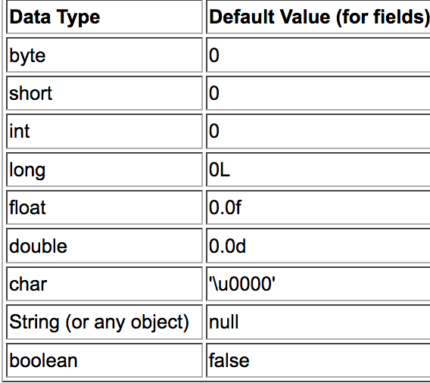
Default Values

Slide 14
Assignment, Arithmetic, and Unary Operators
Program needs operators to do the real job
There are several types of operators:
Assignment Operators
Arithmetic Operators
Unary Operators

Slide 15
Variables and assignment operators
A variable stores its state by assignment operator:
double length = 0.5;
int speed = 0;
String gear = “Double clutch”;
Variable names are case-sensitive.
Variable characters may be letters, digits, dollar signs, or underscore characters.
If the name you choose consists of only one word, spell that word in all lowercase letters.

Slide 16
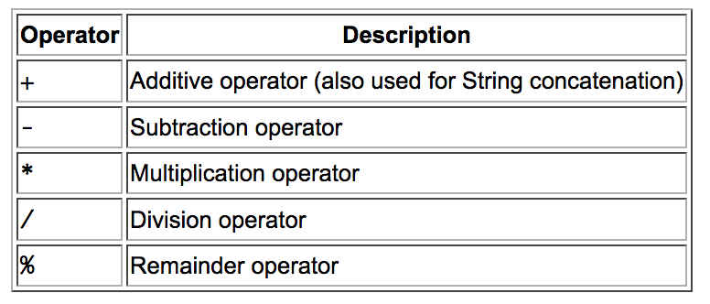
Arithmetic Operators
The Arithmetic Operators

Slide 17
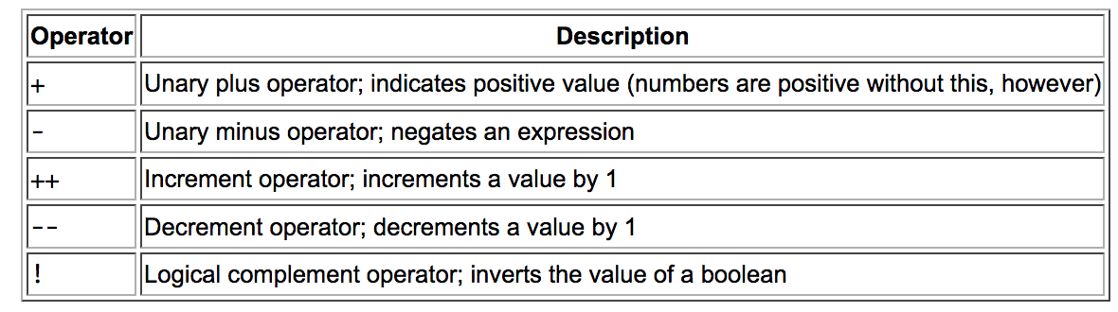
The Unary Operators

Slide 18
Course 2
Flow Control

Slide 19
Strings
The most useful Data type(Object)
The most direct way to create a string is to write:
String greeting = "Hello world!";
As with any other object, you can create String objects by using the new keyword and a constructor. The String class has thirteen constructors that allow you to provide the initial value of the string using different sources, such as an array of characters:
char[] helloArray = { 'h', 'e', 'l', 'l', 'o', '.' };
String helloString = new String(helloArray);
System.out.println(helloString);

Slide 20
Strings
String Length
String palindrome = "Dot saw I was Tod";
int len = palindrome.length();
Concatenating Strings
string1.concat(string2);
"Hello," + " world" + "!”
Such a concatenation can be a mixture of any objects. For each object that is not a String, its toString() method is called to convert it to a String.

Slide 21
Constants and Final keyword
Java does not directly support constants. However, a final variable is effectively a constant.
The static modifier causes the variable to be available without loading an instance of the class where it is defined. The final modifier causes the variable to be unchangeable.
e.g.
public static final int MAX_UNITS = 25;

Slide 22
Flow Control
The if Statement
if (isMoving){
//decrease current speed by 1
currentSpeed--;
}
The else Statement
if (isMoving) {
currentSpeed--; }
else {
System.err.println("The bicycle has already stopped!");
}

Slide 23
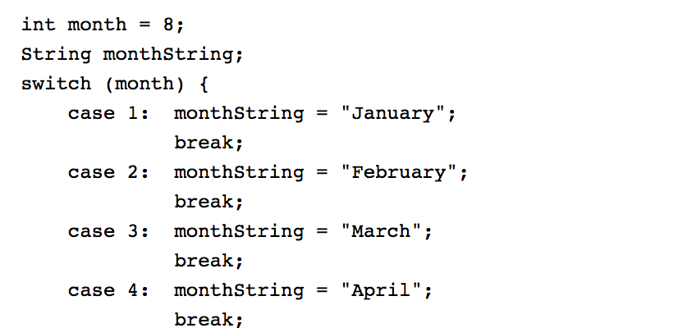
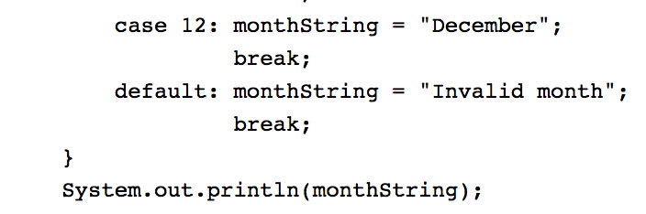
The switch Statement

Slide 24
The while and do-while Statements
while (expression) { statement(s) }
do { statement(s) } while (expression);

Slide 25
The for Statement
for (initialization; termination; increment) { statement(s) }
for(int i=1; i<11; i++){
System.out.println("Count is: " + i);
}

Slide 26
Course 3
Class and Objects

Slide 27
Classes and Objects in Java
Instance Variables
Class Variables
Constructors
Instance Methods
Class Methods
OOP Principles
Instantiation
Encapsulation
Specialization

Slide 28


Classes and Objects in Java
Declaring Classes

Slide 29
Declaring Member Variables
public modifier—the field is accessible from all classes.
private modifier—the field is accessible only within its own class.
In this lesson, be aware that the same naming rules and conventions are used for method and class names, except that
the first letter of a class name should be capitalized, and
the first (or only) word in a method name should be a verb.

Slide 30
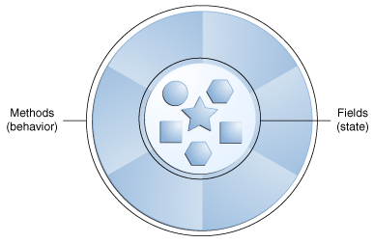
A software object

Slide 31
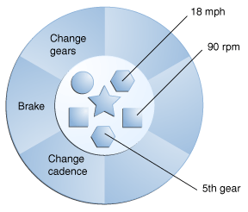
A bicycle modeled as a software object

Slide 32
Software objects
Software objects are conceptually similar to real-world objects: they too consist of state and related behavior. An object stores its state in fields (variables in some programming languages) and exposes its behavior through methods (functions in some programming languages). Methods operate on an object's internal state and serve as the primary mechanism for object-to-object communication. Hiding internal state and requiring all interaction to be performed through an object's methods is known as data encapsulation — a fundamental principle of object-oriented programming.

Slide 33
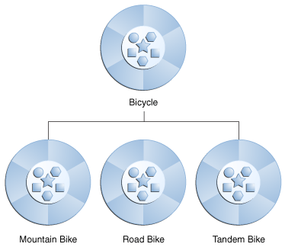
What Is Inheritance?

Slide 34
What Is a Package
package is a namespace that organizes a set of related classes and interfaces. Conceptually you can think of packages as being similar to different folders on your computer. You might keep HTML pages in one folder, images in another, and scripts or applications in yet another. Because software written in the Java programming language can be composed of hundreds or thousands of individual classes, it makes sense to keep things organized by placing related classes and interfaces into packages.

Slide 35
What Is a Class
In the real world, you'll often find many individual objects all of the same kind. There may be thousands of other bicycles in existence, all of the same make and model. Each bicycle was built from the same set of blueprints and therefore contains the same components. In object-oriented terms, we say that your bicycle is an instance of the class of objects known as bicycles. A class is the blueprint from which individual objects are created.

Slide 36
Using the this Keyword
The most common reason for using the this keyword is because a field is shadowed by a method or constructor parameter.
public class Point {
public int x = 0;
public int y = 0;
//constructor
public Point(int a, int b) { x = a; y = b; }
}

Slide 37
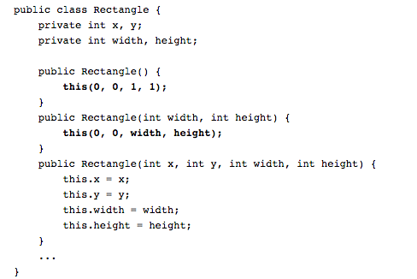

Slide 38
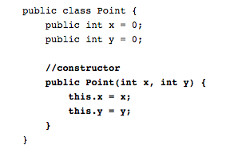

Slide 39
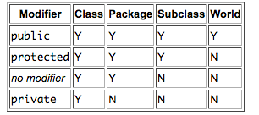
Access Levels

Slide 40
Java Bean
All properties private (use getters/setters)
A public no-argument constructor
Implements Serializable.

Slide 41
Defining Methods
public double calculateAnswer(double wingSpan, int numberOfEngines,
double length, double grossTons) {
//do the calculation here
}
The signature of the method declared above is:
calculateAnswer(double, int, double, double)

Slide 42
Naming a Method
Although a method name can be any legal identifier, code conventions restrict method names. By convention, method names should be a verb in lowercase or a multi-word name that begins with a verb in lowercase, followed by adjectives, nouns, etc. In multi-word names, the first letter of each of the second and following words should be capitalized. Here are some examples:
run runFast getBackground getFinalData

Slide 43
static variable
In Java Variables can be declared with the “static” keyword.
Example: static int y = 0;
When a variable is declared with the keyword static, its called a class variable. All instances share the same copy of the variable. A class variable can be accessed directly with the class, without the need to create a instance.

Slide 44
No “static” Keyword = Instance Variables
Without the static keyword, it’s called instance variable, and each instance of the class has its own copy of the variable.
It is a variable which belongs to the class and not to object(instance)
Static variables are initialized only once , at the start of the execution . These variables will be initialized first, before the initialization of any instance variables
A single copy to be shared by all instances of the class
A static variable can be accessed directly by the class name and doesn’t need any object
Syntax : <class-name>.<variable-name>

Slide 45
Static Methods
It is a method which belongs to the class and not to the object(instance)
A static method can access only static data. It can not access non-static data (instance variables)
A static method can call only other static methods and can not call a non-static method from it.
A static method can be accessed directly by the class name and doesn’t need any object
Syntax: <class-name>.<method-name>
A static method cannot refer to this or super keywords in anyway

Slide 46
instantiation
In programming, instantiation is the creation of a real instance or particular realization of an abstraction or template such as a class of objects or a computer process.

Slide 47
Instance Methods
a method is not declared static then it's an instance method.
A static method belongs to the class itself and a non-static (i.e instance) method belongs to each object that is generated from that class.

Slide 48
Constructors
A class contains constructors that are invoked to create objects from the class blueprint. Constructor declarations look like method declarations—except that they use the name of the class and have no return type. For example, Bicycle has one constructor:

Slide 49
Course 4

Slide 50
What Is Inheritance?
Object-oriented programming allows classes to inherit commonly used state and behavior from other classes.
In this example, Bicycle now becomes the superclass of MountainBike, RoadBike, and TandemBike.
In the Java programming language, each class is allowed to have one direct superclass, and each superclass has the potential for an unlimited number of subclasses:A diagram of classes in a hierarchy.

Slide 51
Creating Subclasses
class SubClass extends SuperClass {
. . .
}
Class MountainBike extends Bicycle {
…
}

Slide 52
What You Can Do in a Subclass
The inherited fields can be used directly, just like any other fields.
You can declare a field in the subclass with the same name as the one in the superclass, thus hiding it (not recommended).
You can declare new fields in the subclass that are not in the superclass.
The inherited methods can be used directly as they are..

Slide 53
What Member Variables Does a Subclass Inherit?
Subclasses inherit those member variables declared as public or protected.
Subclasses inherit those member variables declared with no access specifier as long as the subclass is in the same package as the superclass.
Subclasses don't inherit a superclass's member variable if the subclass declares a member variable using the same name. The subclass's member variable is said to hide the member variable in the superclass.
Subclasses don't inherit the superclass's private member variables.

Slide 54
What Methods Does a Subclass Inherit?
Subclasses inherit those methods declared as public or protected.
Subclasses inherit those superclass methods declared with no access specifier as long as the subclass is in the same package as the superclass.
Subclasses don't inherit a superclass's method if the subclass declares a method using the same name. The method in the subclass is said to override the one in the superclass.
Subclasses don't inherit the superclass's private methods.

Slide 55
Private Members in a Superclass
A subclass does not inherit the private members of its parent class. However, if the superclass has public or protected methods for accessing its private fields, these can also be used by the subclass.
A nested class has access to all the private members of its enclosing class—both fields and methods. Therefore, a public or protected nested class inherited by a subclass has indirect access to all of the private members of the superclass.

Slide 56
Overriding vs. Overloading
The real object type in the run-time, not the reference variable's type, determines which overridden method is used at runtime. In contrast, reference type determines which overloaded method will be used at compile time.
Polymorphism applies to overriding, not to overloading.
Overriding is a run-time concept while overloading is a compile-time concept.

Slide 57
OOP Principles
Encapsulation
Inheritance
Polymorphism

Slide 58
Encapsulation
Encapsulation means putting together all the variables (instance variables) and the methods into a single unit called Class.
It also means hiding data and methods within an Object. Encapsulation provides the security that keeps data and methods safe from inadvertent changes.

Slide 59
Inheritance
A class that is derived from another class is called a subclass (also a derived class, extended class, or child class). The class from which the subclass is derived is called a superclass (also a base class or a parent class).
Excepting Object, which has no superclass, every class has one and only one direct superclass (single inheritance). In the absence of any other explicit superclass, every class is implicitly a subclass of Object.

Slide 60
Polymorphism
In Core, Java Polymorphism is one of easy concept to understand. Polymorphism definition is that Poly means many and morphos means forms.

Slide 61
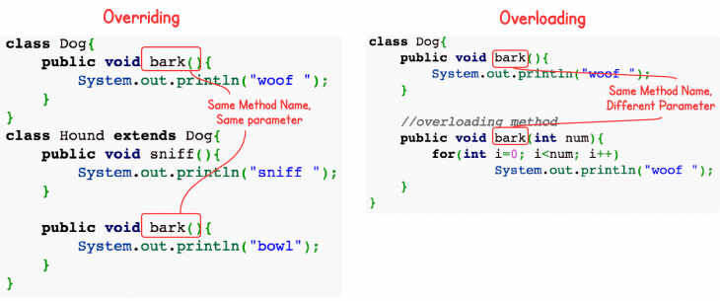
Overloading vs Overriding Java

Slide 62
You can write a new instance method in the subclass that has the same signature as the one in the superclass, thus overriding it.
You can write a new static method in the subclass that has the same signature as the one in the superclass, thus hiding it.
You can declare new methods in the subclass that are not in the superclass.
You can write a subclass constructor that invokes the constructor of the superclass, either implicitly or by using the keyword super

Slide 63
Abstract Methods and Classes
An abstract class is a class that is declared abstract—it may or may not include abstract methods. Abstract classes cannot be instantiated, but they can be subclassed.
An abstract method is a method that is declared without an implementation (without braces, and followed by a semicolon), like this:
abstract void moveTo(double deltaX, double deltaY);

Slide 64
Abstract Class
If a class includes abstract methods, then the class itself must be declared abstract, as in:
public abstract class AbstractDog {
int gender;
public abstract void bark();
}

Slide 65
Interfaces
An interface is a reference type in Java. It is similar to class. It is a collection of abstract methods. A class implements an interface, thereby inheriting the abstract methods of the interface.
Along with abstract methods, an interface may also contain constants, default methods, static methods, and nested types. Method bodies exist only for default methods and static methods.

Slide 66
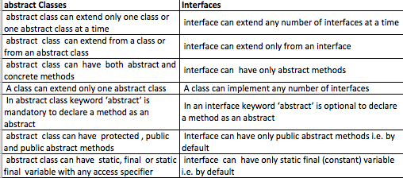
Interface vs. abstract class

Slide 67
Course 6
Exception

Slide 68
Java Exception
An exception (or exceptional event) is a problem that arises during the execution of a program. When an Exception occurs the normal flow of the program is disrupted and the program/Application terminates abnormally, which is not recommended, therefore, these exceptions are to be handled.

Slide 69
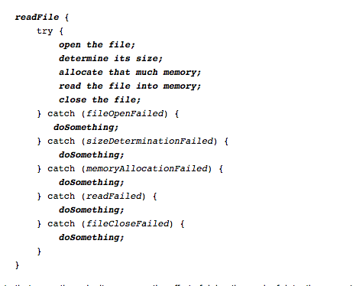
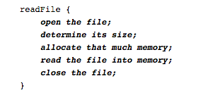
Separating Error-Handling Code from "Regular" Code

Slide 70
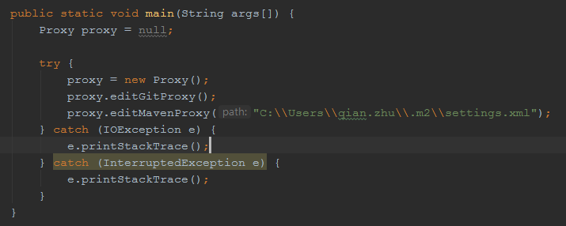
Grouping and Differentiating Error Types

Slide 71
Checked Exceptions
  Checked exceptions − A checked exception is an exception that occurs at the compile time, these are also called as compile time exceptions. These exceptions cannot simply be ignored at the time of compilation, the programmer should take care of (handle) these exceptions or the code cannot be compiled.
  Example:
  IOException, InterruptedException

Slide 72
Unchecked exceptions
Unchecked exceptions − An unchecked exception is an exception that occurs at the time of execution. These are also called as Runtime Exceptions. These include programming bugs, such as logic errors or improper use of an API. Runtime exceptions are ignored at the time of compilation.
Example:
NullPointerException, OutOfIndexException

Slide 73
Is the NumberFormatException consider a checked exception?
No. NumberFormatException is unchecked (= is subclass of RuntimeException). Why?
The number is an user input which can only be decided at Runtime.
Is RuntimeException an unchecked exception?
Yes, exactly.

Slide 74
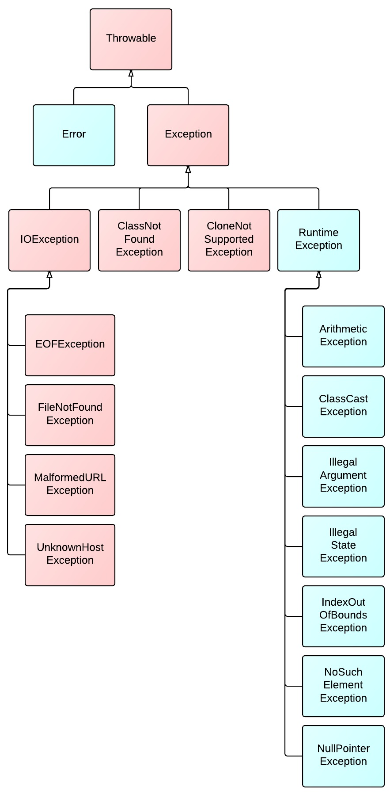
Diagram of Exception Hierarchy

Slide 75
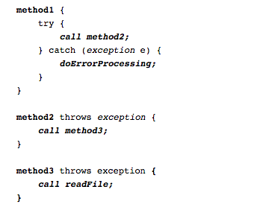
Exception Handling Best Practice
Propagating errors all the way up the Call Stack
The Finally Block:
Will be executed in any condition except System.exit();

Slide 76
System Exceptions vs. Application Exceptions (Optional)
System exception is caused by system error. Most of the time it’s checked exception in Java.
Application exception is caused by business logic. Usually, it’s recoverable and uncheck exception in Java.

Slide 77
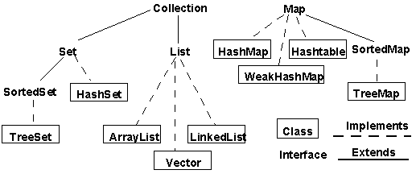
Collections

Slide 78
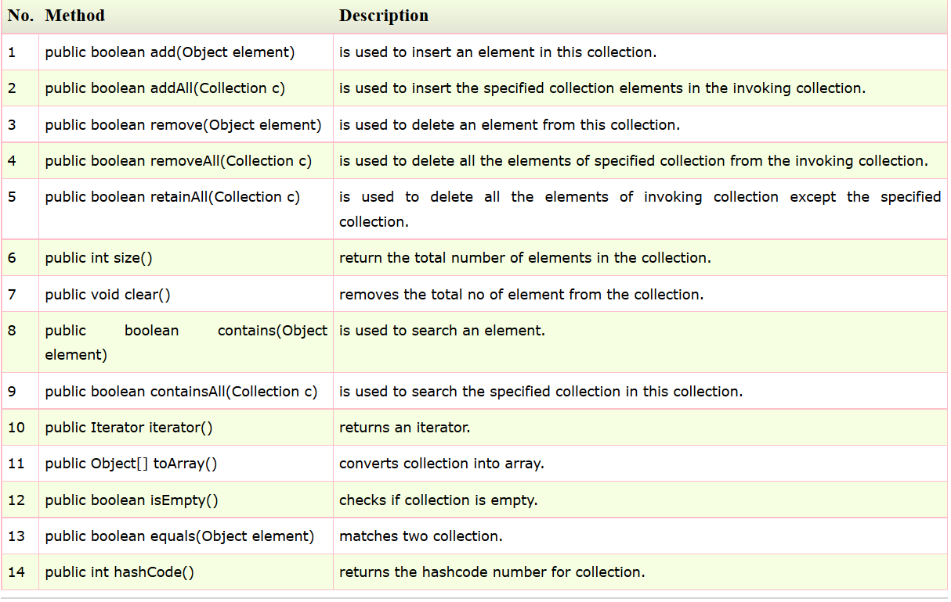
Methods of Collection interface

Slide 79
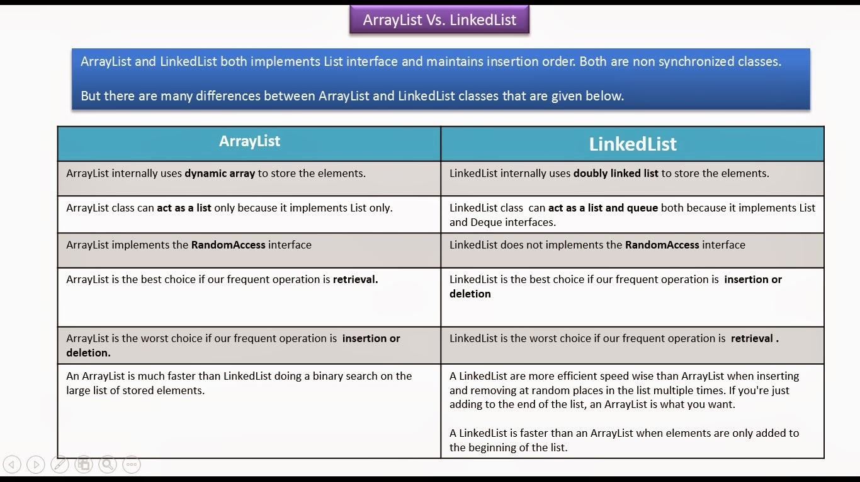
ArrayList Vs LinkedList

Slide 80
Map Interface and Hashmap
Hash table based implementation of the Map interface. This implementation provides all of the optional map operations, and permits null values and the null key. (The HashMap class is roughly equivalent to Hashtable, except that it is unsynchronized and permits nulls.) This class makes no guarantees as to the order of the map; in particular, it does not guarantee that the order will remain constant over time.
Custom Object used in HashMap
Must implement hashCode() and equals()

Slide 81
Processes and Threads
A process has a self-contained execution environment. A process generally has a complete, private set of basic run-time resources; in particular, each process has its own memory space.
Threads are sometimes called lightweight processes. Both processes and threads provide an execution environment, but creating a new thread requires fewer resources than creating a new process.
  Threads exist within a process — every process has at least one. Threads share the process's resources, including memory and open files. This makes for efficient, but potentially problematic, communication.

Slide 82
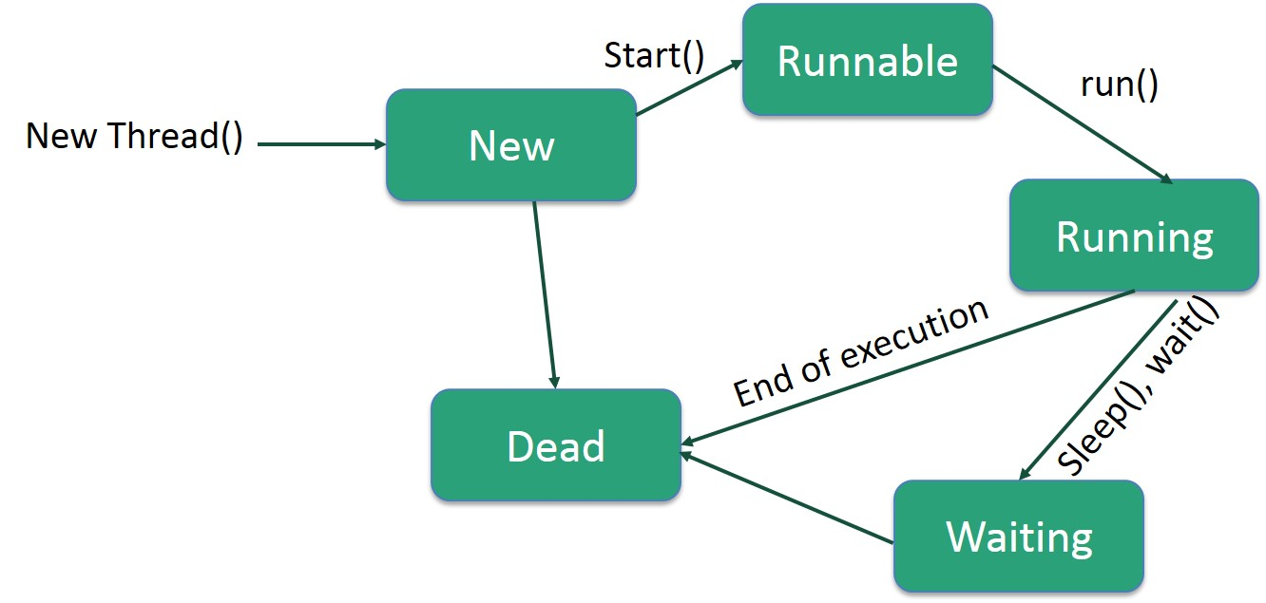
Life Cycle of a Thread

Slide 83
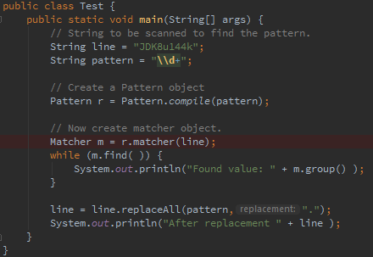
Regular Expression

Slide 84
Serialization
Serialize an object means to convert its state to a byte stream so that the byte stream can be reverted back into a copy of the object.
Deserialization is the process of converting the serialized form of an object back into a copy of the object.
Why use Serialization:
Communication
Persistence

Slide 85
Questions?
THANK YOU!
MERCI!

