Slide 1
Performance and Load Testing

Slide 2
Part 1
Performance & Load Testing Basics

Slide 3
Performance & Load Testing Basics
  Introduction to Performance Testing
  Difference between Performance, Load and Stress Testing
  Why Performance Testing?
  When is it required?
  What should be tested?
  Performance Testing Process
  Load Test configuration for a web system
  Practice Questions

Slide 4
Introduction to Performance Testing
Performance testing is the process of determining the speed or effectiveness of a computer, network, software program or device.
Before going into the details, we should understand the factors that governs Performance testing:
  Throughput
  Response Time
  Tuning
  Benchmarking

Slide 5
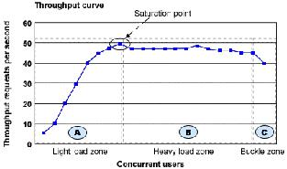
Throughput
Capability of a product to handle multiple transactions in a give period.
Throughput represents the number of requests/business transactions processed by the product in a specified time duration.
As the number of concurrent users increase, the throughput increases almost linearly with the number of requests. As there is very little congestion within the Application Server system queues.

Slide 6
Throughput
In the heavy load zone or Section B, as the concurrent client load increases, throughput remains relatively constant.
In Section C (the buckle zone) one or more of the system components have become exhausted and throughput starts to degrade. For example, the system might enter the buckle zone when the network connections at the Web server exhaust the limits of the network adapter or if the requests exceed operating system limits for file handles.

Slide 7
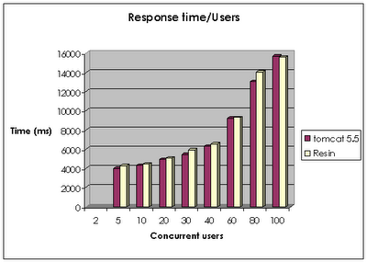
Response Time
It is equally important to find out how much time each of the transactions took to complete.
Response time is defined as the delay between the point of request and the first response from the product.
The response time increases proportionally to the user load.

Slide 8
Response Time = time to send request + Processing Time

Slide 9
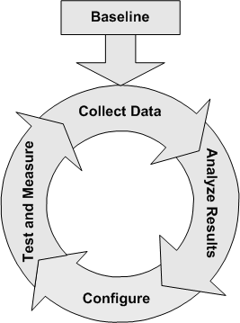
Tuning
Tuning is the procedure by which product performance is enhanced by setting different values to the parameters of the product, operating system and other components.
Tuning improves the product performance without having to touch the source code of the product.

Slide 10
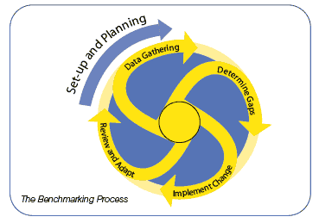
Benchmarking
A very well-improved performance of a product makes no business sense if that performance does not match up to the competitive products.
A careful analysis is needed to chalk out the list of transactions to be compared across products so that an apple-apple comparison becomes possible.

Slide 11
Performance Testing- Definition
The testing to evaluate the response time (speed), throughput and utilization of system to execute its required functions in comparison with different versions of the same product or a different competitive product is called Performance Testing.
Performance testing is done to derive benchmark numbers for the system.
Heavy load is not applied to the system
Tuning is performed until the system under test achieves the expected levels of performance.

Slide 12
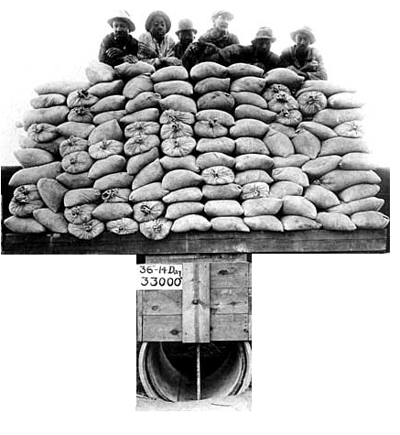
Difference between
Performance, Load and Stress Testing
Load Testing
Process of exercising the system under test by feeding it the largest tasks it can operate with.
Constantly increasing the load on the system via automated tools to simulate real time scenario with virtual users.
Examples:
Testing a word processor by editing a very large document.
For Web Application load is defined in terms of concurrent users or HTTP connections.

Slide 13

Difference between
Performance, Load and Stress Testing
Stress Testing
Trying to break the system under test by overwhelming its resources or by taking resources away from it.
Purpose is to make sure that the system fails and recovers gracefully.
Example:
Double the baseline number for concurrent users/HTTP connections.
Randomly shut down and restart ports on the network switches/routers that connects servers.

Slide 14
Why Performance Testing?
The week of Feb 6, 2000:
Hackers delivered over 1-Billion transactions concurrently to each one of these sites.
      Yahoo
      eBay
      Buy.com
      Amazon
      eTrade
How did you think they performed ?

Slide 15
Why Performance Testing
Identifies problems early on before they become costly to resolve.
Reduces development cycles.
Produces better quality, more scalable code.
Prevents revenue and credibility loss due to poor Web site performance.
Enables intelligent planning for future expansion.
To ensure that the system meets performance expectations such as response time, throughput etc. under given levels of load.
Expose bugs that do not surface in cursory testing, such as memory management bugs, memory leaks, buffer overflows, etc.

Slide 16
When is it required?
Design Phase:
Pages containing lots of images and multimedia for reasonable wait times. Heavy loads are less important than knowing which types of content cause slowdowns.
Development Phase:
To check results of individual pages and processes, looking for breaking points, unnecessary code and bottlenecks.
Deployment Phase:
To identify the minimum hardware and software requirements for the application.

Slide 17
What should be tested?
High frequency transactions: The most frequently used transactions have the potential to impact the performance of all of the other transactions if they are not efficient.
Mission Critical transactions: The more important transactions that facilitate the core objectives of the system should be included, as failure under load of these transactions has, by definition, the greatest impact.
Read Transactions: At least one READ ONLY transaction should be included, so that performance of such transactions can be differentiated from other more complex transactions.
Update Transactions: At least one update transaction should be included so that performance of such transactions can be differentiated from other transactions.

Slide 18
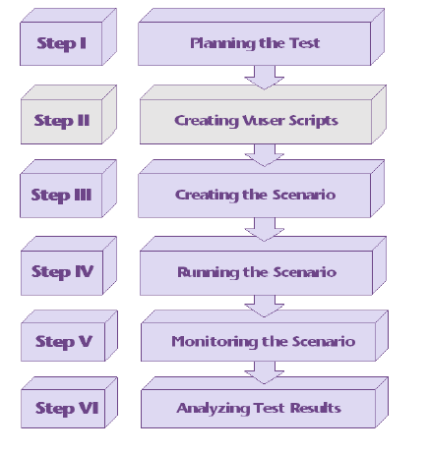
Performance Testing Process

Slide 19
1.Planning
Determine the performance testing objectives
Describe the application to test using a application model
  Describe the Hardware environment
  Create a Benchmark (Agenda) to be recorded in Phase 2.
    Define what tasks each user will perform
    Define (or estimate) the percentage of users per task.

Slide 20
1.Planning
2.Record
3.Modify
Record
  Record the defined testing activities that will be used as a foundation for your load test scripts.
  One activity per task or multiple activities depending on user task definition
Modify
  Modify load test scripts defined by recorder to reflect more realistic Load test simulations.
  Defining the project, users
  Randomize parameters (Data, times, environment)
  Randomize user activities that occur during the load test

Slide 21
4. Execute
Virtual Users (VUs): Test Goals
Start: 5 Max Response Time <= 20 Sec
Incremented by: 5
Maximum: 200
Think Time: 5 sec
Test Script:
One typical user from login through completion.

Slide 22
5.Monitor
6. Analyze
Monitoring the scenario: We monitor scenario execution using the various online runtime monitors.
Analysing test results: During scenario execution, the tool records the performance of the application under different loads. We use the graphs and reports to analyse the application’s performance.

Slide 23
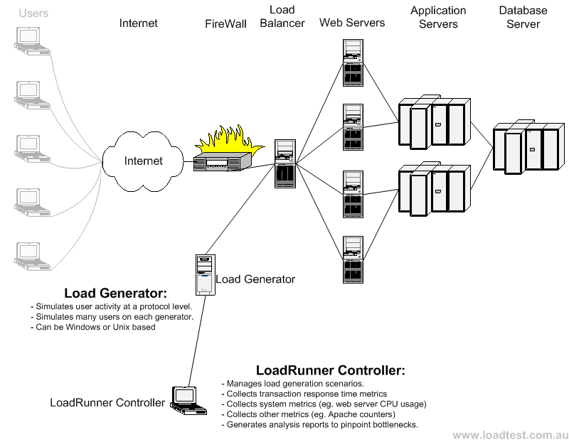
Load Test configuration for a web system

Slide 24
Questions to Review your Skills
What are the factors that governs Performance Testing?
How are Throughput and Response time related with user load?
How do we decide whether the application passed or failed the load test?
What do you mean by Capacity, Stability and Scalability of an application.
What is the difference between Performance, Load and Stress testing?
What is Longevity, endurance, spike and Volume Testing?
At what point in SDLC, performance testing is required?
How to identify the transactions in a complete application for load testing?
Define the 6 steps involved in Performance Testing Process?
Explain the Load Test configuration of a web system and what is the role of Load Generators in it?

Slide 25
Part 2
Load Test Planning

Slide 26
Load Test Planning
  Why Planning
  Analysing the Application
  Defining Testing Objectives
  Gathering Requirements
  Load Test Checklist
  Practice Questions

Slide 27
Why Planning
As in any type of system testing, a well-defined test plan is the first essential step to successful testing.
Planning load testing helps to:
  Build test scenarios that accurately emulate your working environment: Load testing means testing the application under typical working conditions, and checking for system performance, reliability, capacity, and so forth.
  Understand which resources are required for testing: Application testing requires hardware, software, and human resources. Before beginning testing, we should know which resources are available and decide how to use them effectively.
  Define success criteria in measurable terms: Focused testing goals and test criteria ensure successful testing. For example, it’s not enough to define vague objectives like “Check server response time under heavy load.” A more focused success criterion would be “Check that 50 customers can check their account balance simultaneously & that server response time will not exceed 1- minute”

Slide 28
Why Planning
Load test planning is a three-step process:
  Analyzing the Application
    Analysis ensures that the testing environment we create using LoadRunner will accurately reflect the environment and configuration of the application under test.
  Defining Testing Objectives
    Before testing, we should define exactly what we want to accomplish.
  Gathering Requirements
    All the requirements and resources should be evaluated and collected beforehand to avoid any last minute hurdles.

Slide 29
Analyzing the Application
Load testing does not require as much knowledge of the application as functional testing does.
Load tester should have some operational knowledge of the application to be tested.
Load tester should have the idea on how the application is actually used in production to make an informed estimate.
Load tester must know the application architecture (Client Server, Local Deployment, Live URL), Platform and Database used.

Slide 30
Defining Testing Objectives
Determining and recording performance testing objectives involves communicating with the team to establish and update these objectives as the project advances through milestones
Performance, Load or Stress testing: Type and scope of testing should be clear as each type of testing has different requirements.
Goal Setting: General load testing objectives should be defined.

Slide 31
Defining Testing Objectives
Common Objectives:
  Measuring end-user response time
  Defining optimal hardware configuration
  Checking reliability
  Assist the development team in determining the performance characteristics for various configuration options
  Ensure that the new production hardware is no slower than the previous release
  Provide input data for scalability and capacity-planning efforts
  Determine if the application is ready for deployment to production
  Detect bottlenecks to be tuned

Slide 32
Defining Testing Objectives
Stating Objectives in Measurable Terms:
Once you decide on your general load testing objectives, you should identify more focused goals by stating your objectives in measurable terms.
To provide a baseline for evaluation, determine exactly what constitutes acceptable and unacceptable test results.
For example:
  General Objective:
    Product Evaluation: choose hardware for the Web server.
  Focused Objective:
    Product Evaluation: run the same group of 300 virtual users on two different servers, HP and NEC. When all 300 users simultaneously browse the pages of your Web application, determine which hardware gives a better response time.

Slide 33
Gathering Requirements
Users: Identify all the types of people and processes that can put load on the application or system.
  Defining the types of primary end users of the application or system such as purchasers, claims processors, and sales reps
  Add other types of users such as system administrators, managers, and report readers who use the application or system but are not the primary users.
  Add types of non-human users such as batch processes, system backups, bulk data loads and anything else that may add load or consume system resources.
Transactions: For each type of user we identified in the previous step, identify the tasks that the user performs.
Production Environment:
  Performance and capacity of an application is significantly affected by the hardware and software components on which it executes.

Slide 34
Gathering Requirements
Production Environment:
  Speed, capacity, IP address and name, version numbers and other significant information.
Test Environment:
  Should be similar to the production environment as is possible to be able to get meaningful performance results.
  It is important that the databases be set up with the same amount of data in the same proportions as the production environment as that can substantially affect the performance.
Scenarios:
  Select the use cases to include
  Determine how many instances of each use case will run concurrently
  Determine how often the use cases will execute per hour
  Select the test environment

Slide 35
Gathering Requirements
Load test Tool:
  Ability to parameterize data.
  Ability to capture dynamic data and use on subsequent requests.
  Application infrastructure monitoring.
  Support for the application's protocols
Load test Lab must include the following:
  Test Servers.
  Databases.
  Network elements, operating systems and clients and server hardware.

Slide 36
Load Test Check List
Planning
  Objective goals defined
  Test plan written and reviewed
Staff Skills
  Experience in load testing
  Application knowledge
  Systems knowledge
  Communication and people skills
Support Staff
  Key staff identified and allocated
Load Test Lab
  Test servers allocated
  Databases populated
  Load test tools allocated

Slide 37
Questions to Review your Skills
Why planning is required before starting load test?
What are the three steps involved in load test planning?
What information should be collected about the application to be load tested?
What are the common testing objectives?
State the following testing objective in measurable term: “Ensure that the new production hardware is not slower than the previous release”
Why is the knowledge of Production Environment necessary before load test?
What are the factors that need to be considered for creating a scenario?
How to choose a load test tool?
What are the requirements to setup a load test lab?
What are main points in a Load test checklist?

Slide 38
Part 3
Load Testing Tools

Slide 39
Load Testing Tools
  Manual testing Limitations
  Benefits of Automation
  Tools used for Performance Testing
  Practice Questions

Slide 40
Manual Testing Limitations
Do you have the testing resources?
Testing personnel
Client machines
All of you, click the GO button again
How do you coordinate and synchronize users?
How do you collect and analyze results?
How do you achieve test repeatability?
Coordinator
Analysis?
Web server
Database server
Testers
123.20
Load Generation
System Under Test

Slide 41
Manual Testing Limitations
Manual Testing Limitations
Expensive, requiring large amounts of both personnel and machinery.
Complicated, especially co-ordinating and synchronising multiple testers
Involves a high degree of organization, especially to record and analyse results meaningfully
Repeatability of the manual tests is limited

Slide 42
Benefits of Automation
Solves the resource limitations
  Replaces testers with virtual users
  Runs many Vusers on a few machines
Analysis
Controller manages the virtual users
Analyze results with graphs and reports
Controller
Vuser host
Web server
Database server
Load Generation
System Under Test

Slide 43
Benefits of Automation
Using Automated Tools
Reduces personnel requirements by replacing human users with virtual users or Vusers. These Vusers emulate the behaviour of real users
Because numerous Vusers can run on a single computer, the tool reduces the amount of hardware required for testing.
Monitors the application performance online, enabling you to fine-tune your system during test execution.
It automatically records the performance of the application during a test. You can choose from a wide variety of graphs and reports to view the performance data.
Because the tests are fully automated, you can easily repeat them as often as you need.

Slide 44
Tools used for Performance Testing
Open Source
OpenSTA
Diesel Test
TestMaker
Grinder
LoadSim
Jmeter
Rubis
Commercial
LoadRunner
Silk Performer
Qengine
Empirix e-Load

Slide 45
OpenSTA
Developed in C++
HTTP Load Test Application
Advantages:
Open Source Software
A user-friendly graphical interface
The script capture from the browser
The monitoring functionality
Drawbacks:
Only designed for Windows
Only for HTTP

Slide 46
DieselTest
Software designed in Delphi5
For systems under NT Environment
For HTTP/HTTPS applications
Advantages:
Open Source
The quality of the chart
Simple and fast to use
The logging functionality
Drawbacks:
The manual edition of the tests is badly designed
The ambiguity of certain results
Distributed tests are impossible
Specific technology environment (Delphi, NT)

Slide 47
TestMaker
Developed in Java
For HTTP, HTTPS, SOAP, XML-RPC, Mails (SMTP, POP3 and IMAP) applications
Advantages:
The possibility to build any kind of test agent
The power of Java programming with some Python simplifications
Open source
Drawbacks:
Familiarity with the Jython scripting language, Java language and to write it from scratch
The monitoring tools are very basic, since it is limited to the response analysis
Must pay for distributed testing

Slide 48
Grinder
Generic framework for load testing any kind of target systems, with scenario in Jython
Developed in Java
Advantages:
Open Source
You can test everything with scripts in Jython
Drawbacks:
Deployment for distributed test
Poor results and graphical interface

Slide 49
LoadSim
LoadSim is an open source software developed in Java, which is designed for HTTP distributed load testing
Advantages:
Open Source
Generation of script
Each client have a different configuration (user, script…)
Drawbacks:
No graphical interface
Poor results
No graphical representation of result
No monitoring

Slide 50
Jmeter
100% Java desktop application
For Web and FTP, Java, SOAP/XML-RPC, JDBC applications
Advantages:
Open Source
The distributed testing
Various target systems
Extensibility: Pluggable samplers allow unlimited testing capabilities
Drawbacks:
Chart representation quite confuse
Terminology not very clear
Necessary to start remote machine one by one
Remote machines must be declared in a property file before starting application

Slide 51
Rubis
Provided with some load-test tool (designed for Rubis, but some parts of code could be re-used) and a monitoring system.
Developed in Java.
Advantages:
Open Source
Monitoring capabilities
Charts representations and automatic generation of HTML report
Drawbacks:
Specific to Unix environment and Rubis application

Slide 52
Empirix eLoad
Accurate testing of the response times and scalability of web applications and web services
Recording in VBscript
Advantages:
Can simulate hundreds and thousands of concurrent users
Monitoring capabilities and Charts representation
Reasonable Price
Drawbacks:
Complex User Interface
Limitations in recording of complex scenarios

Slide 53
Questions to Review your Skills
What are the limitations of manual load testing?
Why tools are used for automating load test?
List 5 Open Source and 5 Commercial load test tools.
What are the disadvantages of LoadRunner?
Explain the following Load Test tools: Silk Performer, Qengine.
Give a detailed comparison between Empirix E-load and LoadRunner.
Which other tools are commonly used for load testing?

Slide 54
Thank You

