Slide 1

Visualization and Analysis – Tutorial Presentation for Feedback Date: 08-12-2025
Group Name: A 104 Name of Student Presenting: Faraaz Malik

Slide 2
We are using the dataset DS355 - Sleep_health_and_lifestyle_dataset.csv to answer our Research Question “Is there a difference in the median stress level between doctors and software engineers in the 27 to 59 age group?” ¹
Person ID | Gender | Age | Occupation | Sleep Duration | Quality of Sleep | Stress Level | BMI Category | Blood Pressure | Daily Steps
1 | Male | 27 | Software Engineer | 6.1 | 6 | 6 | Over-weight | 126/83 | 4200
2 | Male | 28 | Doctor | 6.2 | 6 | 8 | Normal | 125/80 | 10000
3 | Male | 28 | Doctor | 6.2 | 6 | 8 | Normal | 125/80 | 10000
4 | Male | 28 | Sales Representative | 5.9 | 4 | 8 | Obese | 140/90 | 3000
5 | Male | 28 | Sales Representative | 5.9 | 4 | 8 | Obese | 140/90 | 3000
The dataset has 374 rows and the variables we use are Stress Level (dependent variable) and Occupation (independent variable⁴).
¹ Be sure you follow one of the three prescribed RQ Templates – identifying the type of statistical analysis you will be using. If you do not have the correct RQ, we will stop your presentation here.
² The variable name in your RQ may be different from the column name in cases where the column names are abbreviations.
^{3.4.}Be sure to identify which variable is your dependent variable and which one is your independent variable on this slide

Slide 3
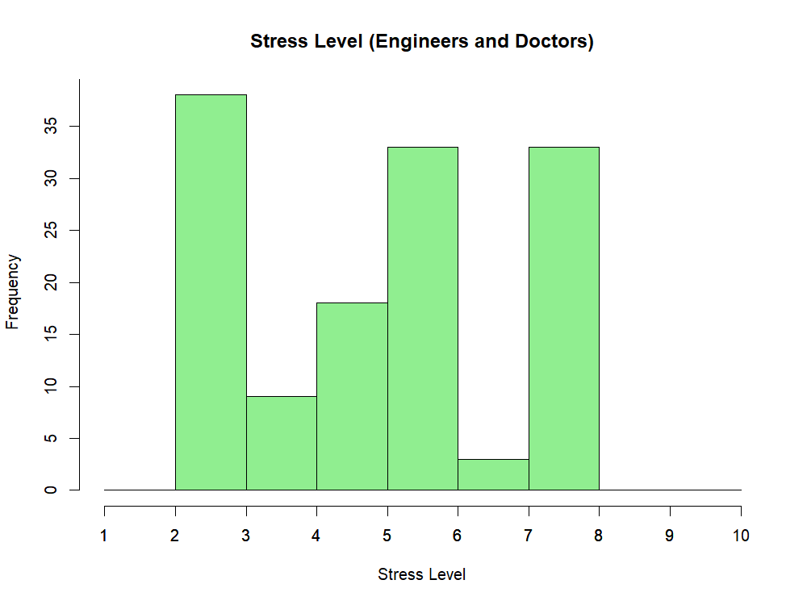
Graph 1: Histogram for stress level by Occupation

Slide 4
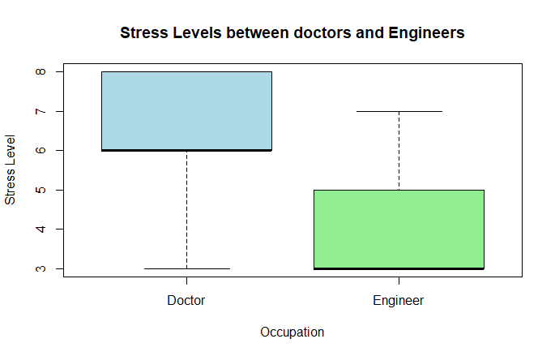
Graph 2: Box Plot for stress levels among both occupations

Slide 5
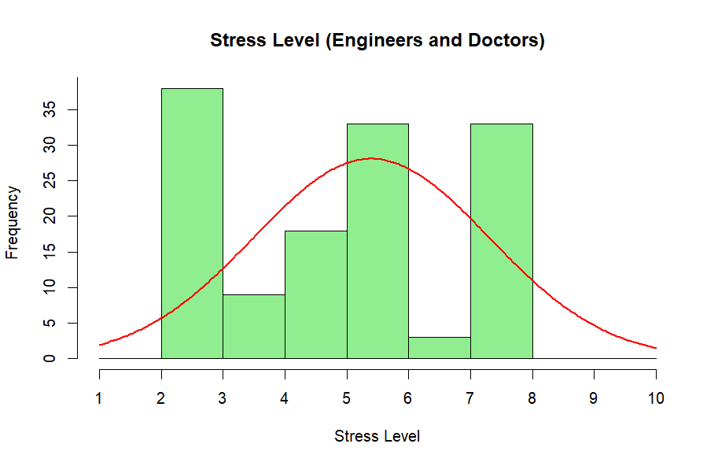
Here is a Histogram showing the frequencies of our dependent variable to include the normal curve overlay (shown in blue).
Our RQ asks about Differences in means/ medians
The normal curve overlay does not follow the shape of the underlying data, so we use the non-parametric test that does not assume normality: Wilcoxon also known as the Mann Whitney U Test.
The example here is borderline, in terms of shape, so when in doubt choose the non-parametric equivalent.
5

Slide 6
R Script and Results – The Analysis
Include a snippet of the R code you used to calculate your test statistic.
subset_df <- subset(df, Occupation == "Doctor" | Occupation == "Engineer")
colnames(subset_df)[8]<- "Stress"
wilcox.test(Stress ~ Occupation, data=subset_df)
Give the value of the test statistic.
W = 4153, p-value < 2.2e-16
p-value is less than 0.05
Is the result significant?
Yes, the result is significant.

Slide 7
R Script and Results – The Analysis
Do you ‘fail to reject the null hypothesis’ or ‘reject the null hypothesis’?
There is a difference in the median stress level between doctors and engineers, so we reject the null hypothesis.
What does the result actually mean in the wider context of learning something useful / answering your RQ?
Doctors and engineers in the 27 to 59 age group do not face the same stress levels. The difference is statistically significant, with doctors facing higher stress levels. Doctors bear the responsibility of decisions that affect human lives and often need to be ready for emergencies whereas engineers rarely face high pressure life-or-death situations.

