Slide 1
Felix Mo
Modelling the capacitance across a Metal-Insulator-Semiconductor device
Application: Future experiment on determining the local band gap of semiconductor materials
Idea for this project proposed by John Marohn
Python package: https://github.com/fm466/semiconductor-tip-capacitor-model-fm466.git

Slide 2
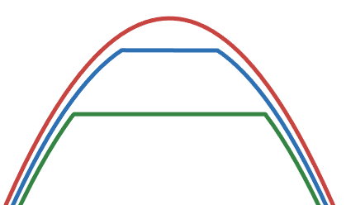
Background
Model an experiment to determine local band gap of semiconductor materials across small areas
Based on the principle of metal-insulator-semiconductor devices
Metal Tip
Larger distance
Band Gap
Short distance
limit
Semiconductor surface

Slide 3
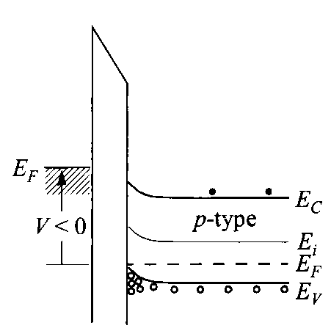
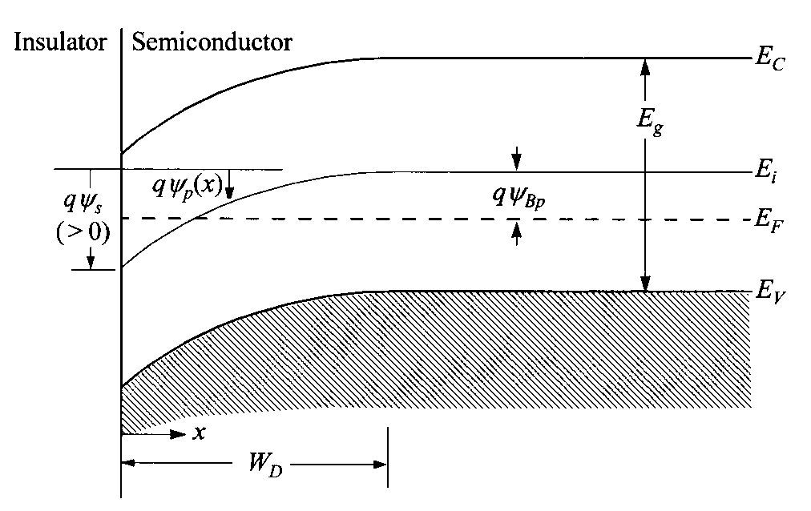
Theory
In the surface space-charge region, band banding takes place as voltage is applied to the system
Modelling this band bending and resultant surface potential by solving Poisson equation

Slide 4
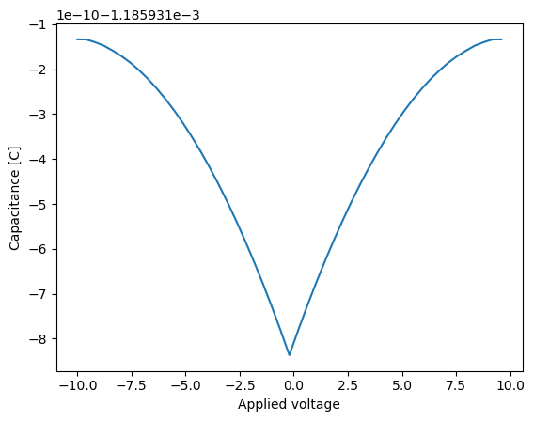
Model
Capacitance is modelled, which would be measured indirectly by change in cantilever spring constant or frequency shift during an experiment
Accepts variables:
Voltage range
Temperature
Semiconductor band gap and
electron affinity
Insulator / Semiconductor permittivity
Conduction / Valence band
density of states
Donor / acceptor density
Metal work function

