Slide 1
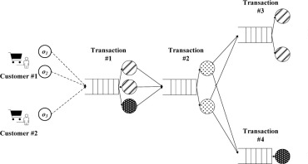
Simulated experiences
Agent’s Policy
Aaron
Josh
Vinayak
Learned Model
Action
Provide data/experiences to learn the model
Environment
Queueing Network
User Configuration
Arrival rate
Service time
Number of nodes
……
Fatima
Jevon
Molly

Slide 2
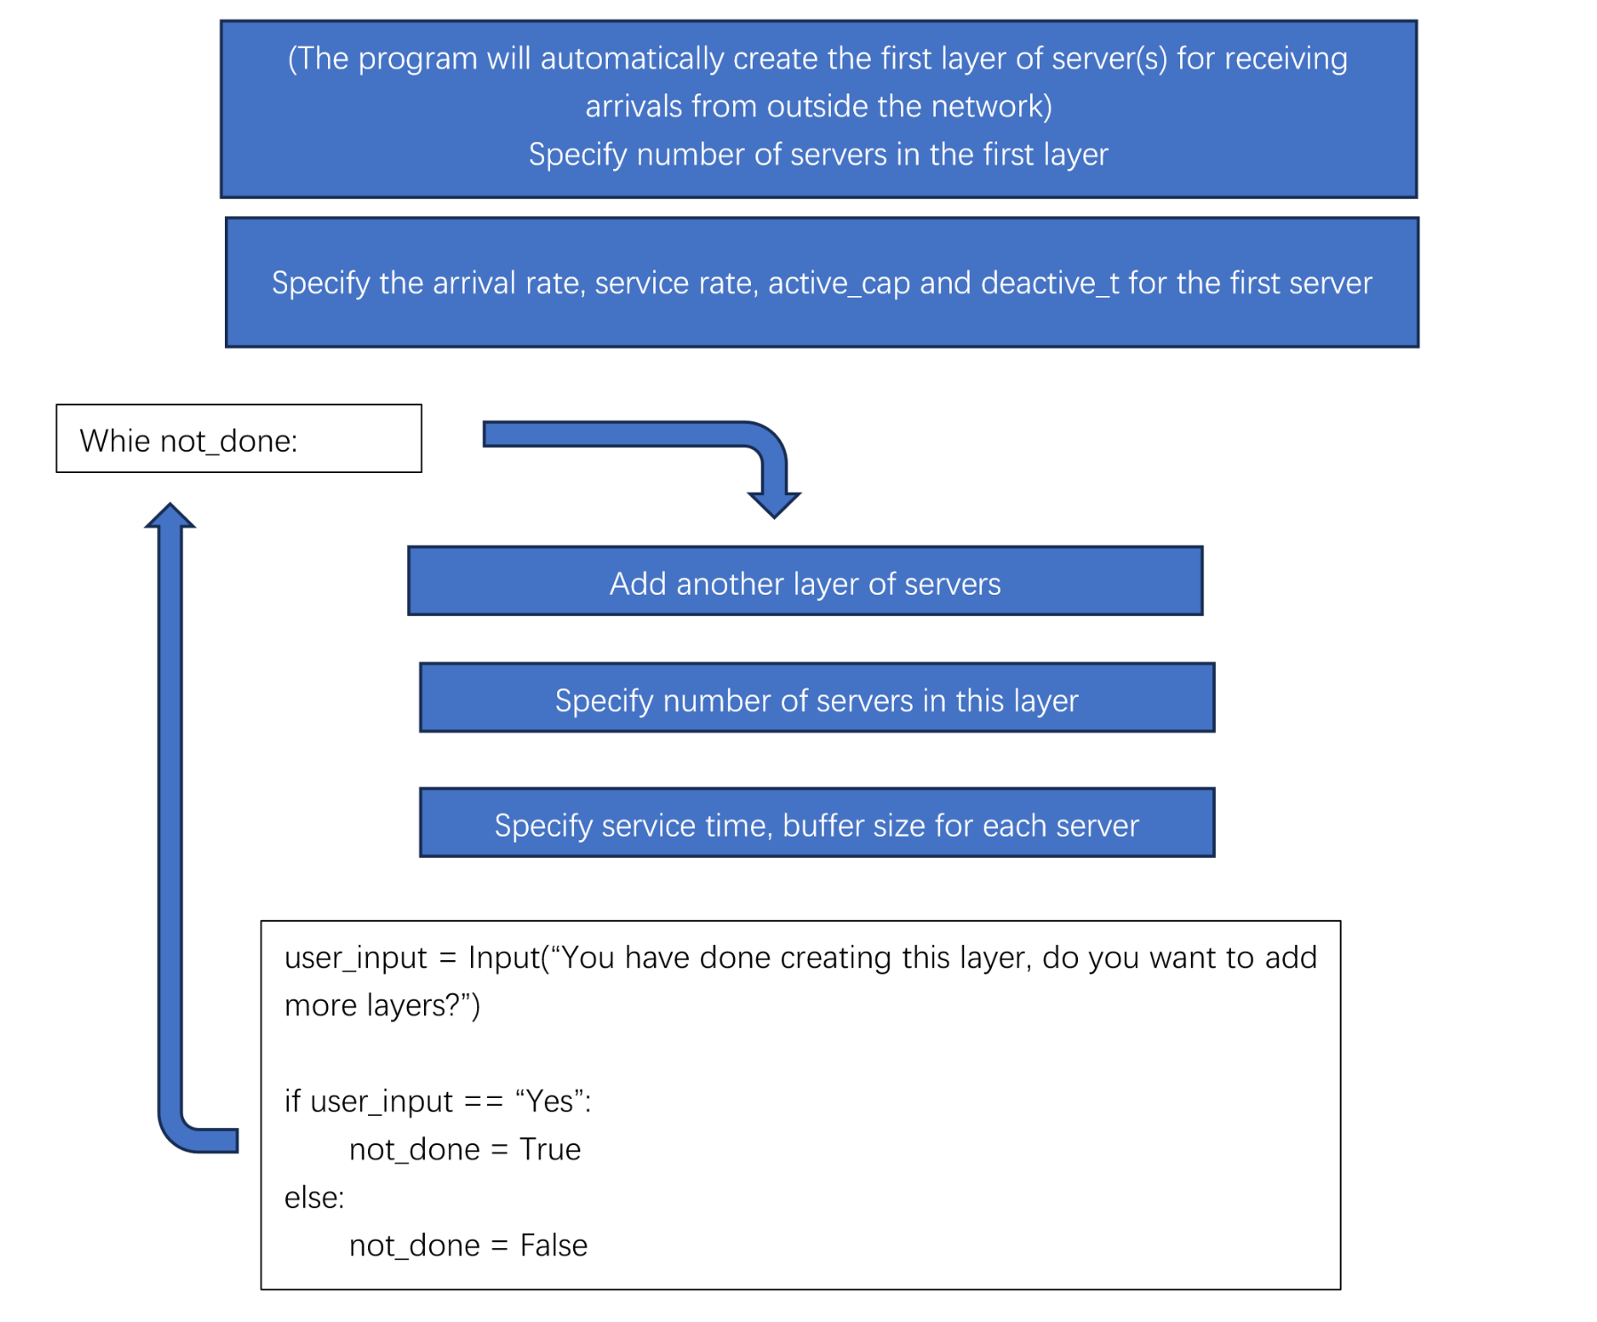

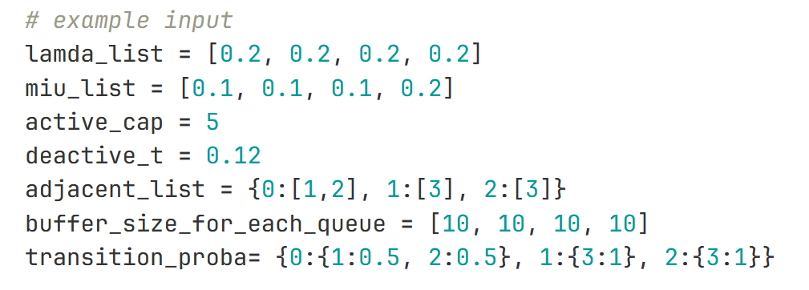
User Prompt
Reporter: Jevon
Wrap data into correct format
Interact

Slide 3
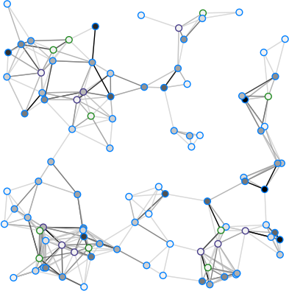
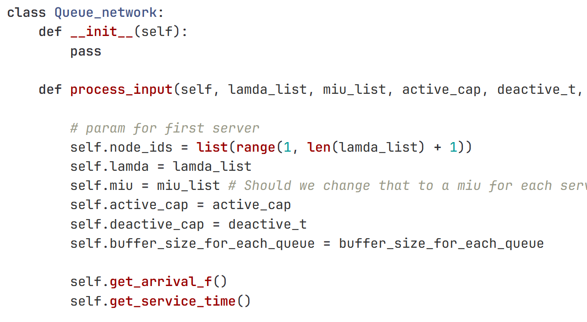
Queueing Network Environment
Reporter: Molly
Given Jevon’s User Inputs
Generate Simulated Industrial System
Create Queueing Network Env

Slide 4

Interact with RL Agent
Reporter: Fatima
Simulated Industrial System
Provide Reward
Retrieve next state

