Slide 1
BS32010 Project
Fiona Macfarlane (110010712)

Slide 2
Introduction
The microarray data used was from an experiment which studied the effects of the drug Roscovitine on Chicken (gallus gallus) cells.
Roscovitine is a cyclin-dependent kinase inhibitor [1].
Analysis can be useful to find the most significant differentially expressed genes.
There are multiple models that can be used to find these genes, including the models used in the packages Limma and DESeq2.
Once the most significant data has been found in can be used in further analysis.
Notes:
Roscovitine can delay the expression of genes and cell growth in presomitic mesoderm. As CDKS play important role in cell growth stage.
Differentially expressed genes are those that respond to the treatment differently than they would normally.
Further analysis, comparison with other species and phylogenetic relationships.

Slide 3
Finding the most significant results
Limma : Linear model for microarray data. [2]
Involves background correction and normalisation of the data.
Limma gives multiple statistical results, but to find the most significant differentially expressed genes we look at the adjusted p-value.
DESeq2 is an alternate method of finding the most significantly differentially expressed genes from the data. [3]
Notes:
Limma was developed by G.Smyth in 2004 using lonnstedt and speed expression models (2002).
RMA normalisation was used. Normalisation/bcorrection removes variation which can alter expression values.
Apval= pvalue adjusted for multiple testing.
A low adjp value gives a high likelihood of evidence for differential expression of the gene, therefore low p value is high significance.
DESEQ based on negative binomial distribution (different from limma).

Slide 4
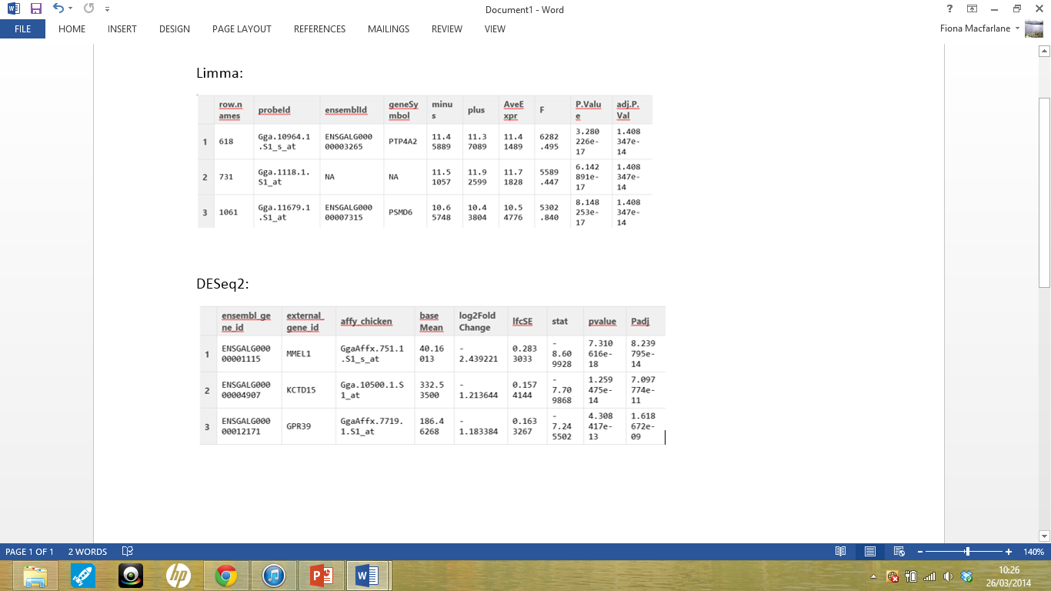
Limma and DESeq2 Results
Notes:
The data was order in accordance to adjpval.
Limma : PTP4A2 gene is most significant.
DESeq2 : MMEL1 gene is most significant.
Chose to work with PTP4A2 gene.

Slide 5
PTP4A2 : Protein tyrosine phosphate type IVA2
Part of the PTP family. [4]
Homologues of the chicken PTP4A2 gene were found using ENSEMBL. [5]
Using Jalview an alignment of 8 homologues for the PTP4A2 gene was created. [6]
R studio was then used to create phylogenetic trees of the alignment. [7]
Allowing relationships to be analysed.
Notes:
PTPs play important regulatory roles in various cellular processes.
Homologues found using orthologues section of ENSEMBLE , the fasta sequences downloaded for 8, and aligned in Jalview using Clusatal ws

Slide 6
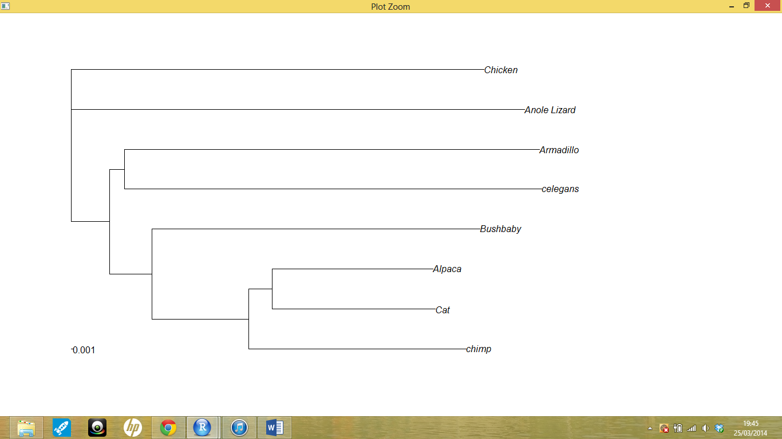
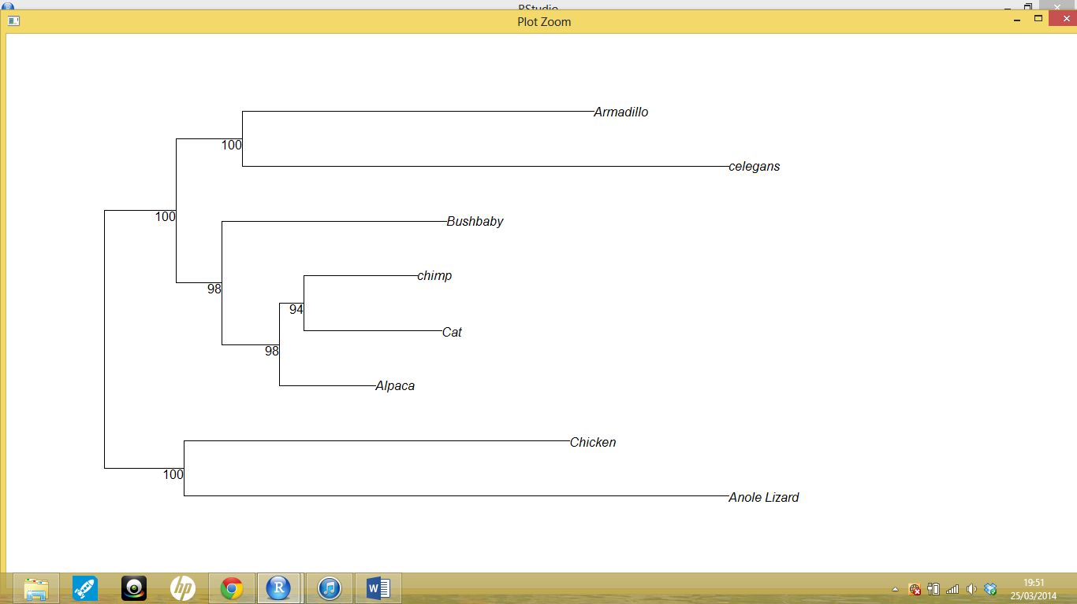
Phylogenetic trees:
Rooted tree
Bootstrapped Tree
Notes:
Both trees suggest a relationship between the Chicken PTP4A2 gene and the Anole lizard PTP4A2 gene.

Slide 7
Comparative genomics
Mummer and Act were used to compare the genomic regions of the chicken and anole Lizard. [8]
Mummer is a package which allows rapid alignment of sequences. [9]
Act is a package used to display the results of running Blastn on the data. [10]
Notes:
Genomic regions contain the PTP4A2 gene, added ~100000 bases either side, to give a more general overview.
Mummer displays the similarities between two sequences in both the forward and reverse strand.
Blastn; Basic Local Alignment Search Tool (nucleotides) looks at short matches of the sequence.

Slide 8
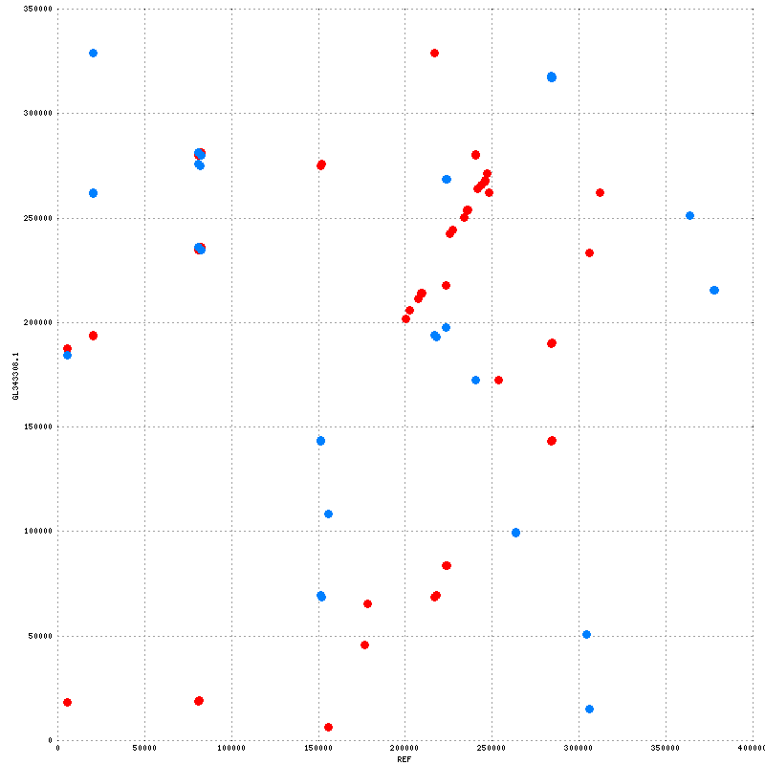
Mummer Results : Plot
Notes:
Show a section of similarity on the “perfect line” in the midlle of forward strand, this suggest this is where the PTP4A” gene is. There are small sections oof similarity in both forward and backward strands elsewhere, but not really anything significant.

Slide 9
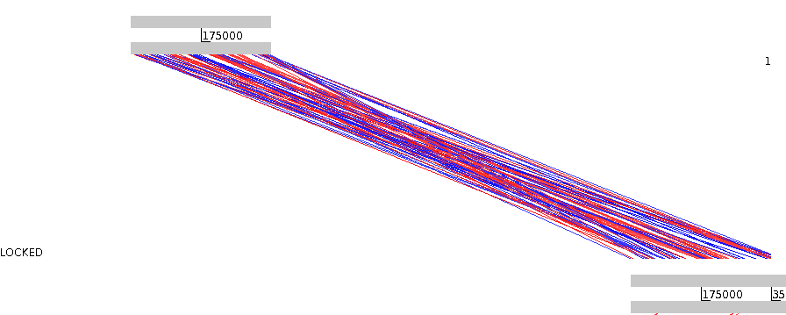
Act Results:
Notes:
Shows regions of similarity between forward and reverse strands when aligned using BLASTn.
Red = matches inforward
Blue = matches in reverse.
Shows that the genomes are similar but not identical (when aligned).

Slide 10
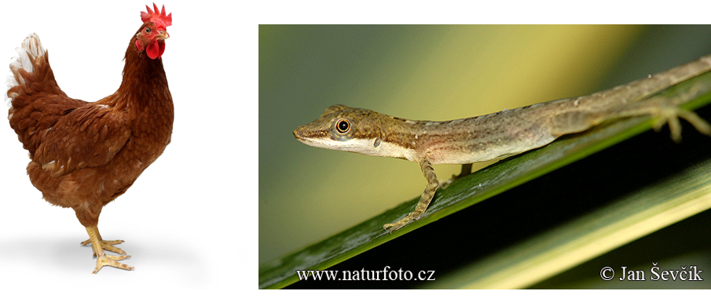
Conclusions
Both the phylogenetic trees and comparative genomics techniques suggest that the Chicken and Anole Lizard PTP4A2 genes are similar but not identical.
Suggest a possible evolutionary relationship. [11,12]
Notes:
The genome regions are different aswell, but the genes are similar.
Ensemble = 92% id between PTP4A2 genes of both species.
Common ancestor.

Slide 11
References
(1) De Azevedo WF, Leclerc S, Meijer L, Havlicek L, Strnad M, Kim SH (1997). "Inhibition of cyclin-dependent kinases by purine analogues: crystal structure of human cdk2 complexed with roscovitine". Eur J Biochem 243 (1-2): 518–526.
(2) Smyth, GK (2005). Limma: linear models for microarray data. In: 'Bioinformatics and Computational Biology Solutions using R and Bioconductor'. R. Gentleman, V. Carey, S. Dudoit, R. Irizarry, W. Huber (eds), Springer, New York, pages 397-420.
(3) Simon Anders and Wolfgang Huber (2010): Differential expression analysis for sequence count data. Genome Biology 11:R106
(4) Zhao Z, Lee CC, Monckton DG, Yazdani A, Coolbaugh MI, Li X, Bailey J, Shen Y, Caskey CT (Sep 1996). "Characterization and genomic mapping of genes and pseudogenes of a new human protein tyrosine phosphatase". Genomics 35 (1): 172–81.
(5) Paul Flicek, M. Ridwan Amode, Daniel Barrell, Kathryn Beal, Konstantinos Billis, Simon Brent, Denise Carvalho-Silva, Peter Clapham, Guy Coates, Stephen Fitzgerald, Laurent Gil, Carlos García Girón, Leo Gordon, Thibaut Hourlier, Sarah Hunt, Nathan Johnson, Thomas Juettemann, Andreas K. Kähäri, Stephen Keenan, Eugene Kulesha, Fergal J. Martin, Thomas Maurel, William M. McLaren, Daniel N. Murphy, Rishi Nag, Bert Overduin, Miguel Pignatelli, Bethan Pritchard, Emily Pritchard, Harpreet S. Riat, Magali Ruffier, Daniel Sheppard, Kieron Taylor, Anja Thormann, Stephen J. Trevanion, Alessandro Vullo, Steven P. Wilder, Mark Wilson, Amonida Zadissa, Bronwen L. Aken, Ewan Birney, Fiona Cunningham, Jennifer Harrow, Javier Herrero, Tim J.P. Hubbard, Rhoda Kinsella, Matthieu Muffato, Anne Parker, Giulietta Spudich, Andy Yates, Daniel R. Zerbino, and Stephen M.J. Searle Ensembl 2014 Nucleic Acids Research 2014 42 Database issue:D749-D755
(6) Waterhouse, A.M., Procter, J.B., Martin, D.M.A, Clamp, M. and Barton, G. J. (2009)"Jalview Version 2 - a multiple sequence alignment editor and analysis workbench“Bioinformatics25 (9) 1189-1191
{7} RStudio (2012). RStudio: Integrated development environment for R (Version 0.96.122) [Computer software]. Boston, MA. Retrieved May 20, 2012.
(8) https://github.com/widdowquinn/Teaching
(9) MUMmer 2.1, NUCmer, and PROmer are described in "Fast Algorithms for Large-scale Genome Alignment and Comparision." A.L. Delcher, A. Phillippy, J. Carlton, and S.L. Salzberg, Nucleic Acids Research (2002), Vol. 30, No. 11 2478-2483.
(10) ACT: the Artemis Comparison Tool. Carver TJ, Rutherfor KM, Berriman M, Rajandream MA, Barrell BG and Parkhill J Bioinformatics (Oxford, England) 2005:21;16;3422-3 PUB-MED: 15976072;DOI: 10.1093/bioinformatics/bti533
(11) http://www.naturephoto-cz.com/anole-lizard-photo-7391.html
(12) http://www.anatomyofviolence.co.uk/wp-content/uploads/2013/10/chicken.jpg
(13) http://www.compbio.dundee.ac.uk/user/pschofield/Teaching/Bioinformatics

Slide 12
Thank you for listening
f.macfarlane@dundee.ac.uk
https://github.com/fmacfarlane/Project.git

