Slide 1
random sample 1
sample statistic
(e.g. mean)
random sample 2
sample statistic
(e.g. mean)
population
...
...
random sample m
sample statistic
(e.g. mean)
sample
distributions
sampling
distribution

Slide 2



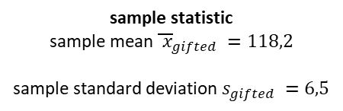
IQs mother gifted childrens
$$μ_{gifted}=??$$
random sample n=36
sample statistic
sample mean ${\overline{ x}}_{gifted} =118,2$
sample standard deviation $s_{gifted} =6,5$
IQs population at large
$$μ_{pop_geral} =100$$
Hypothesis:
$$H_{0}: μ_{gifted}=μ_{pop_geral}$$
$$H_{A}: μ_{gifted}>μ_{pop_geral}$$

Slide 3
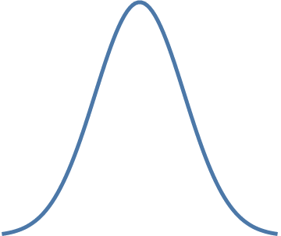
IQs mother gifted childrens
$$μ_{gifted}=??$$
random sample n=36
sample statistic
sample mean ${\overline{ x}}_{gifted} =118,2$
sample standard deviation $s_{gifted} =6,5$
IQs population at large
$$μ_{pop_geral} =100$$
Hypothesis:
$$H_{0}: μ_{gifted}=μ_{pop_geral}$$
$$H_{A}: μ_{gifted}>μ_{pop_geral}$$
random sample 1
...
random sample m
...
sample mean
sample mean
sampling distribution

Slide 4

IQs mother gifted childrens
$$μ_{gifted}=??$$
random sample n=36
sample statistic
sample mean ${\overline{ x}}_{gifted} =118,2$
sample standard deviation $s_{gifted} =6,5$
IQs population at large
$$μ_{pop_geral} =100$$
Hypothesis:
$$H_{0}: μ_{gifted}=μ_{pop_geral}$$
$$H_{A}: μ_{gifted}>μ_{pop_geral}$$
random sample 1
...
random sample m
by the
Central Limit Theorem (CLT)
sampling distribution
we don´t know in this case
...
$$\overline{X} \sim N\left(μ=μ_{pop_geral} ,{SE=SE}_{pop_geral}=\frac{σ_{pop_geral}}{\sqrt{n}}\right)$$
sample mean
sample mean
sampling distribution

Slide 5





IQs mother gifted childrens
$$μ_{gifted}=??$$
random sample n=36
sample statistic
sample mean ${\overline{ x}}_{gifted} =118,2$
sample standard deviation $s_{gifted} =6,5$
IQs population at large
$$μ_{pop_geral} =100$$
Hypothesis:
$$H_{0}: μ_{gifted}=μ_{pop_geral}$$
$$H_{A}: μ_{gifted}>μ_{pop_geral}$$
+
$$H_{0}=True$$
random sample 1
...
random sample m
we can assume that
$$s_{pop_geral}=s_{gifted} =6,5$$
we don´t know in this case
...
$$s_{pop_geral}≈σ_{pop_geral}$$
sample mean
sample mean
sampling distribution
sampling distribution
+
by the
Central Limit Theorem (CLT)
$$\overline{X} \sim N\left(μ=100 , SE=1,084 \right)$$
sampling distribution
$$\overline{X} \sim N\left(μ=μ_{pop_geral} ,{SE=SE}_{pop_geral}=\frac{σ_{pop_geral}}{\sqrt{n}}\right)$$

Slide 6
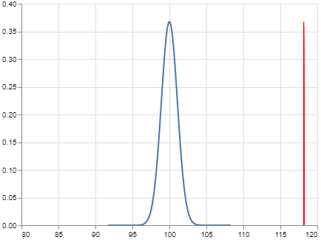


IQs mother gifted childrens
$$μ_{gifted}=??$$
random sample n=36
sample statistic
sample mean ${\overline{ x}}_{gifted} =118,2$
sample standard deviation $s_{gifted} =6,5$
IQs population at large
$$μ_{pop_geral} =100$$
Hypothesis:
$$H_{0}: μ_{gifted}=μ_{pop_geral}$$
$$H_{A}: μ_{gifted}>μ_{pop_geral}$$
+
we have strong evidence to reject $H_{0}$ in favor of $H_{A}$
+
$$H_{0}=True$$
random sample 1
...
random sample m
we can assume that
$$s_{pop_geral}=s_{gifted} =6,5$$
we don´t know in this case
...
$$s_{pop_geral}≈σ_{pop_geral}$$
$$P\left(\overline{x}≥118,2 | H_{0}=True\right)≈0$$
sample mean
sample mean
sampling distribution
sampling distribution
+
by the
Central Limit Theorem (CLT)
$$\overline{X} \sim N\left(μ=100 , SE=1,084 \right)$$
sampling distribution
$$\overline{X} \sim N\left(μ=μ_{pop_geral} ,{SE=SE}_{pop_geral}=\frac{σ_{pop_geral}}{\sqrt{n}}\right)$$

Slide 7
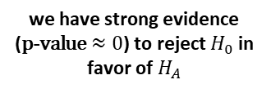
IQs mother gifted childrens
$$μ_{gifted}=??$$
random sample n=36
sample statistic
sample mean ${\overline{ x}}_{gifted} =118,2$
sample standard deviation $s_{gifted} =6,5$
IQs population at large
$$μ_{pop_geral} =100$$
Hypothesis:
$$H_{0}: μ_{gifted}=μ_{pop_geral}$$
$$H_{A}: μ_{gifted}>μ_{pop_geral}$$
+
we have strong evidence ($\text{p}\text{−}\text{value}≈0$) to reject $H_{0}$ in favor of $H_{A}$
+
$$H_{0}=True$$
random sample 1
...
random sample m
we can assume that
$$s_{pop_geral}=s_{gifted} =6,5$$
we don´t know in this case
...
$$s_{pop_geral}≈σ_{pop_geral}$$
$$\text{p}\text{−}\text{value}= P\left(\overline{x}≥118,2 | H_{0}=True\right)≈0$$
sample mean
sample mean
sampling distribution
sampling distribution
+
by the
Central Limit Theorem (CLT)
$$\overline{X} \sim N\left(μ=100 , SE=1,084 \right)$$
sampling distribution
$$\overline{X} \sim N\left(μ=μ_{pop_geral} ,{SE=SE}_{pop_geral}=\frac{σ_{pop_geral}}{\sqrt{n}}\right)$$

