Slide 1
Prediction of survivability among COVID-19 patients using four different ML algorithms
Data Science capstone project

Slide 2

The Problem
Given a Covid-19 patient's current symptom, status, and medical history, will predict whether the patient is in high risk or not.

Slide 3
Dataset
The dataset was provided by the Mexican government (link) .
The raw dataset consists of 21 unique features and 1,048,576 unique patients.

Slide 4
Data Wrangling
Original dataset had 1,048,576 rows.
Samling the dataset with 20,000 rows.
Dropping columns (ICU and INTUBED) with more than 50% data missing.
Fill the missing values of PREGNANT column for male patient with ‘not pregnant’ values.
Target variable DEATH column.

Slide 5
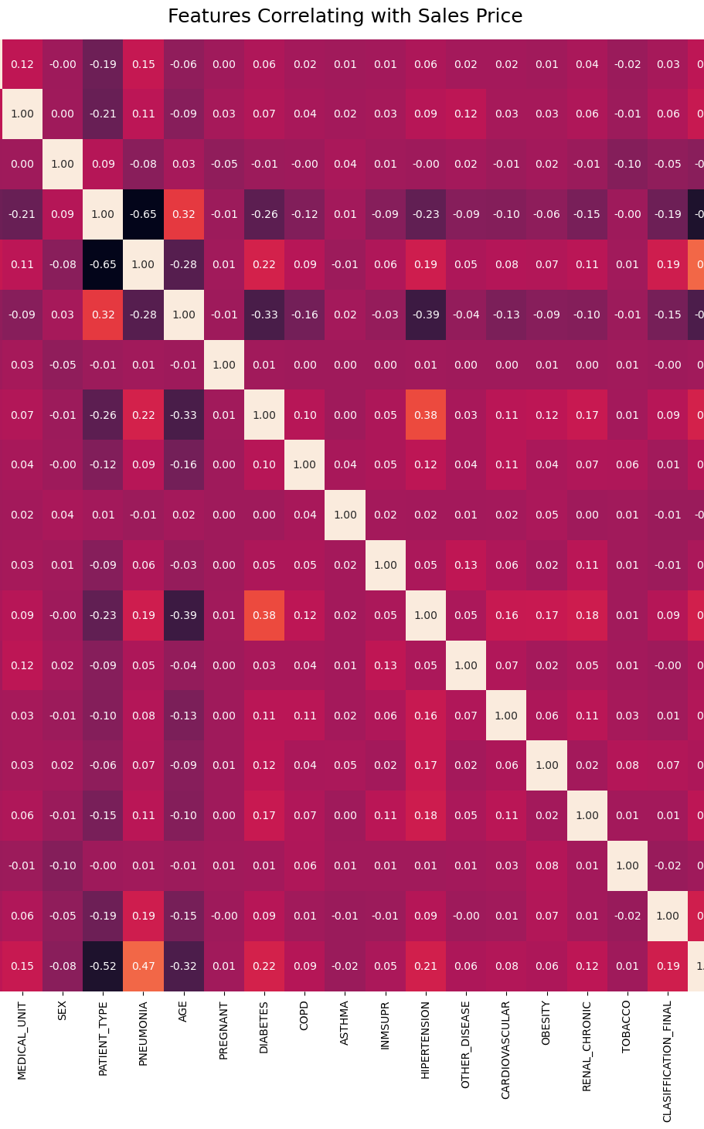
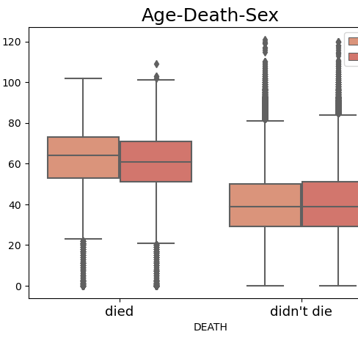
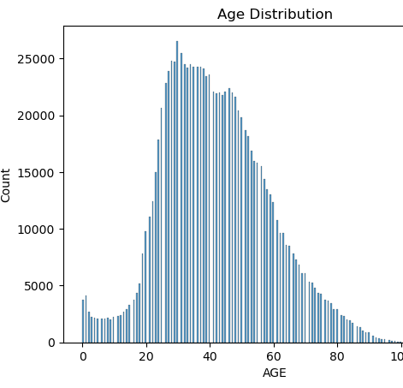
Exploratory data analysis

Slide 6
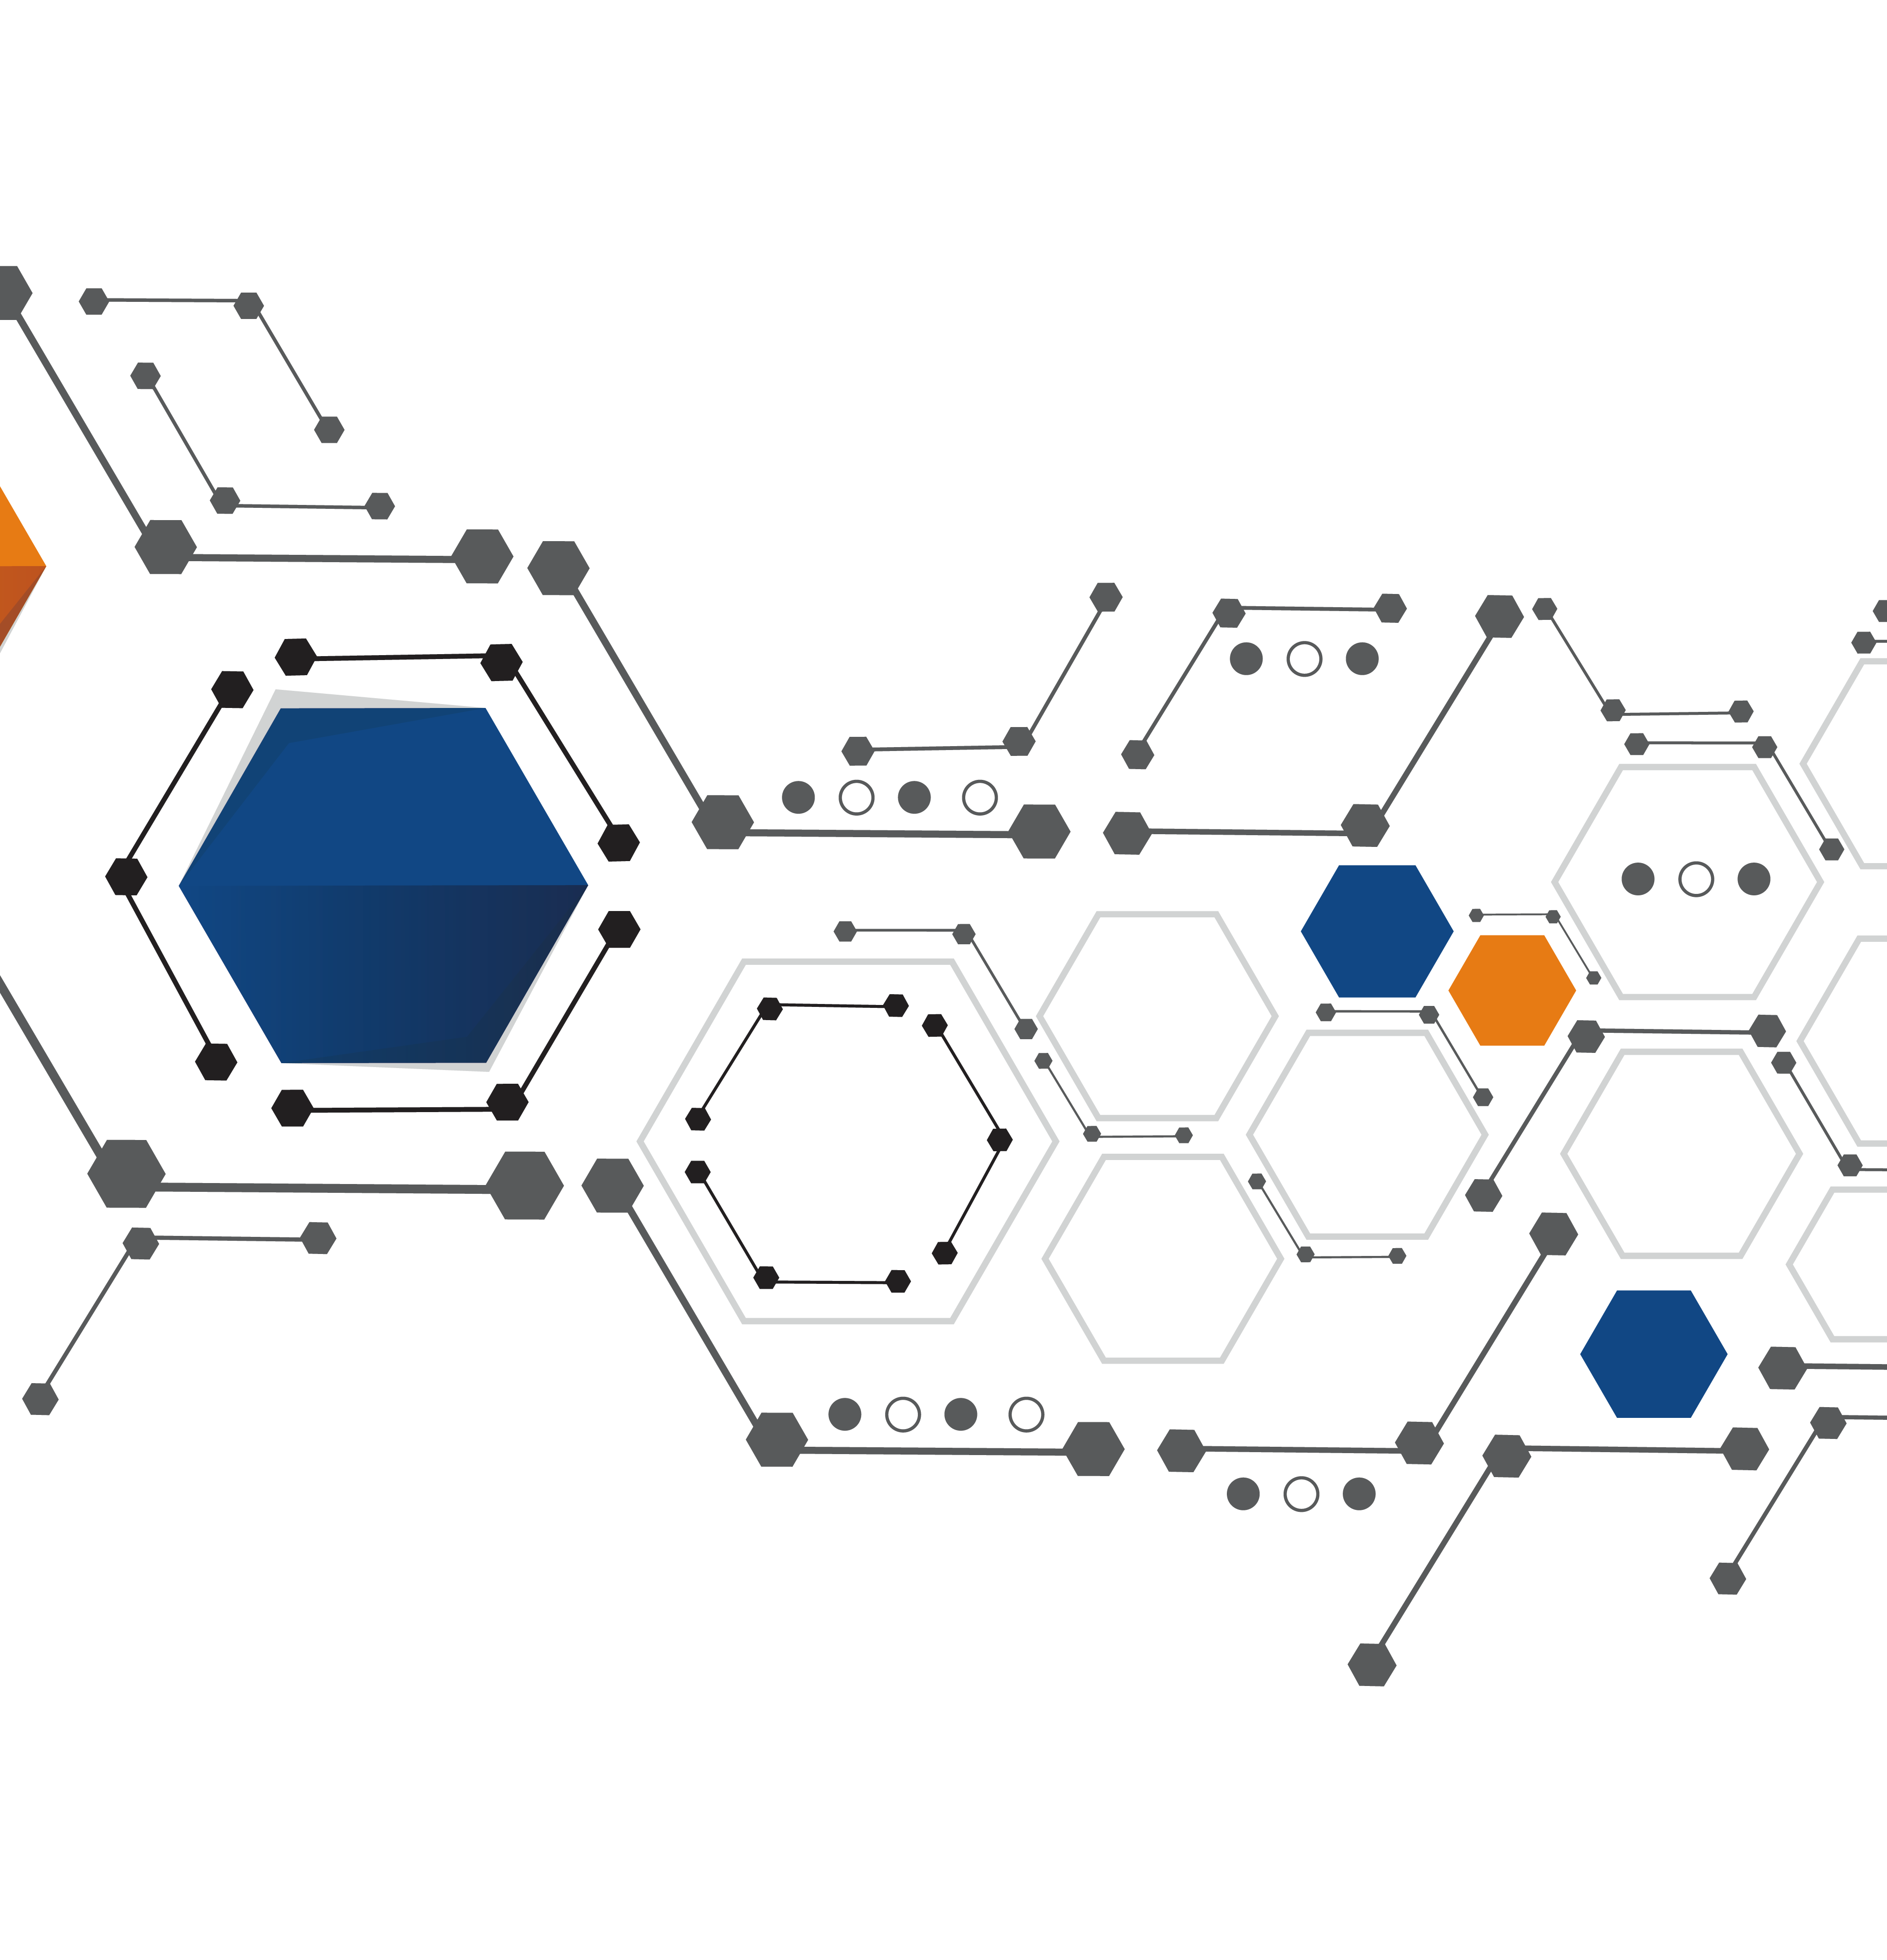
Model selection
Random Forest classifier,
Naive Baise,
Gradient Boosting classifier and
K-nearest neighbor classifier
This Photo by Unknown Author is licensed under CC BY-NC

Slide 7

Model performance
Random Forest classifier 93.75%,
Naive Baise 88.2%,
Gradient Boosting classifier 93.25%
K-nearest neighbor classifier 92.52%

