Slide 1
Google Test
This is a little guide for “gtest”

Slide 2
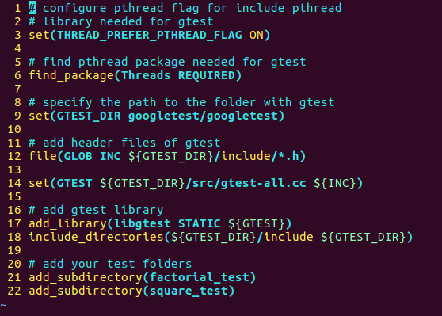
Let’s start
Add test folder to your project.
Add folder with gtest to your test folder.
Add and configure CmakeLists.txt
  Specify gtest folder
  Add test folders
Add clang compiler:
$ export CXX=/usr/bin/clang++

Slide 3
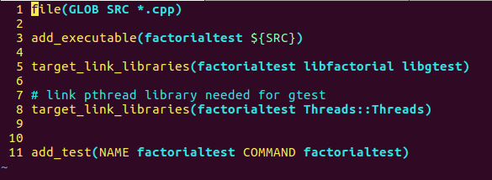
Test folder
Add and configure CMakeLists.txt in your test folders
  add libs with files that you want to test

Slide 4
A little about tests themselves
Tests macro beginning with ASSERT_* or EXPECT_*.
ASSERT_* generate fatal failure when they fail, and abort the current function. EXPECT_* generate nonfatal failures when they fail, which don’t abort the current function.
TEST_F(MyTest, testNoNull) {
. . .
ASSERT_TRUE(n >=0 );
. . .
}
TEST_F(MyTest, testNoNull) {
. . .
EXPECT_TRUE(n >=0 );
. . .
}
If this test fails, the execution of the current test case is terminated.
If this test fails, the execution of the current test is continue.

Slide 5
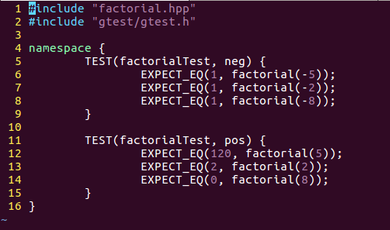
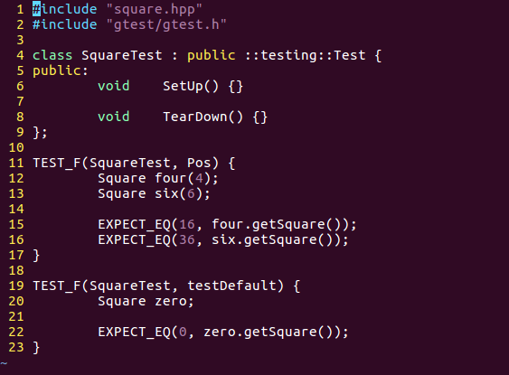
How to determine tests
In test file include header file with functions/classes prototypes.
Include “gtest/gtest.h” file.
Write your tests.
To determine a tests is used the macro “TEST” or “TEST_F”
“TEST” is used for basic tests where you don’t need additional settings.
“TEST_F” is used for more complex tests where you need to prepare additional settings.

Slide 6
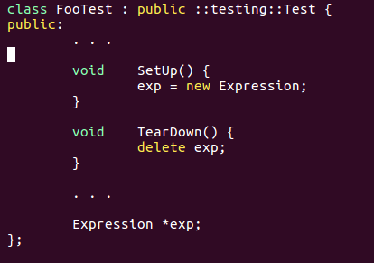
TEST_F (fixture)
To create a fixture, just:
Derive a class from ::testing::Test . Start its body with protected: or public: .
Inside the class, declare any objects you plan to use.
If necessary, write a default constructor or SetUp() function to prepare the objects for each test.
If necessary, write a destructor or TearDown() function to release any resources you allocated in SetUp() .
If needed, define subroutines for your tests to share.

Slide 7
Death Tests
There are assertions that cause application failure, if condition is not met. For this in gtest there is “Death Tests”, which test that such assertion statements work as expexted.

