Slide 1


Slide 2

Background and problem statement

Slide 3
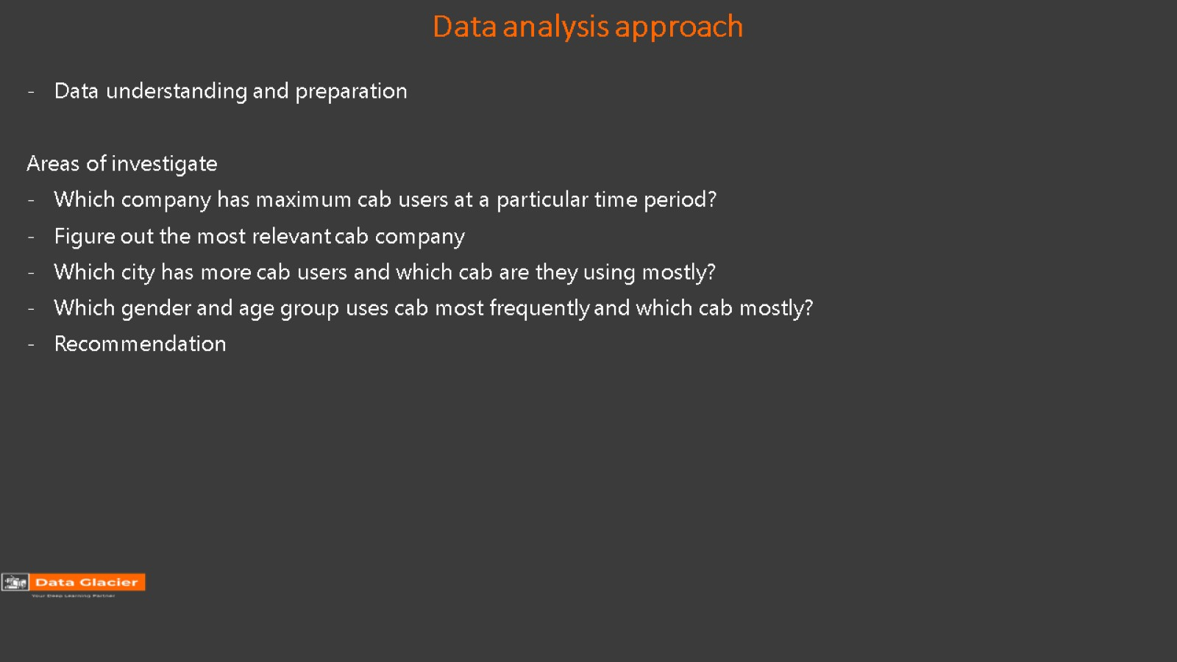
Data analysis approach

Slide 4
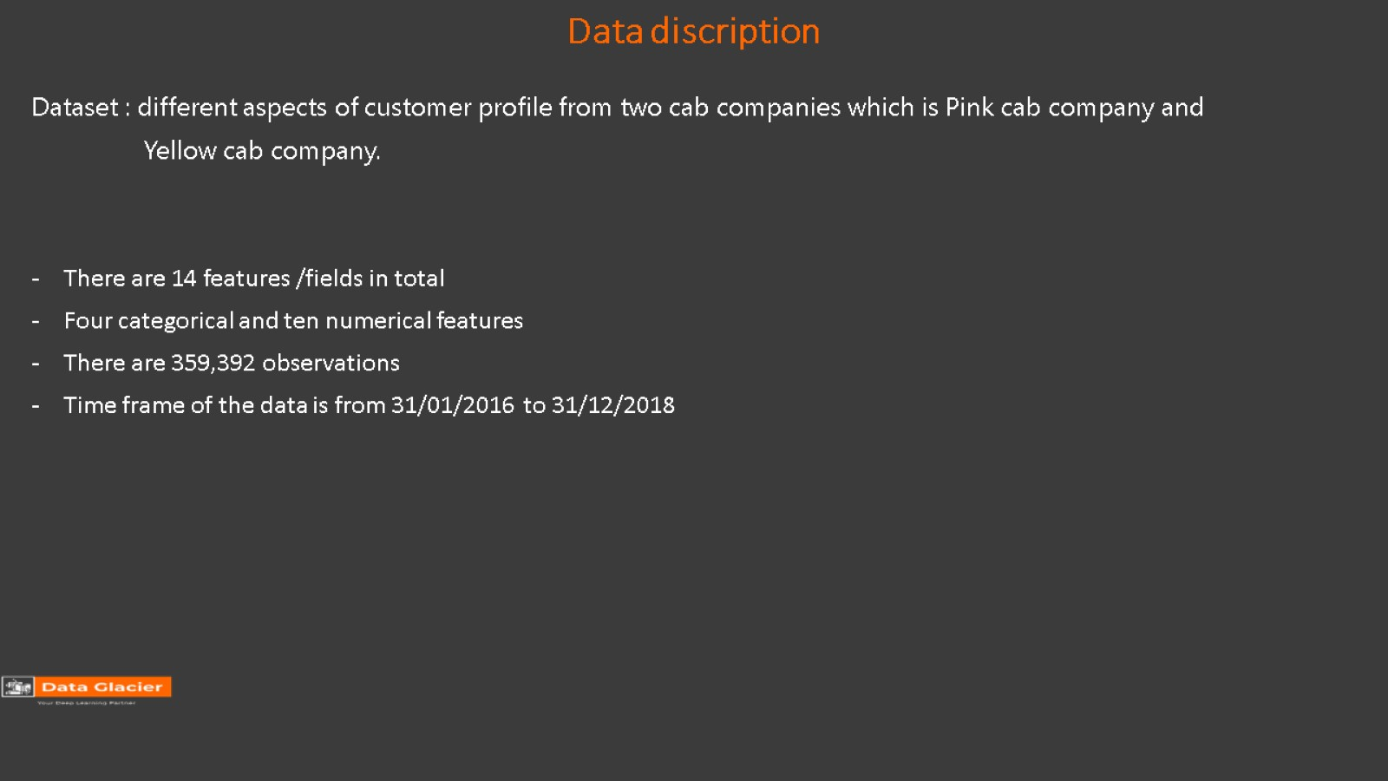
Data discription

Slide 5
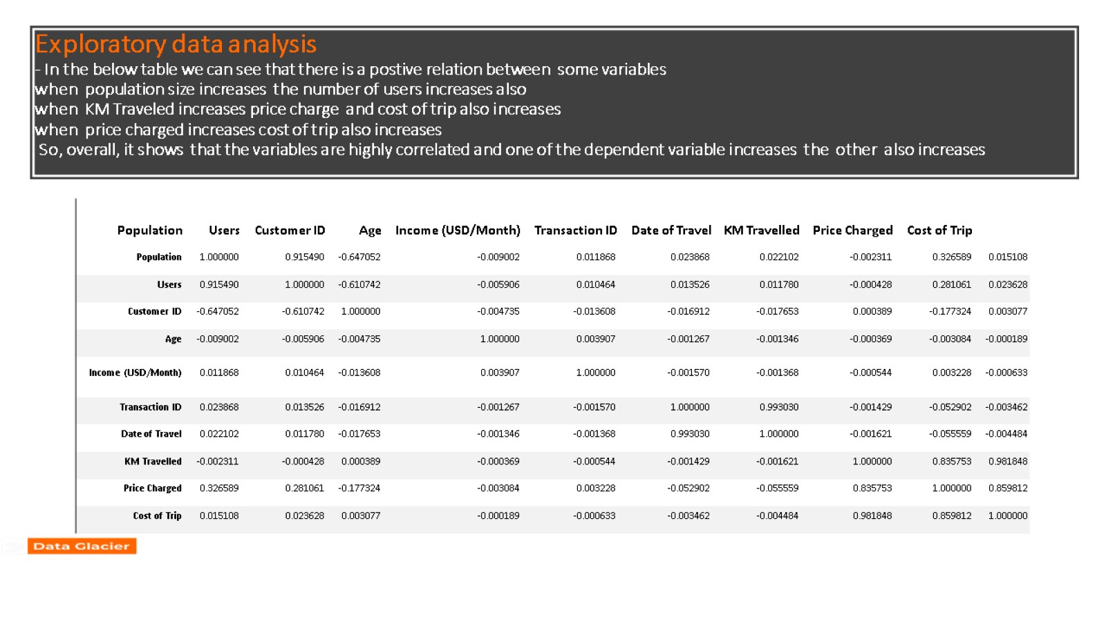
Exploratory data analysis - In the below table we can see that there is a postive relation between some variables when population size increases the number of users increases also when KM Traveled increases price charge and cost of trip also increases when price charged increases cost of trip also increases So, overall, it shows that the variables are highly correlated and one of the dependent variable increases the other also increases

Slide 6
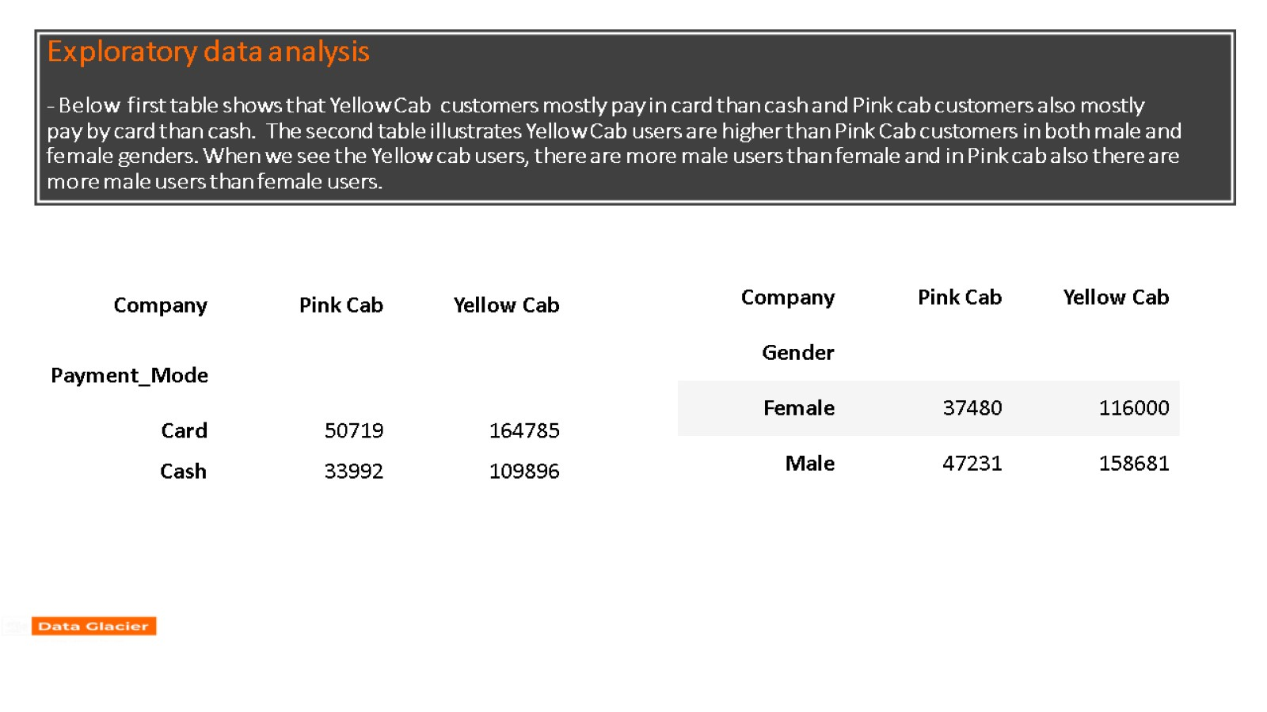
Exploratory data analysis - Below first table shows that Yellow Cab customers mostly pay in card than cash and Pink cab customers also mostly pay by card than cash. The second table illustrates Yellow Cab users are higher than Pink Cab customers in both male and female genders. When we see the Yellow cab users, there are more male users than female and in Pink cab also there are more male users than female users.

Slide 7
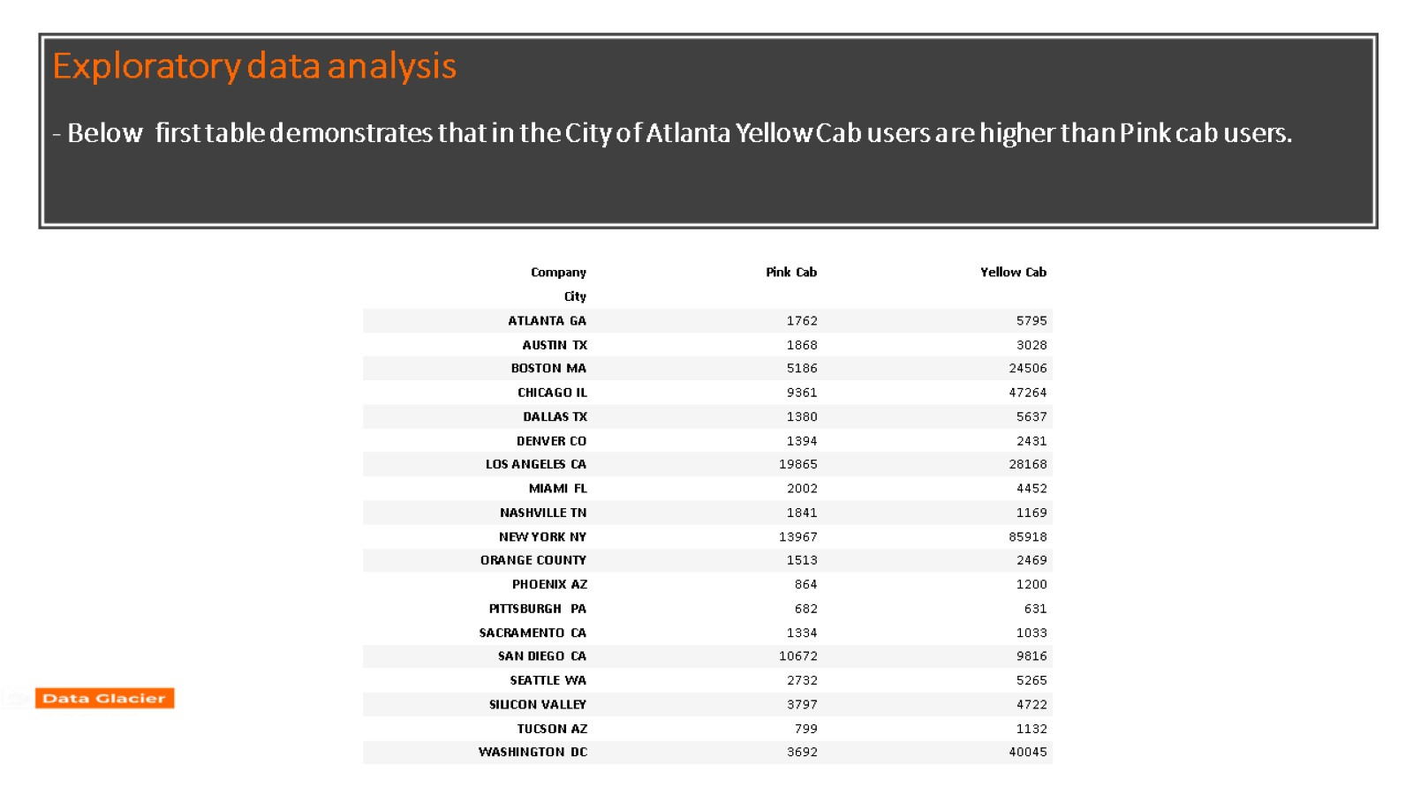
Exploratory data analysis - Below first table demonstrates that in the City of Atlanta Yellow Cab users are higher than Pink cab users.

Slide 8


