Slide 1

XYZ company data analysis and report presentation.

Slide 2

Background and problem statement

Slide 3
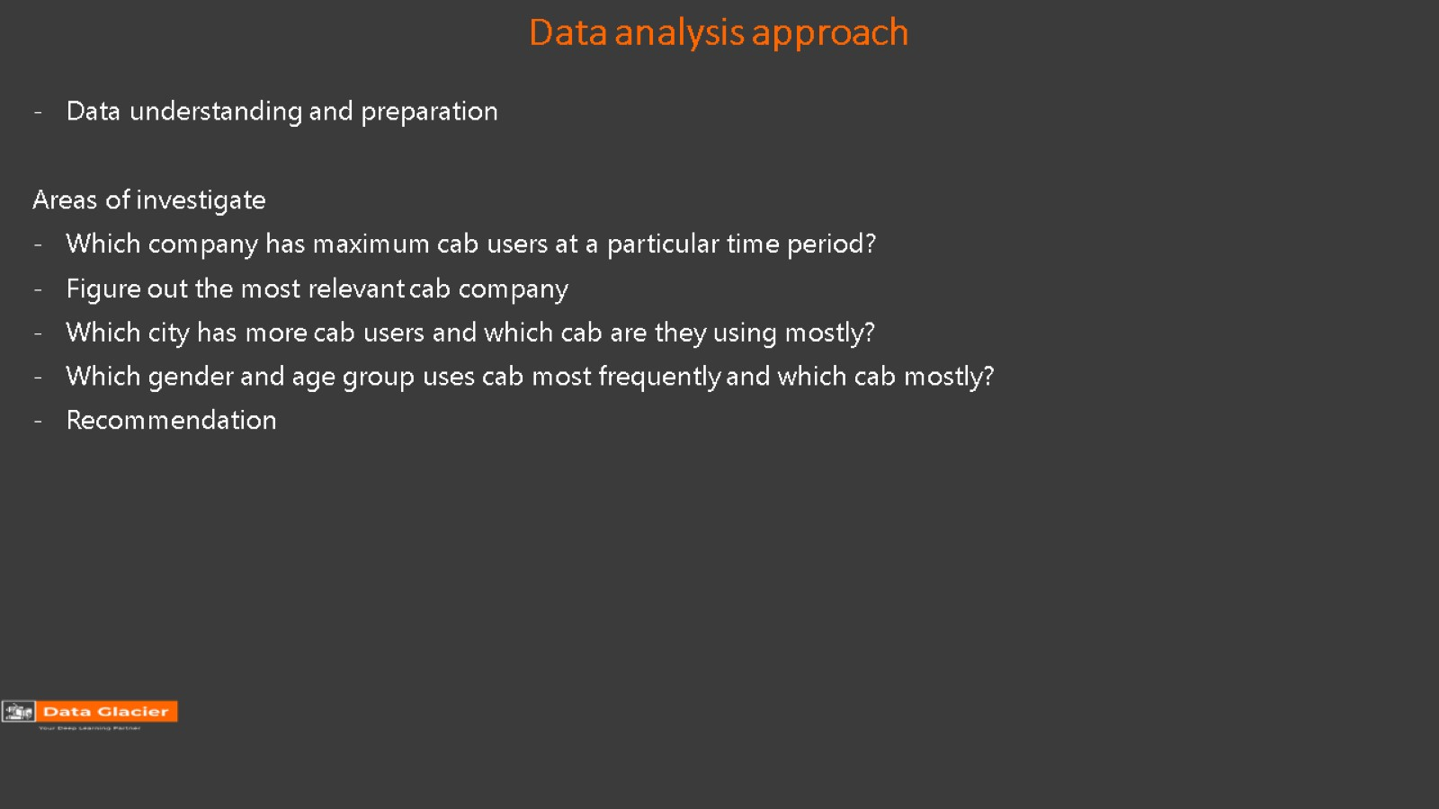
Data analysis approach

Slide 4
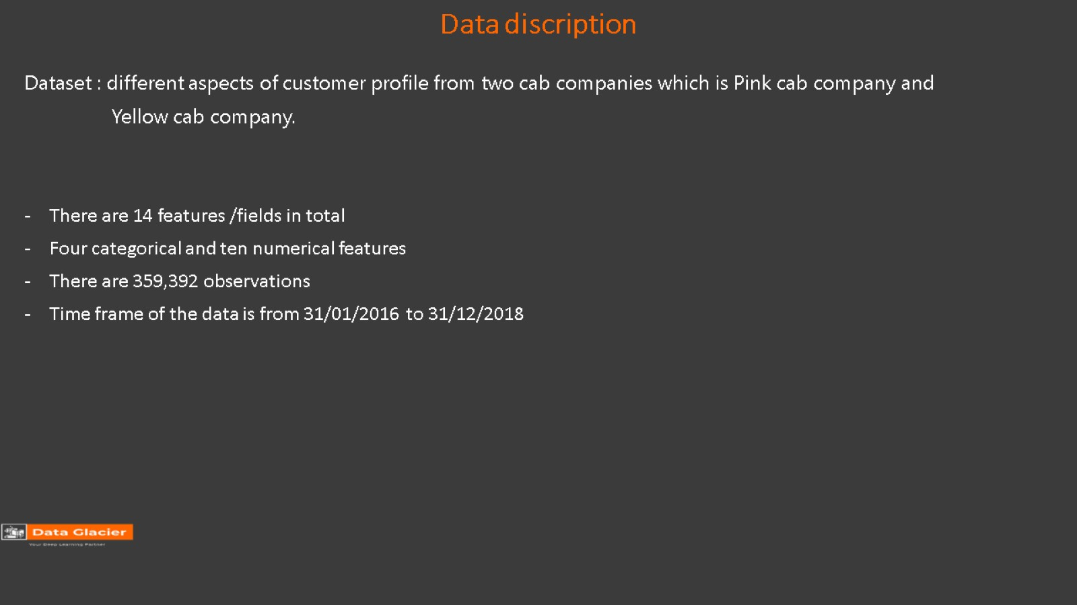
Data discription

Slide 5
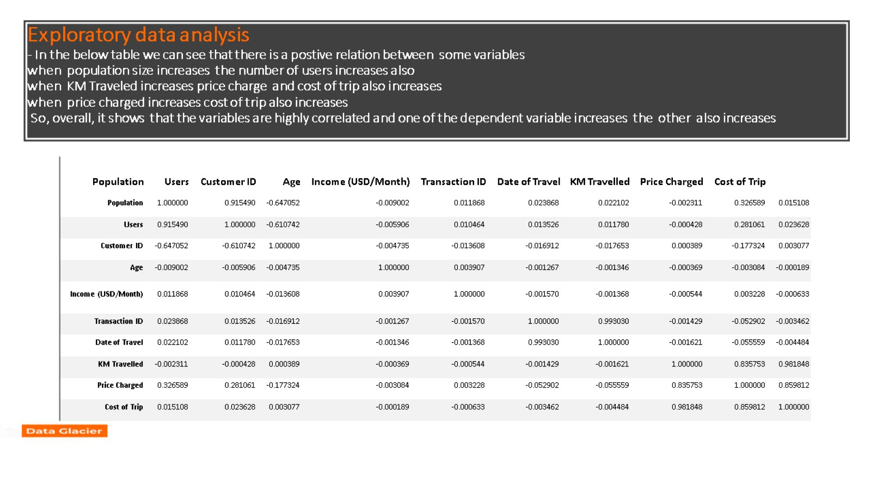
Exploratory data analysis - In the below table we can see that there is a postive relation between some variables when population size increases the number of users increases also when KM Traveled increases price charge and cost of trip also increases when price charged increases cost of trip also increases So, overall, it shows that the variables are highly correlated and one of the dependent variable increases the other also increases

Slide 6
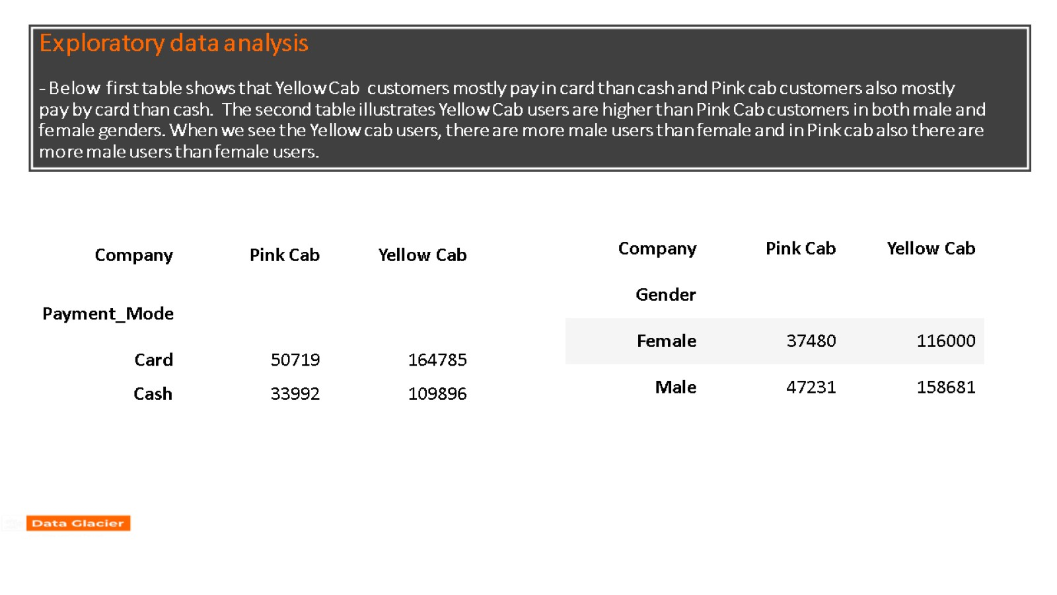
Exploratory data analysis - Below first table shows that Yellow Cab customers mostly pay in card than cash and Pink cab customers also mostly pay by card than cash. The second table illustrates Yellow Cab users are higher than Pink Cab customers in both male and female genders. When we see the Yellow cab users, there are more male users than female and in Pink cab also there are more male users than female users.

Slide 7
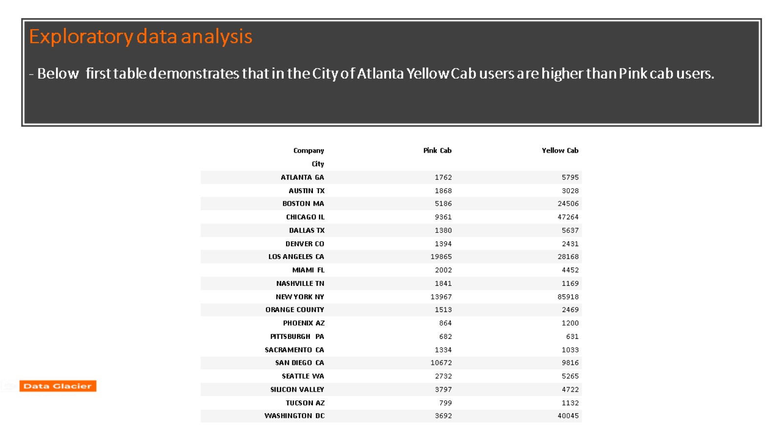
Exploratory data analysis - Below first table demonstrates that in the City of Atlanta Yellow Cab users are higher than Pink cab users.

Slide 8
Population wise analysis

Slide 9
City wise analysis

Slide 10
Cost wise analysis

Slide 11
Age and Gender wise analysis

Slide 12
City and Company wise analysis

Slide 13
Recommendation - When we see in the population-wise analysis in the figure it is very clear that yellow cab is a very dominant one. City-wise analysis shows that in most of the cities yellow cab users are very high than pink cab users, especially in New York, Chicago, Los Angeles, Washington Dc, Boston MA, and San Diego CA. - From the cost-wise analysis figure, we can see that cost of the trip increases in each cab when the users are increasing. And the graph shows that cost of a yellow cab is higher than a pink cab. - Age and Gender wise analysis charts illustrate still yellow cab users of almost any age are very higher than a pink cab. From the charts, we also understand that male users are dominated and are mostly using a yellow cab. Los Angeles, San Diego, and Washington DC have the most yellow cab users. Overall, based on the above analysis we recommend that XYZ company should decide to invest in the yellow cab company.

Slide 14


