Slide 1
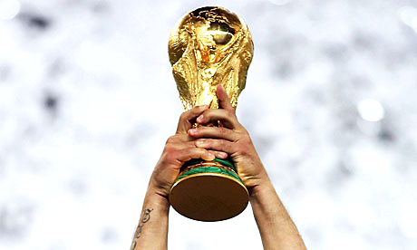
FIFA WORLD CUP - Analysis
Feven Legesse

Slide 2
Today’s
agenda
Project recap
Questions
Processes
Insights
Summary

Slide 3
Project recap
The FIFA World Cup/ simply called World Cup, is an international association football competition between the senior men’s national teams of the members of the Fédération Internationale de Football Association(FIFA). The tournament has been held since 1930 except 1942 and 1946 due to 2nd world war.
Problem statement: Explore and analyse the data to answer specific questions related to the past tournaments and draw conclusion based on insights.
Dataset is collected from the online community platform for data scientists & ML enthusiasts called Kaggle.
Time frame: 1930 - 2014
Includes 20 tournaments

Slide 4
Questions
Which country won the most?
How many numbers of goals per country?
Which matches has highest number
of attendance?
Which stadiums has highest
average attendance?
What is the percentage of
win and lose when they play
home and away places?

Slide 5
Process
1.
2.
3.
4.
Data discovery and understanding
Data cleaning
Exploratory data analysis
Uncover insights

Slide 6
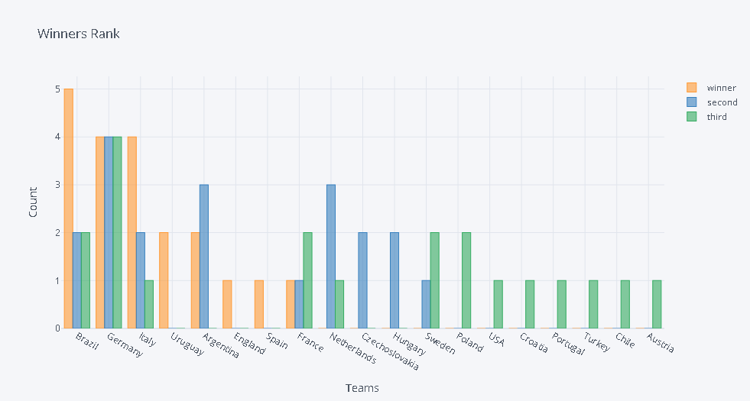
Rank of top 5 winner countries
1. Brazil
2. Germany
3. Italy
4. Uruguay
5. Argentina
Which country won the most?
Insight

Slide 7
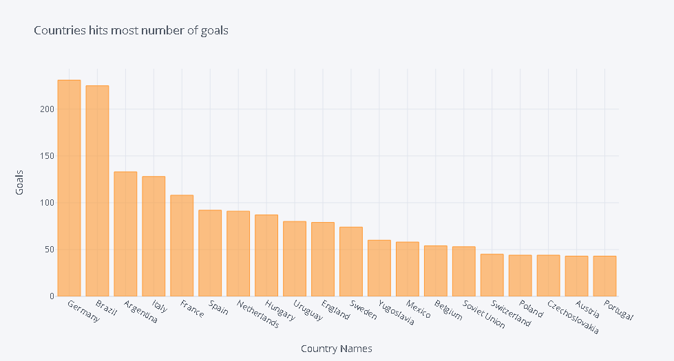
Top 5 countries who hits
most number of goals
1. Germany
2. Brazil
3. Argentina
4. Italy
5. France
How many number of goals per country?
Insight

Slide 8
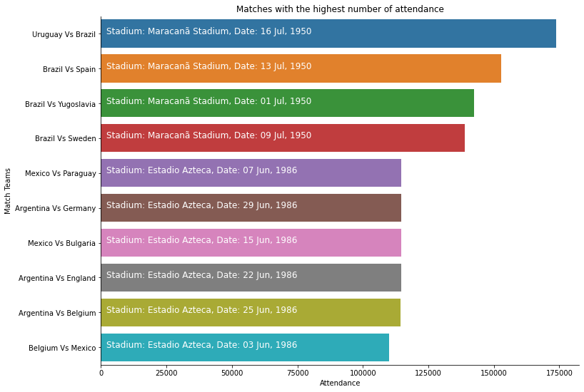
First top 4 matches with highest attendance
1950 tournament
Second top 4 matches with highest attendance
1986 tournament
Which matches has highest number of attendance?
Insight

Slide 9
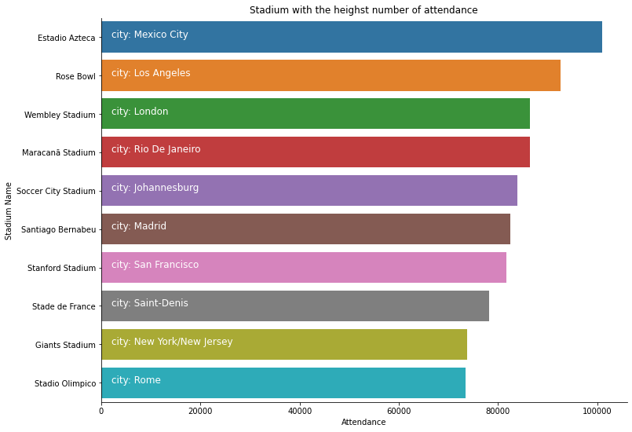
First 5 stadiums with highest attendance
1. Estadio Azteca
2. Rose Bowl
3. Wembley Stadium
4. Maracana Stadium
5. Soccer City Stadium
Which stadiums has highest average attendance?
Insight

Slide 10
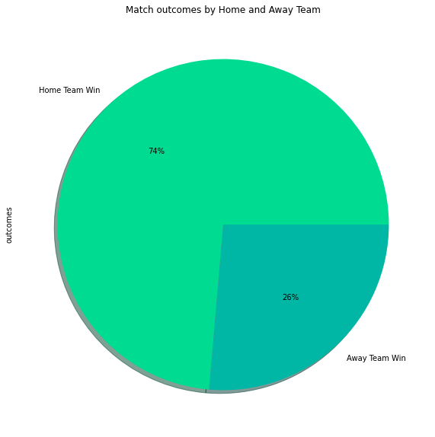
74% Home team wins
26% Away team wins
Insight
What is the percentage of win and lose when they play home and away places?

Slide 11
Summary
Analysis: Even if the number of goals scored by a team is taken to account for winning a match but not always true and there was a significant difference between the home team and the away team which means a country had approximately three times higher chances of winning the match when they played on their place than away.
Insights: Brazil followed by Germany and Italy was the nation who won the most and the 1950 tournament had the highest number of attendees followed by the 1986 one. Playing in their hometown had a significant difference when it came to winning a match.
Next step: This analysis is insightful, and I recommend moving forward with analyzing to find out what leads a country to win by including data related to winning conditions and some other factors like trainer, weather conditions, and number of attendees.

Slide 12
Reference
Wikipedia contributors. (2024, March 6). FIFA World Cup. Wikipedia. https://en.wikipedia.org/wiki/FIFA_World_Cup
FIFA World Cup. (2018, April 23). Kaggle. https://www.kaggle.com/datasets/abecklas/fifa-world-cup?select=WorldCups.csv
Thank you
Any question?

