Slide 1



sales_data_analysis
View in Power BI
Last data refresh:
16/01/2024 11:19:11 UTC
Downloaded at:
16/01/2024 11:21:04 UTC

Slide 2
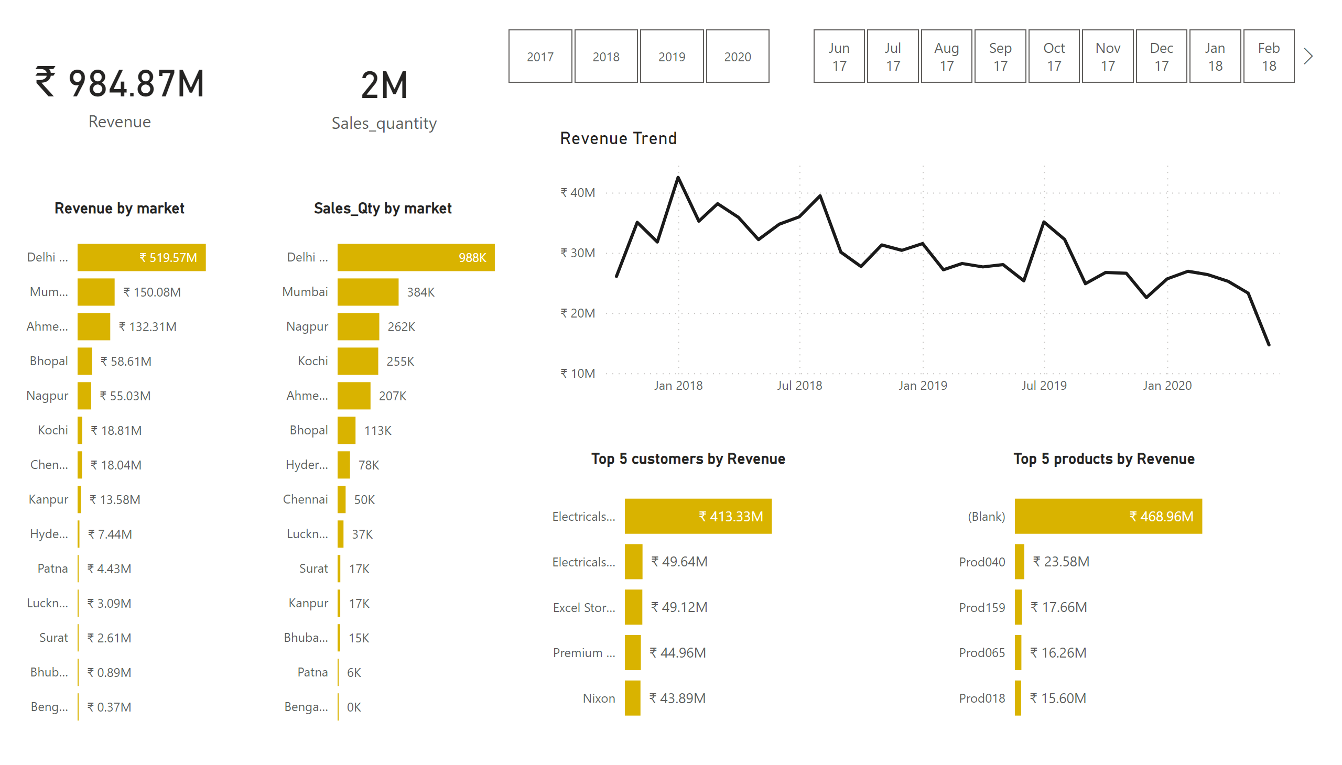
Main insights
Notes:
card
No alt text provided
card
No alt text provided
Revenue by market
No alt text provided
Sales_Qty by market
No alt text provided
slicer
No alt text provided
slicer
No alt text provided
Top 5 customers by Revenue
No alt text provided
Top 5 products by Revenue
No alt text provided
Revenue Trend
No alt text provided

Slide 3
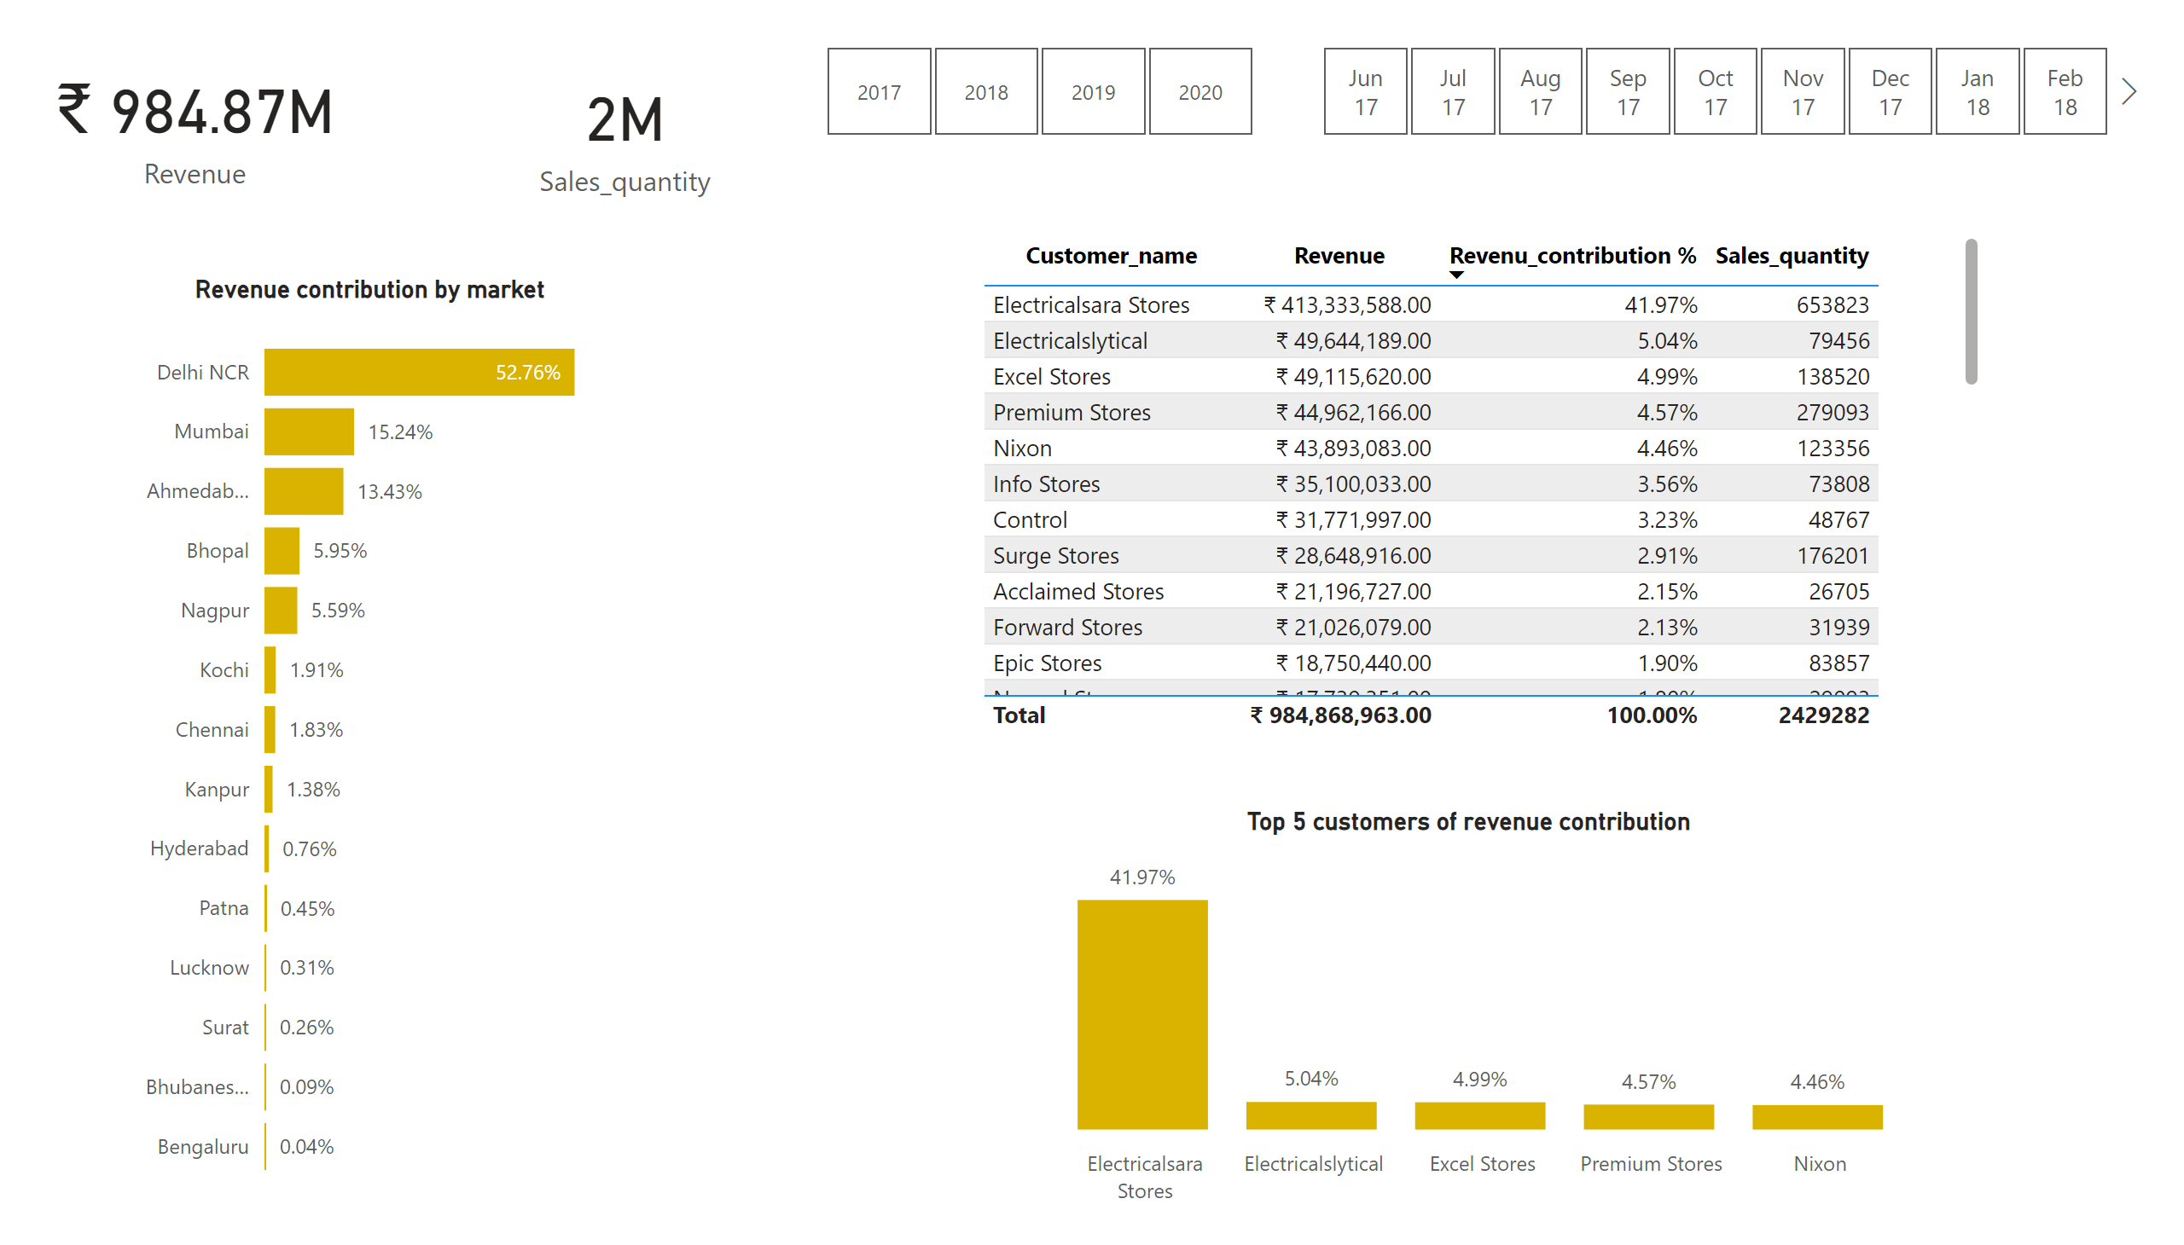
Revenue contribution analysis
Notes:
card
No alt text provided
card
No alt text provided
Revenue contribution by market
No alt text provided
slicer
No alt text provided
slicer
No alt text provided
Top 5 customers of revenue contribution
No alt text provided
Revenue Trend
No alt text provided

Slide 4
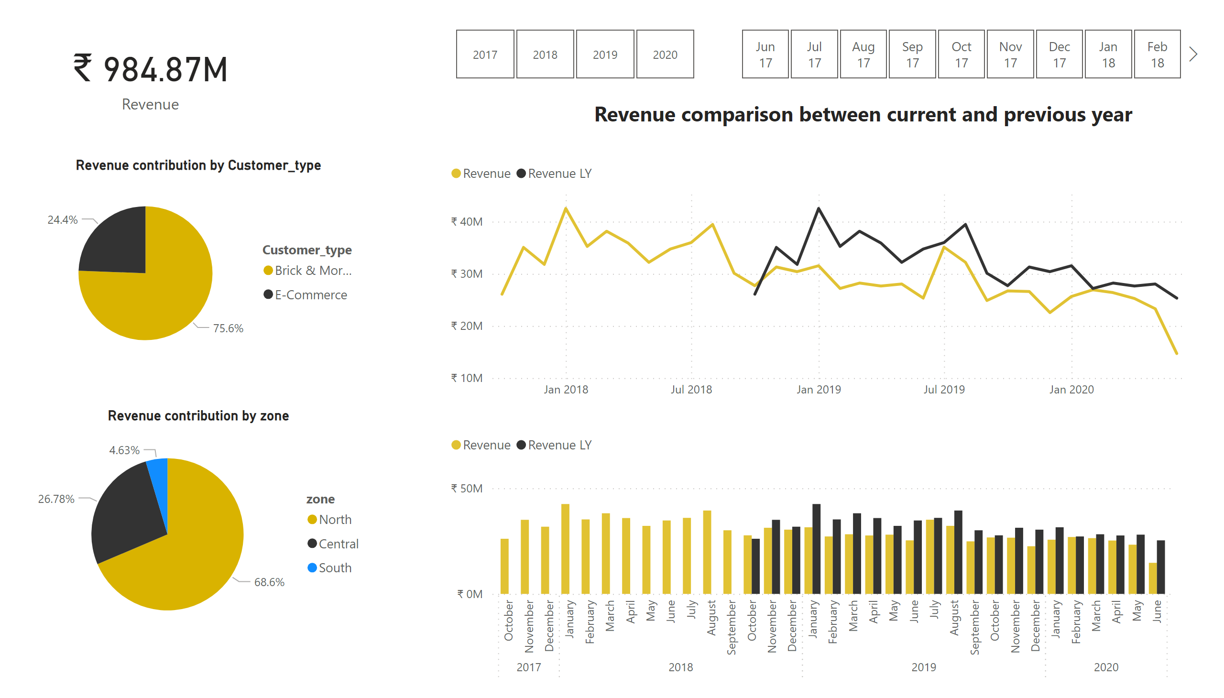
Performance analysis
Notes:
card
No alt text provided
Revenue contribution by zone
No alt text provided
slicer
No alt text provided
slicer
No alt text provided
Comparison between current and previous year revenue
No alt text provided
lineChart
No alt text provided
textbox
No alt text provided
Revenue contribution by Customer_type
No alt text provided

