Slide 1
Capstone – Acme startup Relocation
Frank Manja,
IBM Data Science Professional

Slide 2
Introduction/business problem
ACME Start is a Machine Learning (ML) startup in New York City that recently received Series A Funding in the amount of $20M USD.
ACME currently has 10 employees and is looking to grow to 20 employees by years end.
The startup has outgrown its current location and needs to relocate to accommodate current and future employees.

Slide 3
data
The Chief Executive Officer (CEO) is concerned that the relocation may result in staff attrition so the CEO asks the Human Resources (HR) Director to perform a survey of employees.
The survey asks employees to rank factors that the company will incorporate in the selection of the new location.
These factors include proximity to mass restaurants, parks, and gyms.
The HR Director will use these results of the survey and Foursquare location data to prepare a report of suitable locations for the relocation.

Slide 4
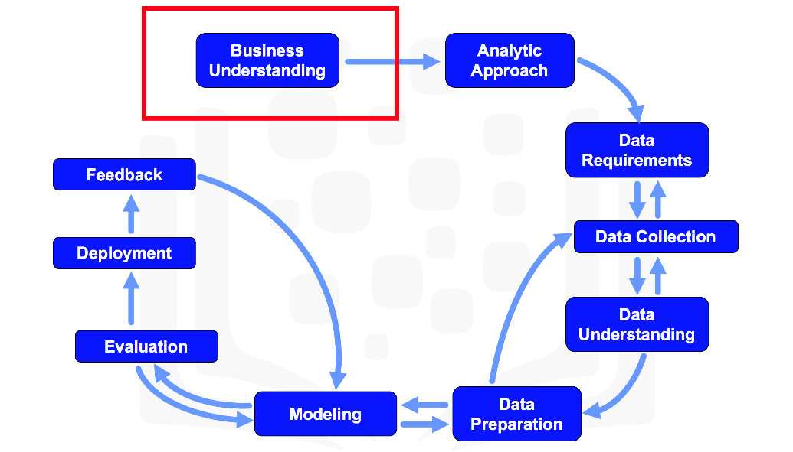
methodology

Slide 5
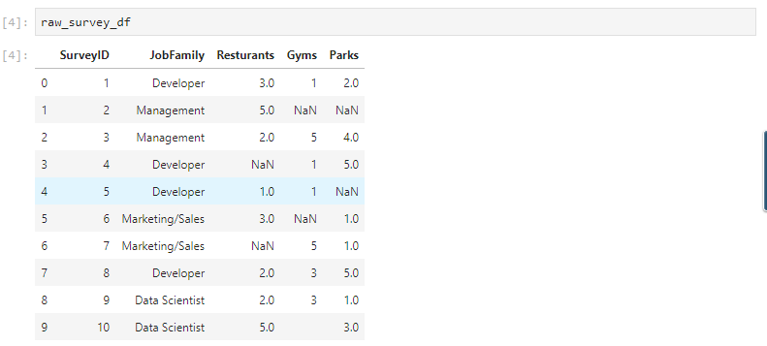
Raw uncleansed data
The raw survey contained ten records. One record for each employee in the startup.

Slide 6
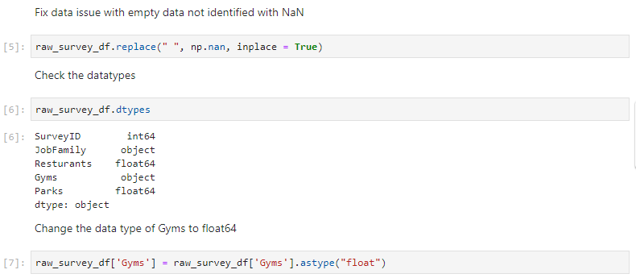
data exploration
As common in most surveys, the survey takers did not answer every question. The Data Science team worked to identify missing data and incorrect datatypes.

Slide 7
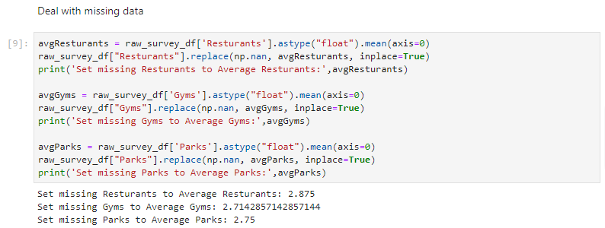
data cleansing
To deal with the missing data the Data Science team replaced missing data with the mean of values of available data.

Slide 8
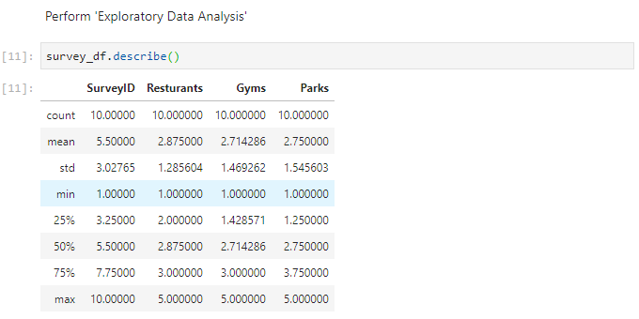
exploratory data analysis
The team performed exploratory data analysis on the survey.

Slide 9
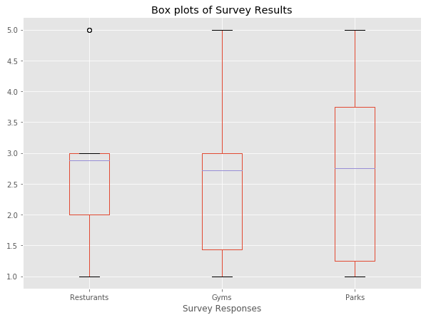
Data visualization - survey
The team visualize the survey data.

Slide 10
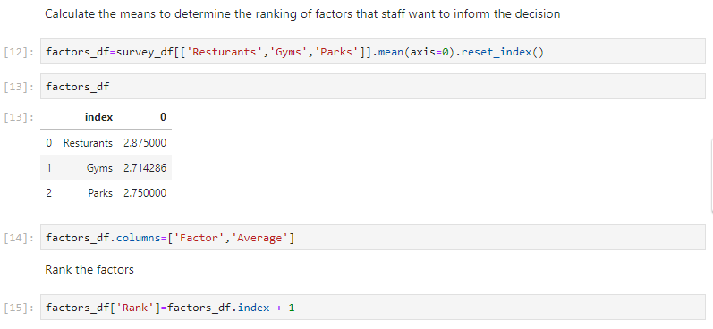
Data analysis - factors
The team calculated the means of survey factors to determine the ranking of location factors that staff want to inform the relocation decision.

Slide 11
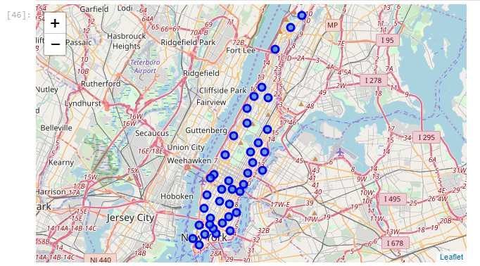
Data visualization -neighborhoods
The New York Neighborhood dataset has a total of 5 boroughs and 306 neighborhoods. A link to the dataset is at https://geo.nyu.edu/catalog/nyu_2451_34572.
The CEO decided to center the relocation search to neighborhoods in Manhattan.

Slide 12
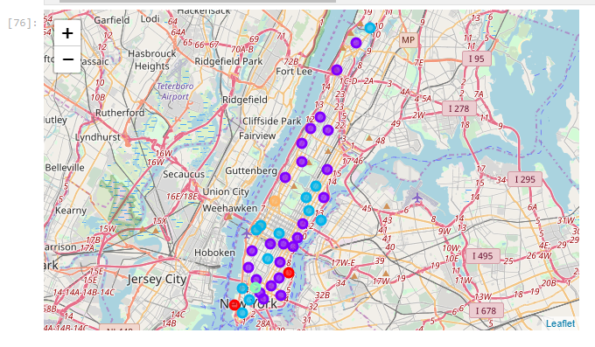
Data analysis – K-means clustering of neighborhoods
The Data Science team used K-means with K=5 to cluster the Manhattan neighborhoods using the employee factors.

Slide 13
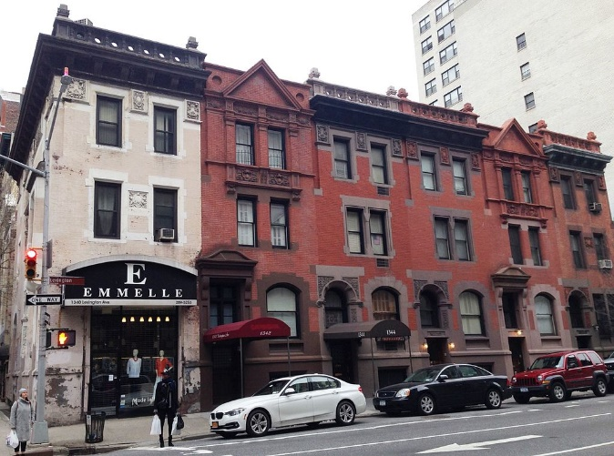
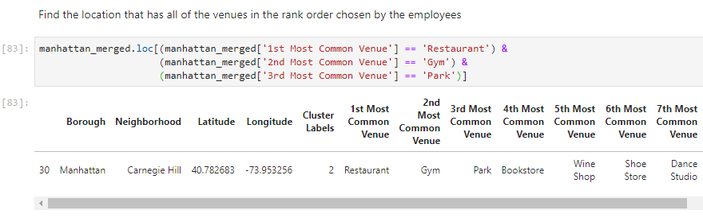
results
The Data Science team found the one location in all of Manhattan that had all the venues in the same rank order as the employees requested in the survey. That location was Carnegie Hill.

