Slide 1
DOSY
How to address
its difficulties
A practical walkthrough · 20 minutes
Ignacio Fernández
Francisco Manuel Arrabal-Campos
University of Almería · CIAIMBITAL / CIMEDES
Notes:
00:00–00:20 · 20 s
This is the story of turning a spectral series into a result we can explain and repeat. Before showing our software, we will examine the two obstacles that motivated its development: preparing the spectrometer properly and processing without changing diffusion information. We then use the tools in three concrete examples. Let us start with the whole route.
Sources:

Slide 2
Measuring, processing and checking DOSY
01
PREPARE THE MEASUREMENT
Calibration and parameter selection
02
UNDERSTAND THE DATA
Processing and inversion can be misleading
03
USE THE TOOLS
Our software and practical cases
04
CHECK THE RESULT
Documented successes and the next ultrafast step
02
Notes:
00:20–00:45 · 25 s
The workshop has four parts but tells one story. First, we need intensity that reflects diffusion and a correct b scale. We then need to preserve that intensity and understand why inversion has no unique answer. Only then will I show how our programs make the work more manageable, using saved examples that can be reviewed. The first operation is to calibrate the 90-degree pulse.
Sources:

Slide 3
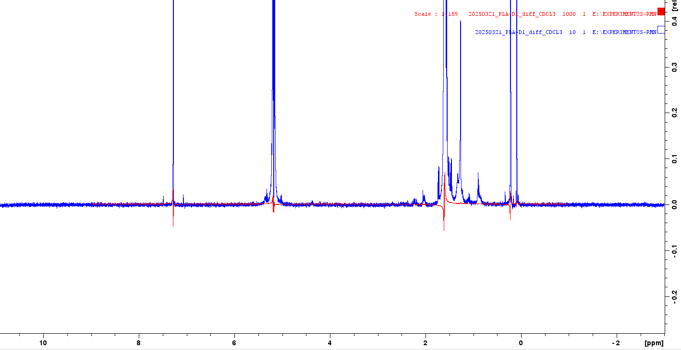
First difficulty: is this really a 90° pulse?
Fixed phase and power
p1 → zg → efp · fixed phase · first null → P1 / 2 → verify
Confusing 180° with 360° changes P90. Use sufficient D1 and fixed RG; inspect artefacts and coherences.
03
Notes:
00:45–01:35 · 50 s
Pulse length depends on the sample, tuning and power. Copying P1 from another preparation can lose signal and alter sequence behaviour. At fixed power, find the first positive-to-negative crossing after the maximum: the 180-degree null. Keep phase, gain and D1 fixed; separate automatic phasing would lose the sign. The sine curve is an ideal model explaining the procedure, not a new spectrometer measurement. Now we do this with your experiment 1000.
Sources:
PLA-D1 pulse calibration: user screenshots and saved experiments 1000 / 10
[local-source: 20250321_PLA-D1_diff_CDCL3]
Bruker TopSpin 3.6 Basic Experiments, pp.109-116; UCSB NMR pulse width calibration
https://nmr.chem.ucsb.edu/protocols/pw90cal.html
<TopSpin>/prog/docu/English/topspin/pdf/step_basic.pdf
Read-only audit of pulse calibration and sequence-dependent timing parameters
[local-source: parameters_pulse_evidence.json]

Slide 4
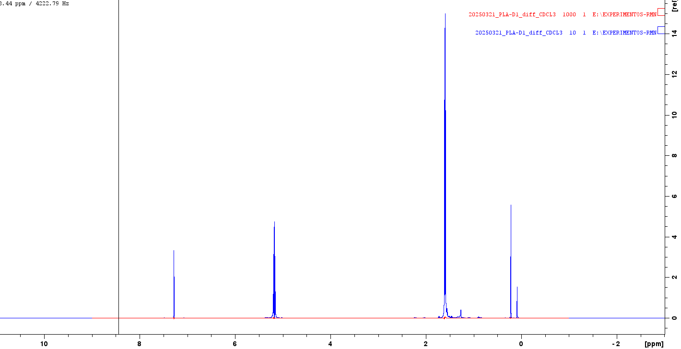
Case 1 · from 22 µs to P90 = 11 µs
EXPNO 1000 · zg
22 µs
÷ 2
P90 = 11 µs
User-identified 180° null. Blue: 90°. Different RG/NS in the screenshots: qualitative comparison.
04
Notes:
01:35–02:25 · 50 s
This is the actual PLA/CDCl3 example. In zg, experiment 1000, P1 is 22 microseconds at PLW1 of 22 watts; the user identifies this first null as 180 degrees. Halving it gives 11 microseconds. DOSY experiment 10 stores P1=11 and P2=22 at the same power. The practical result is a documented value transferable under the same conditions; verify the 90-degree maximum in zg before acquisition. Red and blue use different gain, scans and sequences, so this comparison is qualitative, not an absolute sensitivity-recovery measurement. We now have RF; next the diffusion axis needs a physical scale.
Sources:
PLA-D1 pulse calibration: user screenshots and saved experiments 1000 / 10
[local-source: 20250321_PLA-D1_diff_CDCL3]
Bruker TopSpin 3.6 Basic Experiments, pp.109-116; UCSB NMR pulse width calibration
https://nmr.chem.ucsb.edu/protocols/pw90cal.html
<TopSpin>/prog/docu/English/topspin/pdf/step_basic.pdf
Read-only audit of pulse calibration and sequence-dependent timing parameters
[local-source: parameters_pulse_evidence.json]
p1 evidence
[local-source: parameters_pulse_evidence.json]

Slide 5
Gradients: calibrate a scale that enters quadratically
HYPOTHETICAL ERROR EXAMPLE
G actual = 1.10 G used
Apparent D = 1.21 D
HDO / TBO
|slope| = 1.58627
Standard at actual T · fixed region · residuals · check a second ramp
G new = G previous √(D measured / Dref). TBO profile: Δ = 50 ms, δ = 1.20 ms, SMSQ10.100.
05
Notes:
02:25–03:45 · 80 s
Gradient scale enters b quadratically. In the hypothetical example, actual G ten percent above the value used gives apparent D twenty-one percent higher without spoiling the exponential. Calibrate using a reference ramp at actual temperature, uniform processing, a fixed region and a compatible sequence model. Inspect signed signal, residuals and drift rather than R squared alone. The retained experimental HDO/TBO example has slope 1.58627 at Delta=50 ms, delta=1.20 ms and SMSQ10.100. That historical profile uses point-height extraction, not the new helper integral. HDO value 1.902 times ten to the minus nine applies at 298.15 K; the actual ramp has a different temperature and uses a documented thermal approximation. With a compatible model, new G equals old G times the square root of measured D over reference D. We later replay the helper offline using integrals, retaining the two extractions separately without replacing protected calibration. A compatible equation is not a detail: it changes what b means.
Sources:
DiffAtOnce DOSY TopSpin console assistant
[local-source: README_ES.md]
TBO HDO experimental calibration, 4 September 2026
[local-source: TBO_HDO_20260904.json]
Calibración DOSY según la sonda, secuencia, gradiente, temperatura y referencia interna
[local-source: CALIBRACION_SONDA_SECUENCIA_GRADIENTE.md]
tbo calibration
[local-source: TBO_HDO_20260904.json]
tbo calculation
[local-source: calibracion_tbo.py]
topspin readme
[local-source: README_ES.md]
topspin verification
[local-source: VERIFICACION.txt]

Slide 6
The sequence determines what b means
R² = 1
D / 10⁻⁹ m² s⁻¹
SMSQ / bipolar: 1.000
PGSE: 0.802
Inspect sequence + shape + δ + RF gaps before fitting D
NOISELESS SIMULATION, fixed physical G and no recalibration. The fit checks the decay, not the b scale.
06
Notes:
03:45–04:30 · 45 s
Diffusion equations are not interchangeable. This simulation uses SMSQ-shaped bipolar gradients and fixed physical G. Its proper model gives D=1; rectangular PGSE gives approximately 0.802 with the same decay and R squared equal to one. Check pulse program, shape, units, total delta and RF gaps. In stebpgp1s1d, delta equals twice P30. A reference can absorb a constant b factor in an empirical calibration, but this does not justify transferring it across sequences or timings. Full equations remain in the appendix. Even with correct b, the ramp may lack sufficient information.
Sources:
Read-only comparison of the TBO software profile and acquired pulse program
[local-source: local_equation_audit.json]
D. Sinnaeve (2012), The Stejskal–Tanner Equation Generalized for Any Gradient Shape. Table 2, p.58; definitions pp.50–51
https://doi.org/10.1002/cmr.a.21223
[local-source: Mendeley] Reference Manager\userfiles\35ec08f9-3640-0c4b-0bcc-fe3f454aba96.pdf
TBO HDO experimental calibration, 4 September 2026
[local-source: TBO_HDO_20260904.json]
Ghent University repository — Sinnaeve 2012
https://biblio.ugent.be/publication/2109280

Slide 7
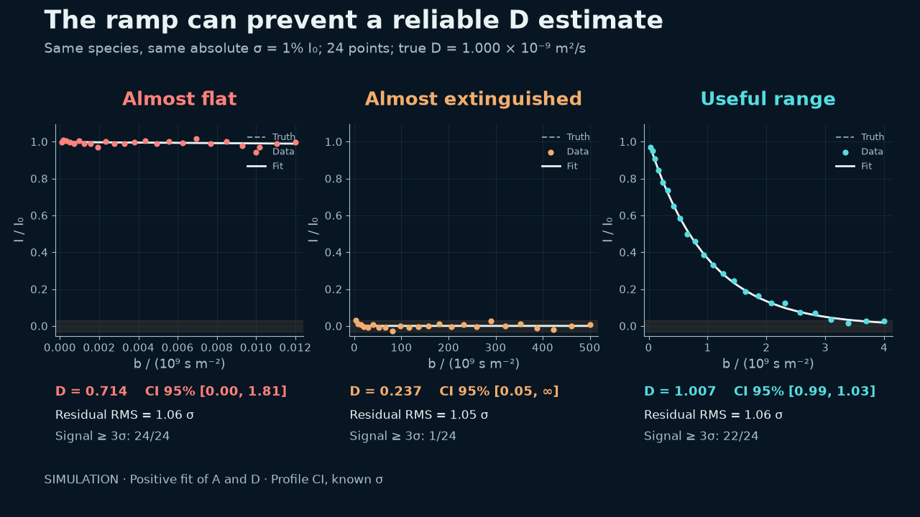
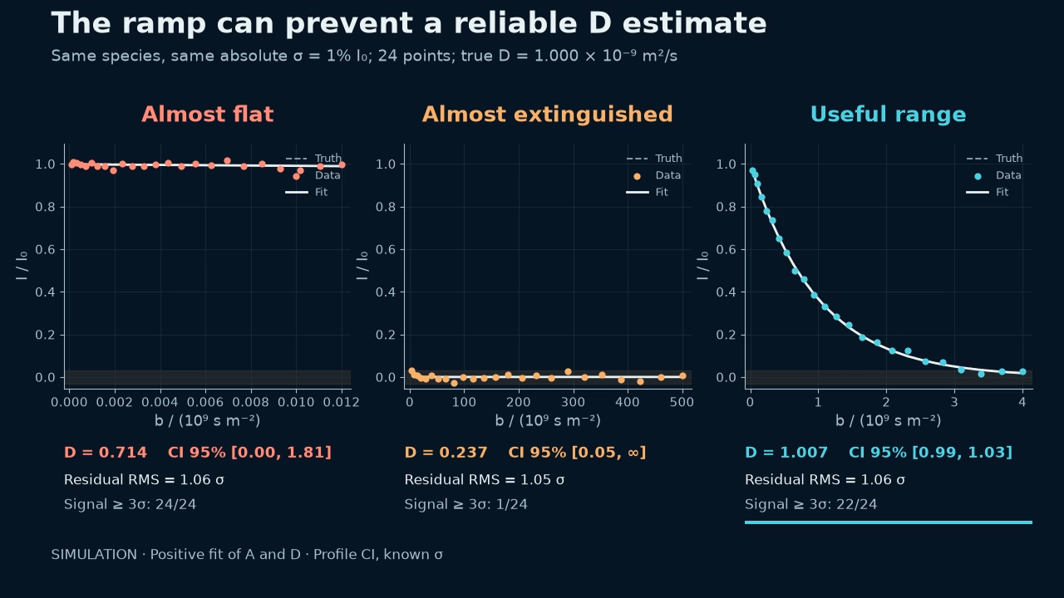
Notes:
04:30–05:30 · 60 s
The three simulated ramps have the same true D of one times ten to the minus nine and one-percent absolute noise. The nearly flat ramp estimates 0.714 with a nominal interval from zero to 1.81. The extinguished ramp estimates 0.237 with an interval from 0.05 to an unidentifiable upper endpoint. The useful ramp estimates 1.007 with an interval from 0.986 to 1.029. Residuals are similar, around one sigma. Acquisition information, not fit appearance, has changed. These intervals are conditional on the simulation model and known noise, not universal limits. Repeat the pilot with different P30/D20 or sensitivity, rather than ask an algorithm for information absent from the data. That is why we choose P30 and D20 from a pilot.
Sources:
P30/D20 teaching simulation and fixed-noise model
[local-source: parameter_simulation_model.json]
Generador configurable de rampas DOSY para TopSpin
[local-source: README.md]
V6 controlled ramp and preprocessing simulations
[local-source: problem_simulations.json]

Slide 8
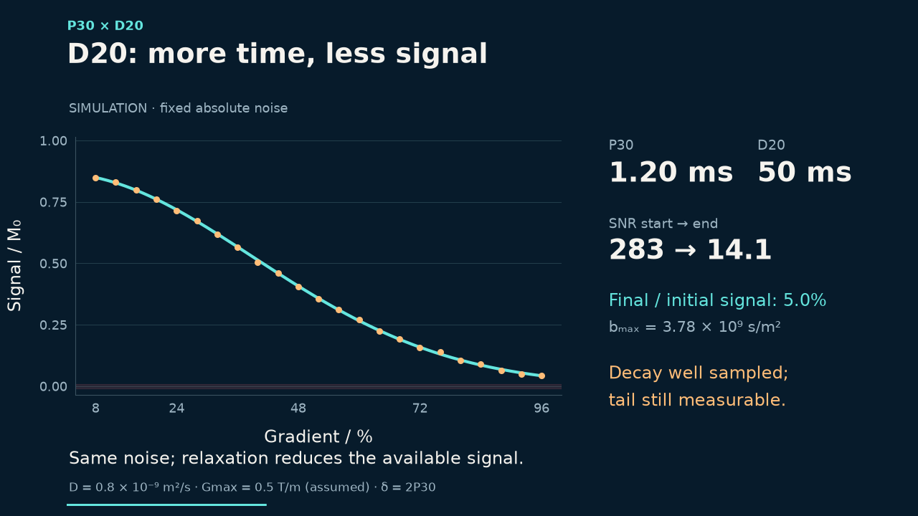
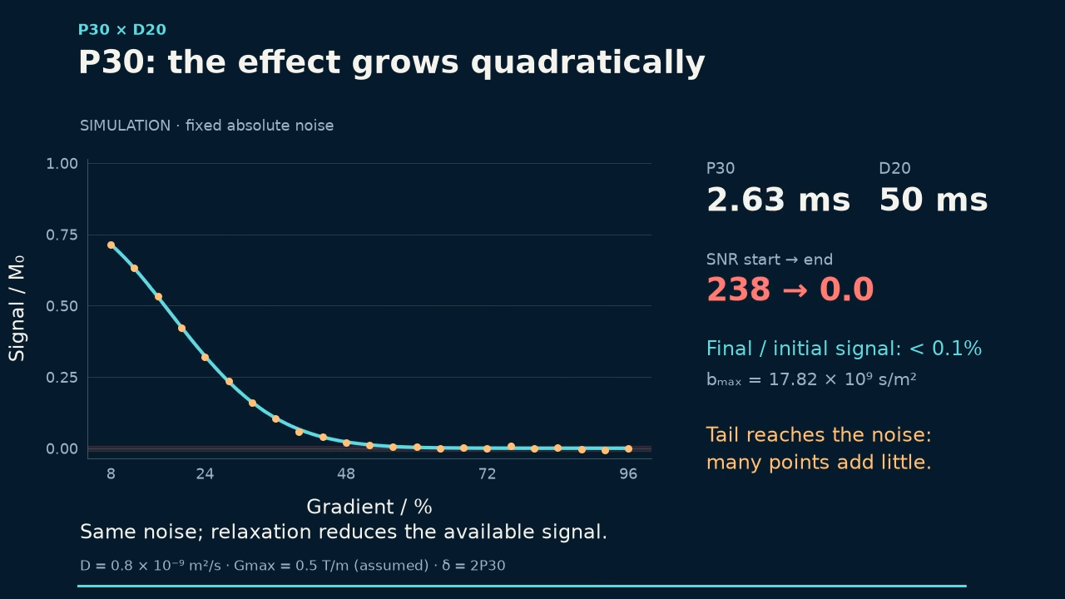
Notes:
05:30–06:40 · 70 s
We do not enter P30 and D20 simply because they worked for a previous sample. Low-, medium- and high-gradient pilots show attenuation of fast and slow signals. Increasing delta or Delta adds diffusion weighting but costs relaxation and sensitivity; Delta also increases exposure to motion, exchange and other dynamics. The animation separates normalized attenuation from absolute signal and uses hypothetical relaxation times; it does not prescribe limits for the real probe. Keep power, temperature and treatment comparable and seek appreciable decay with points remaining above noise. Recovery delays need their own checks too.
Sources:
Read-only audit of pulse calibration and sequence-dependent timing parameters
[local-source: parameters_pulse_evidence.json]
P30/D20 teaching simulation and fixed-noise model
[local-source: parameter_simulation_model.json]

Slide 9
LED and double STE: recover signal without copying delays
Sequence | Relevant delay | Problem to control
ledbpgp2s / 1d | LED = D21 | Eddy-current recovery
dstebpgp3s / 1d | D20 total · D21 LED | Convection / more RF / sensitivity loss
diffSteLED | D5 ≠ LED · LED = D19 | D5: remaining diffusion interval
Double STE: δ = 2P30 · 8 lobes · NS = 16×n
Read the acquired pulseprogram and its constraints before copying parameters
Inspect D1, D16, P19 and DELTA1. Convection compensation has limits and a signal cost.
09
Notes:
06:40–07:35 · 55 s
The next problem is phase and line shape after gradients. LED permits recovery but also costs time and signal. LED is D21 and D5 is unused in ledbpgp2s and dstebpgp3s; in diffSteLED, LED is D19 and D5 is the remaining diffusion interval. For double STE, check two DELTA1 blocks, eight lobes, additional RF pulses and the sixteen-step phase cycle. Convection compensation covers a motion model, not every flow. Three comparable Delta values and temperature controls help investigate Delta-dependent D, but do not identify the cause alone. There is no universal optimizer for these delays. We also repeat different Delta values to look beyond one ramp fit.
Sources:
Read-only audit of pulse calibration and sequence-dependent timing parameters
[local-source: parameters_pulse_evidence.json]
D. Sinnaeve (2012), The Stejskal–Tanner Equation Generalized for Any Gradient Shape. Table 2, p.58; definitions pp.50–51
https://doi.org/10.1002/cmr.a.21223
[local-source: Mendeley] Reference Manager\userfiles\35ec08f9-3640-0c4b-0bcc-fe3f454aba96.pdf

Slide 10
Changing Δ helps reveal that diffusion is not the only process
Δ ↑
Apparent D ↑
Convection
Exchange
Restricted diffusion
Compare three Δ values, T and ramp-specific amplitudes; check the standard
SIMULATION: Gaussian velocities, σv = 100 µm/s, narrow pulses. The cause needs additional evidence.
10
Notes:
07:35–08:10 · 35 s
SPOKEN ROUTE (35 s):
If D changes with Delta, diffusion may not be the only cause of attenuation. The simulation shows dispersed velocities: apparent D increases while true D is constant, and the fit remains excellent. This observation alone does not diagnose convection; inspect temperature, amplitudes and the reference, and consider exchange or restriction. Three Delta values help define the next check.
CONSULTATION DETAILS (do not read during the talk):
In this idealized simulation, Gaussian velocity dispersion of 100 micrometres per second makes apparent D increase from 1.05 to 1.30 and 1.55 as Delta increases from 50 to 100 and 150 ms while true D remains 0.8. The exponential still fits perfectly. This follows from a narrow-pulse model with velocities constant during each encoding, not a universal convection law or the exact acquired pulse program. Experimental Delta dependence can have several causes. Inspect temperature, ramp-specific amplitudes and reference controls before attributing it to convection. After instrument preparation, the second difficulty begins: processing.
Sources:
Idealised velocity-distribution attenuation and Delta dependence
[local-source: convection_idealized_model.json]
prime readme
[local-source: README.md]
Read-only audit of pulse calibration and sequence-dependent timing parameters
[local-source: parameters_pulse_evidence.json]
Williamson et al. (2020), Limits to flow detection in phase contrast MRI
https://pmc.ncbi.nlm.nih.gov/articles/PMC7745993/
Gottwald et al. (2003), Separation of velocity distribution and diffusion using PFG NMR
https://pubmed.ncbi.nlm.nih.gov/12810021/

Slide 11
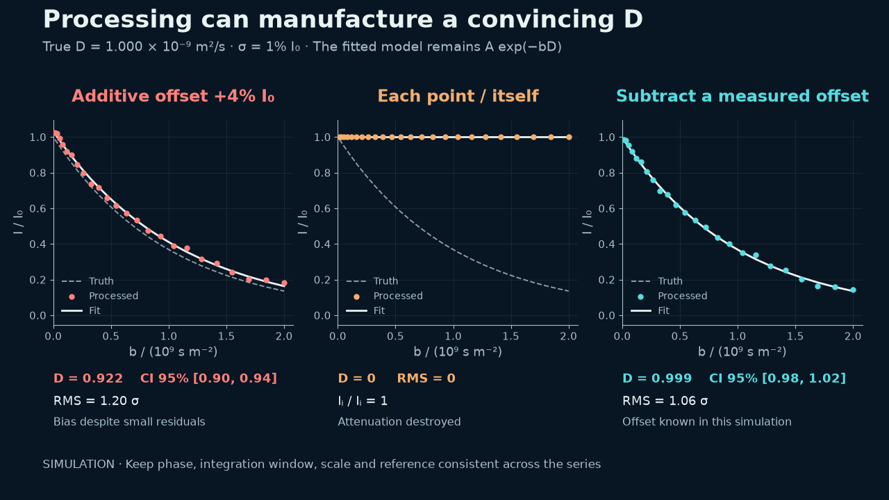
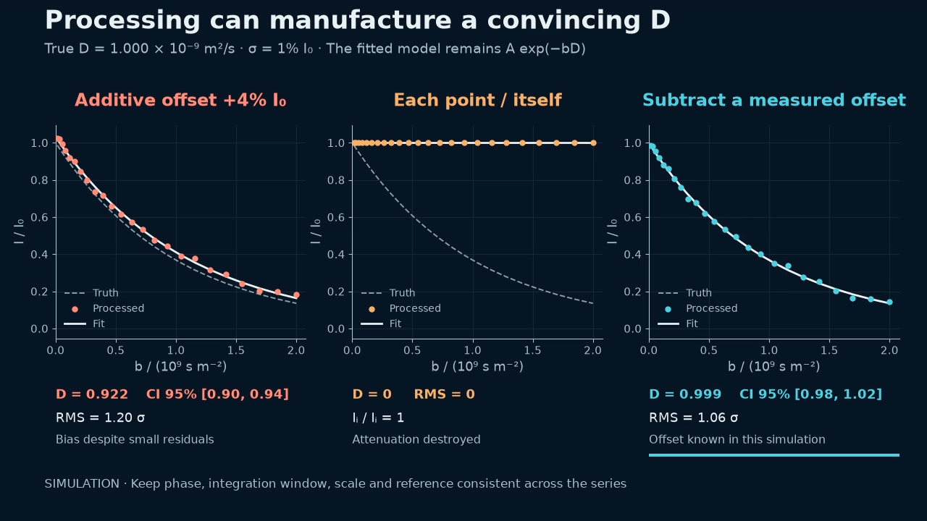
Notes:
08:10–09:10 · 60 s
A DOSY series is not a collection of independent spectra optimized for appearance. Phase, baseline, ppm axis, gain, scans and NC_PROC scaling must permit intensity comparison. In the simulation, a background of just four percent of the first point changes D from one to 0.922 without conspicuous residual failure. Removing the known background recovers 0.999. Normalizing each spectrum by its own signal destroys attenuation and gives artificial D=0. In experiments, background is not known by decree: inspect signal-free regions, overlays and peak shifts. If a signal moves outside the window, extraction is no longer measuring diffusion alone. Correct processing on a derived copy while retaining originals. With comparable intensities, we still need to decide what information can be reconstructed.
Sources:
V6 controlled ramp and preprocessing simulations
[local-source: problem_simulations.json]
prime guide
[local-source: GUIA_PRIME.md]
V6 audit of software actions, observable checks and limitations
[local-source: solutions_mapping.json]

Slide 12
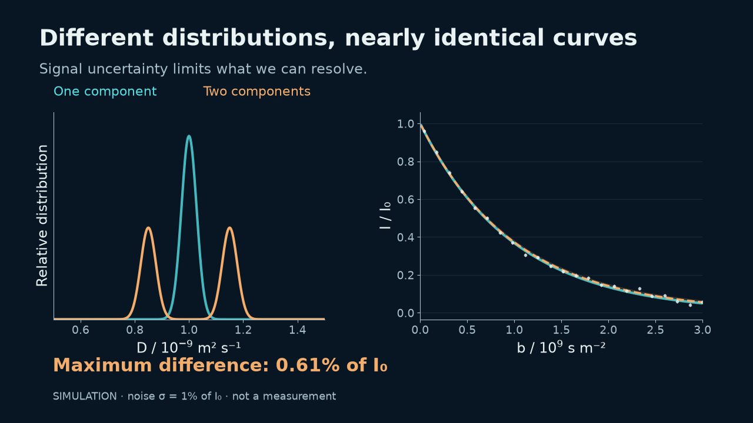

Notes:
09:10–10:20 · 70 s
This is the central difficulty of ILT. A narrow distribution and two nearby components produce curves differing by at most about 0.61 percent of the first point in this design; simulated noise has one-percent sigma. This is not a universal impossibility proof, but shows how easily requested resolution exceeds acquisition support. Inverting the Laplace kernel amplifies noise along weak directions. The useful question is not which algorithm draws two peaks, but whether data, repetition and controls support two diffusion behaviours. We need an explicit preference and a way to check its effect.
Sources:
Reproducible v5 ILT ambiguity and regularization simulations
[local-source: ilt_simulations.json]

Slide 13
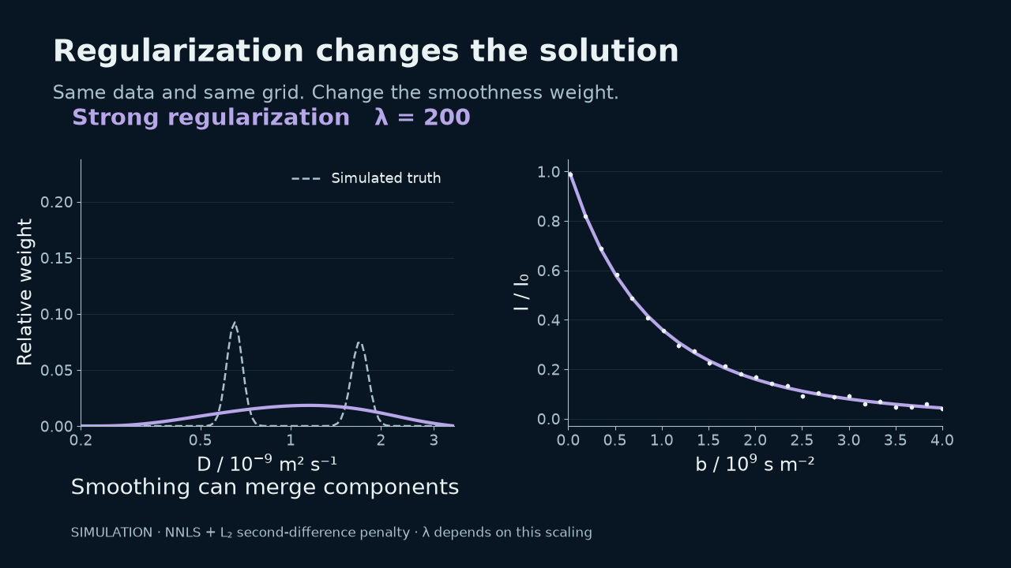
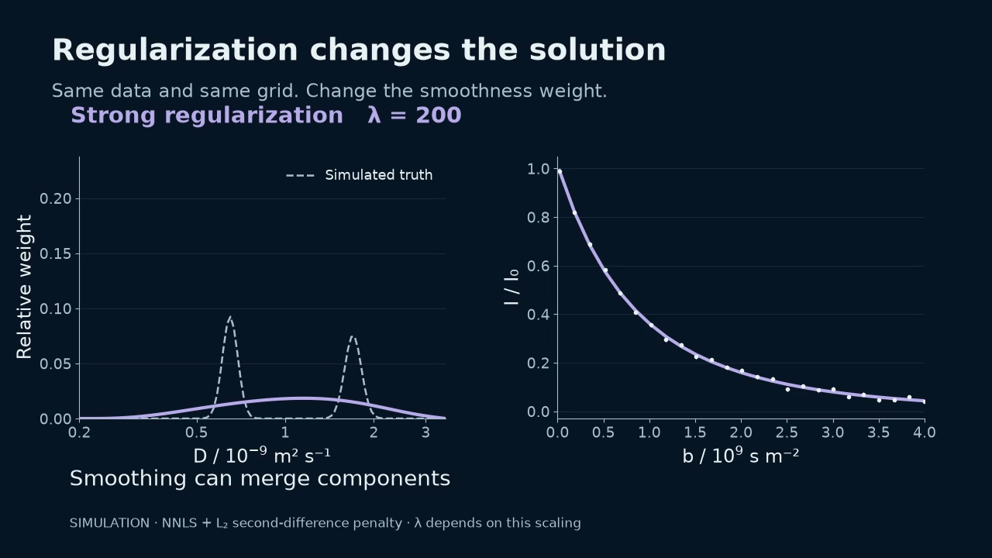
Notes:
10:20–11:15 · 55 s
Regularization stabilizes inversion by imposing a preference. In this computed simulation, three lambda values give RMS residuals around 0.00833, 0.00834 and 0.00842 while producing spiky, moderate or excessively broad solutions. Do not choose using an isolated minimum residual. Start with a minimal model for a simple signal; compare smoothness or entropy for broad distributions, sparsity or model order for few components, and shared structure for overlap. NNLS, Tikhonov, MaxEnt/PALMA, L1/ITAMeD, VP/SCORE and MF/TRAIn-MF/SILT embody different assumptions. SVD, FISTA and ADMM are numerical engines, not evidence of species. The uses-and-limits catalogue remains reference material rather than interrupting the story. We do not always need to solve every frequency independently.
Sources:
Reproducible v5 ILT ambiguity and regularization simulations
[local-source: ilt_simulations.json]
ILT method-choice and appendix guidance
[local-source: ilt_teaching_guidance.json]

Slide 14
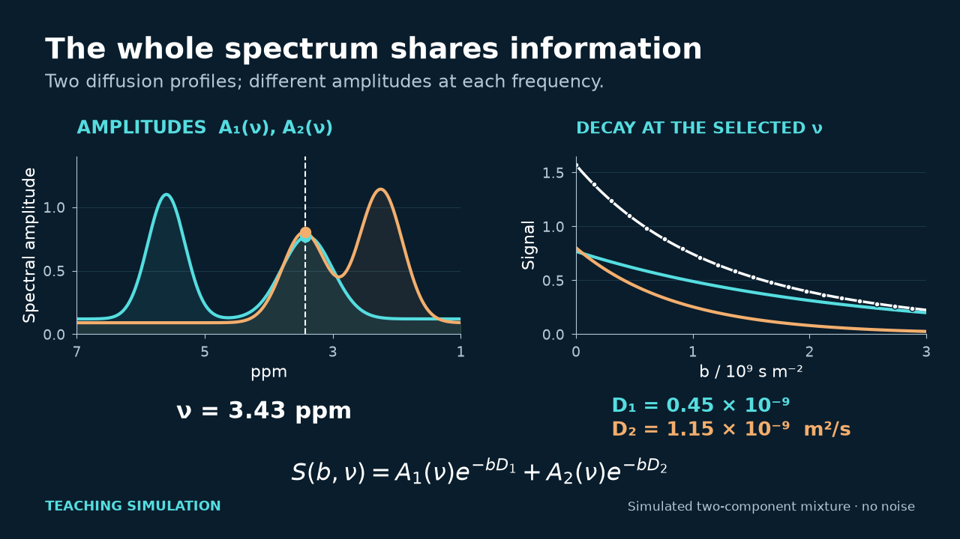
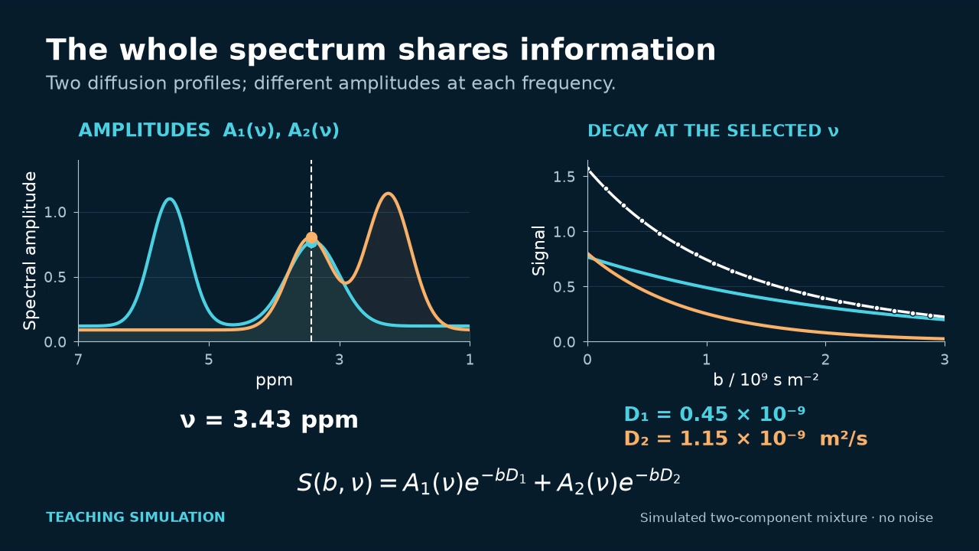
Notes:
11:15–11:50 · 35 s
Several signals can share diffusion profiles with different amplitudes. A joint calculation uses that redundancy: a strong region can help a weak one. We do not impose one D on the whole spectrum. MF and TRAIn-MF share factors, while per-bin TRAIn provides an independent comparison. This movie is conceptual, without added noise. Correlation establishes neither interaction nor chemical identity, and rank is not a molecule count. We will keep the local decay visible while working with the map. We can now explain why we developed our tools.
Sources:
Native signed TRAIn-MF and rank selection
ILT method-choice and appendix guidance
[local-source: ilt_teaching_guidance.json]
Audited bilingual catalogue of local inversion methods and context families
[local-source: ilt_algorithm_catalog_bilingual.json]
University of Manchester NMR — Multivariate DOSY
https://www.nmr.chemistry.manchester.ac.uk/?q=node%2F26

Slide 15
The work our programs help us handle
We know what needs to be checked.
Now we put it into practice with our tools:
prepare, analyse and preserve the result.
Ramp and calibration
One signal and the whole spectrum
Sample series and controls
These are the problems we developed our tools to address.
15
Notes:
11:50–12:10 · 20 s
SPOKEN ROUTE (20 s):
We now understand the obstacles and how to review them. This is why we developed the programs: prepare without transcription, preserve the measurement, analyse a signal or a spectrum, and check the result. Each case starts with an input, performs an operation and retains its output.
CONSULTATION DETAILS (do not read during the talk):
These programs were developed for precisely these obstacles. They automate preparation, reading and comparison while retaining steps needing review. The concrete advantages are less transcription, traceable calibration, progression from one decay to a spectrum and controls alongside the result. A tool cannot rescue an uninformative ramp or replace calibration. Each program addresses a concrete task along the route.
Sources:

Slide 16
Our programs and their functions
Tool | Input | What it provides
TopSpin · xpy | Template and 1D series | Prepare ramps and integrate the standard
DiffAtOnce Prime | Processed Bruker series | Local decay, map and diagnostics
ResinAtOnce | Resin / polymer series | Guided workflow, references and export
DALTAIL · MATLAB | Data and saved configuration | Process batches and reproduce tables
The next cases show the input, the operations and the result.
16
Notes:
12:10–12:45 · 35 s
SPOKEN ROUTE (35 s):
The TopSpin helper prepares ramps and records calibration. Prime lets us explore one signal, a map and diagnostics. ResinAtOnce guides resin/polymer analysis, separating references from conditional results. DALTAIL runs MATLAB/Python batches and reproduces tables from saved settings. These are workflow tools; TRAIn, MF and SILT are engines they use. Let us see the work they save and the output they retain.
CONSULTATION DETAILS (do not read during the talk):
The TopSpin helper prepares ramps and calibrates a reference signal in the console. Prime brings together general DOSY analysis: local signal, whole spectrum, methods and checks. ResinAtOnce organizes resin/polymer samples and ramps, separates references and presents D, Rh and apparent mass with assumptions. DALTAIL is the reproducible MATLAB/Python batch route, sharing functions and saving tables, factors and diagnostics. These are products and workflows, not four new ILT algorithms: TRAIn, MF, SILT and RAI-S are engines within the analysis. We now follow cases showing the work addressed at each stage. First we return to HDO calibration.
Sources:
V6 audit of software actions, observable checks and limitations
[local-source: solutions_mapping.json]
prime readme
[local-source: README.md]
prime guide
[local-source: GUIA_PRIME.md]
Read-only audit of pulse calibration and sequence-dependent timing parameters
[local-source: parameters_pulse_evidence.json]

Slide 17
TopSpin: an HDO calibration report
xpy dosy_workshop.py
REAL HDO · OFFLINE REPLAY
1 Select the series and a fixed region
2 Integrate and provide Dref(T)
3 Review the fit and save the proposal
R² = 0.999775
ΔTE = 0.77 K
Configured limit: 0.50 K
The program detects drift: stabilize and repeat before calibrating
Offline replay. Illustrative candidate at 0.80 K; the usual 0.50 K limit rejects the series.
17
Notes:
12:45–13:50 · 65 s
SPOKEN ROUTE (65 s):
Select HDO series 10 through 32 and a fixed 4.5–4.9 ppm window. The helper integrates, fits and reports. Offline replay gives R squared of 0.99977, but detects 0.77 K temperature drift above the 0.5 K limit and warns about varying phase and dummy scans. Success is preventing an attractive fit from being mistaken for accepted calibration. The illustrative integral candidate does not replace historical height-based calibration. Review, stabilize and repeat; the instrument remains unchanged.
CONSULTATION DETAILS (do not read during the talk):
Open xpy dosy_workshop.py and Calibrate from 1D series. Enter experiments 10 through 32, window 4.5 to 4.9 ppm, the HDO reference and documented reference D. The helper integrates signed areas and checks metadata before accepting a fit. We show an offline replay on actual experimental data: its candidate has slope 1.55703 and R squared of 0.99977, but the default thermal review rejects the ramp because recorded TE spans 0.77 K, above the 0.5 K tolerance. It also detects varying phase and DS. The tolerance was explicitly raised to 0.8 K to produce an illustrative report; that is not calibration acceptance. Success is turning a reassuring-looking fit into a traceable decision. The report retains input, integral, residuals, warnings and a scale proposal. The protected historical profile uses point height and slope 1.58627; it is not replaced or confused with this integral. This is neither a new 3.6.4 console run nor an instrument-constant update. Stabilize temperature and review phase and preparation before using the candidate as calibration. The same console removes manual transcription of three ramps.
Sources:
DiffAtOnce DOSY TopSpin console assistant
[local-source: README_ES.md]
V6 audit of software actions, observable checks and limitations
[local-source: solutions_mapping.json]
prime readme
[local-source: README.md]
prime guide
[local-source: GUIA_PRIME.md]
Read-only audit of pulse calibration and sequence-dependent timing parameters
[local-source: parameters_pulse_evidence.json]
HDO signed-area offline calibration summary
[local-source: summary.json]
HDO signed-area candidate with thermal rejection
[local-source: calibracion_integral_offline.json]
HDO signed-area extracted attenuation
[local-source: atenuacion_integral_residuos.csv]
HDO offline calibration report
[local-source: informe_integral_offline.html]
integral replay summary
[local-source: summary.json]
integral replay result
[local-source: calibracion_integral_offline.json]
integral replay csv
[local-source: atenuacion_integral_residuos.csv]
integral replay script
[local-source: replay_integral_calibration.py]
integral replay spectrum
[local-source: HDO_spectral_inspection.png]
topspin calibration source
[local-source: dosy_calibration.py]
topspin console source
[local-source: dosy_console_ui.py]
tbo calibration
[local-source: TBO_HDO_20260904.json]

Slide 18
TopSpin: three ramps with configurable Δ
xpy dosy_workshop.py
Configurable example | D20 / s | EXPNO
Δ 50 ms | 0.050 | 100–122
Δ 100 ms | 0.100 | 200–222
Δ 150 ms | 0.150 | 300–322
Same template · fixed P30 · complete gradient list · integrate the standard
The assistant prepares parameters and calibrates from the 1D series. Check destinations, units and limits before acquisition.
18
Notes:
13:50–14:35 · 45 s
SPOKEN ROUTE (45 s):
Start from a reviewed template and choose three configurable Delta values. The example uses 50, 100 and 150 ms, fixed P30 and 23 gradients from 8 to 96 percent. That is 69 destinations without transcription. Inspect the plan and collisions before creation; retain CSV and JSON. Prepare in the console or export a macro/Python plan. This demonstrates preparation, not a new acquisition.
CONSULTATION DETAILS (do not read during the talk):
Start with a reviewed template. Define three Delta values, shown as editable examples of 50, 100 and 150 ms, and GPZ6 from 8 to 96 in increments of four. That is 23 points per ramp, 69 experiments, with configurable destinations. Before creation, inspect the plan, ms-to-s units and experiment collisions. The program preserves P30, inherits the template, saves the plan and returns to the open experiment. It does not acquire or decide probe limits. The same generator can export macros or prepare through Python. This demonstration succeeds in producing a coherent, auditable plan without repetitive transcription; it is not a new acquisition of 69 spectra. With acquired, consistently processed data, we open Prime.
Sources:
DiffAtOnce DOSY TopSpin console assistant
[local-source: README_ES.md]
V6 audit of software actions, observable checks and limitations
[local-source: solutions_mapping.json]
prime readme
[local-source: README.md]
prime guide
[local-source: GUIA_PRIME.md]
Read-only audit of pulse calibration and sequence-dependent timing parameters
[local-source: parameters_pulse_evidence.json]
topspin readme
[local-source: README_ES.md]
topspin verification
[local-source: VERIFICACION.txt]
topspin console source
[local-source: dosy_console_ui.py]

Slide 19
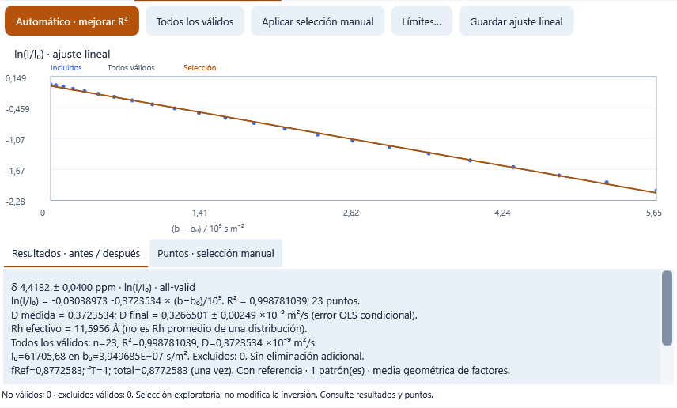
Prime: fit a real signal before the map
1 Open the series
2 Fix the region
3 Fit and review
D final = 0.3267
Result saved with its points, calibration and corrections
TP194 · 4.4182 ± 0.04 ppm · 23 points, 0 excluded · D / 10⁻⁹ m² s⁻¹, conditional on calibration and model.
19
Notes:
14:35–15:30 · 55 s
For TP194, select 4.4182 plus/minus 0.04 ppm. Prime displays signed extraction and all 23 points with no exclusions, giving final D around 0.327 times ten to the minus nine. This is a local monoexponential fit, different from the distribution peak we will see at another region. First inspect all points, tail and residuals; compare methods when information supports it. The panel signed point mean is not the calibrator trapezoidal integral. The saved result retains parameters and calibration: measured D=0.3723534, reference factor=0.8772583, temperature factor=1 and final D=0.3266501. Displayed OLS error=0.00249 is conditional rather than total uncertainty. Success is moving from a spectrum to a traceable, reviewable decay, not identifying a molecule from R squared or optimizing by excluding points. Another difficulty appears when two routes draw different distributions for the same point.
Sources:
prime guide
[local-source: GUIA_PRIME.md]
prime readme
[local-source: README.md]
V6 audit of software actions, observable checks and limitations
[local-source: solutions_mapping.json]
Read-only audit of pulse calibration and sequence-dependent timing parameters
[local-source: parameters_pulse_evidence.json]

Slide 20
Prime and ResinAtOnce: consistency between signal and map
Ramp / EXPNO | Local peak D | Map peak D | Shape difference
10:32 | 0.3270 | 0.3270 | 0.0 %
33:55 | 0.3426 | 0.3426 | 0.0 %
56:78 | 0.3806 | 0.3806 | 0.0 %
TP194 · ≈7.736 ppm · 2048-point D grid
Before: 84.87% shape difference between the local TRAIn signal and the MF map
The same extraction, grid, algorithm and calibration in both paths
D / 10⁻⁹ m² s⁻¹ · internal check on real data. Agreement does not establish species identity.
20
Notes:
15:30–16:30 · 60 s
SPOKEN ROUTE (60 s):
At about 7.736 ppm in TP194, the old map and local curve appeared to have similar means but very different distributions. The solution was identical extraction, a 2048-point grid and TRAIn protocol rather than factor changes to force agreement. Peak positions and shapes now match between routes in all three ramps, as the table shows. This succeeds in analysis consistency on real data. Differences across ramps remain visible; numerical agreement neither identifies molecules nor establishes absolute accuracy.
CONSULTATION DETAILS (do not read during the talk):
We now use a different TP194 experimental point, around 7.736 ppm. In the archived comparison, the old map had peak D=0.2982 and mean D=0.3673; the mean looked close to the local route, but normalized shape difference was 84.87 percent. The solution was not to modify factors to force agreement. With identical extraction, a 2048-point grid and TRAIn protocol, local and map routes agree numerically in all three documented ramps. Their peaks are 0.3270, 0.3426 and 0.3806 times ten to the minus nine; between-route shape difference is zero. Success is removing a numerical analysis inconsistency and detecting when another route needs review. Differences across ramps remain visible; route agreement neither establishes chemical identity nor validates absolute D. A 256-bin screenshot has other values and must not be mixed with the 2048-point table. ResinAtOnce and DALTAIL extend that care to the entire batch.
Sources:
ILT method-choice and appendix guidance
[local-source: ilt_teaching_guidance.json]
Read-only comparison of the TBO software profile and acquired pulse program
[local-source: local_equation_audit.json]
prime guide
[local-source: GUIA_PRIME.md]
V6 audit of software actions, observable checks and limitations
[local-source: solutions_mapping.json]
prime readme
[local-source: README.md]
Read-only audit of pulse calibration and sequence-dependent timing parameters
[local-source: parameters_pulse_evidence.json]
local coherence doc
[local-source: DOSY_COHERENCIA_0.46.0.md]
tp194 parity
[local-source: real-tp194-parity.json]
local signal screenshot
[local-source: resin-local-signal.png]
local signal ui check
[local-source: local-signal-ui.json]

Slide 21
DALTAIL: a reproducible KK2 batch
1 Read FIDs and parameters
2 Process each block consistently
3 Extract and export decays
KK2-50 · OCH₃
3.45–3.70 ppm
Batch: 230 spectra · 10 ramps
DALTAIL repeats the analysis from a saved configuration
Archived decays. Primary D incorporates TTMS and temperature together; molecular masses remain model-dependent.
21
Notes:
16:30–17:25 · 55 s
SPOKEN ROUTE (55 s):
DALTAIL retains settings, decays, factors and tables. This KK2 case is an archived report of 230 spectra and ten ramps. KK2-50 and KK2-51 are summarized by block; KK2-52 keeps an exploratory case rather than averaging artefactual ramps. Reference and temperature factors are applied together once and retained. Success is automating the batch while keeping failures visible. It is neither a current-processing replay nor absolute-mass validation; ResinAtOnce offers the complementary guided workflow.
CONSULTATION DETAILS (do not read during the talk):
ResinAtOnce organizes samples, references and ramps for this analysis. The displayed case was calculated through DALTAIL MATLAB/Python and is not attributed to a ResinAtOnce replay. The archived KK2 report covers 230 spectra and ten ramps. It saves fTTMS, fT=293/T and their product, applied once to the complete axis. KK2-50 and KK2-51 summarize three blocks each; KK2-52 retains one exploratory block rather than averaging long artefactual ramps. Archived TTMS-corrected results at 293 K give D=0.1433 for KK2-50 and 0.08861 for KK2-51, times ten to the minus nine. Between-block SD values are 0.00826 and 0.00658, not population intervals. Success is processing the batch without concealing failures. Masses remain apparent for branched architectures. The current audit finds 213 processed files differing from the archived manifest; checked FIDs and acquired metadata match. These numbers are therefore archived results, not a new run on every current file. The result must also retain what the model does not yet explain.
Sources:
V6 audit of software actions, observable checks and limitations
[local-source: solutions_mapping.json]
prime readme
[local-source: README.md]
prime guide
[local-source: GUIA_PRIME.md]
Read-only audit of pulse calibration and sequence-dependent timing parameters
[local-source: parameters_pulse_evidence.json]
root readme
[local-source: README.md]
kk2 results
[local-source: resumen_principal.csv]
kk2 factors
[local-source: factores_TTMS_temperatura.csv]
kk2 verification
[local-source: validacion.json]
kk2 source manifest
[local-source: fuentes_sha256.csv]
kk2 fid check
[local-source: verificacion_FID.csv]
kk2 region fits
[local-source: ajustes_todas_senales.csv]

Slide 22
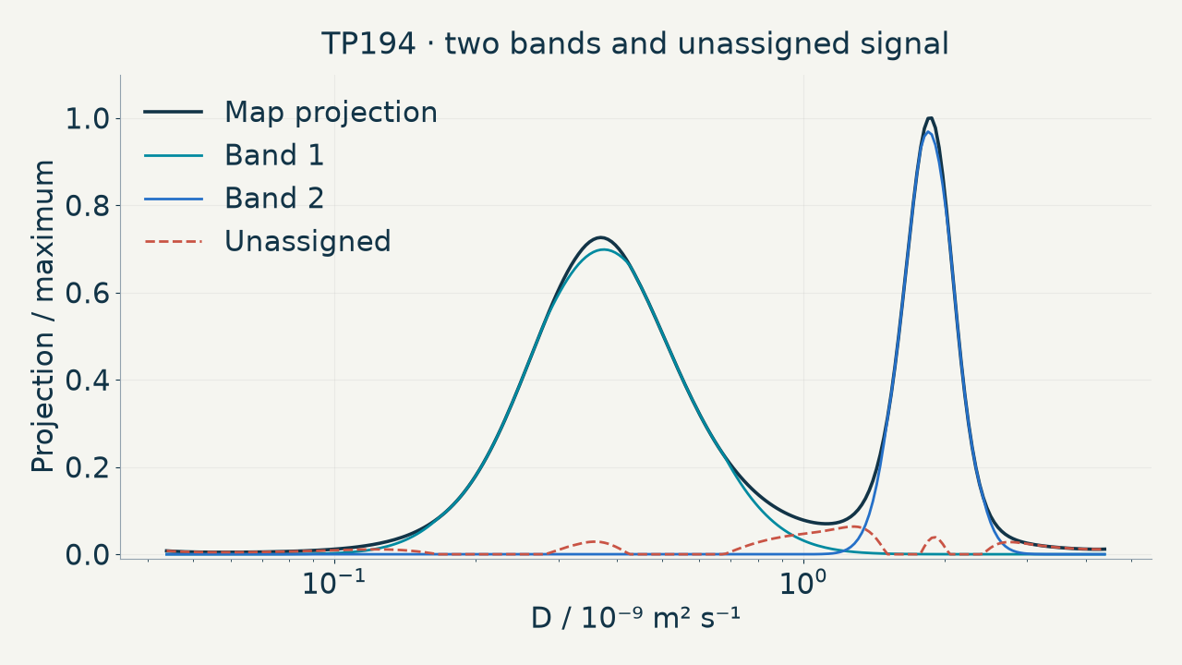
TP194 case · keep what the model cannot explain visible
≈6%
unassigned
Retain the signal
Compare methods
Hold out gradients
A useful map lets us review the fit and what remains unresolved
Real TP194 · archived projection case. Predictive checks are a subsequent Scientific Workbench step.
22
Notes:
17:25–18:10 · 45 s
SPOKEN ROUTE (45 s):
The model describes two bands while retaining about six percent of signal unassigned. We neither erase it nor invent another species to complete the story. Prime lets us revisit signals, compare methods and open Scientific Workbench to explore stability and held-out gradient prediction. These are subsequent checks, not tests claimed to have run in this example. Success is retaining both explained and unresolved signal alongside the saved result.
CONSULTATION DETAILS (do not read during the talk):
The modeled TP194 projection has two descriptive bands centred around 0.375 and 1.847 times ten to the minus nine, but 5.96 percent of area remains unassigned and status remains review_residuals. The original projection gives close results with 6.42 percent unassigned. Residual signal is neither erased nor conveniently converted into another species. Success is representation that retains doubt and lets us trace which signals support each band. Open Prime Scientific Workbench to compare methods, grids and settings and inspect held-out b prediction when design and convergence permit. These checks are implemented; we do not claim every check was run on TP194. QA screenshots of controls are labelled as such. Saving a review does not overwrite D or calibration. After making the conventional route checkable, we consider its next bottleneck: time.
Sources:
ILT method-choice and appendix guidance
[local-source: ilt_teaching_guidance.json]
Read-only comparison of the TBO software profile and acquired pulse program
[local-source: local_equation_audit.json]
prime guide
[local-source: GUIA_PRIME.md]
V6 audit of software actions, observable checks and limitations
[local-source: solutions_mapping.json]
prime readme
[local-source: README.md]
Read-only audit of pulse calibration and sequence-dependent timing parameters
[local-source: parameters_pulse_evidence.json]
tp194 projection doc
[local-source: DOSY_PROJECTION_0.46.1.md]
tp194 projection audit
[local-source: audit.json]
tp194 projection screenshot
[local-source: prime-projection-map.png]
tp194 projection ui check
[local-source: projection-ui.json]
tp194 saved project
[local-source: DiffAtOnce] Prime Results\Calibracion_20260929_084154_43b4f1\calibrado.prime.json

Slide 23
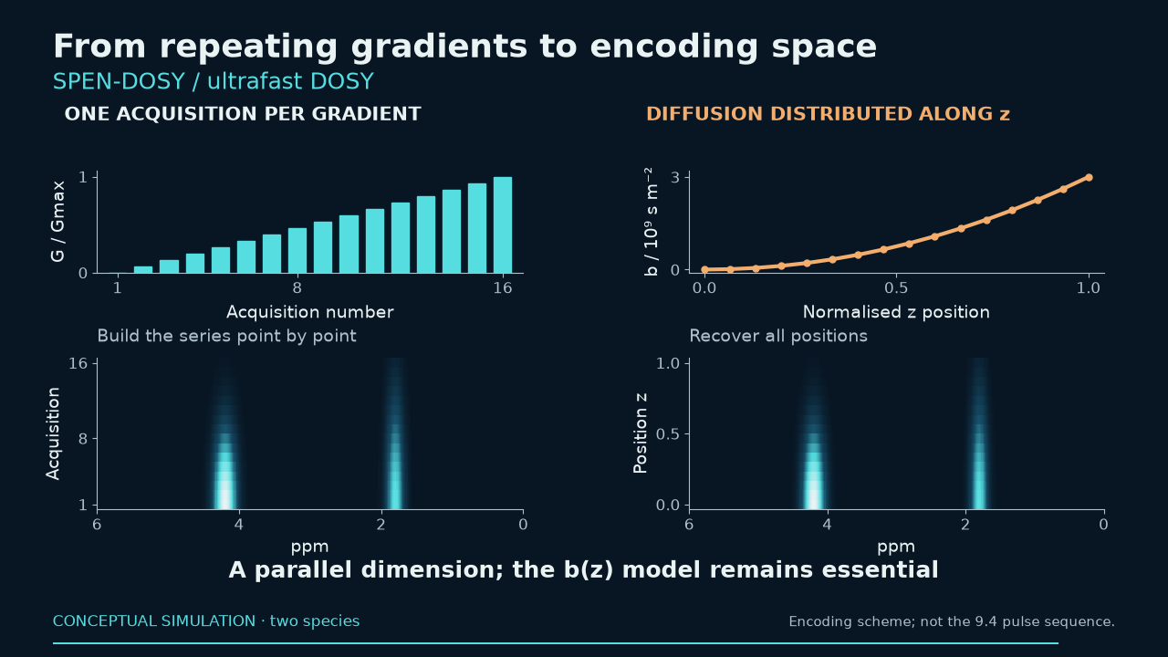
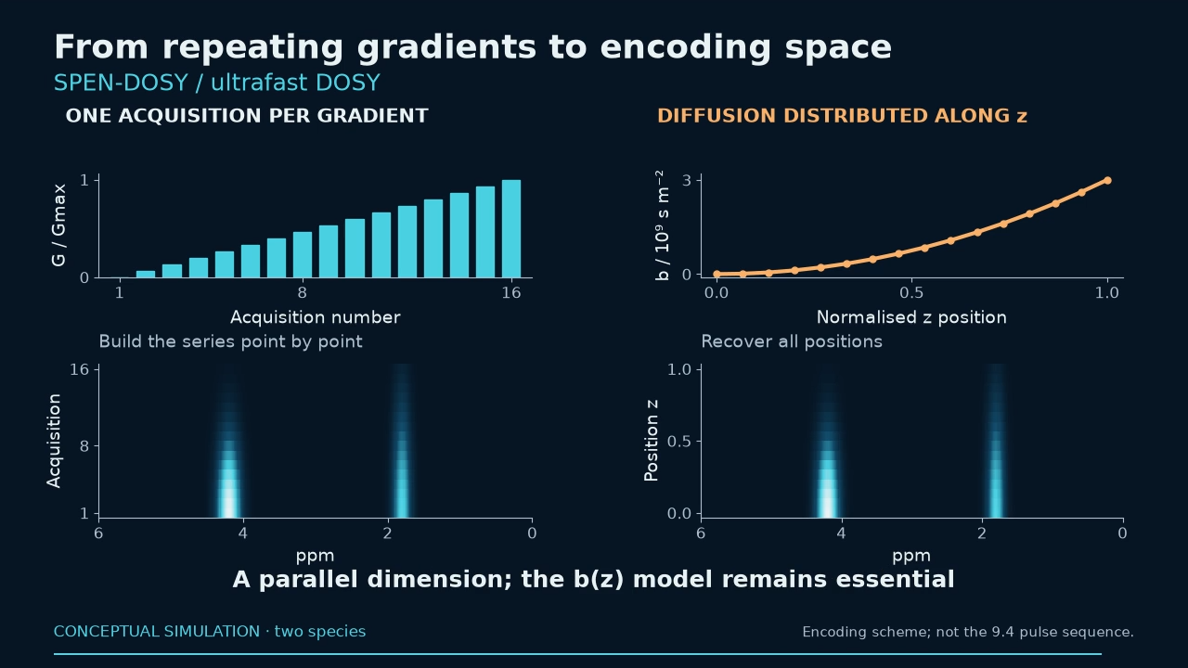
Notes:
18:10–19:10 · 60 s
Conventional acquisition repeats gradients and assumes the preparation remains comparable throughout the series. Time may be limiting for rapid processes, reactions and hyperpolarized signals. Ultrafast DOSY uses spatial encoding: different positions receive different weighting followed by spatial readout. SPEN is the spatial encoding used in these routes, not a wholly separate competitor. Faster acquisition shifts difficulties to phase, spatial sensitivity, bandwidth and b(z) calibration. Cited literature demonstrates applications; these are not attributed to our prototype. Prime’s guided route prompts echo-order, profile and kernel review against conventional controls. This is also the direction of our development for z-gradient probes.
Sources:
Single-scan 2D DOSY NMR spectroscopy
https://pubmed.ncbi.nlm.nih.gov/18835796/
Spatially encoded 2D and 3D diffusion-ordered NMR spectroscopy
https://pubs.rsc.org/en/content/articlehtml/2017/cc/c6cc09028a
Spatially encoded diffusion-ordered NMR spectroscopy of reaction mixtures in organic solvents
https://pubs.rsc.org/en/content/articlelanding/2018/an/c8an00434j
Single-Scan 13C Diffusion-Ordered NMR Spectroscopy of DNP-Hyperpolarised Substrates
https://chemistry-europe.onlinelibrary.wiley.com/doi/10.1002/chem.201703300
Ultrafast diffusion-based unmixing of 1H NMR spectra
https://pubs.rsc.org/en/content/articlehtml/2021/cc/d0cc07757g
Accounting for gradient non-uniformity in spatially-encoded diffusion-ordered NMR spectroscopy
https://www.sciencedirect.com/science/article/pii/S1090780723001787

Slide 24
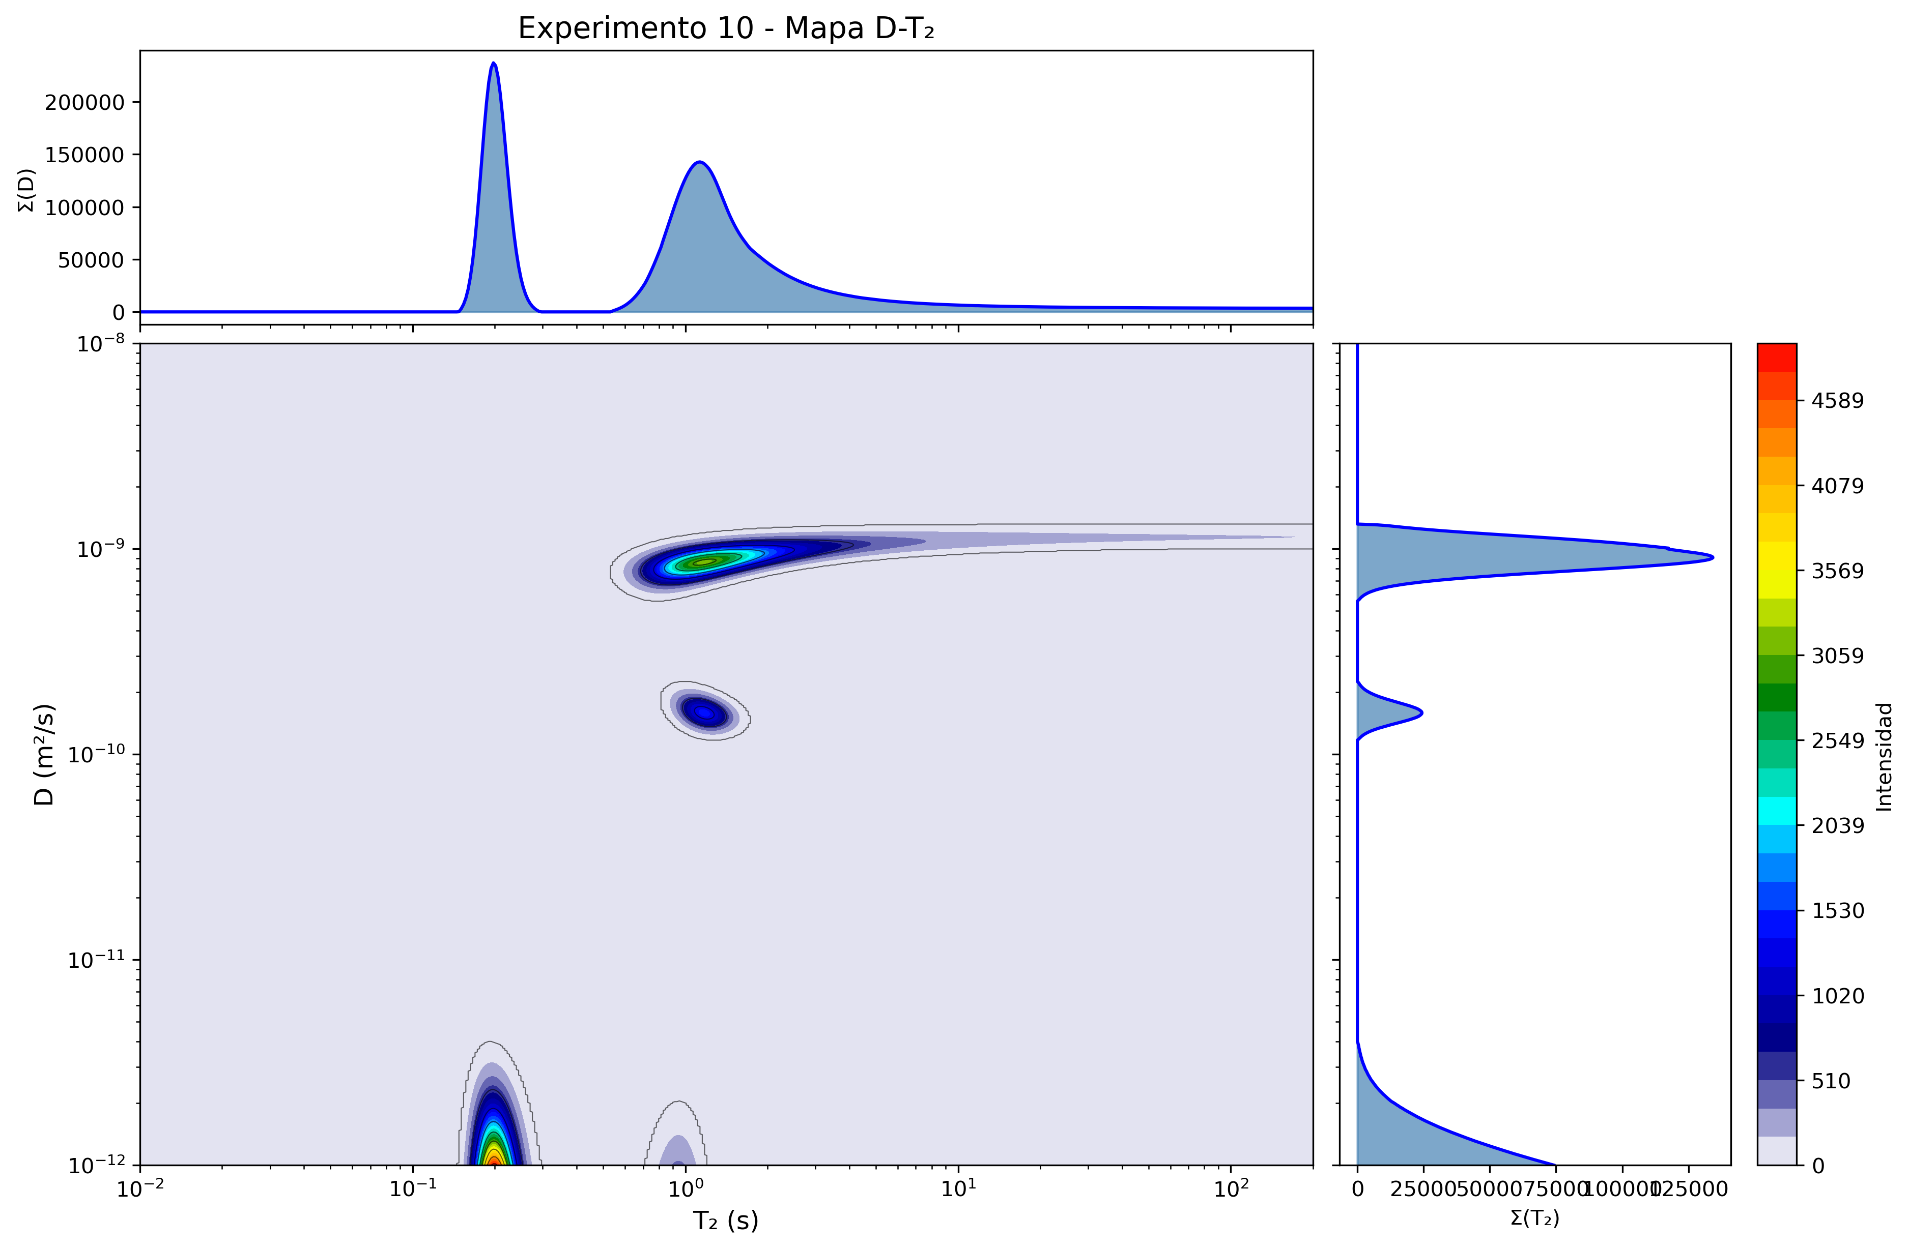
Ultrafast: diffusion and relaxation in one map
UF D–T₂
Experiment 10
4 scans · 32 echoes
≈28 seconds
CURRENT DEVELOPMENT
z gradient
+ EPSI readout
Validate b(z)
and sensitivity
TRAIN2D · 2025 experiment, preceding EPSI v9.4 · D and T₂ accuracy remains to be validated
24
Notes:
19:10–19:50 · 40 s
This image is a TRAIN2D reconstruction of UF D–T2 experiment 10, acquired on 3 June 2025 using 4 scans and 32 echoes in 27.768 s. Diffusion is on the vertical axis and T2 on the horizontal axis; the projections summarize both axes. This experimental example precedes UF_DT2_CS_EPSI v9.4 development: it is neither an output of that program nor a D–ppm map. The notebook uses a nominal maximum gradient and a 1% graphical threshold; the dominant peak reaches the lower D boundary. Do not interpret that boundary as a validated species. Absolute D and T2 accuracy requires calibration controls. Our current development uses a z gradient and EPSI readout; b(z), sensitivity and accuracy with standards remain pending.
Technical reference for EPSI development:
SPOKEN ROUTE (40 s):
We are developing ultrafast for conventional probes with z gradients and shaped RF. Chirp/STE, CPMG and EPSI pulse programs, a calculator and diagnostic reconstruction exist. The difficulty shifts to b(z) calibration and checking sensitivity and accuracy with references and conventional controls. Quantitative experimental validation remains pending: this is a concrete development route, not a new absolute single-scan DOSY demonstration.
CONSULTATION DETAILS (do not read during the talk):
Our current development implements chirp stimulated-echo encoding, CPMG and bipolar EPSI readout, with programs for PABBO, TBI and TBO, a calculator and diagnostic reconstruction. A conventional probe here requires a z gradient and shaped RF, not a gradient-free probe. Current target is Avance III 500 with TopSpin 3.8.0 and scan counts in multiples of sixteen, separate from the helper prepared for 3.6.4. Pulse programs and software exist; quantitative experimental validation of absolute DOSY remains pending. The next success to demonstrate is reference b(z) calibration and accuracy/stability against conventional DOSY. This is a concrete prospect rather than an announced experimental result. Let us return to what the audience can use tomorrow.
Sources:
local_readme
[local-source: README.md]
local_audit
[local-source: AUDITORIA_METODO_UF_DT2_CS_2026-09-19.md]
local_pp
[local-source: UF_DT2_CS_EPSI_v9_4_TBO]
local_calc
[local-source: UF_DT2_CS_calculator_v9_4.py]
local_recon
[local-source: reconstruct_uf_dt2_cs_v9_4.py]
Spatially encoded diffusion-ordered NMR spectroscopy of reaction mixtures in organic solvents
https://pubs.rsc.org/en/content/articlelanding/2018/an/c8an00434j
Single-Scan 13C Diffusion-Ordered NMR Spectroscopy of DNP-Hyperpolarised Substrates
https://chemistry-europe.onlinelibrary.wiley.com/doi/10.1002/chem.201703300
Experimental UF D–T2 experiment 10 (2025), TRAIN2D reconstruction
[local-source: DT2_map_10.png]

Slide 25
A carefully acquired signal.
A reproducible analysis.
A result we can check.
Calibrate and retain useful information
Automate repetitive steps
Review the result with examples and controls
DiffAtOnce Prime · ifernan@ual.es · fmarrabal@ual.es
25
Notes:
19:50–20:00 · 10 s
DOSY calibration and processing are difficult. These examples show how to do the work and where our programs help. A defensible result retains the measurement, assumptions and checks.
Sources:

Slide 26
Prime · local ILT 1/4
Method / component | What it is used for | Main caution
NNLS | Positive baseline without smoothing; diagnose minimum residual. | SciPy NNLS / active-set NNLS; explicit dictionary
Tikhonov | Continuous distributions with controlled smoothness; polymers/polydispersity. | Fixed λ; check penalty order and grid scaling.
FLINT quadratic objective | Positive L2 objective for stable inversion; this library uses NNLS. | Same positive L2 objective; NNLS engine, not FLINT original iteration
GNAT ILT NNLS | Compare GNAT positive ILT branch at a manual lambda. | Manual lambda squared; excludes GNAT GCV/L-curve/UI peak picking
TRAIn-style trust region | Iterative positive trust-region inversion; control its stopping criterion. | Prime uses termFac × NNLS residual; do not interchange it with noise radii.
Reference catalogue · details, availability and sources in notes and accompanying CSV / TXT
26
Notes:
Reference / consulta · 0 s
Positive least squares [nnls]
Use: Positive baseline without smoothing; diagnose minimum residual.
Limitations: SciPy NNLS / active-set NNLS; explicit dictionary
Availability: Prime ILT selector
Objective: `0.5 ‖AC-Y‖F², C>=0`.
Source: [local-source: METHOD_REFERENCE.es.md#nnls]
Positive Tikhonov [tikhonov]
Use: Continuous distributions with controlled smoothness; polymers/polydispersity.
Limitations: Fixed user lambda and order 0/1/2; no automatic CONTIN selection
Availability: Prime ILT selector
Objective: `0.5 ‖AC-Y‖F² + lambda/2 ‖RC‖F², C>=0`.
Source: [local-source: METHOD_REFERENCE.es.md#tikhonov]
FLINT quadratic objective [flint]
Use: Positive L2 objective for stable inversion; this library uses NNLS.
Limitations: Same positive L2 objective; NNLS engine, not FLINT original iteration
Availability: Prime ILT selector
Objective: `0.5 ‖AC-Y‖F² + lambda/2 ‖C‖F², C>=0`.
Source: [local-source: METHOD_REFERENCE.es.md#flint]
GNAT positive ILT branch [gnat_ilt_nnls]
Use: Compare GNAT positive ILT branch at a manual lambda.
Limitations: Manual lambda squared; excludes GNAT GCV/L-curve/UI peak picking
Availability: Prime ILT selector
Objective: `0.5 ‖AC-Y‖F² + lambda²/2 ‖RC‖F², C>=0`.
Source: [local-source: METHOD_REFERENCE.es.md#gnat_ilt_nnls]
TRAIn-style trust region [train]
Use: Iterative positive trust-region inversion; control its stopping criterion.
Limitations: Prime TRAIn uses the shared original engine: termFac × NNLS residual. The library record describes a separate explicit-noise-radius variant; do not interchange parameters.
Availability: Prime ILT selector
Objective: `RSS(A*(eta elementwise squared),Y); discrepancy stopping`.
Source: [local-source: METHOD_REFERENCE.es.md#train]
Sources: [ilt_catalog] Audited bilingual catalogue of local inversion methods and context families: [local-source: ilt_algorithm_catalog_bilingual.json]
[catalog_nnls] Positive least squares: [local-source: METHOD_REFERENCE.es.md#nnls]
[catalog_tikhonov] Positive Tikhonov: [local-source: METHOD_REFERENCE.es.md#tikhonov]
[catalog_flint] FLINT quadratic objective: [local-source: METHOD_REFERENCE.es.md#flint]
[catalog_gnat_ilt_nnls] GNAT positive ILT branch: [local-source: METHOD_REFERENCE.es.md#gnat_ilt_nnls]
[catalog_train] TRAIn-style trust region: [local-source: METHOD_REFERENCE.es.md#train]
nnls — Positive least squares
Prime ILT selector
Positive baseline without smoothing; diagnose minimum residual.
SciPy NNLS / active-set NNLS; explicit dictionary
`0.5 ‖AC-Y‖F², C>=0`.
[local-source: METHOD_REFERENCE.es.md#nnls]
tikhonov — Positive Tikhonov
Prime ILT selector
Continuous distributions with controlled smoothness; polymers/polydispersity.
Fixed user lambda and order 0/1/2; no automatic CONTIN selection
`0.5 ‖AC-Y‖F² + lambda/2 ‖RC‖F², C>=0`.
[local-source: METHOD_REFERENCE.es.md#tikhonov]
flint — FLINT quadratic objective
Prime ILT selector
Positive L2 objective for stable inversion; this library uses NNLS.
Same positive L2 objective; NNLS engine, not FLINT original iteration
`0.5 ‖AC-Y‖F² + lambda/2 ‖C‖F², C>=0`.
[local-source: METHOD_REFERENCE.es.md#flint]
gnat_ilt_nnls — GNAT positive ILT branch
Prime ILT selector
Compare GNAT positive ILT branch at a manual lambda.
Manual lambda squared; excludes GNAT GCV/L-curve/UI peak picking
`0.5 ‖AC-Y‖F² + lambda²/2 ‖RC‖F², C>=0`.
[local-source: METHOD_REFERENCE.es.md#gnat_ilt_nnls]
train — TRAIn-style trust region
Prime ILT selector
Iterative positive trust-region inversion; control its stopping criterion.
Prime TRAIn uses the shared original engine: termFac × NNLS residual. The library record describes a separate explicit-noise-radius variant; do not interchange parameters.
`RSS(A*(eta elementwise squared),Y); discrepancy stopping`.
[local-source: METHOD_REFERENCE.es.md#train]
Sources:
Audited bilingual catalogue of local inversion methods and context families
[local-source: ilt_algorithm_catalog_bilingual.json]
Positive least squares
[local-source: METHOD_REFERENCE.es.md#nnls]
Positive Tikhonov
[local-source: METHOD_REFERENCE.es.md#tikhonov]
FLINT quadratic objective
[local-source: METHOD_REFERENCE.es.md#flint]
GNAT positive ILT branch
[local-source: METHOD_REFERENCE.es.md#gnat_ilt_nnls]
TRAIn-style trust region
[local-source: METHOD_REFERENCE.es.md#train]

Slide 27
Prime · local ILT 2/4
Method / component | What it is used for | Main caution
ITAMeD positive FISTA | Sparse distributions with few peaks through L1 and FISTA. | Fixed grid; check objective scaling before comparing lambda.
Positive smooth sparse inversion | Compromise between few peaks and smoothness. | L1 plus finite-difference quadratic
Positive maximum entropy | Positive distributions regularized by entropy relative to a reference. | Reference depends on data; check convergence and implementation.
PALMA entropy/L1 PPXA+ | Combine peaks and broad distributions with entropy/L1 and a noise radius. | First observation must be positive; verify final feasibility.
Local curvature reweighted Tikhonov | Adapt local smoothing to curvature; compare sensitivity. | Not authentic UPEN2D/MUPEN2D
Reference catalogue · details, availability and sources in notes and accompanying CSV / TXT
27
Notes:
Reference / consulta · 0 s
ITAMeD positive FISTA [itamed]
Use: Sparse distributions with few peaks through L1 and FISTA.
Limitations: Pure diffusion kernel, lambda L1, scaled step and Nesterov; no original GUI
Availability: Prime ILT selector
Objective: `RSS + lambda sum(C), C>=0`.
Source: [local-source: METHOD_REFERENCE.es.md#itamed]
Positive smooth sparse inversion [elastic_net]
Use: Compromise between few peaks and smoothness.
Limitations: L1 plus finite-difference quadratic
Availability: Prime ILT selector
Objective: `0.5 ‖AC-Y‖F² + lambda/2 ‖RC‖F² + l1 sum(C), C>=0`.
Source: [local-source: METHOD_REFERENCE.es.md#elastic_net]
Positive maximum entropy [maxent]
Use: Positive distributions regularized by entropy relative to a reference.
Limitations: Fixed reference; Python L-BFGS and MATLAB/C# projected line search differ
Availability: Prime ILT selector
Objective: `0.5 ‖AC-Y‖F² + lambda sum(C log(C/ref)-C)`.
Source: [local-source: METHOD_REFERENCE.es.md#maxent]
PALMA entropy/L1 PPXA+ [palma]
Use: Combine peaks and broad distributions with entropy/L1 and a noise radius.
Limitations: Positive entropy weight 0<lambda<=1; per-curve ball; lambda=0 signed variant excluded
Availability: Prime ILT selector
Objective: `(1-w)‖x‖1 + w sum(x log x), ‖Ax-Y/scale‖2<=eta/scale`.
Source: [local-source: METHOD_REFERENCE.es.md#palma]
Local curvature reweighted Tikhonov [curvature_reweighted]
Use: Adapt local smoothing to curvature; compare sensitivity.
Limitations: Not authentic UPEN2D/MUPEN2D
Availability: Prime ILT selector
Objective: `Sequence of positive quadratic fits with local curvature weights`.
Source: [local-source: METHOD_REFERENCE.es.md#curvature_reweighted]
Sources: [ilt_catalog] Audited bilingual catalogue of local inversion methods and context families: [local-source: ilt_algorithm_catalog_bilingual.json]
[catalog_itamed] ITAMeD positive FISTA: [local-source: METHOD_REFERENCE.es.md#itamed]
[catalog_elastic_net] Positive smooth sparse inversion: [local-source: METHOD_REFERENCE.es.md#elastic_net]
[catalog_maxent] Positive maximum entropy: [local-source: METHOD_REFERENCE.es.md#maxent]
[catalog_palma] PALMA entropy/L1 PPXA+: [local-source: METHOD_REFERENCE.es.md#palma]
[catalog_curvature_reweighted] Local curvature reweighted Tikhonov: [local-source: METHOD_REFERENCE.es.md#curvature_reweighted]
itamed — ITAMeD positive FISTA
Prime ILT selector
Sparse distributions with few peaks through L1 and FISTA.
Pure diffusion kernel, lambda L1, scaled step and Nesterov; no original GUI
`RSS + lambda sum(C), C>=0`.
[local-source: METHOD_REFERENCE.es.md#itamed]
elastic_net — Positive smooth sparse inversion
Prime ILT selector
Compromise between few peaks and smoothness.
L1 plus finite-difference quadratic
`0.5 ‖AC-Y‖F² + lambda/2 ‖RC‖F² + l1 sum(C), C>=0`.
[local-source: METHOD_REFERENCE.es.md#elastic_net]
maxent — Positive maximum entropy
Prime ILT selector
Positive distributions regularized by entropy relative to a reference.
Fixed reference; Python L-BFGS and MATLAB/C# projected line search differ
`0.5 ‖AC-Y‖F² + lambda sum(C log(C/ref)-C)`.
[local-source: METHOD_REFERENCE.es.md#maxent]
palma — PALMA entropy/L1 PPXA+
Prime ILT selector
Combine peaks and broad distributions with entropy/L1 and a noise radius.
Positive entropy weight 0<lambda<=1; per-curve ball; lambda=0 signed variant excluded
`(1-w)‖x‖1 + w sum(x log x), ‖Ax-Y/scale‖2<=eta/scale`.
[local-source: METHOD_REFERENCE.es.md#palma]
curvature_reweighted — Local curvature reweighted Tikhonov
Prime ILT selector
Adapt local smoothing to curvature; compare sensitivity.
Not authentic UPEN2D/MUPEN2D
`Sequence of positive quadratic fits with local curvature weights`.
[local-source: METHOD_REFERENCE.es.md#curvature_reweighted]
Sources:
Audited bilingual catalogue of local inversion methods and context families
[local-source: ilt_algorithm_catalog_bilingual.json]
ITAMeD positive FISTA
[local-source: METHOD_REFERENCE.es.md#itamed]
Positive smooth sparse inversion
[local-source: METHOD_REFERENCE.es.md#elastic_net]
Positive maximum entropy
[local-source: METHOD_REFERENCE.es.md#maxent]
PALMA entropy/L1 PPXA+
[local-source: METHOD_REFERENCE.es.md#palma]
Local curvature reweighted Tikhonov
[local-source: METHOD_REFERENCE.es.md#curvature_reweighted]

Slide 28
Prime · local ILT 3/4
Method / component | What it is used for | Main caution
BRD dual positive L2 | Solve positive L2 via a dual formulation; explicit lambda. | Fixed alpha; no OSILAP automatic selection or compression.
Chambolle-Pock positive L1 | Solve sparse L1 inversion by primal-dual splitting. | Not PDHGM2; inspect the projected-gradient residual.
Regularized block Kaczmarz | Solve regularized inversion using row/block updates. | Row order matters; the grid adapter uses internal defaults.
Positive L1-LS | Positive L1 solution by interior point; optimization reference. | Fixed lambda and dense Newton; not the original large-scale PCG.
FLINT-FISTA | Iteratively solve the positive FLINT quadratic objective. | Step and stopping differ from upstream; check convergence.
Reference catalogue · details, availability and sources in notes and accompanying CSV / TXT
28
Notes:
Reference / consulta · 0 s
BRD dual positive L2 [brd]
Use: Solve positive L2 via a dual formulation; explicit lambda.
Limitations: Fixed positive alpha and identity regularizer; damped semismooth Newton differs from Julia trust region. No OSILAP automatic alpha/compression pipeline.
Availability: Prime ILT selector
Objective: `0.5 ‖AC-Y‖F² + alpha/2 ‖C‖F², C>=0, solved through dual`.
Source: [local-source: METHOD_REFERENCE.es.md#brd]
Chambolle-Pock positive L1 [pdhg_l1]
Use: Solve sparse L1 inversion by primal-dual splitting.
Limitations: Least-squares dual and positive L1 primal prox; not the archived PDHGM/PDHGM2 update.
Availability: Prime ILT selector
Objective: `0.5 ‖AC-Y‖F² + alpha sum(C), C>=0`.
Source: [local-source: METHOD_REFERENCE.es.md#pdhg_l1]
Regularized block Kaczmarz [kaczmarz]
Use: Solve regularized inversion using row/block updates.
Limitations: The grid adapter uses the engine defaults. Use linear_fit / linearFit / LinearEngines.Fit for seed, block size, inner iterations and explicit row orders. Ordering is a portable generator, not the original NumPy generator; line-search failures are retained.
Availability: Prime ILT selector
Objective: `0.5 ‖AC-Y‖F² + alpha/2 ‖C‖F², C>=0`.
Source: [local-source: METHOD_REFERENCE.es.md#kaczmarz]
Nonnegative L1 interior point [l1_ls_nonnegative]
Use: Positive L1 solution by interior point; optimization reference.
Limitations: Boyd barrier/primal-dual formulation; dense Newton, not original PCG. Fixed lambda; absolute-scaled gap near zero.
Availability: Prime ILT selector
Objective: `RSS + alpha ‖C‖1, C>=0`.
Source: [local-source: METHOD_REFERENCE.es.md#l1_ls_nonnegative]
FLINT positive quadratic iterative core [flint_fista]
Use: Iteratively solve the positive FLINT quadratic objective.
Limitations: FISTA for FLINT objective; exact spectral step and projected-gradient stop differ from upstream power iteration/stagnation.
Availability: Prime ILT selector
Objective: `RSS + alpha ‖C‖F², C>=0`.
Source: [local-source: METHOD_REFERENCE.es.md#flint_fista]
Sources: [ilt_catalog] Audited bilingual catalogue of local inversion methods and context families: [local-source: ilt_algorithm_catalog_bilingual.json]
[catalog_brd] BRD dual positive L2: [local-source: METHOD_REFERENCE.es.md#brd]
[catalog_pdhg_l1] Chambolle-Pock positive L1: [local-source: METHOD_REFERENCE.es.md#pdhg_l1]
[catalog_kaczmarz] Regularized block Kaczmarz: [local-source: METHOD_REFERENCE.es.md#kaczmarz]
[catalog_l1_ls_nonnegative] Nonnegative L1 interior point: [local-source: METHOD_REFERENCE.es.md#l1_ls_nonnegative]
[catalog_flint_fista] FLINT positive quadratic iterative core: [local-source: METHOD_REFERENCE.es.md#flint_fista]
brd — BRD dual positive L2
Prime ILT selector
Solve positive L2 via a dual formulation; explicit lambda.
Fixed positive alpha and identity regularizer; damped semismooth Newton differs from Julia trust region. No OSILAP automatic alpha/compression pipeline.
`0.5 ‖AC-Y‖F² + alpha/2 ‖C‖F², C>=0, solved through dual`.
[local-source: METHOD_REFERENCE.es.md#brd]
pdhg_l1 — Chambolle-Pock positive L1
Prime ILT selector
Solve sparse L1 inversion by primal-dual splitting.
Least-squares dual and positive L1 primal prox; not the archived PDHGM/PDHGM2 update.
`0.5 ‖AC-Y‖F² + alpha sum(C), C>=0`.
[local-source: METHOD_REFERENCE.es.md#pdhg_l1]
kaczmarz — Regularized block Kaczmarz
Prime ILT selector
Solve regularized inversion using row/block updates.
The grid adapter uses the engine defaults. Use linear_fit / linearFit / LinearEngines.Fit for seed, block size, inner iterations and explicit row orders. Ordering is a portable generator, not the original NumPy generator; line-search failures are retained.
`0.5 ‖AC-Y‖F² + alpha/2 ‖C‖F², C>=0`.
[local-source: METHOD_REFERENCE.es.md#kaczmarz]
l1_ls_nonnegative — Nonnegative L1 interior point
Prime ILT selector
Positive L1 solution by interior point; optimization reference.
Boyd barrier/primal-dual formulation; dense Newton, not original PCG. Fixed lambda; absolute-scaled gap near zero.
`RSS + alpha ‖C‖1, C>=0`.
[local-source: METHOD_REFERENCE.es.md#l1_ls_nonnegative]
flint_fista — FLINT positive quadratic iterative core
Prime ILT selector
Iteratively solve the positive FLINT quadratic objective.
FISTA for FLINT objective; exact spectral step and projected-gradient stop differ from upstream power iteration/stagnation.
`RSS + alpha ‖C‖F², C>=0`.
[local-source: METHOD_REFERENCE.es.md#flint_fista]
Sources:
Audited bilingual catalogue of local inversion methods and context families
[local-source: ilt_algorithm_catalog_bilingual.json]
BRD dual positive L2
[local-source: METHOD_REFERENCE.es.md#brd]
Chambolle-Pock positive L1
[local-source: METHOD_REFERENCE.es.md#pdhg_l1]
Regularized block Kaczmarz
[local-source: METHOD_REFERENCE.es.md#kaczmarz]
Nonnegative L1 interior point
[local-source: METHOD_REFERENCE.es.md#l1_ls_nonnegative]
FLINT positive quadratic iterative core
[local-source: METHOD_REFERENCE.es.md#flint_fista]

Slide 29
Prime · shared structure
Method / component | What it is used for | Main caution
Positive row-group sparse inversion | Shared D support across multiple frequencies. | Shared support is not molecular identity; one column reduces to L1.
Nonnegative sparse nuclear regularization | Joint map with few profiles and sparse significant coefficients. | ADMM; not branded ADSpLRU/LRSpILT
Reweighted nuclear heuristic | Strengthen rank/support selection through adaptive weights. | Changing weights; no fixed convex objective certificate
Orthogonal matching pursuit dictionary adapter | Select few D atoms from a dictionary; explicit support limit. | Column scaling affects selection; no automatic noise estimate.
Reference catalogue · details, availability and sources in notes and accompanying CSV / TXT
29
Notes:
Reference / consulta · 0 s
Positive row-group sparse inversion [group_sparse]
Use: Shared D support across multiple frequencies.
Limitations: Shared row L2 sparsity; not chemical identity
Availability: Prime ILT selector
Objective: `0.5 ‖AC-Y‖F² + lambda sum_k ‖C[k,:]‖2, C>=0`.
Source: [local-source: METHOD_REFERENCE.es.md#group_sparse]
Nonnegative sparse nuclear regularization [lowrank_sparse]
Use: Joint map with few profiles and sparse significant coefficients.
Limitations: ADMM; not branded ADSpLRU/LRSpILT
Availability: Prime ILT selector
Objective: `0.5 ‖AC-Y‖F² + l1 sum(C) + low_rank ‖C‖*, C>=0`.
Source: [local-source: METHOD_REFERENCE.es.md#lowrank_sparse]
Reweighted nuclear heuristic [reweighted_lowrank_sparse]
Use: Strengthen rank/support selection through adaptive weights.
Limitations: Changing weights; no fixed convex objective certificate
Availability: Prime ILT selector
Objective: `Adaptive singular-value thresholds inside ADMM`.
Source: [local-source: METHOD_REFERENCE.es.md#reweighted_lowrank_sparse]
Orthogonal matching pursuit dictionary adapter [omp]
Use: Select few D atoms from a dictionary; explicit support limit.
Limitations: Explicit dictionary, positive or signed refits; differs from original CS Fourier mapping. No automatic noise estimate.
Availability: Prime ILT selector
Objective: `Greedy dictionary correlation + restricted LS/NNLS refit`.
Source: [local-source: METHOD_REFERENCE.es.md#omp]
Sources: [ilt_catalog] Audited bilingual catalogue of local inversion methods and context families: [local-source: ilt_algorithm_catalog_bilingual.json]
[catalog_group_sparse] Positive row-group sparse inversion: [local-source: METHOD_REFERENCE.es.md#group_sparse]
[catalog_lowrank_sparse] Nonnegative sparse nuclear regularization: [local-source: METHOD_REFERENCE.es.md#lowrank_sparse]
[catalog_reweighted_lowrank_sparse] Reweighted nuclear heuristic: [local-source: METHOD_REFERENCE.es.md#reweighted_lowrank_sparse]
[catalog_omp] Orthogonal matching pursuit dictionary adapter: [local-source: METHOD_REFERENCE.es.md#omp]
group_sparse — Positive row-group sparse inversion
Prime ILT selector
Shared D support across multiple frequencies.
Shared row L2 sparsity; not chemical identity
`0.5 ‖AC-Y‖F² + lambda sum_k ‖C[k,:]‖2, C>=0`.
[local-source: METHOD_REFERENCE.es.md#group_sparse]
lowrank_sparse — Nonnegative sparse nuclear regularization
Prime ILT selector
Joint map with few profiles and sparse significant coefficients.
ADMM; not branded ADSpLRU/LRSpILT
`0.5 ‖AC-Y‖F² + l1 sum(C) + low_rank ‖C‖*, C>=0`.
[local-source: METHOD_REFERENCE.es.md#lowrank_sparse]
reweighted_lowrank_sparse — Reweighted nuclear heuristic
Prime ILT selector
Strengthen rank/support selection through adaptive weights.
Changing weights; no fixed convex objective certificate
`Adaptive singular-value thresholds inside ADMM`.
[local-source: METHOD_REFERENCE.es.md#reweighted_lowrank_sparse]
omp — Orthogonal matching pursuit dictionary adapter
Prime ILT selector
Select few D atoms from a dictionary; explicit support limit.
Explicit dictionary, positive or signed refits; differs from original CS Fourier mapping. No automatic noise estimate.
`Greedy dictionary correlation + restricted LS/NNLS refit`.
[local-source: METHOD_REFERENCE.es.md#omp]
Sources:
Audited bilingual catalogue of local inversion methods and context families
[local-source: ilt_algorithm_catalog_bilingual.json]
Positive row-group sparse inversion
[local-source: METHOD_REFERENCE.es.md#group_sparse]
Nonnegative sparse nuclear regularization
[local-source: METHOD_REFERENCE.es.md#lowrank_sparse]
Reweighted nuclear heuristic
[local-source: METHOD_REFERENCE.es.md#reweighted_lowrank_sparse]
Orthogonal matching pursuit dictionary adapter
[local-source: METHOD_REFERENCE.es.md#omp]

Slide 30
Prime · joint maps 1/2
Method / component | What it is used for | Main caution
MF-NNLS | Joint distribution map with shared factors. | Predictive rank ≠ molecules; inspect lambdaS, lambdaA, bounds and residuals.
TRAIn-MF | Joint model with signed attenuations; explicit legacy replay. | Historical identifier label does not describe the revised route. Not per-bin TRAIn.
Per-bin TRAIn | Same local fit for every frequency in a region. | Does not impose inter-frequency correlations or shared factors.
RAI-S | Few discrete D values with spectral support selection. | Not RAI-Net or a trained network; a broad distribution may violate the discrete model.
DOME-S | Shared discrete rates with coverage and support review. | Check boundaries, held-out prediction and component count.
Reference catalogue · details, availability and sources in notes and accompanying CSV / TXT
30
Notes:
Reference / consulta · 0 s
MF-NNLS256 [mf-nnls256]
Use: Joint distribution map with shared factors.
Limitations: Predictive rank ≠ molecules; inspect lambdaS, lambdaA, bounds and residuals.
Availability: Native Prime route
Source: [local-source: StudioWindows.Library.cs]
TRAIn-MF (protocolo revisado) [train-mf-historical]
Use: Joint model with signed attenuations; explicit legacy replay.
Limitations: Historical identifier label does not describe the revised route. Not per-bin TRAIn.
Availability: Native Prime route
Source: [local-source: StudioWindows.Library.cs]
TRAIn por bin / per bin [train-per-bin]
Use: Same local fit for every frequency in a region.
Limitations: Does not impose inter-frequency correlations or shared factors.
Availability: Native Prime route
Source: [local-source: StudioWindows.Library.cs]
RAI-S [rai-s]
Use: Few discrete D values with spectral support selection.
Limitations: Not RAI-Net or a trained network; a broad distribution may violate the discrete model.
Availability: Native Prime route
Source: [local-source: StudioWindows.Library.cs]
DOME-S [dome-s]
Use: Shared discrete rates with coverage and support review.
Limitations: Check boundaries, held-out prediction and component count.
Availability: Native Prime route
Source: [local-source: StudioWindows.Library.cs]
Sources: [ilt_catalog] Audited bilingual catalogue of local inversion methods and context families: [local-source: ilt_algorithm_catalog_bilingual.json]
[catalog_mf-nnls256] MF-NNLS256: [local-source: StudioWindows.Library.cs]
[catalog_train-mf-historical] TRAIn-MF (protocolo revisado): [local-source: StudioWindows.Library.cs]
[catalog_train-per-bin] TRAIn por bin / per bin: [local-source: StudioWindows.Library.cs]
[catalog_rai-s] RAI-S: [local-source: StudioWindows.Library.cs]
[catalog_dome-s] DOME-S: [local-source: StudioWindows.Library.cs]
mf-nnls256 — MF-NNLS256
Native Prime route
Joint distribution map with shared factors.
Predictive rank ≠ molecules; inspect lambdaS, lambdaA, bounds and residuals.
[local-source: StudioWindows.Library.cs]
train-mf-historical — TRAIn-MF (protocolo revisado)
Native Prime route
Joint model with signed attenuations; explicit legacy replay.
Historical identifier label does not describe the revised route. Not per-bin TRAIn.
[local-source: StudioWindows.Library.cs]
train-per-bin — TRAIn por bin / per bin
Native Prime route
Same local fit for every frequency in a region.
Does not impose inter-frequency correlations or shared factors.
[local-source: StudioWindows.Library.cs]
rai-s — RAI-S
Native Prime route
Few discrete D values with spectral support selection.
Not RAI-Net or a trained network; a broad distribution may violate the discrete model.
[local-source: StudioWindows.Library.cs]
dome-s — DOME-S
Native Prime route
Shared discrete rates with coverage and support review.
Check boundaries, held-out prediction and component count.
[local-source: StudioWindows.Library.cs]
Sources:
Audited bilingual catalogue of local inversion methods and context families
[local-source: ilt_algorithm_catalog_bilingual.json]
MF-NNLS256
[local-source: StudioWindows.Library.cs]
TRAIn-MF (protocolo revisado)
[local-source: StudioWindows.Library.cs]
TRAIn por bin / per bin
[local-source: StudioWindows.Library.cs]
RAI-S
[local-source: StudioWindows.Library.cs]
DOME-S
[local-source: StudioWindows.Library.cs]

Slide 31
Prime · joint maps and 2D
Method / component | What it is used for | Main caution
SILT-DOSY | Joint map with sparse and low-rank penalties. | Nonconvex reweighting; operational stop ≠ global optimum.
SILT original ADSpLRU | Replay the supplied original core with diagnostics. | Historical stop ≠ KKT certificate; separate from revised SILT.
TRAIn2D · C# | Separable D–T2 inversion or other two-operator problems. | No lambda; termFac and NNLS residual. Physical kernel/profile must be reviewed.
FISTA 2D · C# | Positive L1 2D inversion using a separable operator. | Not a verbatim ITAMeD copy; KKT does not validate the physical model.
Reference catalogue · details, availability and sources in notes and accompanying CSV / TXT
31
Notes:
Reference / consulta · 0 s
SILT revisado / revised [silt-dosy]
Use: Joint map with sparse and low-rank penalties.
Limitations: Nonconvex reweighting; operational stop ≠ global optimum.
Availability: Native Prime route
Source: [local-source: StudioWindows.Library.cs]
SILT original / ADSpLRU [silt-original]
Use: Replay the supplied original core with diagnostics.
Limitations: Historical stop ≠ KKT certificate; separate from revised SILT.
Availability: Native Prime route
Source: [local-source: StudioWindows.Library.cs]
TRAIn2D (adaptación C#) [train2d_prime]
Use: Separable D–T2 inversion or other two-operator problems.
Limitations: No lambda; termFac and NNLS residual. Physical kernel/profile must be reviewed.
Availability: Native Prime route
Source: [local-source: UfNotebookWindow.cs]
FISTA 2D (variante C# inspirada en ITAMeD) [fista2d_prime]
Use: Positive L1 2D inversion using a separable operator.
Limitations: Not a verbatim ITAMeD copy; KKT does not validate the physical model.
Availability: Native Prime route
Source: [local-source: UfNotebookWindow.cs]
Sources: [ilt_catalog] Audited bilingual catalogue of local inversion methods and context families: [local-source: ilt_algorithm_catalog_bilingual.json]
[catalog_silt-dosy] SILT revisado / revised: [local-source: StudioWindows.Library.cs]
[catalog_silt-original] SILT original / ADSpLRU: [local-source: StudioWindows.Library.cs]
[catalog_train2d_prime] TRAIn2D (adaptación C#): [local-source: UfNotebookWindow.cs]
[catalog_fista2d_prime] FISTA 2D (variante C# inspirada en ITAMeD): [local-source: UfNotebookWindow.cs]
silt-dosy — SILT revisado / revised
Native Prime route
Joint map with sparse and low-rank penalties.
Nonconvex reweighting; operational stop ≠ global optimum.
[local-source: StudioWindows.Library.cs]
silt-original — SILT original / ADSpLRU
Native Prime route
Replay the supplied original core with diagnostics.
Historical stop ≠ KKT certificate; separate from revised SILT.
[local-source: StudioWindows.Library.cs]
train2d_prime — TRAIn2D (adaptación C#)
Native Prime route
Separable D–T2 inversion or other two-operator problems.
No lambda; termFac and NNLS residual. Physical kernel/profile must be reviewed.
[local-source: UfNotebookWindow.cs]
fista2d_prime — FISTA 2D (variante C# inspirada en ITAMeD)
Native Prime route
Positive L1 2D inversion using a separable operator.
Not a verbatim ITAMeD copy; KKT does not validate the physical model.
[local-source: UfNotebookWindow.cs]
Sources:
Audited bilingual catalogue of local inversion methods and context families
[local-source: ilt_algorithm_catalog_bilingual.json]
SILT revisado / revised
[local-source: StudioWindows.Library.cs]
SILT original / ADSpLRU
[local-source: StudioWindows.Library.cs]
TRAIn2D (adaptación C#)
[local-source: UfNotebookWindow.cs]
FISTA 2D (variante C# inspirada en ITAMeD)
[local-source: UfNotebookWindow.cs]

Slide 32
Library · discrete components 1/2
Method / component | What it is used for | Main caution
Positive variable projection | Fit a fixed number of exponential components without a D grid. | Fixed rank and local minima; no guaranteed identification.
SCORE | Separate component spectra by sharing D across frequencies. | Request signed amplitudes; the generic VP default is positive.
OUTSCORE | Unmixing that penalizes overlap between component spectra. | GNAT absolute spectral cross-talk objective; fixed rank
HYSCORE | Balance reconstruction and spectral separation in a discrete model. | GNAT hybrid residual/cross-talk objective; explicit relative weight
AIC/BIC selection over VP | Choose model order among variable-projection models using AIC/BIC. | Not original Provencher DISCRETE or SPLMOD
Reference catalogue · details, availability and sources in notes and accompanying CSV / TXT
32
Notes:
Reference / consulta · 0 s
Positive variable projection [vp]
Use: Fit a fixed number of exponential components without a D grid.
Limitations: Fixed rank; independent local engines and deterministic starts
Availability: Specialized API; not in Prime ILT selector
Objective: `min over log(D): 0.5 ‖A(D) C*(D)-Y‖F², C*(D)>=0`.
Source: [local-source: METHOD_REFERENCE.es.md#vp]
SCORE [score]
Use: Separate component spectra by sharing D across frequencies.
Limitations: VP with unconstrained amplitudes for GNAT SCORE; fixed-D and explicit NUG supported
Availability: Specialized API; not in Prime ILT selector
Objective: `Variable projection with signed linear amplitudes when Positive=false`.
Source: [local-source: METHOD_REFERENCE.es.md#score]
OUTSCORE [outscore]
Use: Unmixing that penalizes overlap between component spectra.
Limitations: GNAT absolute spectral cross-talk objective; fixed rank
Availability: Specialized API; not in Prime ILT selector
Objective: `GNAT constant + pairwise overlap of absolute area-normalized spectra`.
Source: [local-source: METHOD_REFERENCE.es.md#outscore]
HYSCORE [hyscore]
Use: Balance reconstruction and spectral separation in a discrete model.
Limitations: GNAT hybrid residual/cross-talk objective; explicit relative weight
Availability: Specialized API; not in Prime ILT selector
Objective: `hybrid_weight * RSS + (1-hybrid_weight) * OUTSCORE`.
Source: [local-source: METHOD_REFERENCE.es.md#hyscore]
AIC/BIC selection over VP [discrete_selection]
Use: Choose model order among variable-projection models using AIC/BIC.
Limitations: Not original Provencher DISCRETE or SPLMOD
Availability: Specialized API; not in Prime ILT selector
Objective: `Known-noise RSS plus AIC/BIC/AICc model penalty over K>=1`.
Source: [local-source: METHOD_REFERENCE.es.md#discrete_selection]
Sources: [ilt_catalog] Audited bilingual catalogue of local inversion methods and context families: [local-source: ilt_algorithm_catalog_bilingual.json]
[catalog_vp] Positive variable projection: [local-source: METHOD_REFERENCE.es.md#vp]
[catalog_score] SCORE: [local-source: METHOD_REFERENCE.es.md#score]
[catalog_outscore] OUTSCORE: [local-source: METHOD_REFERENCE.es.md#outscore]
[catalog_hyscore] HYSCORE: [local-source: METHOD_REFERENCE.es.md#hyscore]
[catalog_discrete_selection] AIC/BIC selection over VP: [local-source: METHOD_REFERENCE.es.md#discrete_selection]
vp — Positive variable projection
Specialized API; not in Prime ILT selector
Fit a fixed number of exponential components without a D grid.
Fixed rank; independent local engines and deterministic starts
`min over log(D): 0.5 ‖A(D) C*(D)-Y‖F², C*(D)>=0`.
[local-source: METHOD_REFERENCE.es.md#vp]
score — SCORE
Specialized API; not in Prime ILT selector
Separate component spectra by sharing D across frequencies.
VP with unconstrained amplitudes for GNAT SCORE; fixed-D and explicit NUG supported
`Variable projection with signed linear amplitudes when Positive=false`.
[local-source: METHOD_REFERENCE.es.md#score]
outscore — OUTSCORE
Specialized API; not in Prime ILT selector
Unmixing that penalizes overlap between component spectra.
GNAT absolute spectral cross-talk objective; fixed rank
`GNAT constant + pairwise overlap of absolute area-normalized spectra`.
[local-source: METHOD_REFERENCE.es.md#outscore]
hyscore — HYSCORE
Specialized API; not in Prime ILT selector
Balance reconstruction and spectral separation in a discrete model.
GNAT hybrid residual/cross-talk objective; explicit relative weight
`hybrid_weight * RSS + (1-hybrid_weight) * OUTSCORE`.
[local-source: METHOD_REFERENCE.es.md#hyscore]
discrete_selection — AIC/BIC selection over VP
Specialized API; not in Prime ILT selector
Choose model order among variable-projection models using AIC/BIC.
Not original Provencher DISCRETE or SPLMOD
`Known-noise RSS plus AIC/BIC/AICc model penalty over K>=1`.
[local-source: METHOD_REFERENCE.es.md#discrete_selection]
Sources:
Audited bilingual catalogue of local inversion methods and context families
[local-source: ilt_algorithm_catalog_bilingual.json]
Positive variable projection
[local-source: METHOD_REFERENCE.es.md#vp]
SCORE
[local-source: METHOD_REFERENCE.es.md#score]
OUTSCORE
[local-source: METHOD_REFERENCE.es.md#outscore]
HYSCORE
[local-source: METHOD_REFERENCE.es.md#hyscore]
AIC/BIC selection over VP
[local-source: METHOD_REFERENCE.es.md#discrete_selection]

Slide 33
Library · discrete components 2/2
Method / component | What it is used for | Main caution
DECRA | Algebraic decomposition of exponential components with uniform b. | Requires uniform b steps and sufficient rank; poles may be nonphysical.
Explicit-region local SCORE | Apply SCORE to explicitly selected ppm regions. | Use disjoint regions; segmentation is not automatic.
Automatic LOCODOSY local inversion | Segment regions, estimate local order and reduce components. | Adapted segmentation; reported intervals are not calibrated uncertainty.
ESPIRA-II AAA-selected Loewner pencil | Identify exponential sums through poles and a fixed rank. | Uniform sampling and fixed rank; retain nonphysical poles.
Reference catalogue · details, availability and sources in notes and accompanying CSV / TXT
33
Notes:
Reference / consulta · 0 s
DECRA [decra]
Use: Algebraic decomposition of exponential components with uniform b.
Limitations: Original GNAT algebra; uniform b, isotropic noise, full rank; nonphysical eigenvalues fail
Availability: Specialized API; not in Prime ILT selector
Objective: `SVD and eigenvalues of shifted equally spaced attenuation blocks`.
Source: [local-source: METHOD_REFERENCE.es.md#decra]
Explicit-region local SCORE [local_score]
Use: Apply SCORE to explicitly selected ppm regions.
Limitations: Use disjoint regions for portable use: MATLAB does not check overlap across regions. Explicit local SCORE does not segment automatically.
Availability: Specialized API; not in Prime ILT selector
Objective: `SCORE independently on explicit column-index regions`.
Source: [local-source: METHOD_REFERENCE.es.md#local_score]
Automatic LOCODOSY local inversion [locodosy_auto]
Use: Segment regions, estimate local order and reduce components.
Limitations: Native automatic inversion; C# legacy error refit (LM), display and fuzzy clustering now separate APIs. Original GUI segmentation adapted; no calibrated confidence intervals.
Availability: Specialized API; not in Prime ILT selector
Objective: `Threshold segmentation, SVD order, local SCORE/OUTSCORE/DECRA, component reduction`.
Source: [local-source: METHOD_REFERENCE.es.md#locodosy_auto]
ESPIRA-II AAA-selected Loewner pencil [espira2]
Use: Identify exponential sums through poles and a fixed rank.
Limitations: Uniform sample spacing; fixed rank; complex/nonphysical poles retained; optional uniform-b diffusion validation; no ESPIRA-I or general AAA package
Availability: Specialized API; not in Prime ILT selector
Objective: `AAA-selected Loewner pencil + complex exponential amplitude fit`.
Source: [local-source: METHOD_REFERENCE.es.md#espira2]
Sources: [ilt_catalog] Audited bilingual catalogue of local inversion methods and context families: [local-source: ilt_algorithm_catalog_bilingual.json]
[catalog_decra] DECRA: [local-source: METHOD_REFERENCE.es.md#decra]
[catalog_local_score] Explicit-region local SCORE: [local-source: METHOD_REFERENCE.es.md#local_score]
[catalog_locodosy_auto] Automatic LOCODOSY local inversion: [local-source: METHOD_REFERENCE.es.md#locodosy_auto]
[catalog_espira2] ESPIRA-II AAA-selected Loewner pencil: [local-source: METHOD_REFERENCE.es.md#espira2]
decra — DECRA
Specialized API; not in Prime ILT selector
Algebraic decomposition of exponential components with uniform b.
Original GNAT algebra; uniform b, isotropic noise, full rank; nonphysical eigenvalues fail
`SVD and eigenvalues of shifted equally spaced attenuation blocks`.
[local-source: METHOD_REFERENCE.es.md#decra]
local_score — Explicit-region local SCORE
Specialized API; not in Prime ILT selector
Apply SCORE to explicitly selected ppm regions.
Use disjoint regions for portable use: MATLAB does not check overlap across regions. Explicit local SCORE does not segment automatically.
`SCORE independently on explicit column-index regions`.
[local-source: METHOD_REFERENCE.es.md#local_score]
locodosy_auto — Automatic LOCODOSY local inversion
Specialized API; not in Prime ILT selector
Segment regions, estimate local order and reduce components.
Native automatic inversion; C# legacy error refit (LM), display and fuzzy clustering now separate APIs. Original GUI segmentation adapted; no calibrated confidence intervals.
`Threshold segmentation, SVD order, local SCORE/OUTSCORE/DECRA, component reduction`.
[local-source: METHOD_REFERENCE.es.md#locodosy_auto]
espira2 — ESPIRA-II AAA-selected Loewner pencil
Specialized API; not in Prime ILT selector
Identify exponential sums through poles and a fixed rank.
Uniform sample spacing; fixed rank; complex/nonphysical poles retained; optional uniform-b diffusion validation; no ESPIRA-I or general AAA package
`AAA-selected Loewner pencil + complex exponential amplitude fit`.
[local-source: METHOD_REFERENCE.es.md#espira2]
Sources:
Audited bilingual catalogue of local inversion methods and context families
[local-source: ilt_algorithm_catalog_bilingual.json]
DECRA
[local-source: METHOD_REFERENCE.es.md#decra]
Explicit-region local SCORE
[local-source: METHOD_REFERENCE.es.md#local_score]
Automatic LOCODOSY local inversion
[local-source: METHOD_REFERENCE.es.md#locodosy_auto]
ESPIRA-II AAA-selected Loewner pencil
[local-source: METHOD_REFERENCE.es.md#espira2]

Slide 34
Library · decomposition and FID
Method / component | What it is used for | Main caution
MCR-ALS | Multivariate decomposition with constraints and optional exponential profiles. | Rotational ambiguity remains; an exponential fit is needed to obtain D.
Symmetric FastICA | Explore statistically independent factors; fit D afterwards if appropriate. | Statistical independence estimates neither D nor molecular identity.
Three-way CP-ALS | Three-dimensional data with factors shared across modes. | Local solution; it does not perform DOSY inversion by itself.
GNAT Fourier RRT | Fourier-Laplace reconstruction from complex FID and uniform b. | Requires uniform b and correctly oriented FID; output is a complex map.
GNAT Fourier FDM | Resolve poles/frequencies from FIDs through filter diagonalization. | Numerical policies differ; output is not a calibrated physical density.
Reference catalogue · details, availability and sources in notes and accompanying CSV / TXT
34
Notes:
Reference / consulta · 0 s
MCR-ALS [mcr_als]
Use: Multivariate decomposition with constraints and optional exponential profiles.
Limitations: Positivity options and optional exponential decays; no GNAT GUI/rotational guarantee
Availability: Specialized API; not in Prime ILT selector
Objective: `Alternating LS/NNLS of decay and spectral factors`.
Source: [local-source: METHOD_REFERENCE.es.md#mcr_als]
Symmetric FastICA [fastica]
Use: Explore statistically independent factors; fit D afterwards if appropriate.
Limitations: Algebraic factors, no automatic diffusion identification
Availability: Specialized API; not in Prime ILT selector
Objective: `Whitening + symmetric tanh fixed-point iteration`.
Source: [local-source: METHOD_REFERENCE.es.md#fastica]
Three-way CP-ALS [parafac]
Use: Three-dimensional data with factors shared across modes.
Limitations: Three-way API; use parafac_nd for four-way tensors; full N-way constraints/uncertainty not ported
Availability: Specialized API; not in Prime ILT selector
Objective: `Three-way CP least squares by alternating LS/NNLS`.
Source: [local-source: METHOD_REFERENCE.es.md#parafac]
GNAT Fourier RRT [rrt]
Use: Fourier-Laplace reconstruction from complex FID and uniform b.
Limitations: Uniform b and direct-time FID; explicit/overlapping Fourier windows. Complex map, not masses; no GUI/phase/calibration.
Availability: Specialized API; not in Prime ILT selector
Objective: `Regularized resolvent of complex Fourier pencils`.
Source: [local-source: METHOD_REFERENCE.es.md#rrt]
GNAT Fourier FDM [fdm]
Use: Resolve poles/frequencies from FIDs through filter diagonalization.
Limitations: Legacy eigen policy failed cross-language agreement. Portable policy fixes bilinear normalization, eigenvector signs and near-real-pole broadening. Neither is calibrated physical density.
Availability: Specialized API; not in Prime ILT selector
Objective: `Generalized-eigen Fourier filter diagonalization`.
Source: [local-source: METHOD_REFERENCE.es.md#fdm]
Sources: [ilt_catalog] Audited bilingual catalogue of local inversion methods and context families: [local-source: ilt_algorithm_catalog_bilingual.json]
[catalog_mcr_als] MCR-ALS: [local-source: METHOD_REFERENCE.es.md#mcr_als]
[catalog_fastica] Symmetric FastICA: [local-source: METHOD_REFERENCE.es.md#fastica]
[catalog_parafac] Three-way CP-ALS: [local-source: METHOD_REFERENCE.es.md#parafac]
[catalog_rrt] GNAT Fourier RRT: [local-source: METHOD_REFERENCE.es.md#rrt]
[catalog_fdm] GNAT Fourier FDM: [local-source: METHOD_REFERENCE.es.md#fdm]
mcr_als — MCR-ALS
Specialized API; not in Prime ILT selector
Multivariate decomposition with constraints and optional exponential profiles.
Positivity options and optional exponential decays; no GNAT GUI/rotational guarantee
`Alternating LS/NNLS of decay and spectral factors`.
[local-source: METHOD_REFERENCE.es.md#mcr_als]
fastica — Symmetric FastICA
Specialized API; not in Prime ILT selector
Explore statistically independent factors; fit D afterwards if appropriate.
Algebraic factors, no automatic diffusion identification
`Whitening + symmetric tanh fixed-point iteration`.
[local-source: METHOD_REFERENCE.es.md#fastica]
parafac — Three-way CP-ALS
Specialized API; not in Prime ILT selector
Three-dimensional data with factors shared across modes.
Three-way API; use parafac_nd for four-way tensors; full N-way constraints/uncertainty not ported
`Three-way CP least squares by alternating LS/NNLS`.
[local-source: METHOD_REFERENCE.es.md#parafac]
rrt — GNAT Fourier RRT
Specialized API; not in Prime ILT selector
Fourier-Laplace reconstruction from complex FID and uniform b.
Uniform b and direct-time FID; explicit/overlapping Fourier windows. Complex map, not masses; no GUI/phase/calibration.
`Regularized resolvent of complex Fourier pencils`.
[local-source: METHOD_REFERENCE.es.md#rrt]
fdm — GNAT Fourier FDM
Specialized API; not in Prime ILT selector
Resolve poles/frequencies from FIDs through filter diagonalization.
Legacy eigen policy failed cross-language agreement. Portable policy fixes bilinear normalization, eigenvector signs and near-real-pole broadening. Neither is calibrated physical density.
`Generalized-eigen Fourier filter diagonalization`.
[local-source: METHOD_REFERENCE.es.md#fdm]
Sources:
Audited bilingual catalogue of local inversion methods and context families
[local-source: ilt_algorithm_catalog_bilingual.json]
MCR-ALS
[local-source: METHOD_REFERENCE.es.md#mcr_als]
Symmetric FastICA
[local-source: METHOD_REFERENCE.es.md#fastica]
Three-way CP-ALS
[local-source: METHOD_REFERENCE.es.md#parafac]
GNAT Fourier RRT
[local-source: METHOD_REFERENCE.es.md#rrt]
GNAT Fourier FDM
[local-source: METHOD_REFERENCE.es.md#fdm]

Slide 35
Library · linear cores
Method / component | What it is used for | Main caution
Signed L1 interior point | Signed sparse linear fits; not automatically a positive distribution. | Signed output does not represent positive masses without constraints.
PLSS residual recursive solver | Consistent linear systems; auxiliary unregularized core. | For consistent systems; signed, unregularized output.
IRLS (fixed p) dictionary adapter | Explore sparse solutions through reweighted least squares. | Signed output; iterate stability does not prove global optimality.
Weighted PLSS recursive core | Weighted consistent linear systems; auxiliary core. | Consistent systems and signed output; not every PLSS variant is included.
CP-ALS 3D / 4D | Factorize three/four-way tensors; multi-experiment studies. | Local solution; stability is not a stationarity certificate.
Reference catalogue · details, availability and sources in notes and accompanying CSV / TXT
35
Notes:
Reference / consulta · 0 s
Signed L1 interior point [l1_ls]
Use: Signed sparse linear fits; not automatically a positive distribution.
Limitations: Same signed L1 barrier objective; dense Newton. Negative coefficients are not physical masses.
Availability: Specialized API; not in Prime ILT selector
Objective: `RSS + alpha ‖C‖1, C signed`.
Source: [local-source: METHOD_REFERENCE.es.md#l1_ls]
PLSS residual recursive solver [plss_r]
Use: Consistent linear systems; auxiliary unregularized core.
Limitations: Consistent linear systems; signed, unregularized; breakdown retained. No claims for other PLSS variants.
Availability: Specialized API; not in Prime ILT selector
Objective: `Unregularized recursive residual sketches for A*C=Y`.
Source: [local-source: METHOD_REFERENCE.es.md#plss_r]
Fixed-p smoothed IRLS dictionary adapter [irls]
Use: Explore sparse solutions through reweighted least squares.
Limitations: Signed; explicit epsilon; no original Fourier sampling or automatic epsilon heuristic. Iterate stability not an optimality certificate.
Availability: Specialized API; not in Prime ILT selector
Objective: `Fixed-p smoothed iteratively reweighted least squares`.
Source: [local-source: METHOD_REFERENCE.es.md#irls]
Weighted PLSS recursive core [plss_rw2]
Use: Weighted consistent linear systems; auxiliary core.
Limitations: Exact diagonal-variable implementation of RW2 via guarded residual recurrence; signed, consistent systems; zero/dependent-direction guards differ from upstream failures; no KZ/RW1
Availability: Specialized API; not in Prime ILT selector
Objective: `Diagonal variable transform + guarded residual PLSS recursion`.
Source: [local-source: METHOD_REFERENCE.es.md#plss_rw2]
Three/four-way CP-ALS [parafac_nd]
Use: Factorize three/four-way tensors; multi-experiment studies.
Limitations: Positive/unconstrained factors, deterministic initialization; local solution, objective-stagnation stop, no N-way constraint/uncertainty suite.
Availability: Specialized API; not in Prime ILT selector
Objective: `Three/four-way CP alternating LS/NNLS`.
Source: [local-source: METHOD_REFERENCE.es.md#parafac_nd]
Sources: [ilt_catalog] Audited bilingual catalogue of local inversion methods and context families: [local-source: ilt_algorithm_catalog_bilingual.json]
[catalog_l1_ls] Signed L1 interior point: [local-source: METHOD_REFERENCE.es.md#l1_ls]
[catalog_plss_r] PLSS residual recursive solver: [local-source: METHOD_REFERENCE.es.md#plss_r]
[catalog_irls] Fixed-p smoothed IRLS dictionary adapter: [local-source: METHOD_REFERENCE.es.md#irls]
[catalog_plss_rw2] Weighted PLSS recursive core: [local-source: METHOD_REFERENCE.es.md#plss_rw2]
[catalog_parafac_nd] Three/four-way CP-ALS: [local-source: METHOD_REFERENCE.es.md#parafac_nd]
l1_ls — Signed L1 interior point
Specialized API; not in Prime ILT selector
Signed sparse linear fits; not automatically a positive distribution.
Same signed L1 barrier objective; dense Newton. Negative coefficients are not physical masses.
`RSS + alpha ‖C‖1, C signed`.
[local-source: METHOD_REFERENCE.es.md#l1_ls]
plss_r — PLSS residual recursive solver
Specialized API; not in Prime ILT selector
Consistent linear systems; auxiliary unregularized core.
Consistent linear systems; signed, unregularized; breakdown retained. No claims for other PLSS variants.
`Unregularized recursive residual sketches for A*C=Y`.
[local-source: METHOD_REFERENCE.es.md#plss_r]
irls — Fixed-p smoothed IRLS dictionary adapter
Specialized API; not in Prime ILT selector
Explore sparse solutions through reweighted least squares.
Signed; explicit epsilon; no original Fourier sampling or automatic epsilon heuristic. Iterate stability not an optimality certificate.
`Fixed-p smoothed iteratively reweighted least squares`.
[local-source: METHOD_REFERENCE.es.md#irls]
plss_rw2 — Weighted PLSS recursive core
Specialized API; not in Prime ILT selector
Weighted consistent linear systems; auxiliary core.
Exact diagonal-variable implementation of RW2 via guarded residual recurrence; signed, consistent systems; zero/dependent-direction guards differ from upstream failures; no KZ/RW1
`Diagonal variable transform + guarded residual PLSS recursion`.
[local-source: METHOD_REFERENCE.es.md#plss_rw2]
parafac_nd — Three/four-way CP-ALS
Specialized API; not in Prime ILT selector
Factorize three/four-way tensors; multi-experiment studies.
Positive/unconstrained factors, deterministic initialization; local solution, objective-stagnation stop, no N-way constraint/uncertainty suite.
`Three/four-way CP alternating LS/NNLS`.
[local-source: METHOD_REFERENCE.es.md#parafac_nd]
Sources:
Audited bilingual catalogue of local inversion methods and context families
[local-source: ilt_algorithm_catalog_bilingual.json]
Signed L1 interior point
[local-source: METHOD_REFERENCE.es.md#l1_ls]
PLSS residual recursive solver
[local-source: METHOD_REFERENCE.es.md#plss_r]
Fixed-p smoothed IRLS dictionary adapter
[local-source: METHOD_REFERENCE.es.md#irls]
Weighted PLSS recursive core
[local-source: METHOD_REFERENCE.es.md#plss_rw2]
Three/four-way CP-ALS
[local-source: METHOD_REFERENCE.es.md#parafac_nd]

Slide 36
Library · other Laplace cores
Method / component | What it is used for | Main caution
ADSpLRU archived reweighted ADMM | Joint sparse/low-rank unmixing with reweighted ADMM. | Historical residual stop is not a fixed convex-objective certificate.
IPSpLRU incremental proximal recurrence | Joint unmixing with an incremental proximal recurrence. | Explicit initialization and update count; convergence is not guaranteed.
LRSpILT archived ADMM recurrence | Joint DOSY reconstruction using low-rank and sparse structure. | Adaptive thresholds; relative stopping is not an optimality certificate.
PDHGM2 NMRInversions.jl | Replay the NMRInversions.jl recurrence and check KKT separately. | Projection does not guarantee the positive objective; inspect actual KKT.
ILT.jl positive ridge | Positive inversion with a signed baseline term. | NNLS replaces Ipopt; baseline is also penalized and alpha is fixed.
Reference catalogue · details, availability and sources in notes and accompanying CSV / TXT
36
Notes:
Reference / consulta · 0 s
ADSpLRU archived reweighted ADMM [adsplru]
Use: Joint sparse/low-rank unmixing with reweighted ADMM.
Limitations: RMS scales dictionary and data; adaptive singular and entry thresholds; legacy residual stop is not a fixed convex certificate
Availability: Specialized API; not in Prime ILT selector
Objective: `RMS-scaled ADMM with adaptive singular-value and entry shrinkage`.
Source: [local-source: METHOD_REFERENCE.es.md#adsplru]
IPSpLRU incremental proximal recurrence [ipsplru]
Use: Joint unmixing with an incremental proximal recurrence.
Limitations: 999 default updates; explicit initial matrix; all columns; no fixed-objective convergence certificate
Availability: Specialized API; not in Prime ILT selector
Objective: `Quadratic prox -> reweighted SVT -> reweighted entry shrinkage -> positivity`.
Source: [local-source: METHOD_REFERENCE.es.md#ipsplru]
LRSpILT archived ADMM recurrence [lrspilt]
Use: Joint DOSY reconstruction using low-rank and sparse structure.
Limitations: Adaptive singular thresholds and fixed entry threshold; no original GUI/truth diagnostics; legacy relative stop
Availability: Specialized API; not in Prime ILT selector
Objective: `ADMM with adaptive singular thresholds and fixed L1 threshold`.
Source: [local-source: METHOD_REFERENCE.es.md#lrspilt]
NMRInversions.jl PDHGM2 recurrence [pdhgm2]
Use: Replay the NMRInversions.jl recurrence and check KKT separately.
Limitations: Keeps extrapolated primal and projection after quadratic inverse; reports actual positive-L1 KKT separately; fixed alpha; bounded iterations
Availability: Specialized API; not in Prime ILT selector
Objective: `alpha/2 ‖AC-Y‖F² + sum(C), C>=0 (checked target)`.
Source: [local-source: METHOD_REFERENCE.es.md#pdhgm2]
ILT.jl positive ridge with signed baseline [ilt_julia]
Use: Positive inversion with a signed baseline term.
Limitations: Exact baseline elimination plus NNLS replaces Ipopt; alpha squared also penalizes baseline; caller supplies whitened baseline column; no automatic alpha selection
Availability: Specialized API; not in Prime ILT selector
Objective: `RSS(A C+z beta,Y) + alpha² (‖C‖F²+‖beta‖2²), C>=0, beta signed`.
Source: [local-source: METHOD_REFERENCE.es.md#ilt_julia]
Sources: [ilt_catalog] Audited bilingual catalogue of local inversion methods and context families: [local-source: ilt_algorithm_catalog_bilingual.json]
[catalog_adsplru] ADSpLRU archived reweighted ADMM: [local-source: METHOD_REFERENCE.es.md#adsplru]
[catalog_ipsplru] IPSpLRU incremental proximal recurrence: [local-source: METHOD_REFERENCE.es.md#ipsplru]
[catalog_lrspilt] LRSpILT archived ADMM recurrence: [local-source: METHOD_REFERENCE.es.md#lrspilt]
[catalog_pdhgm2] NMRInversions.jl PDHGM2 recurrence: [local-source: METHOD_REFERENCE.es.md#pdhgm2]
[catalog_ilt_julia] ILT.jl positive ridge with signed baseline: [local-source: METHOD_REFERENCE.es.md#ilt_julia]
adsplru — ADSpLRU archived reweighted ADMM
Specialized API; not in Prime ILT selector
Joint sparse/low-rank unmixing with reweighted ADMM.
RMS scales dictionary and data; adaptive singular and entry thresholds; legacy residual stop is not a fixed convex certificate
`RMS-scaled ADMM with adaptive singular-value and entry shrinkage`.
[local-source: METHOD_REFERENCE.es.md#adsplru]
ipsplru — IPSpLRU incremental proximal recurrence
Specialized API; not in Prime ILT selector
Joint unmixing with an incremental proximal recurrence.
999 default updates; explicit initial matrix; all columns; no fixed-objective convergence certificate
`Quadratic prox -> reweighted SVT -> reweighted entry shrinkage -> positivity`.
[local-source: METHOD_REFERENCE.es.md#ipsplru]
lrspilt — LRSpILT archived ADMM recurrence
Specialized API; not in Prime ILT selector
Joint DOSY reconstruction using low-rank and sparse structure.
Adaptive singular thresholds and fixed entry threshold; no original GUI/truth diagnostics; legacy relative stop
`ADMM with adaptive singular thresholds and fixed L1 threshold`.
[local-source: METHOD_REFERENCE.es.md#lrspilt]
pdhgm2 — NMRInversions.jl PDHGM2 recurrence
Specialized API; not in Prime ILT selector
Replay the NMRInversions.jl recurrence and check KKT separately.
Keeps extrapolated primal and projection after quadratic inverse; reports actual positive-L1 KKT separately; fixed alpha; bounded iterations
`alpha/2 ‖AC-Y‖F² + sum(C), C>=0 (checked target)`.
[local-source: METHOD_REFERENCE.es.md#pdhgm2]
ilt_julia — ILT.jl positive ridge with signed baseline
Specialized API; not in Prime ILT selector
Positive inversion with a signed baseline term.
Exact baseline elimination plus NNLS replaces Ipopt; alpha squared also penalizes baseline; caller supplies whitened baseline column; no automatic alpha selection
`RSS(A C+z beta,Y) + alpha² (‖C‖F²+‖beta‖2²), C>=0, beta signed`.
[local-source: METHOD_REFERENCE.es.md#ilt_julia]
Sources:
Audited bilingual catalogue of local inversion methods and context families
[local-source: ilt_algorithm_catalog_bilingual.json]
ADSpLRU archived reweighted ADMM
[local-source: METHOD_REFERENCE.es.md#adsplru]
IPSpLRU incremental proximal recurrence
[local-source: METHOD_REFERENCE.es.md#ipsplru]
LRSpILT archived ADMM recurrence
[local-source: METHOD_REFERENCE.es.md#lrspilt]
NMRInversions.jl PDHGM2 recurrence
[local-source: METHOD_REFERENCE.es.md#pdhgm2]
ILT.jl positive ridge with signed baseline
[local-source: METHOD_REFERENCE.es.md#ilt_julia]

Slide 37
Library · regularization and unmixing
Method / component | What it is used for | Main caution
TailoredNorm archived p sweep | Explore a p-norm sweep; replay the archived numerical policy. | The original threshold can annihilate output; retain this failure.
UPEN2D adaptive spatial penalties | 2D distributions with adaptive local smoothing; two physical operators. | NNLS inner solver; no original compression. Check both operators.
MUPEN2D spatial multi-penalty FISTA | 2D inversion with adaptive multiple penalties; signed output. | Signed output; distinguish corrected adjoint from the historical policy.
SUnSAL unmixing ADMM | Sparse unmixing with an explicit dictionary and optional constraints. | Justify positivity and sum-one; L1 is constant on a positive simplex.
CLSUnSAL collaborative unmixing | Collaborative unmixing with support shared across columns. | Historical stopping is not an optimality certificate.
Reference catalogue · details, availability and sources in notes and accompanying CSV / TXT
37
Notes:
Reference / consulta · 0 s
TailoredNorm archived p sweep [tailored_norm]
Use: Explore a p-norm sweep; replay the archived numerical policy.
Limitations: Retains machine eps and absolute pinv cutoff 2e8, often annihilating output; no silently repaired result. Explicit cutoff alternatives change numerical policy
Availability: Specialized API; not in Prime ILT selector
Objective: `Archived fixed p=1..2 recurrence and absolute pinv cutoff`.
Source: [local-source: METHOD_REFERENCE.es.md#tailored_norm]
UPEN2D adaptive spatial penalties [upen2d]
Use: 2D distributions with adaptive local smoothing; two physical operators.
Limitations: Native NNLS inner rather than original projected Newton CG; no SVD/B compression. Pure diffusion requires caller diffusion kernel, e.g. Kr=I for window coupling.
Availability: Specialized API; not in Prime ILT selector
Objective: `‖Kc X Kr^T-Y‖F² + spatial quadratic penalties updated from residual/derivatives`.
Source: [local-source: METHOD_REFERENCE.es.md#upen2d]
MUPEN2D spatial multi-penalty FISTA [mupen2d]
Use: 2D inversion with adaptive multiple penalties; signed output.
Limitations: SIGNED coefficients. Explicit legacy AT/monitor or corrected-adjoint policy. No SVD, T1/T2 filter, GUI or forced DOSY border mask. Zero-iterate undefined weight reported
Availability: Specialized API; not in Prime ILT selector
Objective: `Adaptive quadratic spatial penalty + signed L1 FISTA; legacy or adjoint policy`.
Source: [local-source: METHOD_REFERENCE.es.md#mupen2d]
SUnSAL unmixing ADMM [sunsal]
Use: Sparse unmixing with an explicit dictionary and optional constraints.
Limitations: Explicit positivity and sum-one. Dictionary RMS scaling and archived mu policy. Signed rank-deficient equality LS uses nullspace elimination rather than invalid inverse shortcut
Availability: Specialized API; not in Prime ILT selector
Objective: `0.5 RSS + lambda ‖C‖1 with optional positivity/simplex`.
Source: [local-source: METHOD_REFERENCE.es.md#sunsal]
CLSUnSAL collaborative unmixing [clsunsal]
Use: Collaborative unmixing with support shared across columns.
Limitations: Preserves original nonzero scaled-dual initialization and mu update without dual rescaling; legacy stop not optimality certificate; no S2WSU/MUA pipeline
Availability: Specialized API; not in Prime ILT selector
Objective: `Collaborative row-L2 sparsity with archived ADMM policy`.
Source: [local-source: METHOD_REFERENCE.es.md#clsunsal]
Sources: [ilt_catalog] Audited bilingual catalogue of local inversion methods and context families: [local-source: ilt_algorithm_catalog_bilingual.json]
[catalog_tailored_norm] TailoredNorm archived p sweep: [local-source: METHOD_REFERENCE.es.md#tailored_norm]
[catalog_upen2d] UPEN2D adaptive spatial penalties: [local-source: METHOD_REFERENCE.es.md#upen2d]
[catalog_mupen2d] MUPEN2D spatial multi-penalty FISTA: [local-source: METHOD_REFERENCE.es.md#mupen2d]
[catalog_sunsal] SUnSAL unmixing ADMM: [local-source: METHOD_REFERENCE.es.md#sunsal]
[catalog_clsunsal] CLSUnSAL collaborative unmixing: [local-source: METHOD_REFERENCE.es.md#clsunsal]
tailored_norm — TailoredNorm archived p sweep
Specialized API; not in Prime ILT selector
Explore a p-norm sweep; replay the archived numerical policy.
Retains machine eps and absolute pinv cutoff 2e8, often annihilating output; no silently repaired result. Explicit cutoff alternatives change numerical policy
`Archived fixed p=1..2 recurrence and absolute pinv cutoff`.
[local-source: METHOD_REFERENCE.es.md#tailored_norm]
upen2d — UPEN2D adaptive spatial penalties
Specialized API; not in Prime ILT selector
2D distributions with adaptive local smoothing; two physical operators.
Native NNLS inner rather than original projected Newton CG; no SVD/B compression. Pure diffusion requires caller diffusion kernel, e.g. Kr=I for window coupling.
`‖Kc X Kr^T-Y‖F² + spatial quadratic penalties updated from residual/derivatives`.
[local-source: METHOD_REFERENCE.es.md#upen2d]
mupen2d — MUPEN2D spatial multi-penalty FISTA
Specialized API; not in Prime ILT selector
2D inversion with adaptive multiple penalties; signed output.
SIGNED coefficients. Explicit legacy AT/monitor or corrected-adjoint policy. No SVD, T1/T2 filter, GUI or forced DOSY border mask. Zero-iterate undefined weight reported
`Adaptive quadratic spatial penalty + signed L1 FISTA; legacy or adjoint policy`.
[local-source: METHOD_REFERENCE.es.md#mupen2d]
sunsal — SUnSAL unmixing ADMM
Specialized API; not in Prime ILT selector
Sparse unmixing with an explicit dictionary and optional constraints.
Explicit positivity and sum-one. Dictionary RMS scaling and archived mu policy. Signed rank-deficient equality LS uses nullspace elimination rather than invalid inverse shortcut
`0.5 RSS + lambda ‖C‖1 with optional positivity/simplex`.
[local-source: METHOD_REFERENCE.es.md#sunsal]
clsunsal — CLSUnSAL collaborative unmixing
Specialized API; not in Prime ILT selector
Collaborative unmixing with support shared across columns.
Preserves original nonzero scaled-dual initialization and mu update without dual rescaling; legacy stop not optimality certificate; no S2WSU/MUA pipeline
`Collaborative row-L2 sparsity with archived ADMM policy`.
[local-source: METHOD_REFERENCE.es.md#clsunsal]
Sources:
Audited bilingual catalogue of local inversion methods and context families
[local-source: ilt_algorithm_catalog_bilingual.json]
TailoredNorm archived p sweep
[local-source: METHOD_REFERENCE.es.md#tailored_norm]
UPEN2D adaptive spatial penalties
[local-source: METHOD_REFERENCE.es.md#upen2d]
MUPEN2D spatial multi-penalty FISTA
[local-source: METHOD_REFERENCE.es.md#mupen2d]
SUnSAL unmixing ADMM
[local-source: METHOD_REFERENCE.es.md#sunsal]
CLSUnSAL collaborative unmixing
[local-source: METHOD_REFERENCE.es.md#clsunsal]

Slide 38
Library · specific domains
Method / component | What it is used for | Main caution
Fully constrained least squares | Positive sum-to-one unmixing only when normalization justifies it. | Sum-one is mandatory; justify it for DOSY intensities.
MRI mixture of Wisharts/tensors matrix core | Directional MRI diffusion using Wishart/tensor mixtures. | Not scalar DOSY ILT; directional encoding is required.
MRI Q-ball harmonic transform | Angular Q-ball MRI reconstruction in a supplied harmonic basis. | External harmonic basis; neither scalar ILT nor normalized probability.
Reference catalogue · details, availability and sources in notes and accompanying CSV / TXT
38
Notes:
Reference / consulta · 0 s
Fully constrained least squares [fcls]
Use: Positive sum-to-one unmixing only when normalization justifies it.
Limitations: Same nonnegative simplex quadratic objective; simplex FISTA with KKT replaces cvxopt QP. Sum-one must be physically justified for DOSY
Availability: Specialized API; not in Prime ILT selector
Objective: `0.5 RSS, C>=0, each column sums to 1`.
Source: [local-source: METHOD_REFERENCE.es.md#fcls]
MRI mixture of Wisharts/tensors matrix core [mow]
Use: Directional MRI diffusion using Wishart/tensor mixtures.
Limitations: Requires directional b encoding and unit directions; NNLS or signed damped SVD; optional unnormalized shell profile. No image I/O, baseline estimation, DOT, GUI or spherical basis generation
Availability: Specialized API; not in Prime ILT selector
Objective: `Wishart kernel (1+tr(BD)/shape)^(-shape), or tensor exponential`.
Source: [local-source: METHOD_REFERENCE.es.md#mow]
MRI Q-ball harmonic transform [qbi]
Use: Angular Q-ball MRI reconstruction in a supplied harmonic basis.
Limitations: Caller-supplied real even-harmonic basis; archived P_l(0) convention without 2pi; no scalar ILT claim or normalized probability
Availability: Specialized API; not in Prime ILT selector
Objective: `Least-squares real even-harmonic fit followed by P_l(0) multipliers`.
Source: [local-source: METHOD_REFERENCE.es.md#qbi]
Sources: [ilt_catalog] Audited bilingual catalogue of local inversion methods and context families: [local-source: ilt_algorithm_catalog_bilingual.json]
[catalog_fcls] Fully constrained least squares: [local-source: METHOD_REFERENCE.es.md#fcls]
[catalog_mow] MRI mixture of Wisharts/tensors matrix core: [local-source: METHOD_REFERENCE.es.md#mow]
[catalog_qbi] MRI Q-ball harmonic transform: [local-source: METHOD_REFERENCE.es.md#qbi]
fcls — Fully constrained least squares
Specialized API; not in Prime ILT selector
Positive sum-to-one unmixing only when normalization justifies it.
Same nonnegative simplex quadratic objective; simplex FISTA with KKT replaces cvxopt QP. Sum-one must be physically justified for DOSY
`0.5 RSS, C>=0, each column sums to 1`.
[local-source: METHOD_REFERENCE.es.md#fcls]
mow — MRI mixture of Wisharts/tensors matrix core
Specialized API; not in Prime ILT selector
Directional MRI diffusion using Wishart/tensor mixtures.
Requires directional b encoding and unit directions; NNLS or signed damped SVD; optional unnormalized shell profile. No image I/O, baseline estimation, DOT, GUI or spherical basis generation
`Wishart kernel (1+tr(BD)/shape)^(-shape), or tensor exponential`.
[local-source: METHOD_REFERENCE.es.md#mow]
qbi — MRI Q-ball harmonic transform
Specialized API; not in Prime ILT selector
Angular Q-ball MRI reconstruction in a supplied harmonic basis.
Caller-supplied real even-harmonic basis; archived P_l(0) convention without 2pi; no scalar ILT claim or normalized probability
`Least-squares real even-harmonic fit followed by P_l(0) multipliers`.
[local-source: METHOD_REFERENCE.es.md#qbi]
Sources:
Audited bilingual catalogue of local inversion methods and context families
[local-source: ilt_algorithm_catalog_bilingual.json]
Fully constrained least squares
[local-source: METHOD_REFERENCE.es.md#fcls]
MRI mixture of Wisharts/tensors matrix core
[local-source: METHOD_REFERENCE.es.md#mow]
MRI Q-ball harmonic transform
[local-source: METHOD_REFERENCE.es.md#qbi]

Slide 39
Context · models and engines
Method / component | What it is used for | Main caution
Mono / multi-exponential fitting | Few expected components; start with monoexponential fitting on an isolated signal. | A k-exponential fit assumes k; nearby D values are hard to resolve.
CONTIN | Positive continuous distribution with regularization and its own parameter selection. | Fixed-lambda Tikhonov is not the full CONTIN program.
SVD / TSVD | Diagnose informative rank; compress the problem or truncate weak modes. | SVD alone does not guarantee positivity; more bins do not create resolution.
FISTA | Numerical engine for L1 or L2 objectives with projection/proximal operators. | The engine alone defines neither the prior nor the experiment.
UPEN / 2DUPEN / MUPEN2D | Adaptive local smoothing for sharp peaks and broad regions. | Specify version, positivity and operators; not generic curvature_reweighted.
Reference catalogue · details, availability and sources in notes and accompanying CSV / TXT
39
Notes:
Reference / consulta · 0 s
Mono / multi-exponential fitting [mono_fit]
Use: Few expected components; start with monoexponential fitting on an isolated signal.
Limitations: A k-exponential fit assumes k; nearby D values are hard to resolve.
Availability: Literature context; check implementation
Source: https://nmr.chemistry.manchester.ac.uk/?q=node/430
CONTIN [contin_original]
Use: Positive continuous distribution with regularization and its own parameter selection.
Limitations: Fixed-lambda Tikhonov is not the full CONTIN program.
Availability: Literature context; check implementation
Source: https://doi.org/10.1016/0010-4655(82)90174-6
SVD / TSVD / compression [svd_tsvd]
Use: Diagnose informative rank; compress the problem or truncate weak modes.
Limitations: SVD alone does not guarantee positivity; more bins do not create resolution.
Availability: Literature context; check implementation
Source: https://arxiv.org/abs/1609.00324
FISTA / proximal acceleration [fista_general]
Use: Numerical engine for L1 or L2 objectives with projection/proximal operators.
Limitations: The engine alone defines neither the prior nor the experiment.
Availability: Literature context; check implementation
Source: https://doi.org/10.1137/080716542
UPEN / 2DUPEN / MUPEN2D [upen_family]
Use: Adaptive local smoothing for sharp peaks and broad regions.
Limitations: Specify version, positivity and operators; not generic curvature_reweighted.
Availability: Literature context; check implementation
Source: https://arxiv.org/abs/1609.00324
Sources: [ilt_catalog] Audited bilingual catalogue of local inversion methods and context families: [local-source: ilt_algorithm_catalog_bilingual.json]
[catalog_mono_fit] Mono / multi-exponential fitting: https://nmr.chemistry.manchester.ac.uk/?q=node/430
[catalog_contin_original] CONTIN: https://doi.org/10.1016/0010-4655(82)90174-6
[catalog_svd_tsvd] SVD / TSVD / compression: https://arxiv.org/abs/1609.00324
[catalog_fista_general] FISTA / proximal acceleration: https://doi.org/10.1137/080716542
[catalog_upen_family] UPEN / 2DUPEN / MUPEN2D: https://arxiv.org/abs/1609.00324
mono_fit — Mono / multi-exponential fitting
Literature context; check implementation
Few expected components; start with monoexponential fitting on an isolated signal.
A k-exponential fit assumes k; nearby D values are hard to resolve.
https://nmr.chemistry.manchester.ac.uk/?q=node/430
contin_original — CONTIN
Literature context; check implementation
Positive continuous distribution with regularization and its own parameter selection.
Fixed-lambda Tikhonov is not the full CONTIN program.
https://doi.org/10.1016/0010-4655(82)90174-6
svd_tsvd — SVD / TSVD / compression
Literature context; check implementation
Diagnose informative rank; compress the problem or truncate weak modes.
SVD alone does not guarantee positivity; more bins do not create resolution.
https://arxiv.org/abs/1609.00324
fista_general — FISTA / proximal acceleration
Literature context; check implementation
Numerical engine for L1 or L2 objectives with projection/proximal operators.
The engine alone defines neither the prior nor the experiment.
https://doi.org/10.1137/080716542
upen_family — UPEN / 2DUPEN / MUPEN2D
Literature context; check implementation
Adaptive local smoothing for sharp peaks and broad regions.
Specify version, positivity and operators; not generic curvature_reweighted.
https://arxiv.org/abs/1609.00324
Sources:
Audited bilingual catalogue of local inversion methods and context families
[local-source: ilt_algorithm_catalog_bilingual.json]
Mono / multi-exponential fitting
https://nmr.chemistry.manchester.ac.uk/?q=node/430
CONTIN
https://doi.org/10.1016/0010-4655(82)90174-6
SVD / TSVD / compression
https://arxiv.org/abs/1609.00324
FISTA / proximal acceleration
https://doi.org/10.1137/080716542
UPEN / 2DUPEN / MUPEN2D
https://arxiv.org/abs/1609.00324

Slide 40
Context · multidimensional and learning
Method / component | What it is used for | Main caution
EDMILT | Multidimensional ILT with tailored regularization; D–T2/T1–T2 correlations. | Requires multidimensional data/operators; not assumed implemented in Prime selector.
DRECT | Learned Laplace-map reconstruction from synthetic training. | Check kernel, SNR and domain; a checkpoint is not local validation.
DREAM | Learned reconstruction with aleatoric uncertainty estimation. | Network uncertainty certifies neither identity nor coverage outside training.
CoMeF / DOSY-Net / DLEMLR / DILT | Other learned architectures for ILT/DOSY/multidimensional data. | Check architecture, weights and domain; archived code need not be in Prime.
Reference catalogue · details, availability and sources in notes and accompanying CSV / TXT
40
Notes:
Reference / consulta · 0 s
EDMILT [edmilt]
Use: Multidimensional ILT with tailored regularization; D–T2/T1–T2 correlations.
Limitations: Requires multidimensional data/operators; not assumed implemented in Prime selector.
Availability: Literature context; check implementation
Source: https://pmc.ncbi.nlm.nih.gov/articles/PMC8397344/
DRECT [drect]
Use: Learned Laplace-map reconstruction from synthetic training.
Limitations: Check kernel, range, SNR and distribution shift; archived checkpoint is not local validation.
Availability: Literature context; check implementation
Source: https://github.com/WryBin/DRECT
DREAM [dream]
Use: Learned reconstruction with aleatoric uncertainty estimation.
Limitations: Network uncertainty certifies neither identity nor coverage outside training.
Availability: Literature context; check implementation
Source: https://pmc.ncbi.nlm.nih.gov/articles/PMC12383262/
CoMeF / DOSY-Net / DLEMLR / DILT [neural_other]
Use: Other learned architectures for ILT/DOSY/multidimensional data.
Limitations: Heterogeneous family: inspect each paper, weights and domain. Archived code ≠ available in Prime.
Availability: Literature context; check implementation
Source: https://github.com/chenbo-cyber/DLEMLR
Sources: [ilt_catalog] Audited bilingual catalogue of local inversion methods and context families: [local-source: ilt_algorithm_catalog_bilingual.json]
[catalog_edmilt] EDMILT: https://pmc.ncbi.nlm.nih.gov/articles/PMC8397344/
[catalog_drect] DRECT: https://github.com/WryBin/DRECT
[catalog_dream] DREAM: https://pmc.ncbi.nlm.nih.gov/articles/PMC12383262/
[catalog_neural_other] CoMeF / DOSY-Net / DLEMLR / DILT: https://github.com/chenbo-cyber/DLEMLR
edmilt — EDMILT
Literature context; check implementation
Multidimensional ILT with tailored regularization; D–T2/T1–T2 correlations.
Requires multidimensional data/operators; not assumed implemented in Prime selector.
https://pmc.ncbi.nlm.nih.gov/articles/PMC8397344/
drect — DRECT
Literature context; check implementation
Learned Laplace-map reconstruction from synthetic training.
Check kernel, range, SNR and distribution shift; archived checkpoint is not local validation.
https://github.com/WryBin/DRECT
dream — DREAM
Literature context; check implementation
Learned reconstruction with aleatoric uncertainty estimation.
Network uncertainty certifies neither identity nor coverage outside training.
https://pmc.ncbi.nlm.nih.gov/articles/PMC12383262/
neural_other — CoMeF / DOSY-Net / DLEMLR / DILT
Literature context; check implementation
Other learned architectures for ILT/DOSY/multidimensional data.
Heterogeneous family: inspect each paper, weights and domain. Archived code ≠ available in Prime.
https://github.com/chenbo-cyber/DLEMLR
Sources:
Audited bilingual catalogue of local inversion methods and context families
[local-source: ilt_algorithm_catalog_bilingual.json]
EDMILT
https://pmc.ncbi.nlm.nih.gov/articles/PMC8397344/
DRECT
https://github.com/WryBin/DRECT
DREAM
https://pmc.ncbi.nlm.nih.gov/articles/PMC12383262/
CoMeF / DOSY-Net / DLEMLR / DILT
https://github.com/chenbo-cyber/DLEMLR

Slide 41
Context · discrete and selection
Method / component | What it is used for | Main caution
DISCRETE / SPLMOD / Prony | Finite exponential sums; poles and amplitudes. | Discrete assumption, order and sampling matter; not a continuous distribution.
Landweber / CG / LSQR | Iterative engines; early stopping as regularization. | Residual convergence does not prove component resolution.
Discrepancy / L-curve / GCV | Choose regularization or rank and study stability/uncertainty. | Selection/diagnostic strategies; not new solvers or experimental truth.
Reference catalogue · details, availability and sources in notes and accompanying CSV / TXT
41
Notes:
Reference / consulta · 0 s
DISCRETE / SPLMOD / Prony / matrix pencil [discrete_original]
Use: Finite exponential sums; poles and amplitudes.
Limitations: Discrete assumption, order and sampling matter; not a continuous distribution.
Availability: Literature context; check implementation
Source: https://nmr.chemistry.manchester.ac.uk/?q=node/430
Landweber / CG / LSQR / early stopping [iterative_general]
Use: Iterative engines; early stopping as regularization.
Limitations: Residual convergence does not prove component resolution.
Availability: Literature context; check implementation
Source: https://web.stanford.edu/group/SOL/software/lsqr/
Discrepancy / L-curve / GCV / held-out / bootstrap [parameter_selection]
Use: Choose regularization or rank and study stability/uncertainty.
Limitations: Selection/diagnostic strategies; not new solvers or experimental truth.
Availability: Literature context; check implementation
Source: https://nmr.chemistry.manchester.ac.uk/?q=node/430
Sources: [ilt_catalog] Audited bilingual catalogue of local inversion methods and context families: [local-source: ilt_algorithm_catalog_bilingual.json]
[catalog_discrete_original] DISCRETE / SPLMOD / Prony / matrix pencil: https://nmr.chemistry.manchester.ac.uk/?q=node/430
[catalog_iterative_general] Landweber / CG / LSQR / early stopping: https://web.stanford.edu/group/SOL/software/lsqr/
[catalog_parameter_selection] Discrepancy / L-curve / GCV / held-out / bootstrap: https://nmr.chemistry.manchester.ac.uk/?q=node/430
discrete_original — DISCRETE / SPLMOD / Prony / matrix pencil
Literature context; check implementation
Finite exponential sums; poles and amplitudes.
Discrete assumption, order and sampling matter; not a continuous distribution.
https://nmr.chemistry.manchester.ac.uk/?q=node/430
iterative_general — Landweber / CG / LSQR / early stopping
Literature context; check implementation
Iterative engines; early stopping as regularization.
Residual convergence does not prove component resolution.
https://web.stanford.edu/group/SOL/software/lsqr/
parameter_selection — Discrepancy / L-curve / GCV / held-out / bootstrap
Literature context; check implementation
Choose regularization or rank and study stability/uncertainty.
Selection/diagnostic strategies; not new solvers or experimental truth.
https://nmr.chemistry.manchester.ac.uk/?q=node/430
Sources:
Audited bilingual catalogue of local inversion methods and context families
[local-source: ilt_algorithm_catalog_bilingual.json]
DISCRETE / SPLMOD / Prony / matrix pencil
https://nmr.chemistry.manchester.ac.uk/?q=node/430
Landweber / CG / LSQR / early stopping
https://web.stanford.edu/group/SOL/software/lsqr/
Discrepancy / L-curve / GCV / held-out / bootstrap
https://nmr.chemistry.manchester.ac.uk/?q=node/430

Slide 42
Sequence-dependent equations
b = (γgδ)² F
Rectangular gradients | F
PGSE / PGSTE | Δ − δ/3
Balanced bipolar | Δ − δ/3 − τ/2
Double bipolar | Δ − 2δ/3 − (τ₁ + τ₂)/2
Bipolar δ: sum of lobes · τ: internal gap including RF
Double: two equal Δ/2 blocks; verify the program definition
Sinnaeve (2012) · doi: 10.1002/cmr.a.21223
42
Notes:
Reference / consulta · 0 s
I/I0=exp(-bD) describes free Gaussian diffusion, but b depends on the sequence. This table uses rectangular gradient pulses only, adapting Sinnaeve Table 2, page 58. Monopolar PGSE or PGSTE gives F=Delta-delta/3. A balanced bipolar pair subtracts the internal-interval correction tau/2. A double bipolar experiment, with two equal Delta/2 blocks, has two duration corrections and intervals tau1 and tau2. Bipolar delta is the sum of the two lobe durations, each delta/2, excluding the gap between them. For the double experiment, Delta is the total time as defined in the table. Do not substitute Bruker parameter names without inspecting the timing diagram. Sine, sine-squared and smoothed rectangular shapes change both the area factor and the timing correction. One-shot sequences also require imbalance parameters and cannot use the balanced bipolar column unchanged. Additional gradients, cross-terms and restricted diffusion are not automatically covered. In practice, inspect the acquired pulseprogram and GPNAM6 shape, identify the family and use the matching b definition. Bipolar does not mean convection compensated. The workshop does not require deriving the table.
Sources: [sinnaeve_2012] D. Sinnaeve (2012), The Stejskal–Tanner Equation Generalized for Any Gradient Shape. Table 2, p.58; definitions pp.50–51: https://doi.org/10.1002/cmr.a.21223
[calibration] Calibración DOSY según la sonda, secuencia, gradiente, temperatura y referencia interna: [local-source: CALIBRACION_SONDA_SECUENCIA_GRADIENTE.md]
[parameters_audit] Read-only audit of pulse calibration and sequence-dependent timing parameters: [local-source: parameters_pulse_evidence.json]
Sources:
D. Sinnaeve (2012), The Stejskal–Tanner Equation Generalized for Any Gradient Shape. Table 2, p.58; definitions pp.50–51
https://doi.org/10.1002/cmr.a.21223
[local-source: Mendeley] Reference Manager\userfiles\35ec08f9-3640-0c4b-0bcc-fe3f454aba96.pdf
Calibración DOSY según la sonda, secuencia, gradiente, temperatura y referencia interna
[local-source: CALIBRACION_SONDA_SECUENCIA_GRADIENTE.md]
Read-only audit of pulse calibration and sequence-dependent timing parameters
[local-source: parameters_pulse_evidence.json]

Slide 43
stebpgp1s1d + SMSQ10.100
b = 0.81 (γgδ)² [Δ − 0.32525 δ − τ/2]
δ = 2 × P30
τ = D16 + P2
Area = 0.90
In b: 0.90² = 0.81
The TBO profile uses τ≈D16
Its measured calibration is retained
Shape, timing, G and Dref(T) must correspond to the same experimental profile.
43
Notes:
Reference / consulta · 0 s
This is the shared TBO profile model for stebpgp1s1d with SMSQ10.100. The 0.81 factor is 0.90 squared: 0.90 is this shape's area factor, not a universal probe property. The theoretical smoothed-rectangle bipolar timing coefficient is (6344*pi^2-207)/(19440*pi^2), approximately 0.3252585656; the profile retains 0.32525. P30=600 microseconds per lobe gives delta=1.20 milliseconds. P1 is an RF pulse duration and does not replace P30. In this experiment's timing diagram, tau includes d16 and p2, while the profile approximates tau by D16. The stored D16=1 ms and P2=31.6 microseconds give a full interval of 1.0316 ms. State the approximation and preserve the experimental calibration. Use seconds, tesla per metre and gamma in radians per second per tesla to obtain b in s/m². GPZ6/100 is a fraction of the calibrated maximum gradient. Check the acquired sequence and shape file, not just the probe name. When Delta, delta or shape changes, recalculate b with the appropriate model and check the standard; empirical b100 applies to its original acquisition conditions.
Sources: [sinnaeve_2012] D. Sinnaeve (2012), The Stejskal–Tanner Equation Generalized for Any Gradient Shape. Table 2, p.58; definitions pp.50–51: https://doi.org/10.1002/cmr.a.21223
[calibration] Calibración DOSY según la sonda, secuencia, gradiente, temperatura y referencia interna: [local-source: CALIBRACION_SONDA_SECUENCIA_GRADIENTE.md]
[equation_audit] Read-only comparison of the TBO software profile and acquired pulse program: [local-source: local_equation_audit.json]
[tbo] TBO HDO experimental calibration, 4 September 2026: [local-source: TBO_HDO_20260904.json]
[parameters_audit] Read-only audit of pulse calibration and sequence-dependent timing parameters: [local-source: parameters_pulse_evidence.json]
Sources:
D. Sinnaeve (2012), The Stejskal–Tanner Equation Generalized for Any Gradient Shape. Table 2, p.58; definitions pp.50–51
https://doi.org/10.1002/cmr.a.21223
[local-source: Mendeley] Reference Manager\userfiles\35ec08f9-3640-0c4b-0bcc-fe3f454aba96.pdf
Calibración DOSY según la sonda, secuencia, gradiente, temperatura y referencia interna
[local-source: CALIBRACION_SONDA_SECUENCIA_GRADIENTE.md]
Read-only comparison of the TBO software profile and acquired pulse program
[local-source: local_equation_audit.json]
TBO HDO experimental calibration, 4 September 2026
[local-source: TBO_HDO_20260904.json]
Read-only audit of pulse calibration and sequence-dependent timing parameters
[local-source: parameters_pulse_evidence.json]

Slide 44
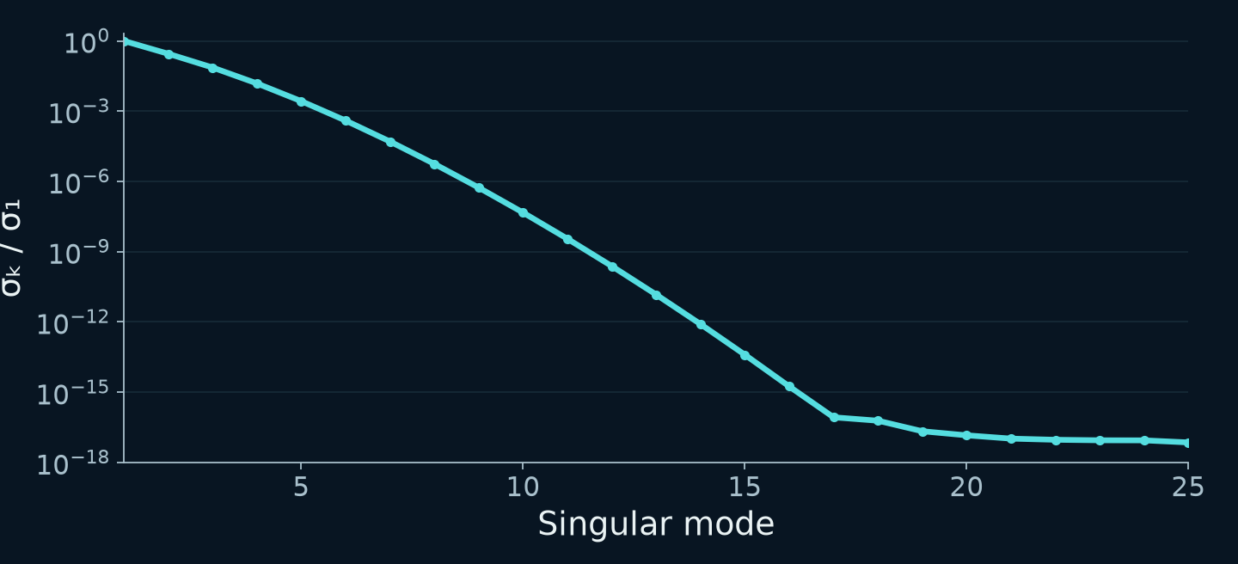
Noise is amplified when the decay is inverted
S = Kf + ε
25
measurements
110
weights to reconstruct
Regularization imposes a preference on the solution
SIMULATION · weak kernel directions · small residuals admit very different solutions
44
Notes:
Reference / consulta · 0 s
The minimum explanation of ill-conditioning is this exponential kernel with very similar columns. Some combinations of weights barely affect the signal; inversion amplifies noise in those directions. The example has 25 measurements and 110 weights, but the problem is not merely counting unknowns: singular values decay rapidly. A denser grid adds no measured information. Regularisation introduces a preference among compatible solutions; next we examine its cost.
Sources:
Reproducible v5 ILT ambiguity and regularization simulations
[local-source: ilt_simulations.json]
ILT method-choice and appendix guidance
[local-source: ilt_teaching_guidance.json]

Slide 45
Each algorithm favours a different solution
Observed problem | Family / examples | Preference and risk
Isolated signal | Monoexp. / NNLS | Minimal model / unstable unregularized peaks
Broad distribution | Tikhonov / MaxEnt / PALMA | Regularization / may merge components
Few components | ITAMeD / L1 / VP / SCORE | Sparsity or model order / wrong assumptions
Overlapping signals | MF / TRAIn-MF / SILT | Shared structure / spurious factors
Compare solutions with the same b values, noise and preprocessing
Complete catalogue in the appendix: uses, limits and availability. FISTA/ADMM/SVD are engines, not physical models.
45
Notes:
Reference / consulta · 0 s
Do not select by the most fashionable name. For one expected diffusion in an isolated signal, start with a monoexponential model. For a continuous distribution, smoothing, entropy or combinations such as PALMA impose different preferences. A few discrete species call for sparse or discrete fitting with justified order and separation. Use joint routes for relationships across frequencies. FISTA, ADMM and SVD are numerical tools: they do not replace the physical model on their own. The full appendix explains each use and limitation. Its records include overlapping methods, routes and components rather than unique algorithm counts or experimental certification.
Sources:
Audited bilingual catalogue of local inversion methods and context families
[local-source: ilt_algorithm_catalog_bilingual.json]
ILT method-choice and appendix guidance
[local-source: ilt_teaching_guidance.json]

