Slide 1
Comparison of Gradient-based Optimization Methods for the Time Series Sample Mean Problem in DTW Space
Max Reinhard & Faraz Maschhur

Slide 2
Main takeaways from this presentation
What gradient-based optimization is
How to apply it to the sample mean problem in DTW spaces
Basic understanding of some state-of-the-art methods

Slide 3
Outline
Introduction
Fréchet function
Gradient descent
SSG, SAdam & SSGLD
Experiments
Results
Conclusion

Slide 4
Introduction

Slide 5
Introduction
Samples are sets of time series
DTW distance is calculated between two time series
calculation of sample mean needs distance measure
certain classification methods need mean (e.g. k-means)
we need to solve the sample mean problem
Real use case: Voice Recognition/Classification

Slide 6
Fréchet function

Slide 7
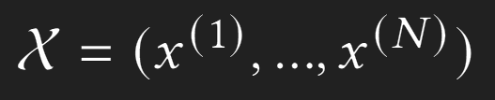
Fréchet function

Slide 8
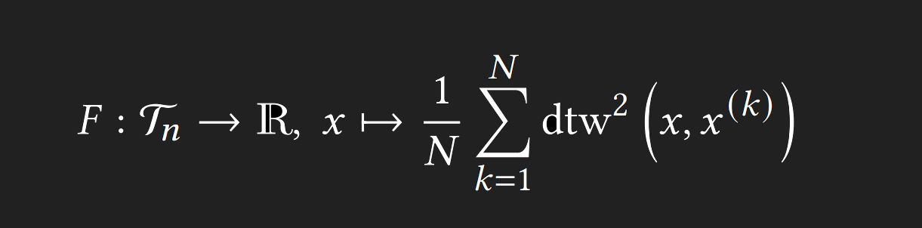
Fréchet function

Slide 9
Fréchet function
non-smooth, non-convex ⇒ non-differentiable
subgradients are defined for the Fréchet function at every point
sample mean problem ⇒ minimizing the Fréchet function of that sample
minimizing the Fréchet function is NP-hard

Slide 10
Gradient descent

Slide 11
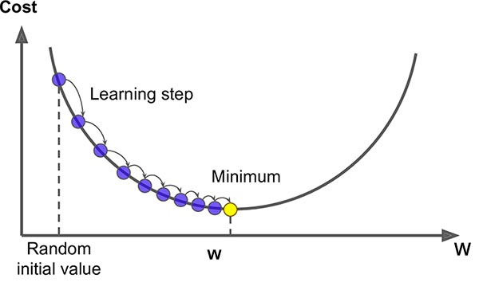
Gradient descent
Gradient descent
→ compute gradient for all data points
Stochastic gradient descent
→ pick random data point for gradient computation
z

Slide 12
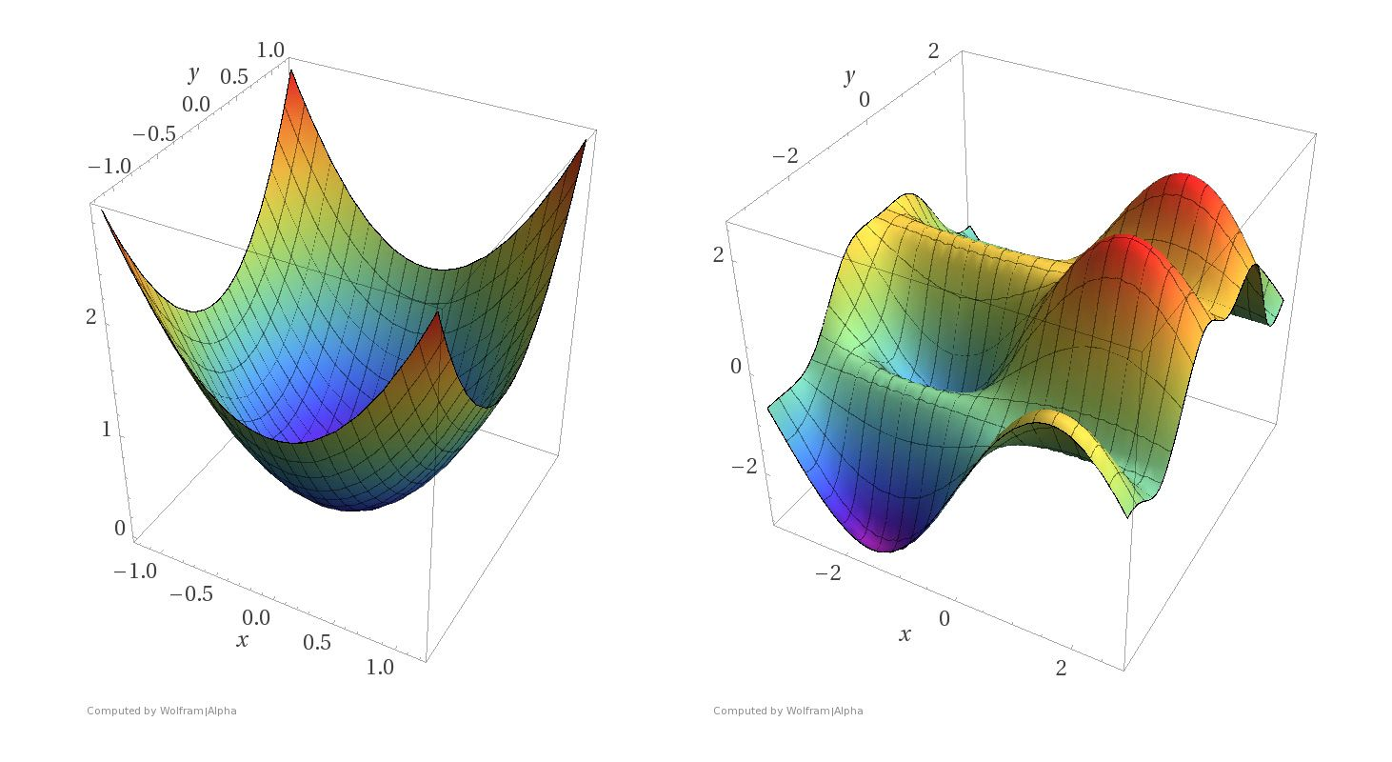
Gradient descent

Slide 13
SSG, SAdam & SSGLD

Slide 14
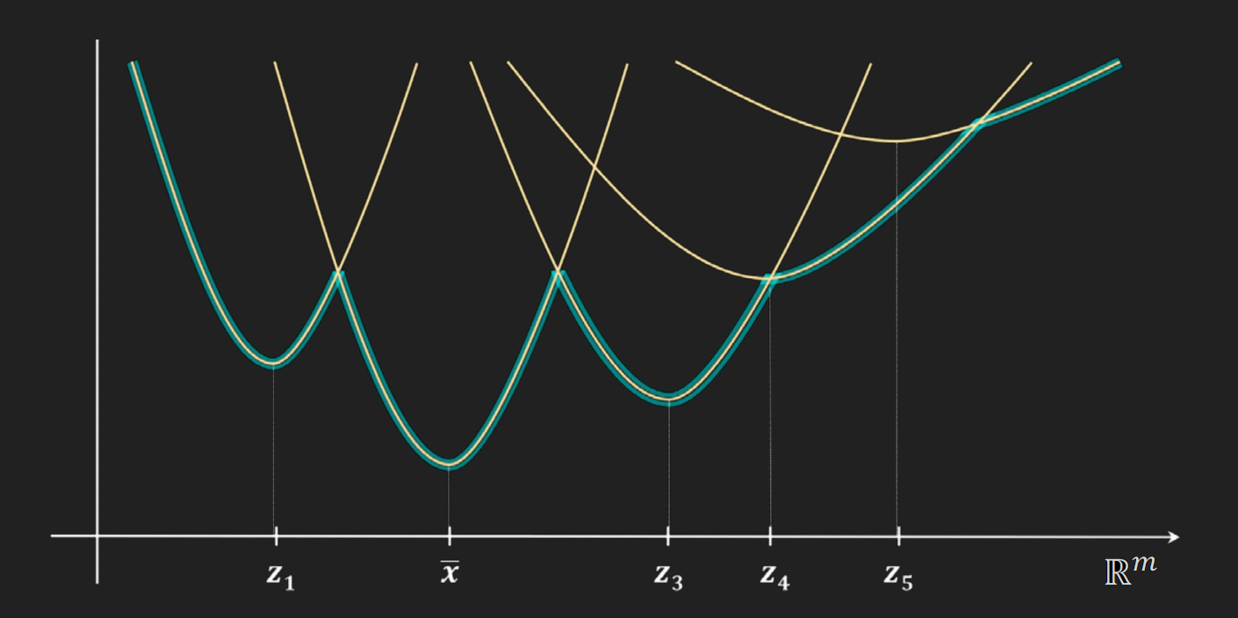
Stochastic Subgradient Descent (SSG)

Slide 15
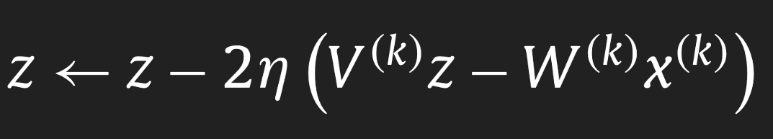
SSG
Update step:
new solution
learning rate
previous solution
subgradient

Slide 16
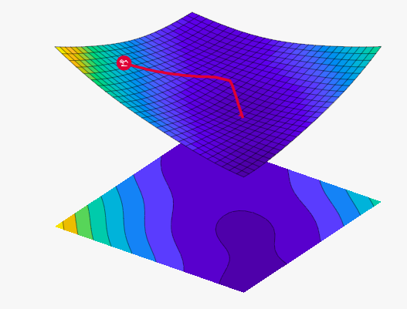
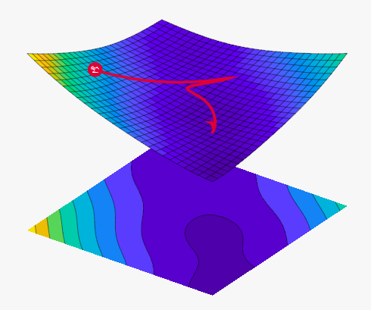
Adam
SGD
Adam

Slide 17
(S)Adam
Adam:
parameter-wise (dimension-wise) learning rates
momentum
Subgradient Adam (SAdam):
→ Adam with subgradients
Adam

Slide 18
(S)SGLD
short for stochastic gradient langevin dynamics
adds scaled gaussian noise in update steps
similar to Stochastic Gradient Descent
update accepted only after distance calculation
calculates function value for each accepted update
SSGLD: uses subgradients and dtw distance

Slide 19
Experiments

Slide 20
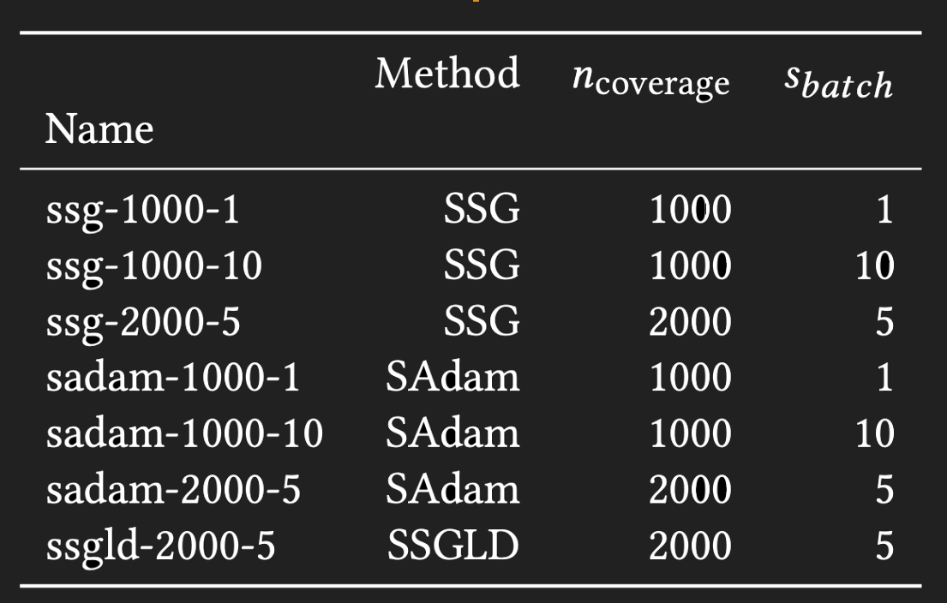
Experiments
Configuration parameters
number of data points (samples) to visit: n_coverage
batch size: s_batch
number of update steps:
n_coverage / s_batch

Slide 21
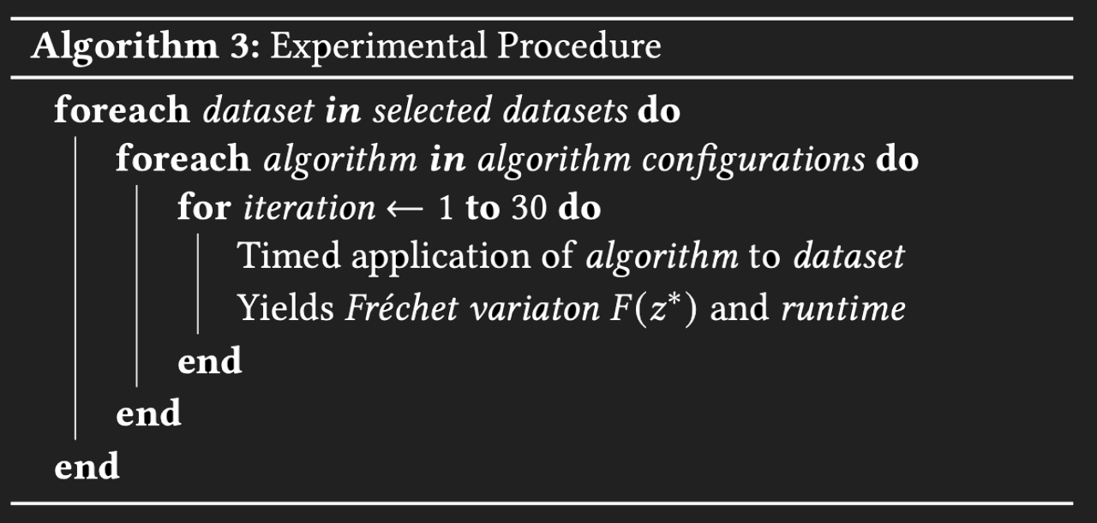
Experiments
24 datasets from UCR Time Series Classification Archive
24 * 30 = 720 iterations per algorithm

Slide 22
Results

Slide 23
Results
comparing effectiveness of same algorithm with different configurations
also comparing effectiveness of the different algorithms regardless of their configurations
measured which configuration or algorithm outperformed their counterparts
outperforming: lower mean variation over all iterations

Slide 24
Results - SSGLD
tested only one SSGLD configuration in main experiment line: ssgld-2000-5
ssgld-2000-5 did not run on all datasets due to missing time
early testing of two SSGLD configurations on 4 datasets: ssgld-1000-1, ssgld-1000-10
in total, on four datasets we tested all three SSGLD configurations

Slide 25
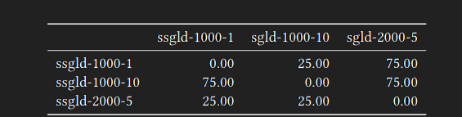
Results - SSGLD
ssgld-2000-5 outperforms other configurations in 75% of the datasets
ssgld-1000-1 outperforms ssgld-1000-10 in 75% of the datasets
ssgld-2000-5 > ssgld-1000-1 > ssgld-1000-10

Slide 26
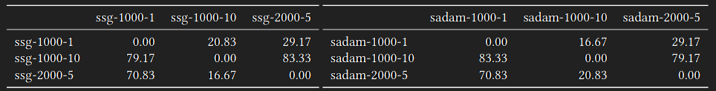
Results - SSG & SAdam
ssg-1000-1 outperforms the other SSG configurations
sadam-1000-1 outperforms the other SAdam configurations
ssg-1000-1 > ssg-2000-5 > ssg-1000-10
sadam-1000-1 > sadam-2000-5 > sadam-1000-10

Slide 27
Results - Configurations
lower batch size seems to matter more than a higher number of samples visited
more updates ⇒ better performance

Slide 28
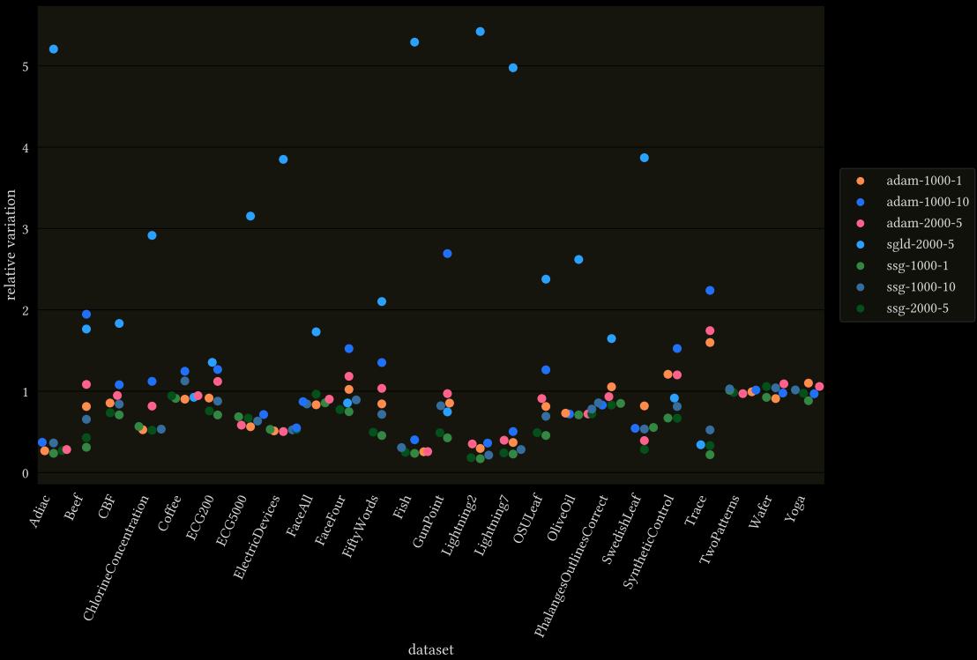
Results - Algorithms

Slide 29
Conclusion

Slide 30
Contributions
Adaptation of two advanced gradient descent methods
Adam as SAdam
SGLD as SSGLD
Comparative evaluation of different algorithms and configuration
SSG generally performs best
Number of update steps is influential parameter

Slide 31
Future work
Different gradient-based optimization methods
Hyperparameter research, especially for SSGLD
Configuration (n_coverage, s_batch) research

Slide 32
References
Images:
https://vis.ensmallen.org/
https://saugatbhattarai.com.np/wp-content/uploads/2018/06/gradient-descent-1.jpg
https://blog.paperspace.com/intro-to-optimization-in-deep-learning-gradient-descent/
Literature:
Nonsmooth Analysis and Subgradient Methods for Averaging in Dynamic Time Warping Spaces: https://arxiv.org/abs/1701.06393
Hardness of Consensus Problems for Circular Strings and Time Series Averaging: https://www.researchgate.net/publication/324387635_Hardness_of_Consensus_Problems_for_Circular_Strings_and_Time_Series_Averaging

Slide 33
Are there questions?

