Slide 1
Version control with Git for scientists
May 26, 2017
PY Barriat & F. Massonnet http://www.climate.be:3000/TECLIM/Git_Training

Slide 2
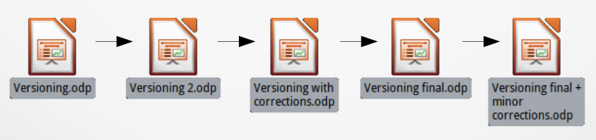
Discuss
How do you manage different file versions ?
How do you work with collaborators on the same files ?

Slide 3
Notions of code versioning
Track the history and evolution of the project
think of it as a series of snapshots (commits) of your code
Benefits:
team work
tracking bugs
recovering from mistakes
Different usage:
local
client-server (SVN)
distributed (Git)

Slide 4
What is Git ?
Version control system
Manage different versions of files
Collaborate with yourself
Collaborate with other people
Why use Git
“Always remember your first collaborator is your future self, and your past self doesn’t answer emails”
→ Christie Balhai

Slide 5
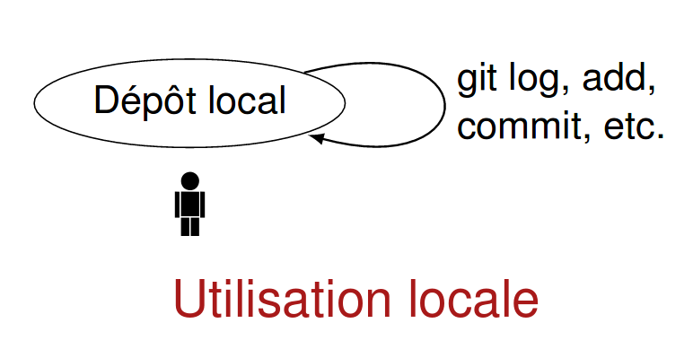
What is Git good for ?
Local
Backup, reproducibility

Slide 6
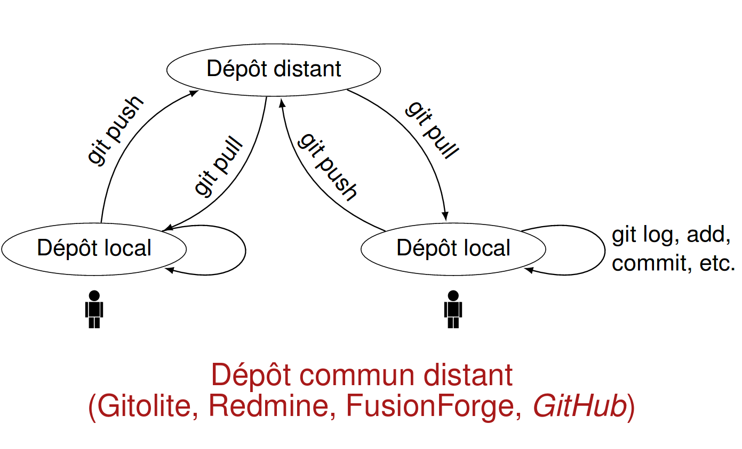
What is Git good for ?
Client-Server
Backup, reproducibility, collaboration

Slide 7
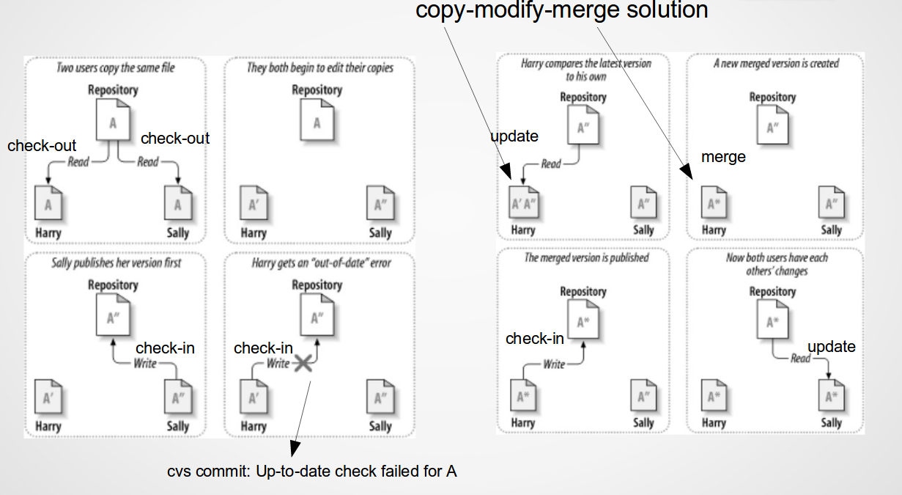
Limitation

Slide 8
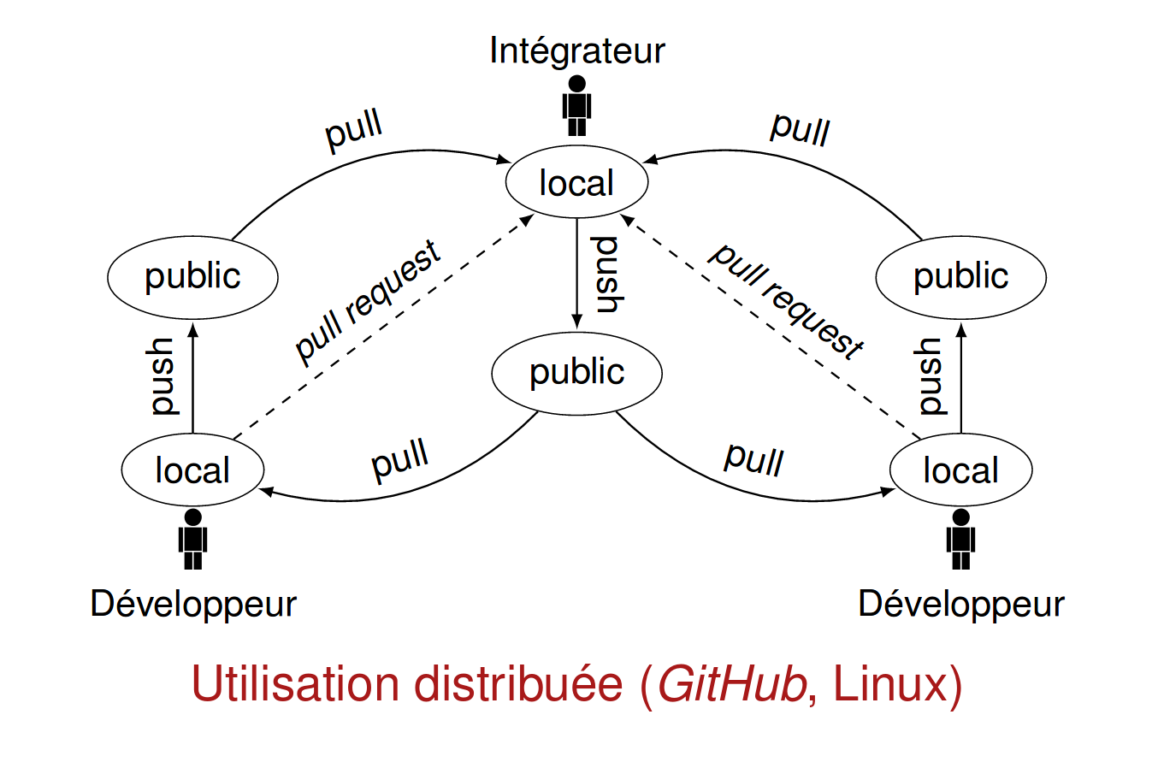
What is GIT good for ?
Distributed
Backup, reproducibility, collaboration, transparency

Slide 9
Difference between Git & GitHub?
Git is the version control system service
Git runs local if you don't use GitHub
GitHub is the hosting service, a website
on which you can publish (push) your Git repositories and collaborate with other people
- It provides a backup of your files
- It gives you a visual interface for navigating your repos
- It gives other people a way to navigate your repos
- It makes repo collaboration easy (e.g., multiple people contributing to the same project)
- It provides a lightweight issue tracking system

Slide 10
… and GitLab vs GitHub vs others
GitLab is an alternative to GitHub
GitLab is free for unlimited private projects. GitHub doesn't provide private projects for free
And for ELIC, Gogs does the job
shares the same features (Dashboard, File browser, Issue tracking, Groups support, Webhooks, etc)
easy to install, cross-platform friendly,
uses little memory, uses little CPU power
… and 100% free

Slide 11
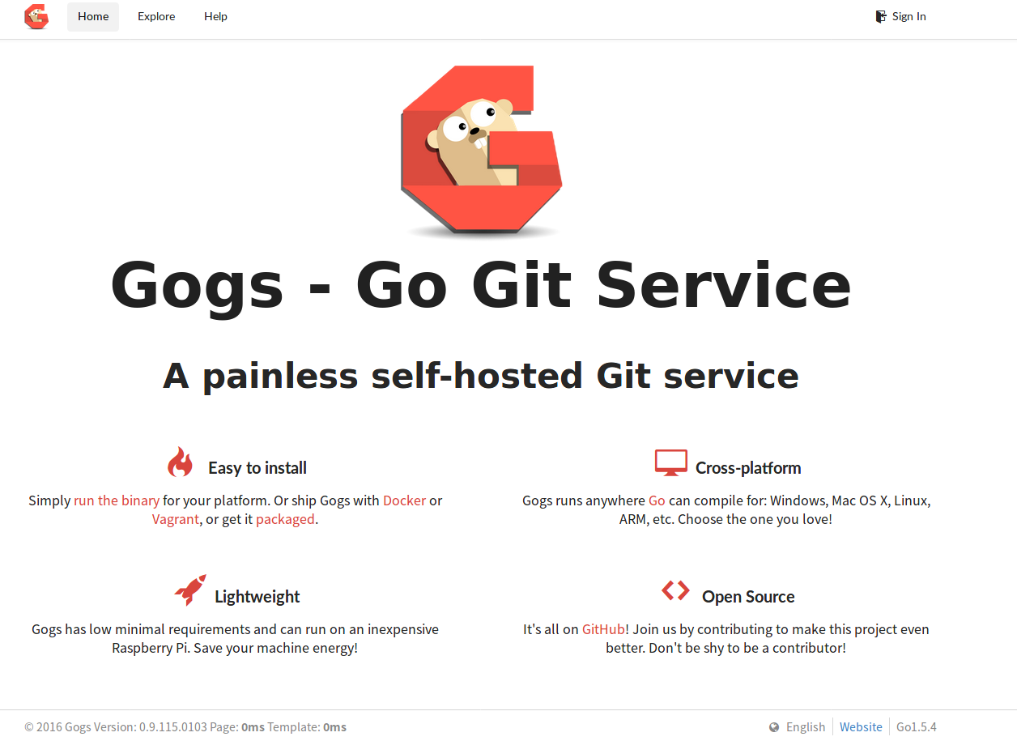
Gogs: http://www.climate.be:3000

Slide 12
Simple guide for getting started
Checkout a remote repository
create a local working copy of a remote repository by running the command
git clone http://pbarriat@www.climate.be:3000/TECLIM/Git_Training.git
or
git clone ssh://git@www.climate.be:3022/TECLIM/Git_Training.git
Add & commit
You can propose changes (add it to the Index)
You can commit these changes to the HEAD
git add <filename>
git commit -m “Commit message”

Slide 13

Git workflow
Your local repository consists of three "trees" maintained by git
the first one is your Working Directory which holds the actual files
the second one is the Index which acts as a staging area
and finally the HEAD which points to the last commit you've made

Slide 14
Simple guide for getting started
Pushing changes
Your changes are now in the HEAD of your local working copy. To send those changes to your remote repository
git push
Update
to update your local repository to the newest commit, execute
git pull
in your working directory to fetch and merge remote changes.

Slide 15
Replace local changes
In case you did something wrong, which for sure never happens ;), you can replace local changes using the command
git checkout -- <filename>
this replaces the changes in your working tree with the last content in HEAD. Changes already added to the index, as well as new files, will be kept

Slide 16
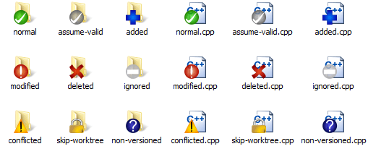
Windows users
How commonly do programmers use Git GUIs instead of the command line?
use programs like SourceTree or TortoiseGit
But, to be familiar with Git, try the command line
(clone, push/pull, merge, rebase, log, tag, format-patch/am, bisect, blame, etc).

Slide 17
Simple Git Exercices
First, configure your environment (just once)
(on your laptop, on your ELIC account, etc)
Now, clone http://www.climate.be:3000/TECLIM/Git_Training
Theses are very simple exercices to learn to manipulate git. In each folder, simply run ./create.sh and follow the guide ;)
git config --global user.name "Your Name"
git config --global user.email "foo@bar.be"
git config --global color.ui auto
git config --global core.editor "vim"
git config --list

