Slide 1

Test Automation using
Robot Framework
Students summer practice
Ramona TICAU, Mihai PARVU
21-07-2020

Slide 2
Agenda
1
Test Automation – what is it?
2
Test Automation – why?
3
Test Automation – tools
4
Robot Framework – overview
5
Robot Framework – example
6
Robot Framework – test data syntax
7
Robot Framework – creating tests
8
Selenium Library – overview
9
Exercise – in classroom
10
Exercise – homework

Slide 3
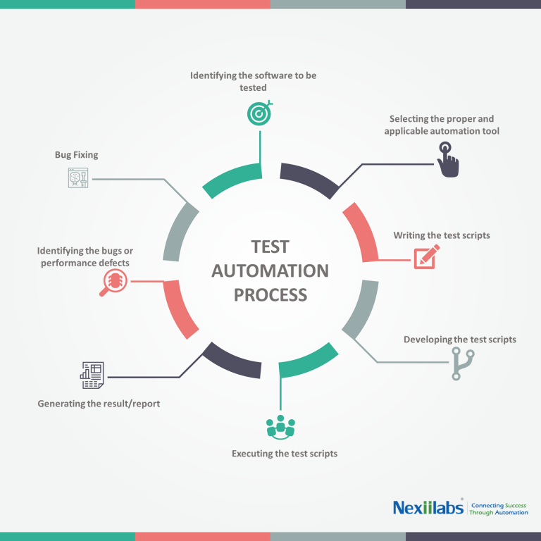
Test Automation – What is it?
Manual vs. automated testing?
Test automation is the practice of running tests automatically, managing test data, and utilizing results to improve software quality.
Types of automated tests:
Unit tests
Acceptance tests
Smoke tests
Performance tests
….

Slide 4

Test Automation – Why?
Save time by less manual testing
Quality Assurance
Repeatability
Reusability
Programable
Early detection of defects
24/7 execution
Fast to execute
Increase test coverage

Slide 5

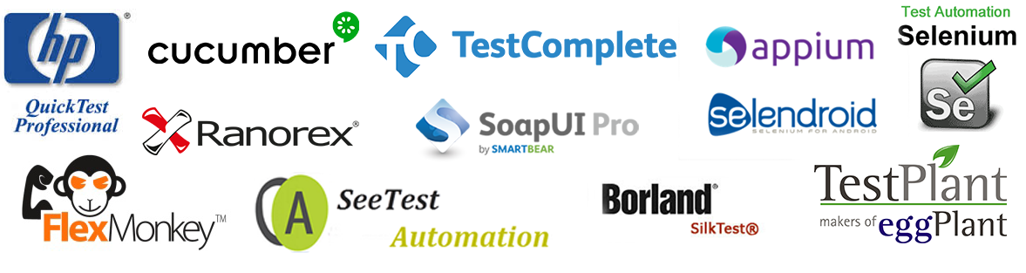
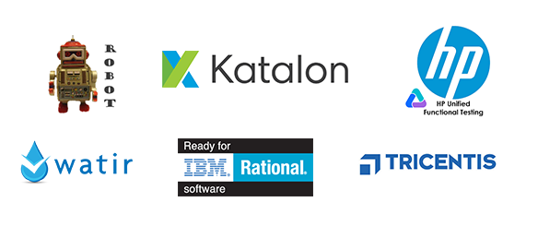
Test Automation – tools
A test automation tool is a piece of software that enables people to define software testing tasks, that are afterwards run with as little human interaction as possible.
There are a plethora of different types of test automation tools available and they differ in:
types of application they test (web, desktop, mobile),
the way the test cases are set up (by writing code using a scripting language, writing code in a full programming language, recording steps performed using a GUI),
their licenses (free, freemium, commercial)

Slide 6




Robot Framework –overview
Robot Framework is a generic test automation framework very suitable for even those who are not too familiar with programming.
keyword driven -> easy to read and understand,
reusability,
open source (it’s free for everyone!),
full extendibility with Python, Java and other programming languages,
flexibility: it can be used in almost any environment (mobile, web, embedded systems - you name it!)
2005
Development started by Pekka Klärck, for Nokia Networks
2008
Robot Framework 2.0 was released as open source.
nowadays
Numerous external libraries and a huge community of users.
Actively supported by many industry-leading companies.
https://robotframework.org

Slide 7
Robot Framework – example
*** Settings ***
Documentation A test suite with a single test for valid login.
...
... This test has a workflow that is created using keywords in
... the imported resource file.
Library SeleniumLibrary
*** Variables ***
${SERVER} localhost:7272
${BROWSER} Firefox
${DELAY} 0
${VALID USER} demo
${VALID PASSWORD} mode
${LOGIN URL} http://${SERVER}/
${WELCOME URL} http://${SERVER}/welcome.html
${ERROR URL} http://${SERVER}/error.html
*** Test Cases ***
Valid Login
Open Browser To Login Page
Input Username demo
Input Password mode
Submit Credentials
Welcome Page Should Be Open
[Teardown] Close Browser
*** Keywords ***
Open Browser To Login Page
Open Browser ${LOGIN URL} ${BROWSER}
Maximize Browser Window
Set Selenium Speed ${DELAY}
Login Page Should Be Open
Login Page Should Be Open
Title Should Be Login Page
Go To Login Page
Go To ${LOGIN URL}
Login Page Should Be Open
Input Username
[Arguments] ${username}
Input Text username_field ${username}
Input Password
[Arguments] ${password}
Input Text password_field ${password}
Submit Credentials
Click Button login_button
Welcome Page Should Be Open
Location Should Be ${WELCOME URL}
Title Should Be Welcome Page

Slide 8
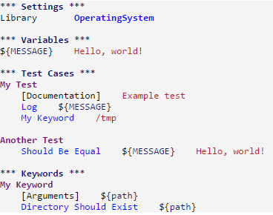
Robot Framework – test data syntax
Test data is structured in four tables/sections :
Settings
  Importing test libraries, resource files and variable file
  Defining metadata for test suites and test cases
Variables
  Defining variables that can be used elsewhere in the test data
Test Cases
  Creating test cases from available keywords
Rules:
Keywords
rule: the test data tables must have one or more asterisk before their names
  Creating user keywords from existing lower-level keywords
rule: two or more spaces between cells

Slide 9
Robot Framework – creating tests (1/3)
Build test scenario:
what functionality you need to test?
which are the actions you need to perform?
what do you want to verify?
*** Settings ***
Library SeleniumLibrary
*** Test Cases ***
Valid Login
Open Browser http://localhost:7272 Chrome
Maximize Browser Window
Login Page Should Be Open
Input Text username_field demo
Input Text password_field mode
Click Button login_button
Location Should Be http://localhost:7272/welcome.html
Title Should Be Welcome Page
Import the needed libraries (there you have your keywords)
Build your testcase, with the available keywords from the libraries.
! Remember the syntax rules

Slide 10
Robot Framework – creating tests (2/3) – introducing variables & high level keywords
*** Variables ***
${SERVER} localhost:7272
${BROWSER} Chrome
${VALID USER} demo
${VALID PASSWORD} mode
${LOGIN URL} http://${SERVER}/
${WELCOME URL} http://${SERVER}/welcome.html
*** Test Cases ***
Valid Login
Open Browser To Login Page
Input Username And Password ${VALID USER} ${VALID PASSWORD}
Submit Credentials
Welcome Page Should Be Open
Close Browser
*** Keywords ***
Open Browser To Login Page
Open Browser ${LOGIN URL} ${BROWSER}
Maximize Browser Window
Login Page Should Be Open
Input Username And Password
[Arguments] ${username} ${password}
Input Text username_field ${username}
Input Text password_field ${password}
Submit Credentials
Click Button login_button
Welcome Page Should Be Open
Location Should Be ${WELCOME URL}
Title Should Be Welcome Page
extract variables
recreate the test using higher level keywords
build higher level keywords

Slide 11
Robot Framework – creating tests (3/3) – benefits of high level keywords
BEFORE
(using library keywords)
AFTER
(using high level keywords)
*** Test Cases ***
Valid Login
Open Browser http://localhost:7272 Chrome
Maximize Browser Window
Login Page Should Be Open
Input Text username_field demo
Input Text password_field mode
Click Button login_button
Location Should Be http://localhost:7272/welcome.html
Title Should Be Welcome Page
*** Test Cases ***
Valid Login
Open Browser To Login Page
Input Username And Password ${VALID USER} ${VALID PASSWORD}
Submit Credentials
Welcome Page Should Be Open
Close Browser
easy to read
easy to maintain
reusability

Slide 12
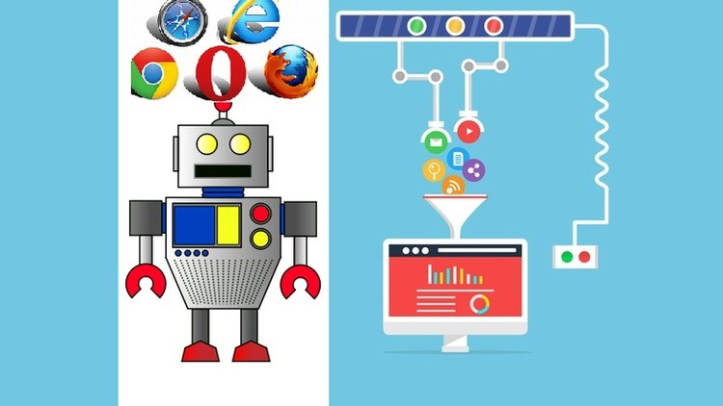
Selenium Library – overview
Web testing library for Robot Framework
Python implementation of Selenium Webdriver to use with Robot Framework
Works in real web browser instance
Specialized keywords to control the browser
It works in most modern browsers
Keywords documentation: http://robotframework.org/SeleniumLibrary/SeleniumLibrary.html
Source code: https://github.com/robotframework/SeleniumLibrary
Issue tracker: https://github.com/robotframework/SeleniumLibrary/issues

Slide 13
Useful links
Robot Framework webpage
Robot Framework on GitHub
Robot Framework User Guide
Robot Framework Quick Start Guide
Robot Framework – How to write good tests
This is your starting point!
Open issues & contribute
The go-to documentation
Getting started to write tests
To read while writing your first tests

Slide 14

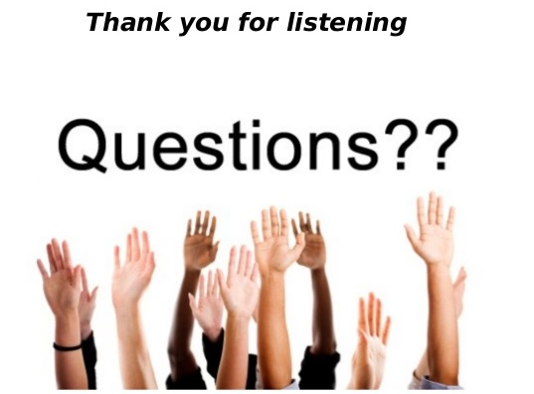

Slide 15
Exercise – in classroom
Automate a test which places an order on https://www.saucedemo.com/
The order should contain:
- 1 x Sauce Labs Onesie
- 1 x Test.allTheThings() T-Shirt (Red)
Check that the order total should be $25.90

Slide 16
Exercise – homework
1. Read How to write good test cases using Robot Framework
2. Finish and improve the classroom test case by extracting variables, keywords
where necessary (e.g. Add Item To Cart, Go To Checkout), extract resource file
(see here).
3. Sandbox Exercise with Robot Framework: Automate something fun!
Can be any webpage of your choosing (e.g. Youtube, Steam, StackOverflow etc.).
Don’t forget we’re writing tests and you have to verify something.

