Slide 1


GIT
July-2020

Slide 2
Agenda
  What is GIT
  Version Control System
  How to use GIT
  Commands
  Branches
  Goal
  Useful links

Slide 3
What is GIT?
  Version control system (VCS) for tracking changes in source code during software development
  Git tracks the changes you make to files, so you have a record of what has been done, and you can revert to specific versions should you ever need to
  Git also makes collaboration easier, allowing changes by multiple people to all be merged into one source

Slide 4
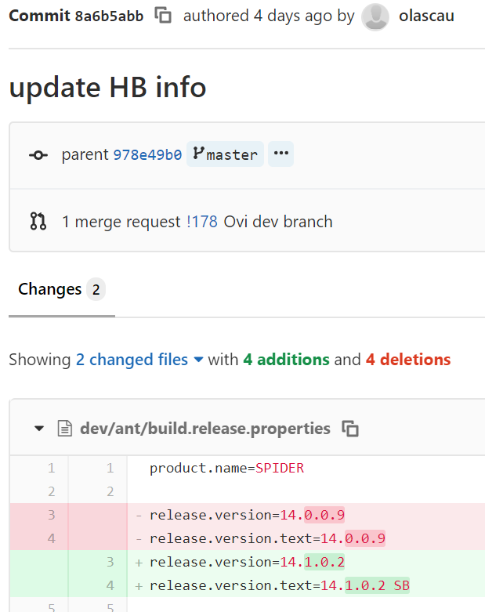
What is a Version Control System?
  System to manage changes on files
Who
When
Why
What
olascau
4 days ago
new release
update HB info

Slide 5
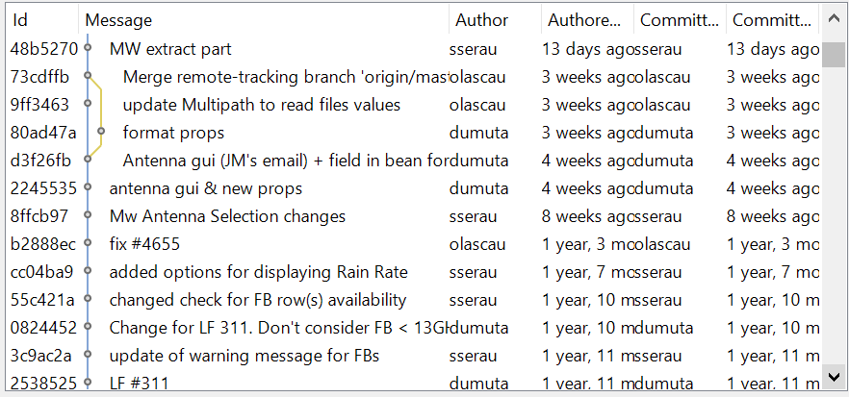
Why to use a Version Control System?
  Revert to or review prior changes
  Maintain multiple versions
  Compare differences
  Share and collaborate
  Continuous Integration & Delivery

Slide 6
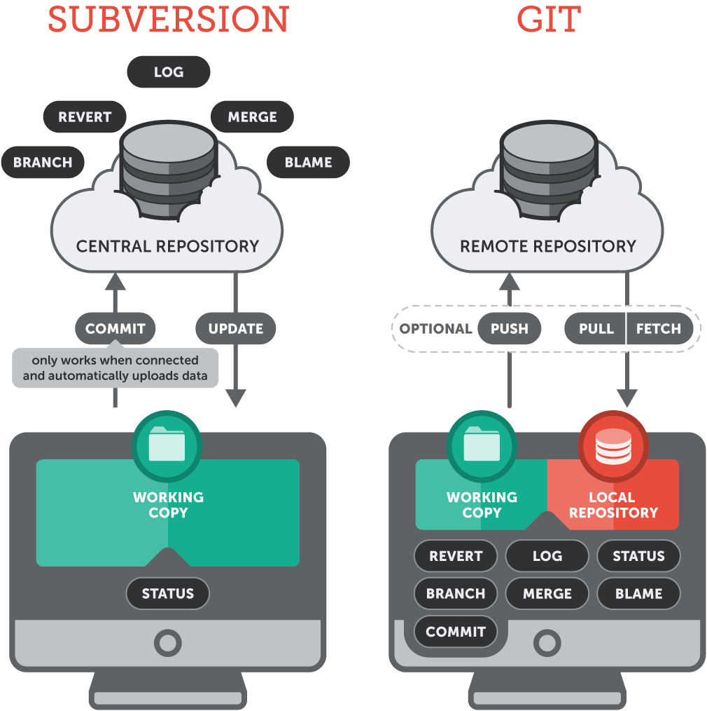
Distributed vs. Centralized Version Control System
  Centralized
Subversion is a centralized VCS: all team members work towards a single central repository, placed on a remote server.
  Distributed
In Git things work a little differently, a Git user will "clone" a repository from a remote server. In return, he receives a full-fledged repository, not just a working copy. The user then has his own repository on his local machine - including all of the project's history.

Slide 7
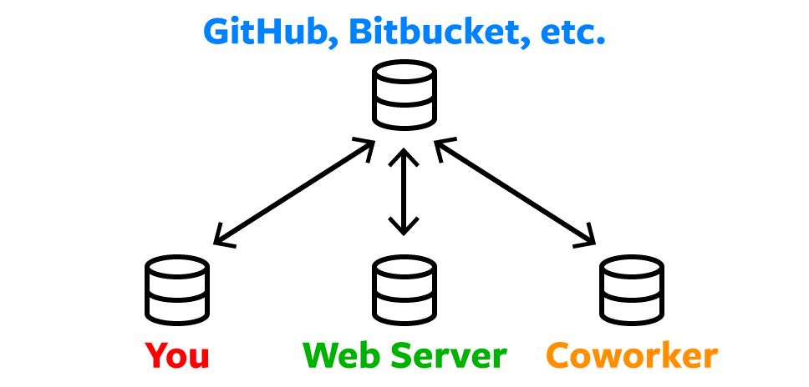
Remote Repositories (on GitHub & Bitbucket)
Storing a copy of your Git repo with an online host (such as GitHub or Bitbucket) gives you a centrally located place where you can upload your changes and download changes from others, letting you collaborate more easily with other developers.

Slide 8
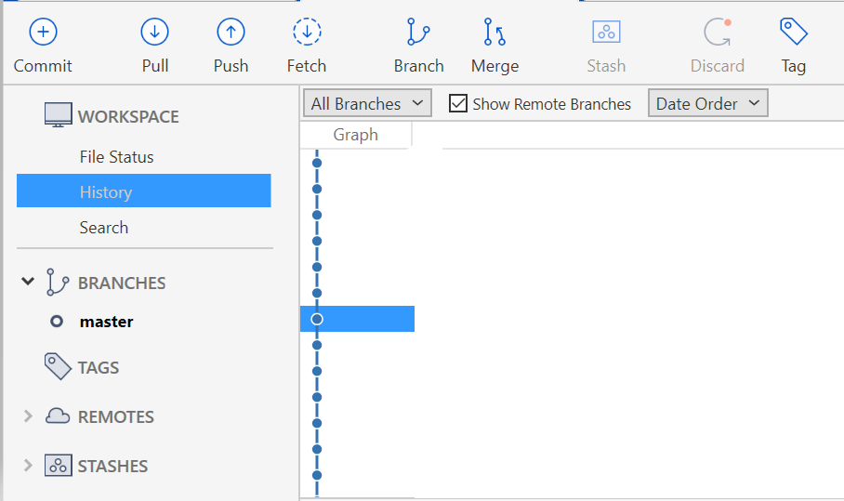
Ways to Use Git
Git is software that you can access via a command line (terminal), a desktop app that has a GUI (graphical user interface) such as Sourcetree (shown below) or Plugins (for instance, Eclipse plugin for git)

Slide 9
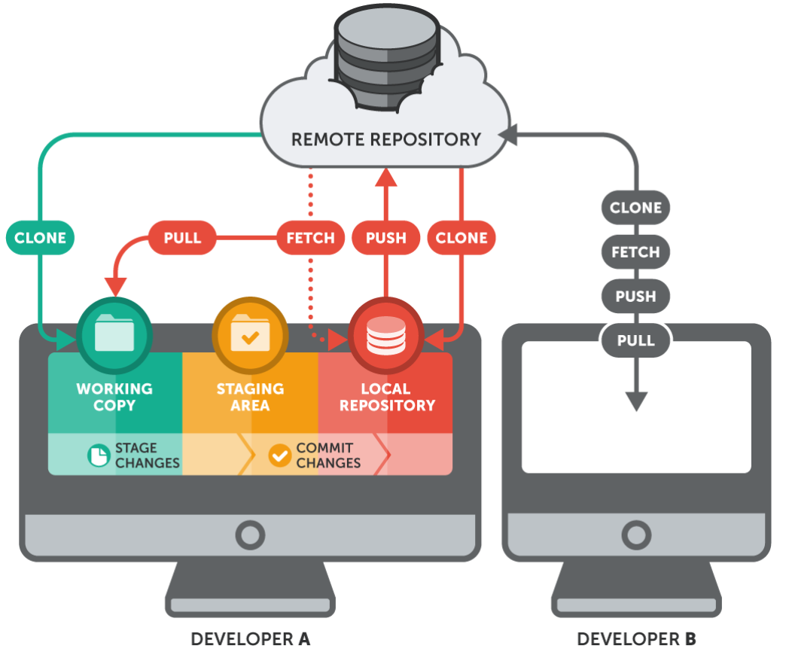
Understand the working of GIT

Slide 10
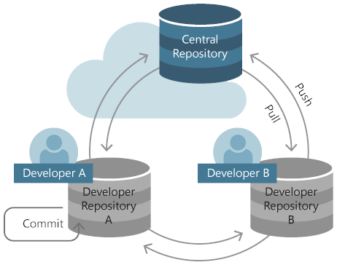
GIT repository
A Git repository (or repo for short) contains all of the project files and the entire revision history. You’ll take an ordinary folder of files (such as a website’s root folder), and tell Git to make it a repository. This creates a .git subfolder, which contains all of the Git metadata for tracking changes.

Slide 11
Clone in GIT
Using clone you can clone/download a repository and its entire version history. Instead of getting just a working copy, Git receives a full copy of nearly all data that the server has. Every version of every file for the history of the project is pulled down by default when you run git clone.
You clone a repository with git clone <url>. For example, if you want to clone the Git project “apachepoitest”, you can do so like this:
$ git clone https://github.com/<user_name>/apachepoitest

Slide 12
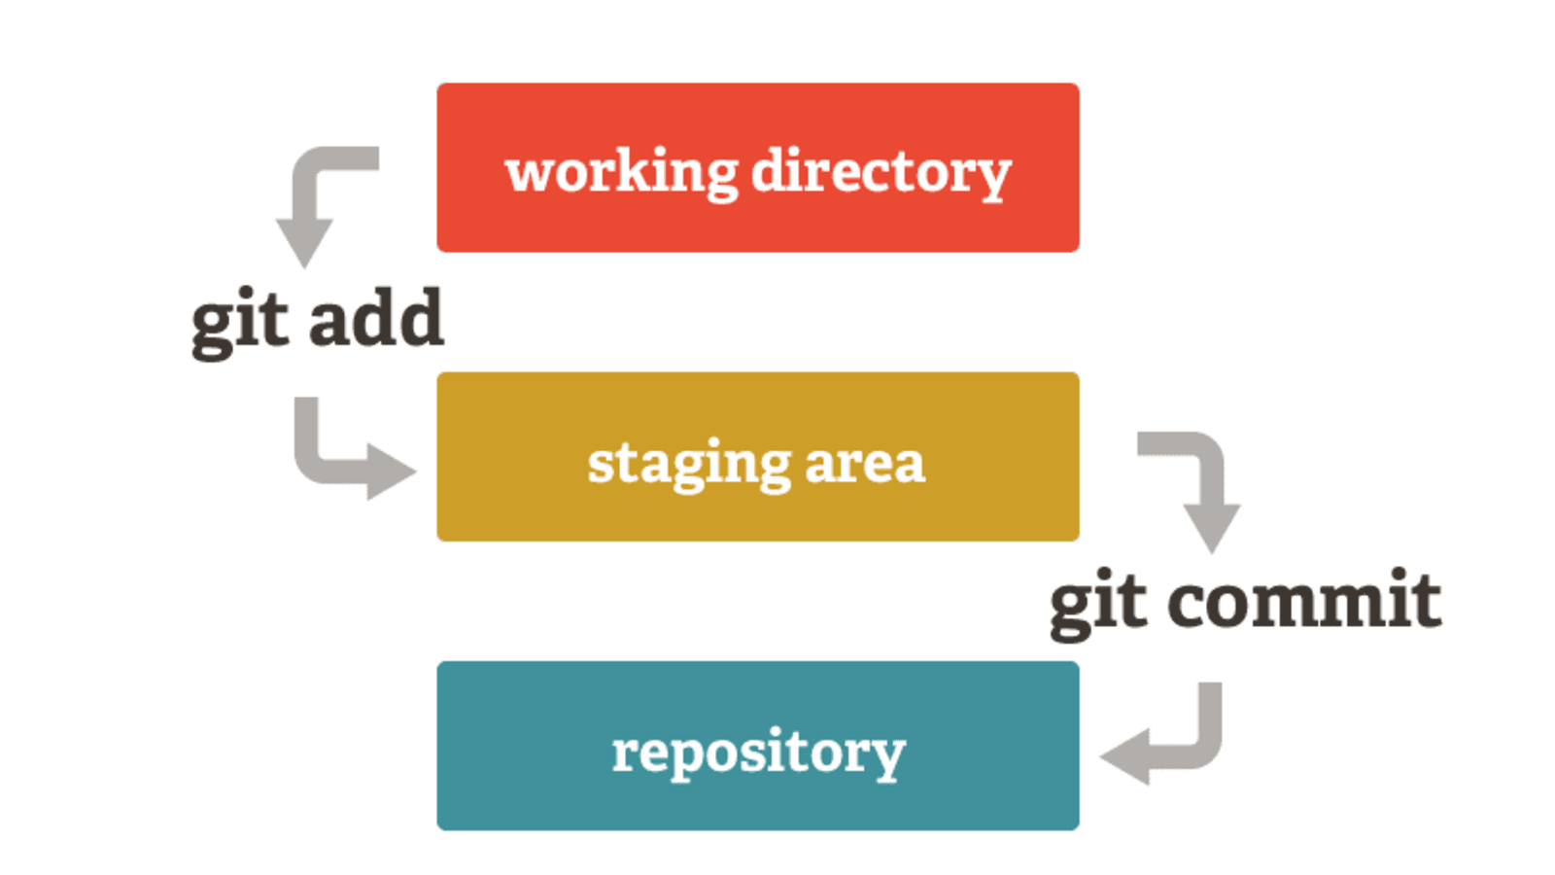
Stage & Commit
Think of Git as keeping a list of changes to files. So how do we tell Git to record our changes? Each recorded change to a file or set of files is called a commit.
Before we make a commit, we must tell Git what files we want to commit. This is called staging. Why must we do this? Why can’t we just commit the file directly?
Let’s say you’re working on a two files, but only one of them is ready to commit. You don’t want to be forced to commit both files, just the one that’s ready. That’s where Git’s add command comes in. We add files to a staging area, and then we commit the files that have been staged.

Slide 13
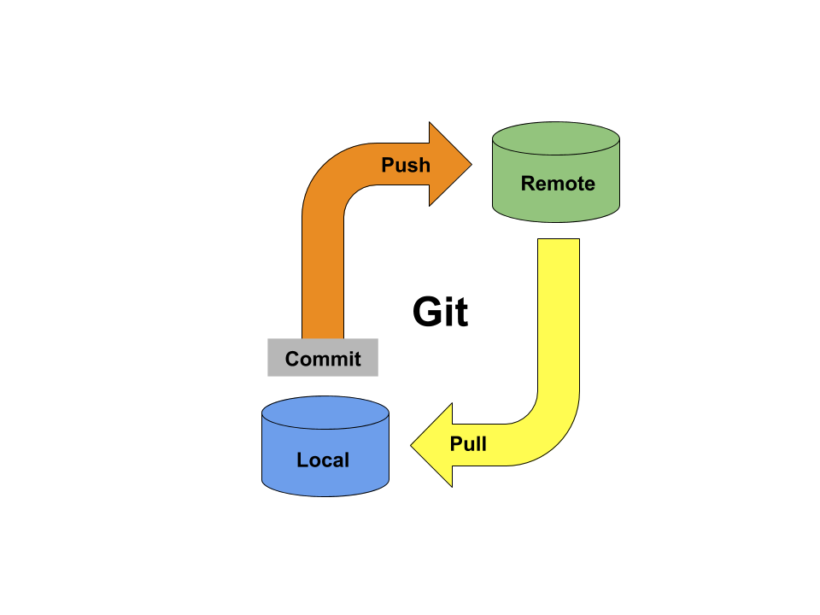
Push & Pull
The git push command is used to upload local repository content to a remote repository. Pushing is how you transfer commits from your local repository to a remote repo.
The git pull command is used to fetch and download content from a remote repository and immediately update the local repository to match that content.

Slide 14
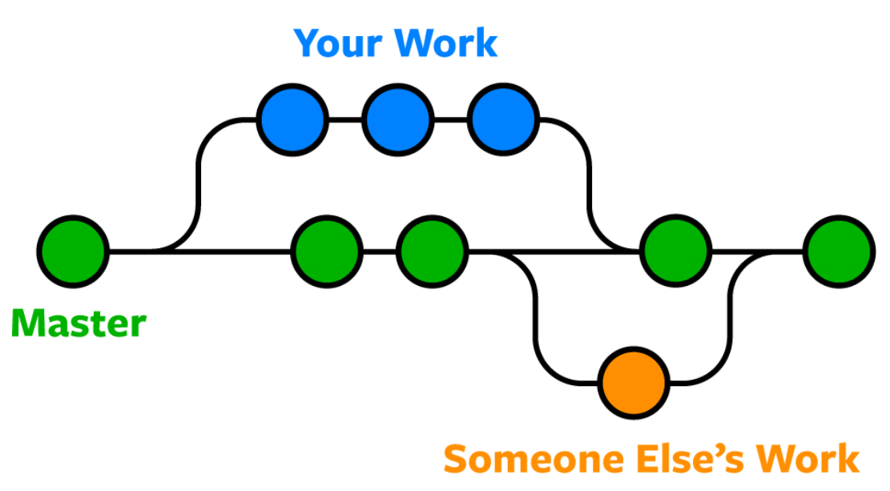
Branching in GIT
Branches provide an isolated environment for every change in you codebase. Branches can be created for features or for developers. This ensures that the master branch always contains production – quality – code.

Slide 15
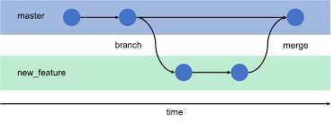
An example of how Git branches are useful
Let’s say you need to work on a new feature for a website. You create a new branch and start working. You haven’t finished your new feature, but you get a request to make a rush change that needs to go live on the site today. You switch back to the master branch, make the change, and push it live.
Then you can switch back to your new feature branch and finish your work. When you’re done, you merge the new feature branch into the master branch and both the new feature and rush change are kept!

Slide 16
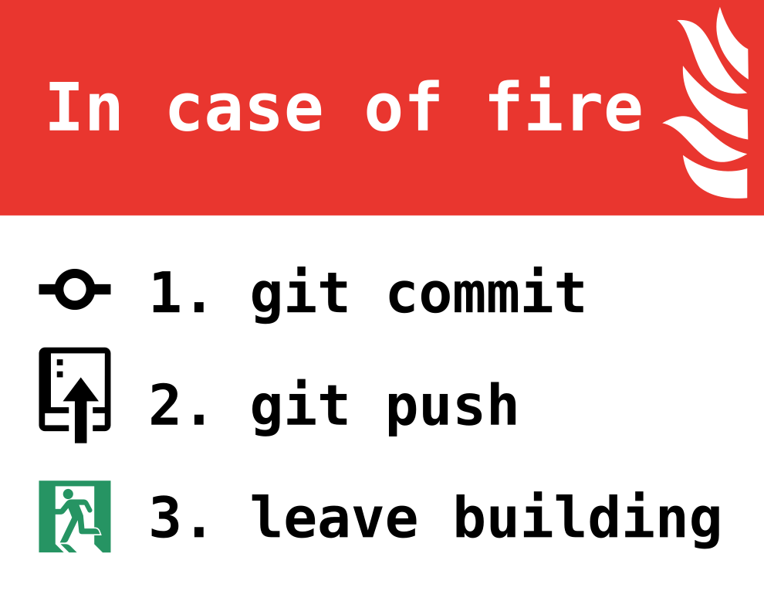
Goal
Use version control for your own projects

Slide 17
  Useful links
  GIT & GITHUB
  Interactive way to learn Git on the Web
  Install and configure Git plugin in Eclipse
  First project with GitHub

