Slide 1

Students summer practice
Ancuta ZAHARIE, Ioana MIRONIUC
07-07-2020

Slide 2
Agenda
01
Software development - overview
02
History of adopting Agile
03
Agile Software Development - core values
04
Agile Software Development - principles
05
Agile - summary
06
Scrum - overview
07
Scrum - roles
08
Scrum - events
09
Scrum - artifacts
10
Scrum - values

Slide 3
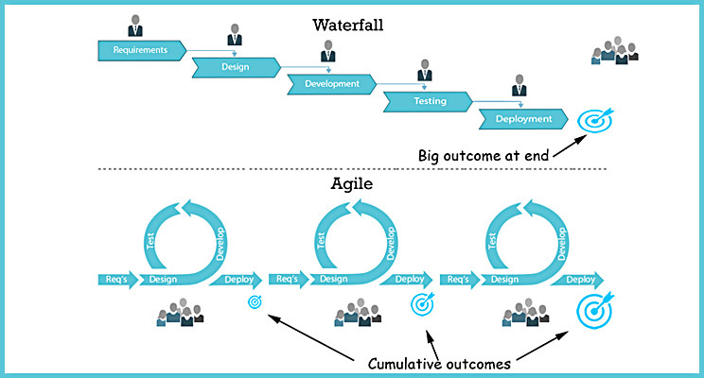
Software Development overview

Slide 4
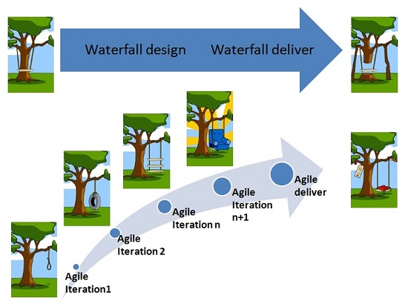
Waterfall vs. Agile

Slide 5


History of adopting Agile
Since when?
    February 2001 = Agile ‘Software Development’ Manifesto
    Agile development refers to any development process that is aligned with the concepts of the Agile Manifesto. The Manifesto was developed by a group fourteen leading figures in the software industry, and reflects their experience of what approaches do and do not work for software development.
    The Agile Manifesto was created as an alternative to document-driven, heavyweight software development processes such as the waterfall approach.
Why to use Agile?
    Customers find that the vendor is more responsive to development requests.
    Vendors reduce wastage by focusing development effort on high-value features
    Team members enjoy development work and like to see their work used and valued
    Product Managers can easily ensure that development work is aligned with customer needs
    Provides high visibility into the state of a development project, on a daily basis
    Enables teams to deliver value faster, with greater quality and predictability, and greater aptitude to respond to change

Slide 6
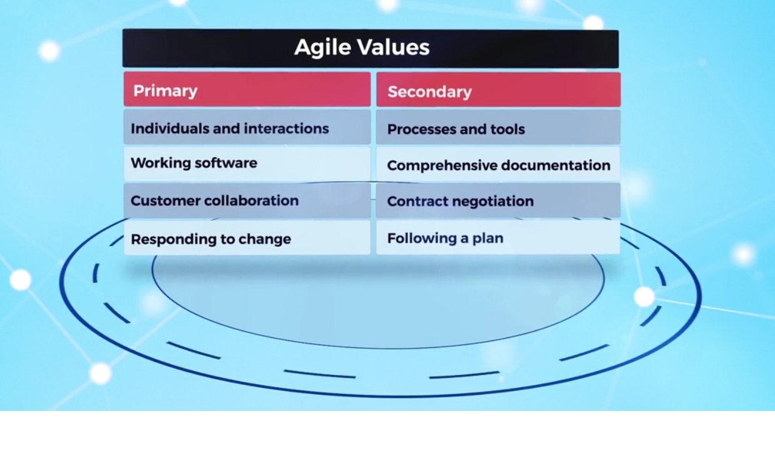
Agile Software Development – core values

Slide 7
Agile Software Development – principles (1)
01
Satisfy the customer
04
Work together
Our highest priority is to satisfy the customer through early and continuous delivery of valuable software.
Business people and developers must work together daily throughout the project.
02
Welcome change
05
Motivate individuals
Welcome changing requirements, even late in development
Build projects around motivated individuals. Give them the environment and support they need, and trust them to get the job done
Deliver software frequently
Use face-to-face communication
03
06
Deliver working software frequently, with a preference to the shorter timescale
The most efficient and effective method of conveying information to and within a development team is face-to-face conversation

Slide 8
Agile Software Development – principles (2)
Working software equals progress
Simplicity
07
10
Working software is the primary measure of progress
Simplicity--the art of maximizing the amount of work not done--is essential
Constant pace
Self-organizing
08
11
Promote sustainable development.
The sponsors, developers, and users should be able to maintain a constant pace indefinitely
The best architectures, requirements, and designs emerge from self-organizing teams
Technical excellence
Team reflection at regular intervals
09
12
Continuous attention to technical excellence and good design
At regular intervals, the team reflects on how to become more effective, then tunes and adjusts its behaviour accordingly

Slide 9
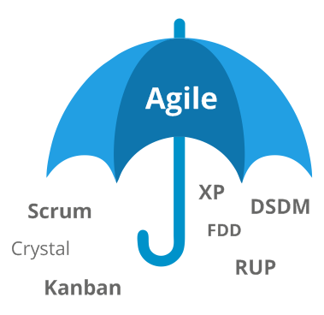
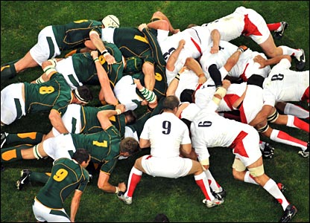
Agile - summary
Agile is a philosophy
Scrum is a framework
Scrum is a process framework that has been used to manage work on complex products since the early 1990s
A “process framework” is a particular set of practices that must be followed
Ken Schwaber and Jeff Sutherland developed Scrum
Agile software development is a philosophy for managing software projects and teams

Slide 10
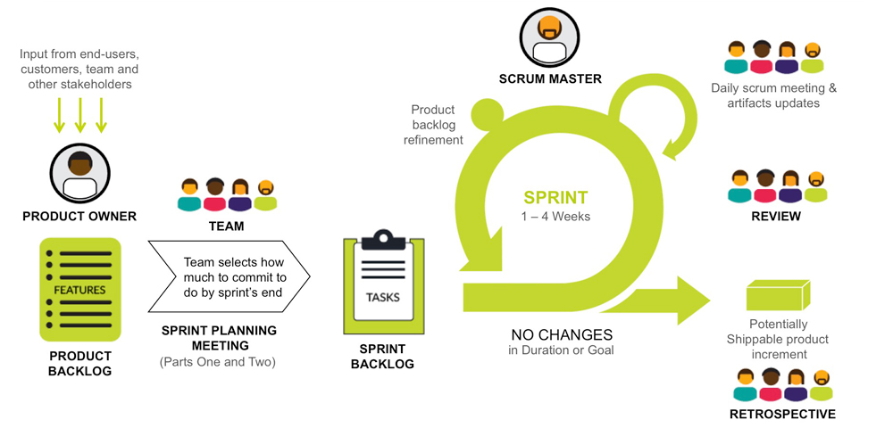
Scrum - overview

Slide 11

Scrum – Roles
Product Owner
Represents the client and the business in general for the product on which they’re working
What to build next?
Scrum Master
Development Team
Responsible for ensuring the team has everything they need to deliver value
How to build it on time?
A group of cross-functional team members all focused on the delivery of working software
How to build it best?

Slide 12
Scrum – Events
Sprint Planning
Scrum Events
Sprint Retrospective
What can be delivered in the Increment resulting from the upcoming Sprint?
How will the work needed to deliver the Increment be achieved?
Inspect how the last sprint went
Identify and order the major items that went well and potential improvements
Create a plan for implementing improvements
1
5
Daily scrum
Sprint Review
2
4
What did I do yesterday?
What will I do today?
Do I see any impediments?
Informal meeting, is held at the end of the Sprint
inspect the Increment
adapt the Product Backlog if needed
3
Backlog Refinement
Refine upcoming backlog items to ensure they are READY when needed

Slide 13
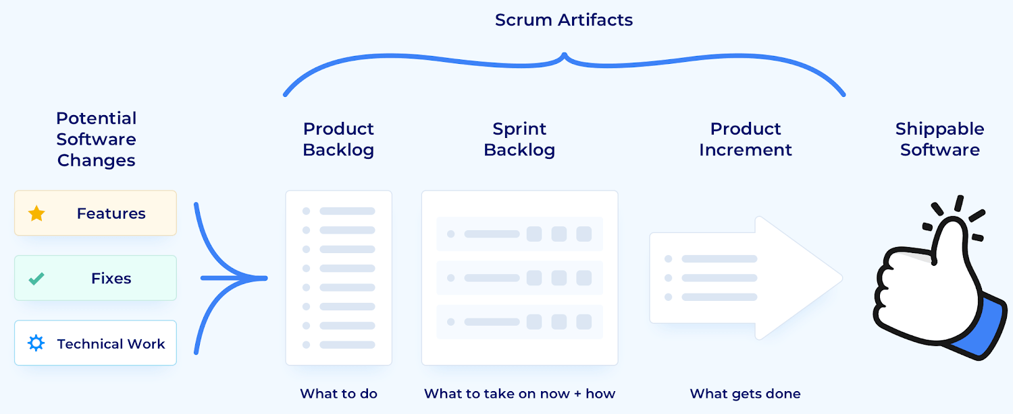
Scrum – Artifacts

Slide 14
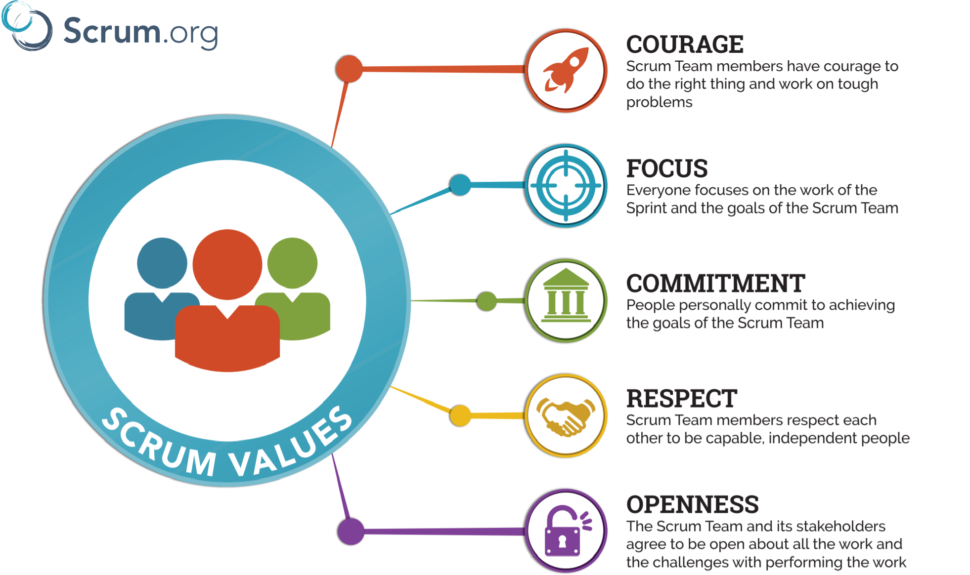
Scrum – Values

Slide 15
Useful links
https://agilemanifesto.org/
https://www.agilealliance.org/agile101/
https://www.integratedconsulting.ro/insights/agile-in-business/
https://www.scrum.org/resources/what-is-scrum
https://www.scrumguides.org/scrum-guide.html
https://medium.com/@francoismugorozi/my-understanding-of-the-scrum-framework-and-benefits-of-the-scrum-events-ebd889da1472
https://article.efecte.com/blog/en/what-is-agile-in-it-and-how-to-get-into-the-right-mindset
https://pmtonomy.com/methodologies/agile
https://usefyi.com/scrum/
https://www.plutora.com/blog/12-agile-principles
https://www.cprime.com/resources/what-is-agile-what-is-scrum/

Slide 16
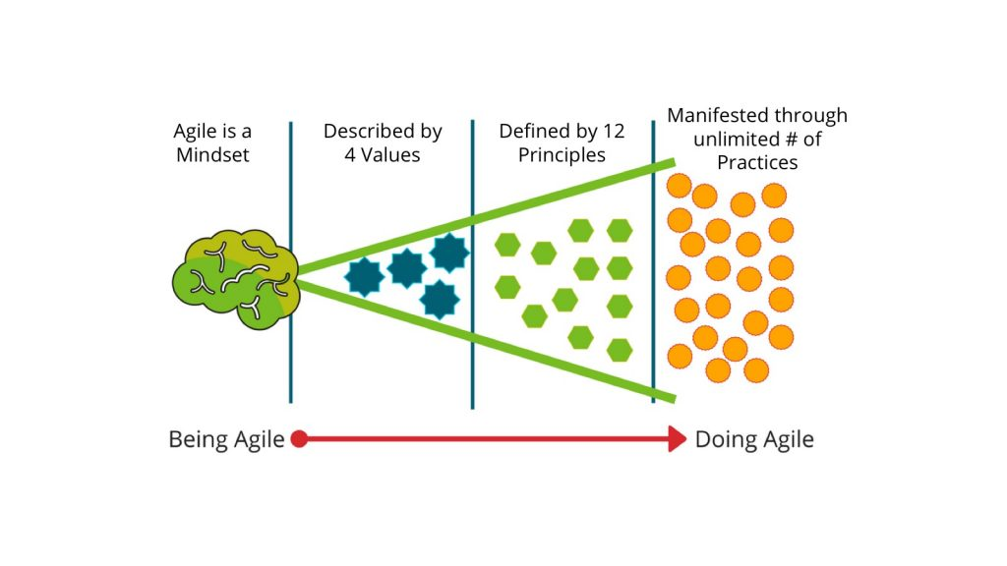
Being Agile, Doing Agile

Slide 17


17
© 2019 Nokia

