Slide 1
Fabrice Matulic, PhD
Senior/Lead Researcher in Human Computer Interaction, XR and Applied AI at Preferred Networks, Tokyo
20+ years of international R&D experience across industry and academia
Proven record of leading international multidisciplinary teams through end-to-end research cycles
Published 50+ papers at top-tier HCI conferences with multiple Best Paper and Honourable Mention awards, alongside numerous patents
Core Research Areas: head-mounted AR/VR, mobile XR, hand/fingertip tracking, multimodal input (pen, touch, gestures, gaze, speech), cross-device interaction, large displays, and AI-supported interfaces.
Notes:
Homepage: https://fmatulic.github.io/

Slide 2


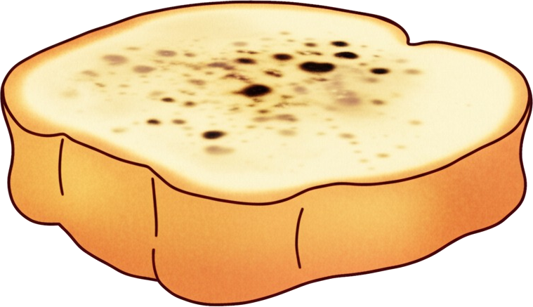


What if you could give a face and a voice to physical objects via AR?

Slide 3
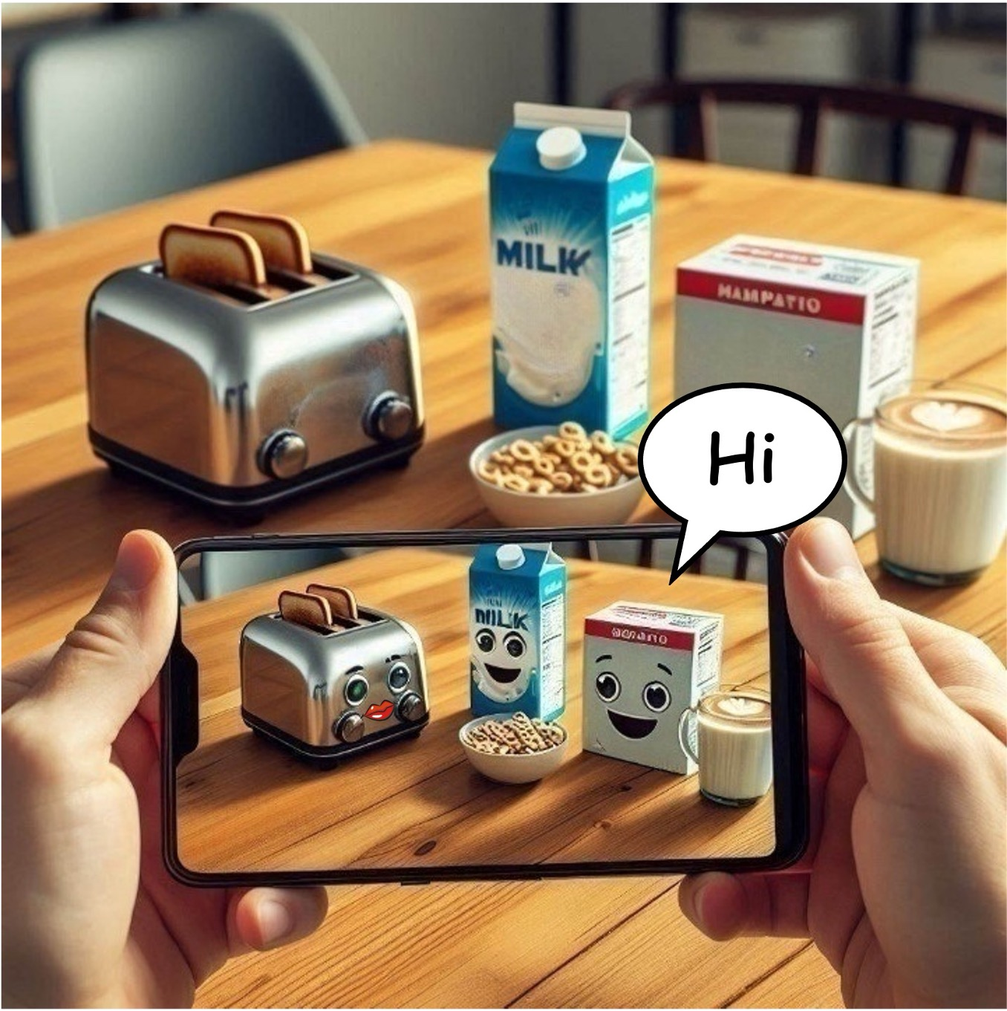
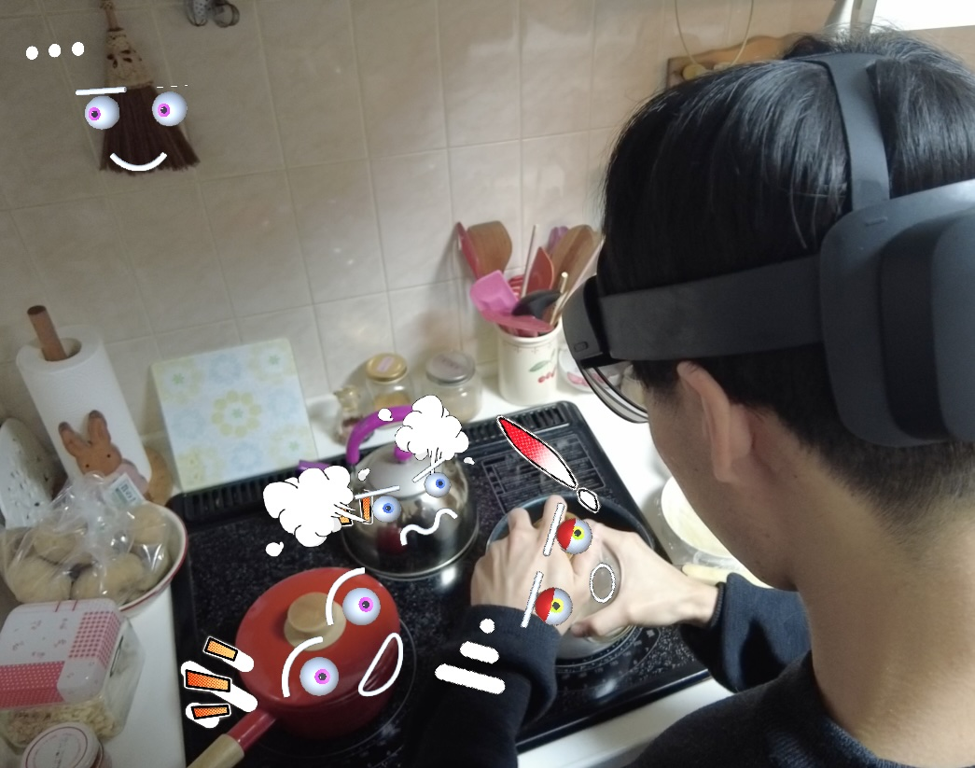
Anthropomorphism × AR × AI =
PersonifiAR

Slide 4
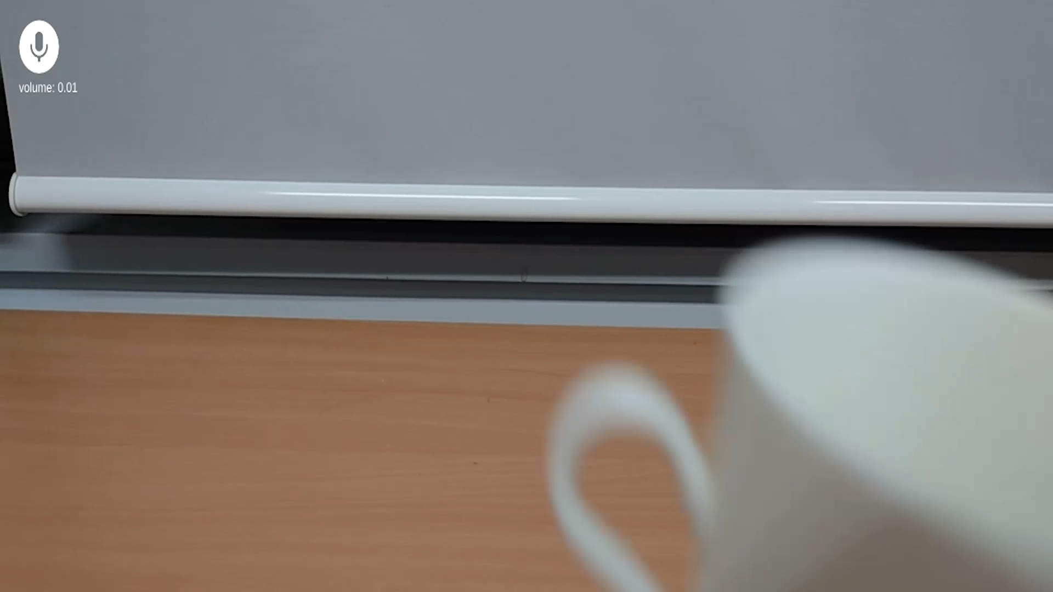
Notes:
Want to talk to your cup? Point your phone or your AR glasses at it and a talking character will automatically be generated.
The characters are assigned names and personalities that match the properties of their physical objects.
Characters can chat with the user and between each other. They react to scene changes and physical interactions such as grabbing, proximity and staring.
This enables rich human-like dialogues with everyday objects grounded in the real world (compared to purely virtual avatars).

Slide 5
Application Scenarios
Entertainment and Storytelling: personal Toy Story experience, spontaneous comedy shows
Education and Learning: talking exhibits in museum, characters popping out of books
Friendlier Smart Homes: IoT devices as friendly characters (instead of disembodied voices)
Companionship and Well-being: Talk with personal objects for comfort
Notes:
Further details: https://tech.preferred.jp/en/blog/talking-ar-characters/

