Slide 1

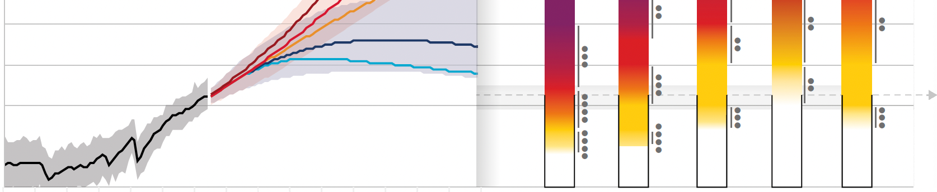
Quantifying Climate Risks

