Slide 1
Travelmate
Group E
(Shuai Wang, Gábor Mihucz, Alexander Behrmann, Viktor Szendrei)

Slide 2
Overview
The objective behind our application is to allow its users to log the travels they made. The application will encourage users to travel, discover the world, and share it with the public.
Each user will create an account which can be either visible by anyone or to people who are signed in. Each user will have the opportunity to upload his travels to the app which will include a location, a start, and an end date. Each user will also have a passport which will contain flags (or stamps, tbd) of the countries he visited. Users will also have a percentage of countries “unlocked”. Users will also be ranked by how well travelled they are. Everyone will be able to upvote and comment other’s travels and pictures.

Slide 3
Requirements
Users must be able to log their travels on the website and view them on their profile
Users must have a passport which shows the countries they visited, and the
percentage of countries visited divided by the number of countries in the whole world.
Users must be able to view their travels on a map
Users must be able to login using Facebook, Twitter, or their email
Users must able to set privacy settings for their profile(public, and login required)
Users must be able to comment other people’s travels and upvote them
Each travel must have a start date and end date
Users must be able to add photos related to their travel.
Users must be able to search for other users in the network

Slide 4
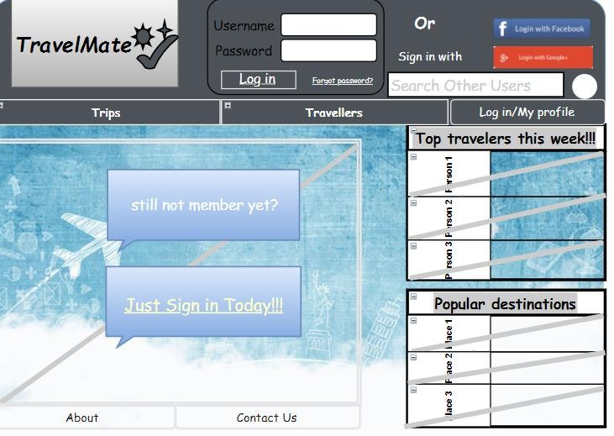
Wireframe(Index View)

Slide 5
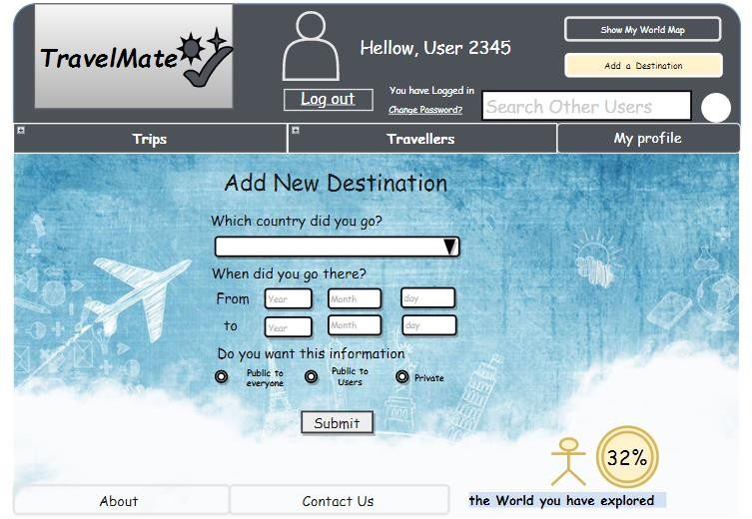
Wireframe(Add New Destination)

Slide 6
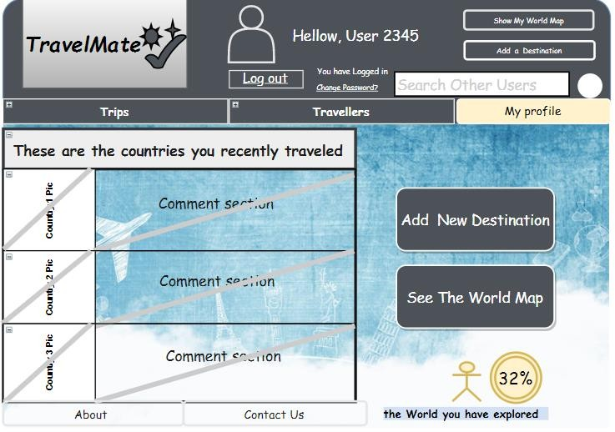
Wireframe 3(Profile Page)

Slide 7
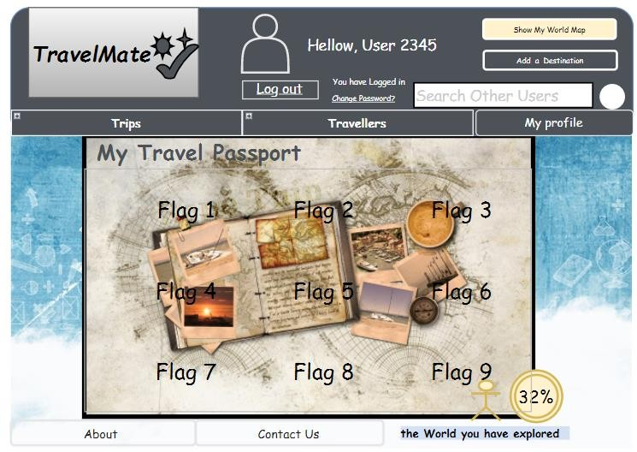
Wireframe 4(Passport)

Slide 8
Site Map
Home page (index)
Login
Search results
Trips
Travellers
<username>
Most popular
Most recent
Most well-travelled
Most Active
Add New Trip
View Passport
About
Contact

Slide 9
Site URLs
/index
/login
/<username>
/<username>/add-new-trip
/<username>/view-passport
/travellers
/travellers/most-well-travelled
/travellers/most-active
/trips
/trips/most-popular
/trips/most-recent
/about-us
/contact-us
/search-results

Slide 10
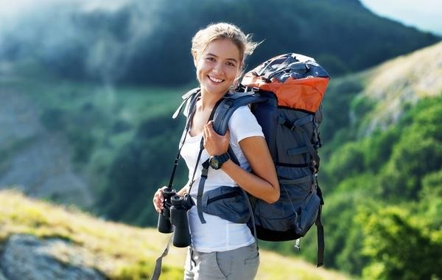
Persona One
This is Ingeborg. She is a 21-year-old female from Norway. She is currently travelling around the world on a shoe-string budget. Her goal is to visit every single country in the world until she turns 30
– while taking at least one selfie in every single waking hour.
A born extrovert, she would naturally like to share her experiences and photos with as many people on as many channels as possible.
She also enjoys meeting fellow travelers be it on the road or online, in order to exchange travel tips and whatnot. She gets upset when thinks about the fact that it is difficult to find relevant travel blogs online.

Slide 11

Persona Two
Andrew is a 62-year-old stock broker in a Central European country. Although he is very good with
numbers, his main passion in life is traveling.
Unfortunately, life never turned out so that he could go on extended travels.
However, he is still eager to get to know more about the places planet Earth has to offer. He loves to listen to the stories of others about traveling and he is an avid fan of the Discovery Channel. He has a large collection of travel books which he keeps sorted in his private library according to how good they are.

Slide 12
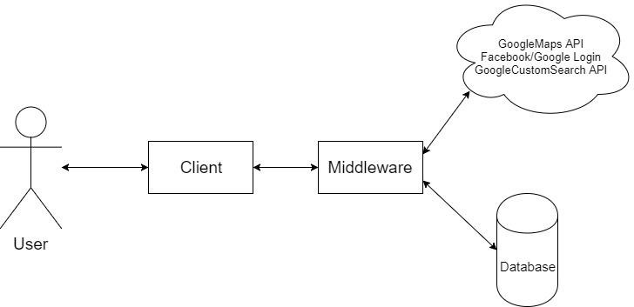
System Architecture

Slide 13
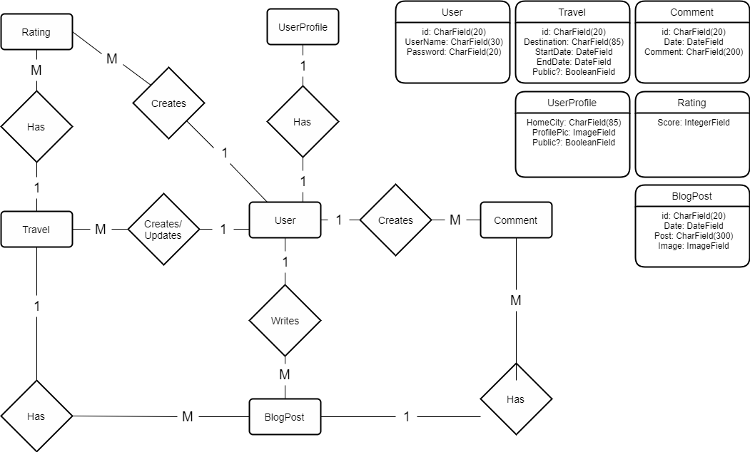
ER Diagram

Slide 14
Design of Travelmate

Slide 15
Purpose of Travelmate
Travelmate is a travel logbook.
Allow users to log their trips on a network.
Encourage them to travel and discover the world.
Rate, and comment other users trips

Slide 16
Design of Travelmate
Build a large database
Get the information from the database
Obtain information from the user
Make the user interface intuitive
Notes:
Containing countries, users, trips, blogs, comments, pictures,…
For the map, passport, blogs about trips, comments,
Such as trips, home country
User is not lost, easy for him to use

Slide 17
Technologies Used
Ajax
jQuery
Python Social (Facebook and Twitter login)
Authentication-redux
Bootstrap
JSON
Google Maps API
HTML, CSS

Slide 18
Contributions of Team Members

Slide 19
Viktor
Javascript
jQuery
AJAX
Forms
Population script
Certain views

Slide 20
Gabor
Views.py
Paginated lists
Templates
URL matching
Certain forms

Slide 21
Dylan

Slide 22
Alexander
Bootstrap
User Authentication
Design of views
Testing
Search

Slide 23
Live Demo
https://travelm8.pythonanywhere.com/

