Slide 1
500 Cities Project
Fraud in Health Surveys

Slide 2
What is 500 Cities?
CDC surveyed 500 largest cities in America
Measured chronic diseases, risky behaviors, and preventative behaviors
Measured down to Census Tract
Meant to help implement change by targeting specific areas
First study of its kind

Slide 3
Method Used
Benford Analysis
Used to analyze fraud in large lists of numbers by looking at the first digits
Typically used for financial purposes, but should work on any long list of numbers

Slide 4
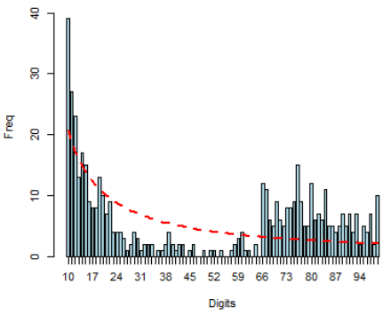
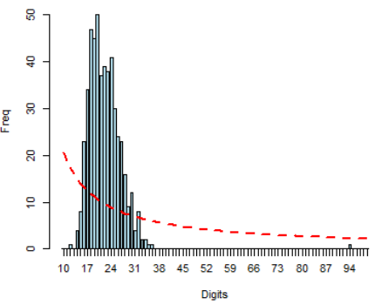
Results
No variable followed Benford's Law
All variables followed one of the distributions below

Slide 5
Is there fraud?
No!
There isn't a lot of variance in responses, so the digits are in a small range
So the leading digits are all clustered together

