Slide 1
Advantages of a Bear Market
Yes there is a Positive Side to a Bear Market!

Slide 2
Investing in Stocks
1. Represents ownership in a firm
2. Earn a return in two ways
Price of the stock rises
Dividends are paid to the stock holder
3. Stockholders have claim on all assets
4. Right to vote for directors and on certain issues
5. Two types
Common stock
Right to vote
Receive dividends
Preferred stock
Receive a fixed devidend
Do not usually vote

Slide 3

Investing in Stocks: Sample Corporate Stock Certificate

Slide 4
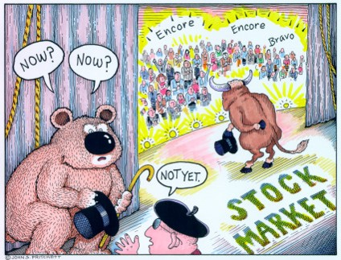
What is a Bear Market?
A decline of 15-20% of the broad market coupled with pessimistic sentiment underlying the stock market.

Slide 5
Stock Market Indexes: the Dow Jones Industrial Average
Companies of | the Dow Jones | Industrial Average
3M | American Express | Apple
Boeing | Caterpillar | Chevron
Cisco | Coca-Cola | Disney
DowDuPont Inc | Exxon Mobil | Goldman Sachs
Home Depot | IBM | Intel
Johnson & Johnson | JPMorgan Chase | McDonald's
Merck | Microsoft | Nike
Pfizer | Procter & Gamble | Travelers Companies Inc
United Technologies | UnitedHealth | Verizon
Visa | Wal-Mart | Walgreen

Slide 6
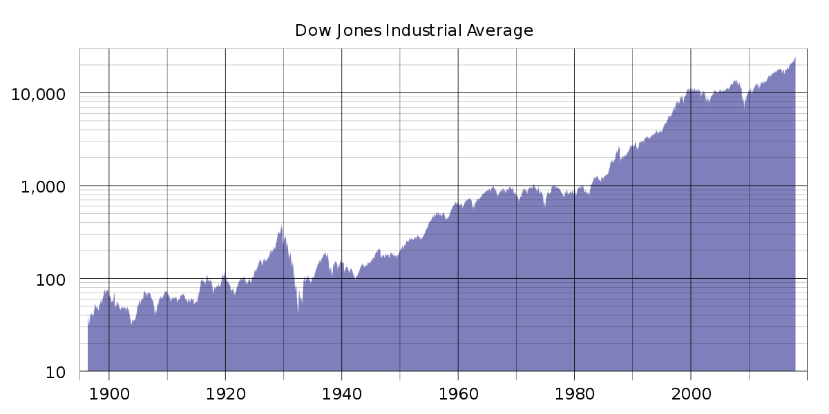
Dow Jones

Slide 7
The Last Bear Markets
Sept. 30, 2002 Dow 7,528
Jan. 5, 2004 Dow 10,668
Oct. 8, 2007 Dow 14,093

Slide 8
What do I do in a Bear Market?
Decide if this is a market correction or the start of something more
Review the stocks you own
Review stocks you wanted to own but were too expensive at time of research
Check your portfolio for balance or the type of stocks you own

