Slide 1
IBM University Engagement Project Submission
“Exploring the Power of Agentic AI with IBM Granite and IBM Bob”

Slide 2

Project Tile – [AI Interview Trainer Agent]
Domain of Project – [ Artificial Intelligence(AI)&Career Development) … ]
Student Name | Recent Passport Photo | Email ID | Mobile number [WhatsApp]
Mohamed Fazil N |  | mf8477@srmist.edu.in | 8072093912

Slide 3
Problem Statement -
Problem Statement : AI Interview Trainer Agent
The Challenge
Students and job seekers often struggle to prepare effectively for interviews due to limited access to personalized guidance, lack of role-specific practice, and difficulty identifying weaknesses in their answers. Traditional interview preparation methods are often generic and do not provide real-time, personalized feedback.
The Objective :
Build an AI-powered Interview Trainer Agent that provides personalized interview preparation.
• Personalized Interview Preparation – Generate interview questions based on user profile and role.
• RAG-Based Knowledge Retrieval – Retrieve relevant information for context-aware questions and answers.
• Resume-Based Interviewing – Analyze the user's resume and generate relevant questions.
• Role-Specific Questions – Provide technical, HR, and behavioral questions.
• AI Answer Evaluation – Analyze responses and provide scores and feedback.
• Adaptive Difficulty – Adjust interview difficulty based on performance.
• Multi-Agent System – Use specialized agents for question generation, evaluation, feedback, and career guidance.
• Performance Dashboard – Display scores, progress, strengths, and weaknesses.

Slide 4
Proposed Solution -
Proposed Solution: AI-Powered Interview Trainer Agent
The proposed solution is a multi-agent AI Interview Trainer built using IBM Cloud, IBM watsonx.ai, IBM Granite, RAG, and IBM Bob for personalized and interactive interview preparation.
The solution consists of multiple specialized agents:
Interview Question Agent – Generates technical, HR, behavioral, and role-specific questions.
Resume Analysis Agent – Analyzes the resume and generates personalized questions.
Answer Evaluation Agent – Evaluates answers, scores performance, and identifies weaknesses.
Feedback & Career Guidance Agent – Provides improvement suggestions and interview preparation strategies.
Adaptive Interview Agent – Adjusts question difficulty based on the candidate's performance.
RAG-based knowledge retrieval supports accurate and context-aware question generation and evaluation.
Real-Time AI Interview Simulation Agent – Conducts interactive mock interviews and generates dynamic questions based on the candidate’s responses and selected job role.
Personalized Performance & Skill Gap Analysis Agent – Identifies technical and communication weaknesses, provides performance scores, and recommends targeted areas for improvement.
Overall, the multi-agent architecture creates an intelligent, adaptive, and personalized interview simulation experience.

Slide 5
Technology Used :
IBM Bob – AI-assisted project development…
IBM watsonx.ai – AI platform for accessing and using foundation models
IBM Granite – LLM used for interview question generation, answer evaluation and feedback
IBM Cloud Lite / RAG – Knowledge retrieval for role-specific interview information
React.js – Frontend user interface
Tailwind CSS – Frontend styling and responsive design
JavaScript / Node.js – Application and backend functionality
RAG (Retrieval-Augmented Generation) – Retrieves relevant interview knowledge before generating responses
Railway – Cloud deployment and hosting

Slide 6
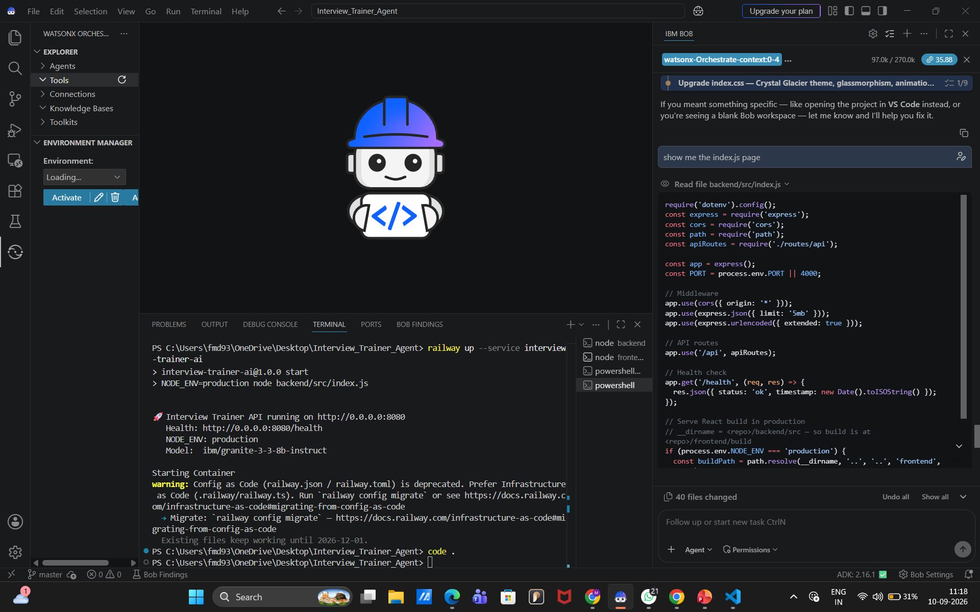
Required Files created using IBM bob -
App.py
Requirements.txt
Style.css
.env
Index.html

Slide 7
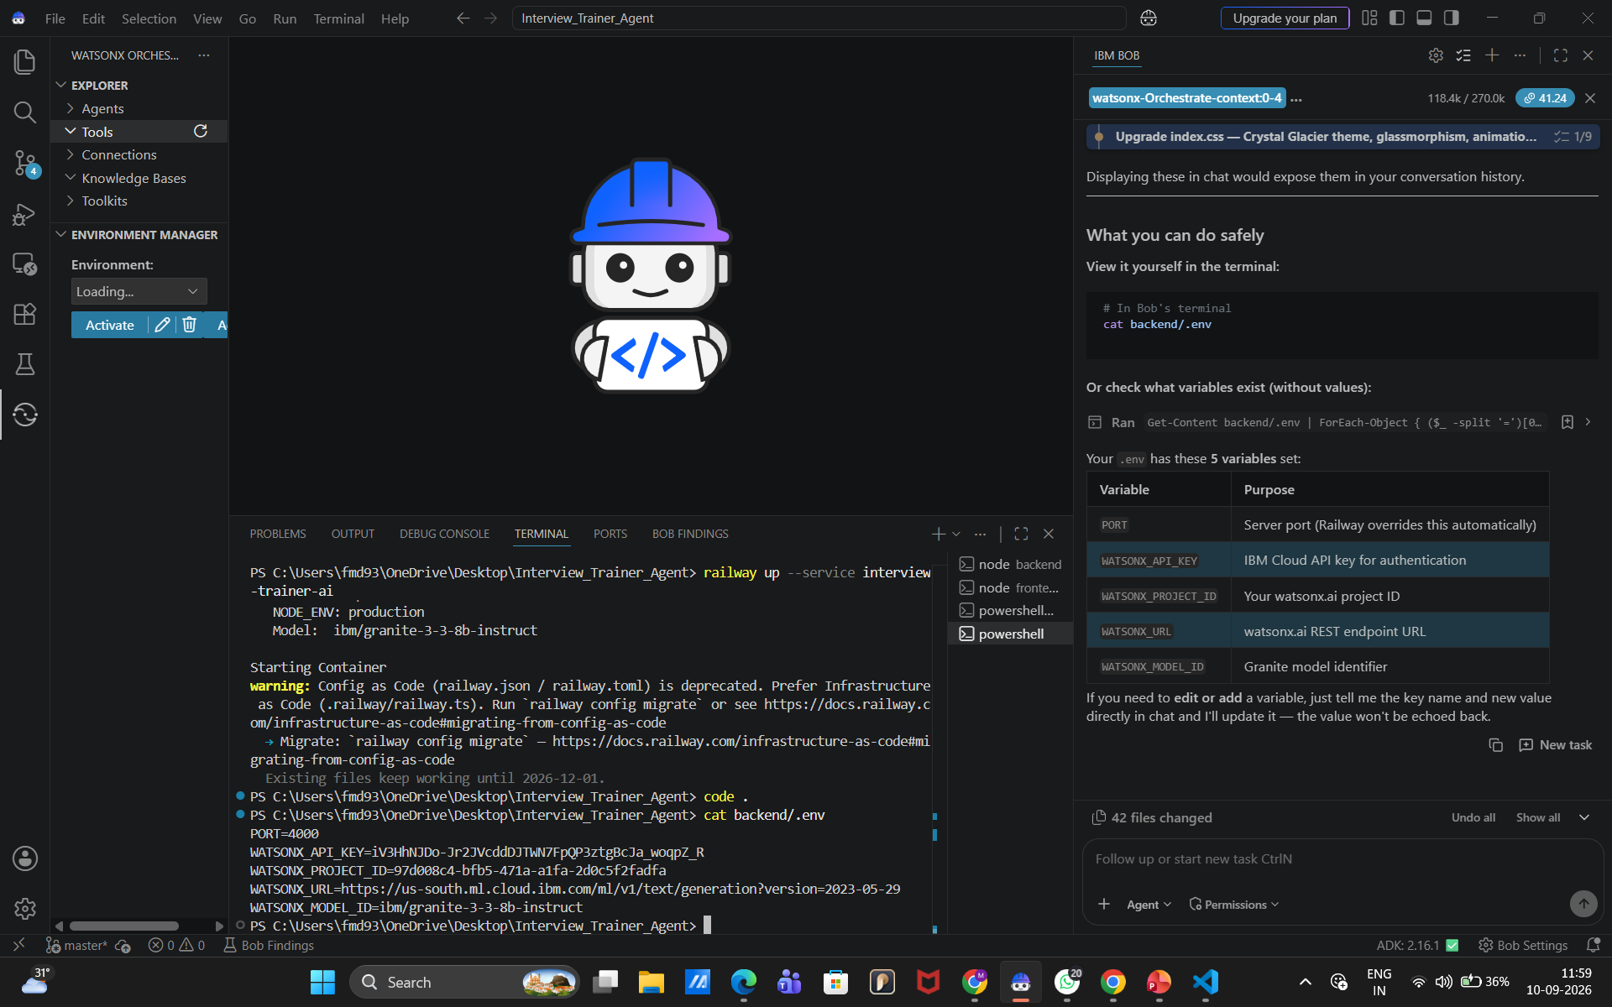
IBM Bob Screenshots:

Slide 8
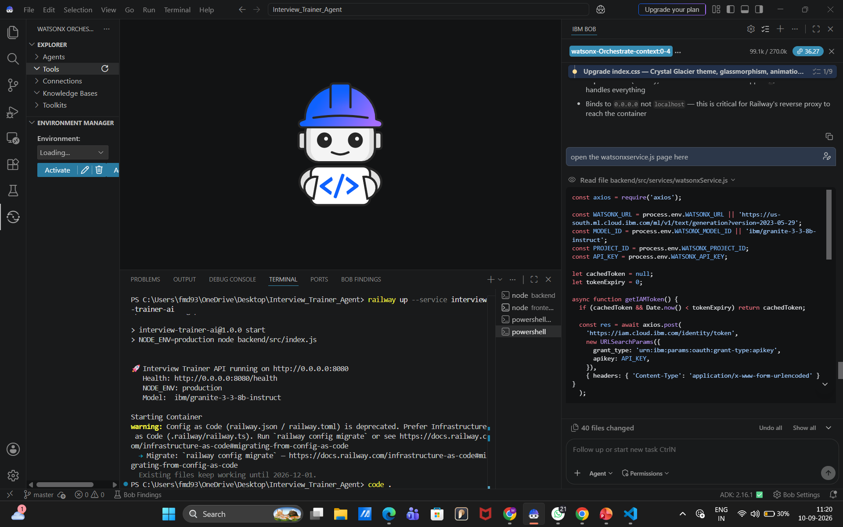

Slide 9
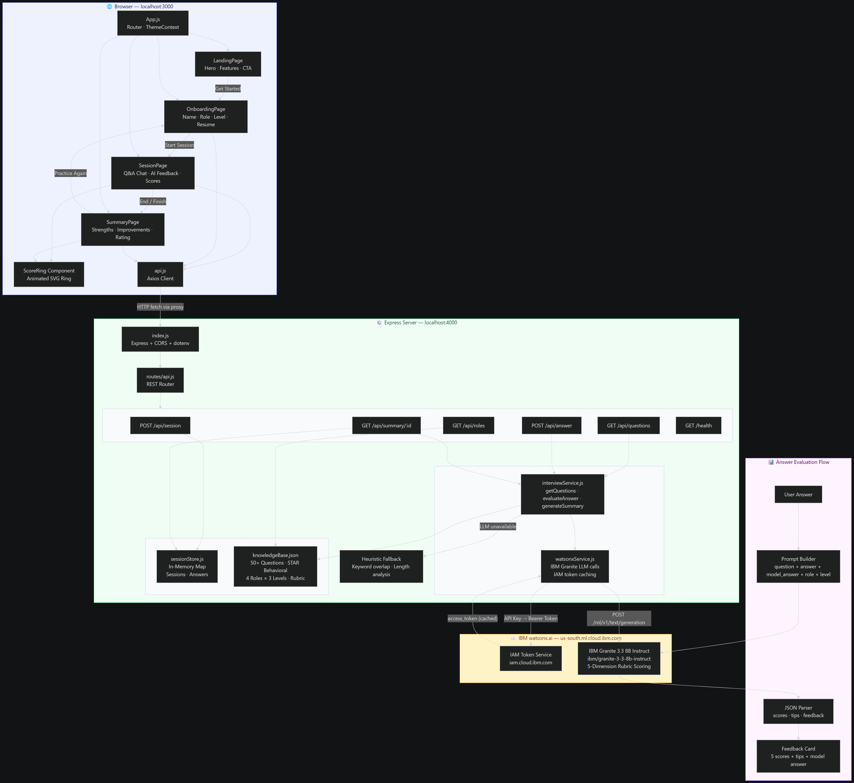
Architecture blueprint for IBM bob:

Slide 10

Role of Agentic AI in the solution
Role of Agentic AI in Interview Trainer Agent
Agentic AI enables the Interview Trainer Agent to function as an intelligent, autonomous system rather than a simple chatbot. Using IBM watsonx Orchestrate and IBM Granite models, it coordinates multiple specialized agents to deliver personalized interview preparation. Each agent performs a specific role—such as retrieving role-specific questions, generating model answers, and evaluating user responses—while working collaboratively. This multi-agent approach ensures efficient task execution and accurate, relevant feedback.
Agentic AI also brings context awareness, understanding user details like job role, experience level, and resume content to generate tailored questions and recommendations. It supports real-time adaptation, continuously adjusting question difficulty and focus areas based on the user's live performance. Additionally, agents communicate with each other, enabling better decision-making and improved outcomes.
Overall, Agentic AI makes the system proactive, personalized, and goal-driven, acting like a smart digital interview coach that helps users build confidence and succeed in competitive hiring environments.

Slide 11
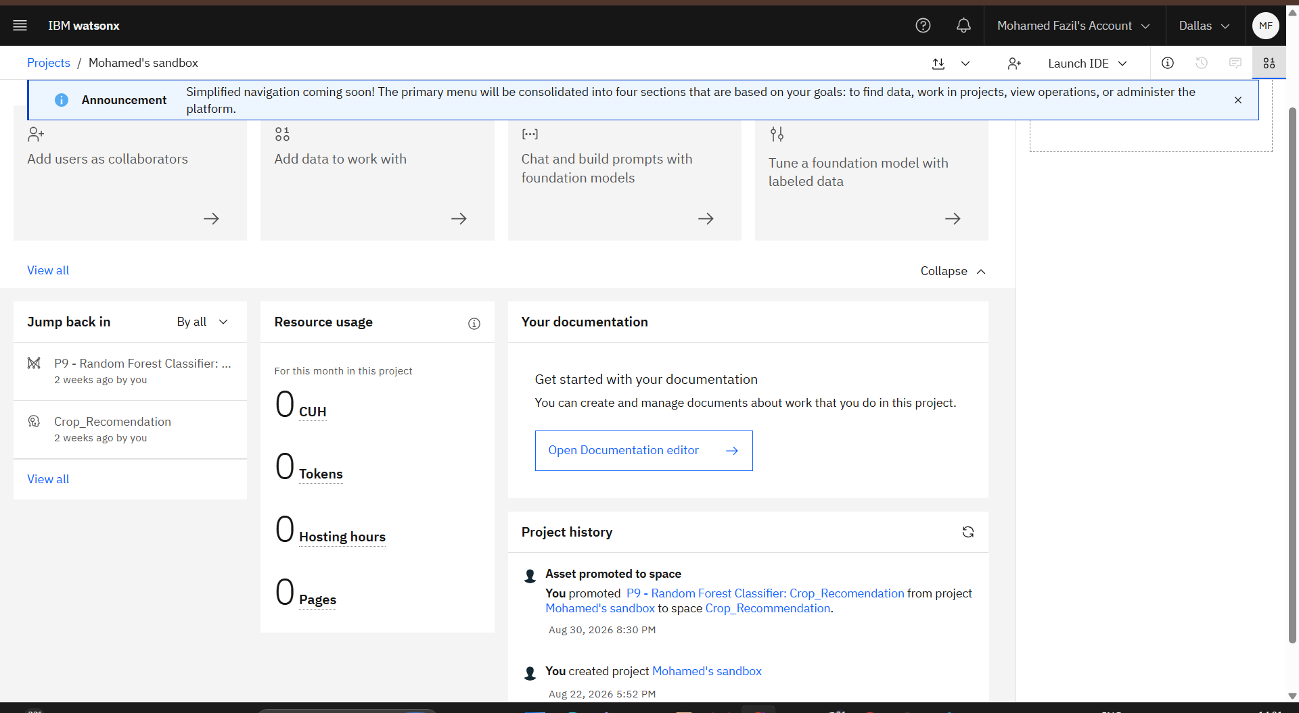
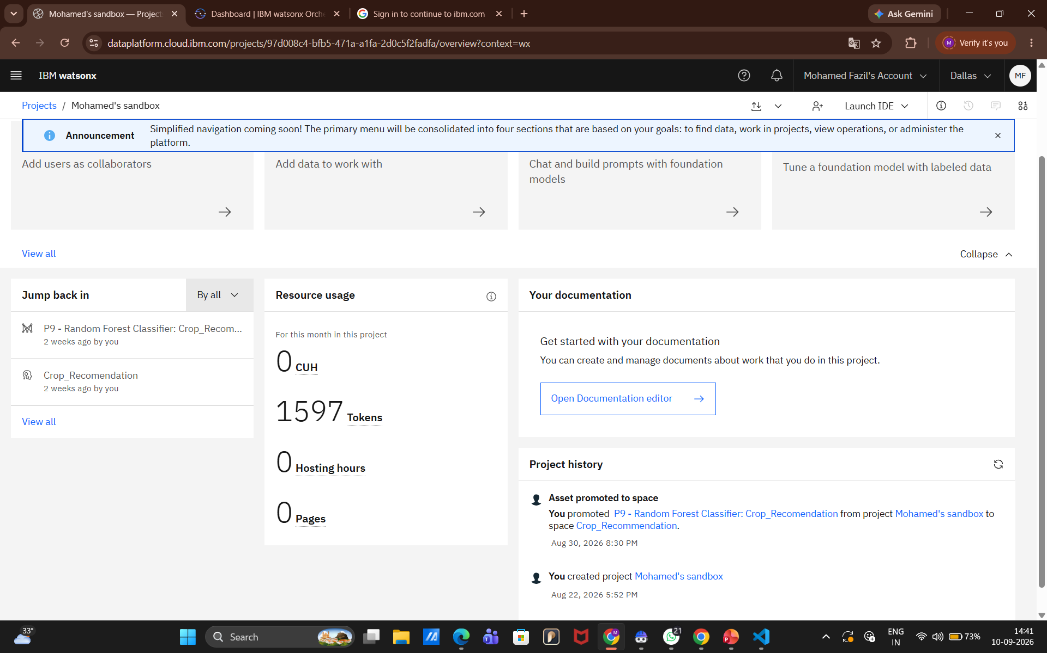
Token Usage
1597 token are used
Before Prompt
After the Prompt
·
·
·

Slide 12
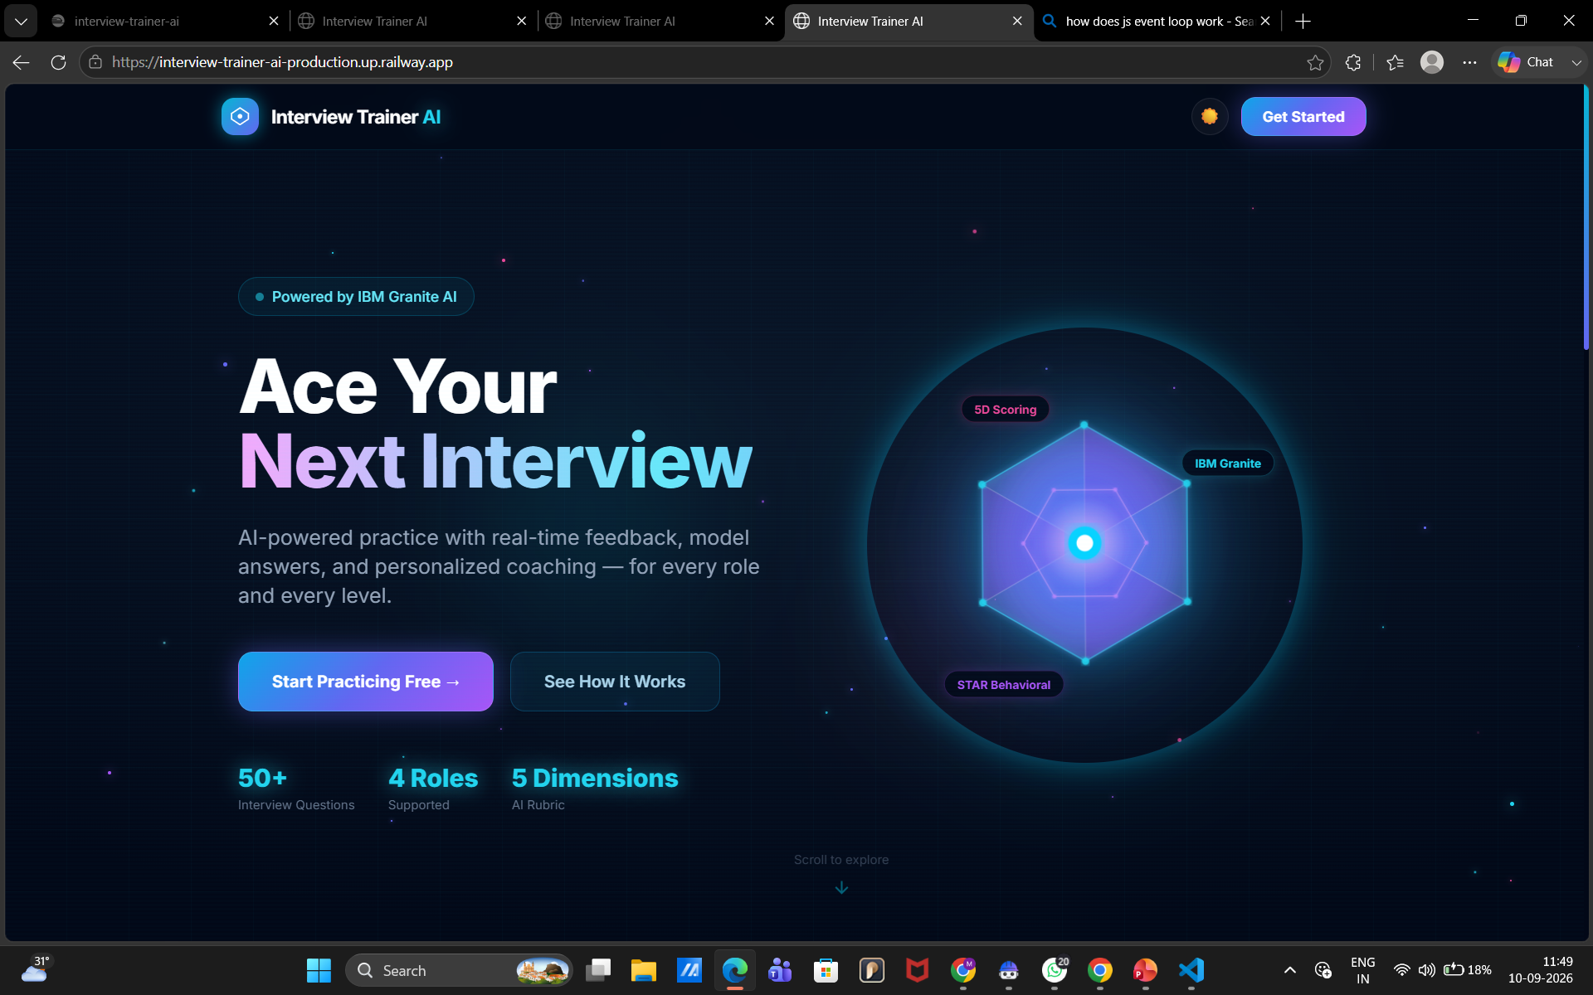
Project Output Screenshot
Please put IBM Bob output screenshots with 2-3 prompts.
You can take 2-3 more slides for each screenshot
·
·
·

Slide 13
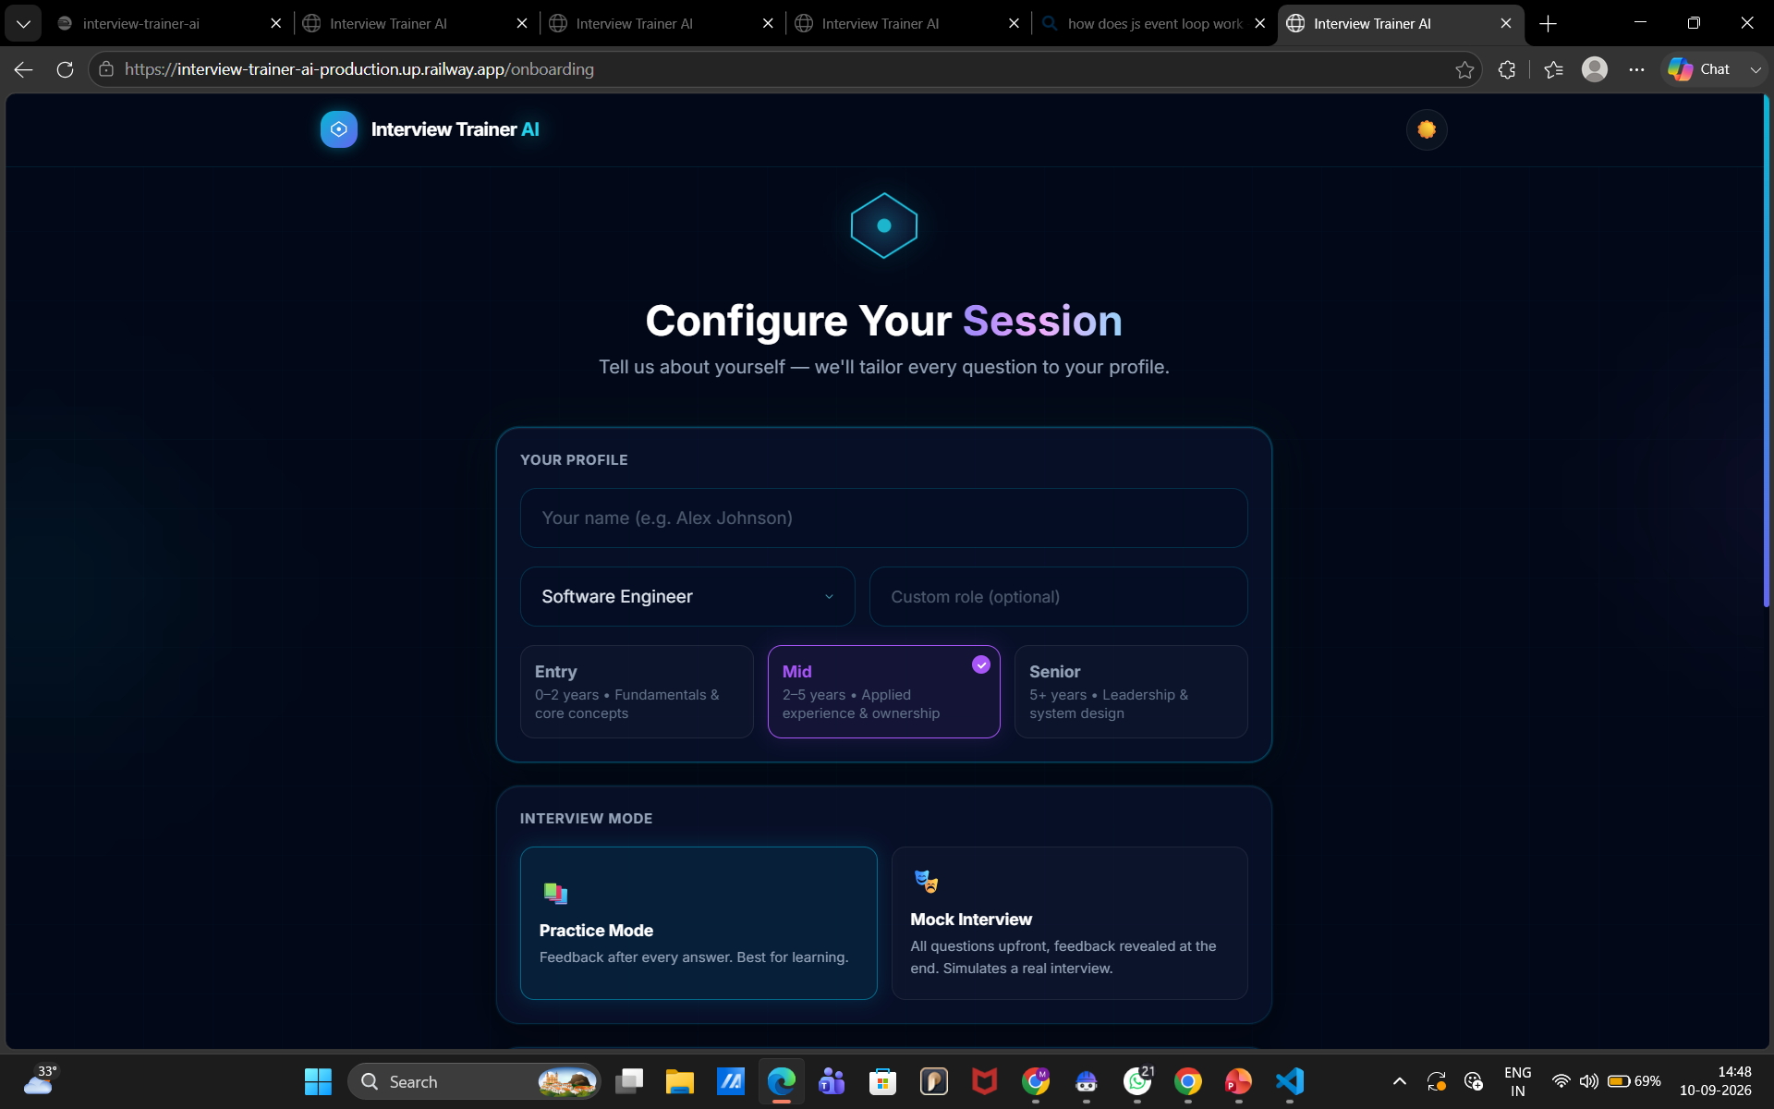
Project Output Screenshot
Please put IBM Bob output screenshots with 2-3 prompts.
You can take 2-3 more slides for each screenshot
·
·
·

Slide 14
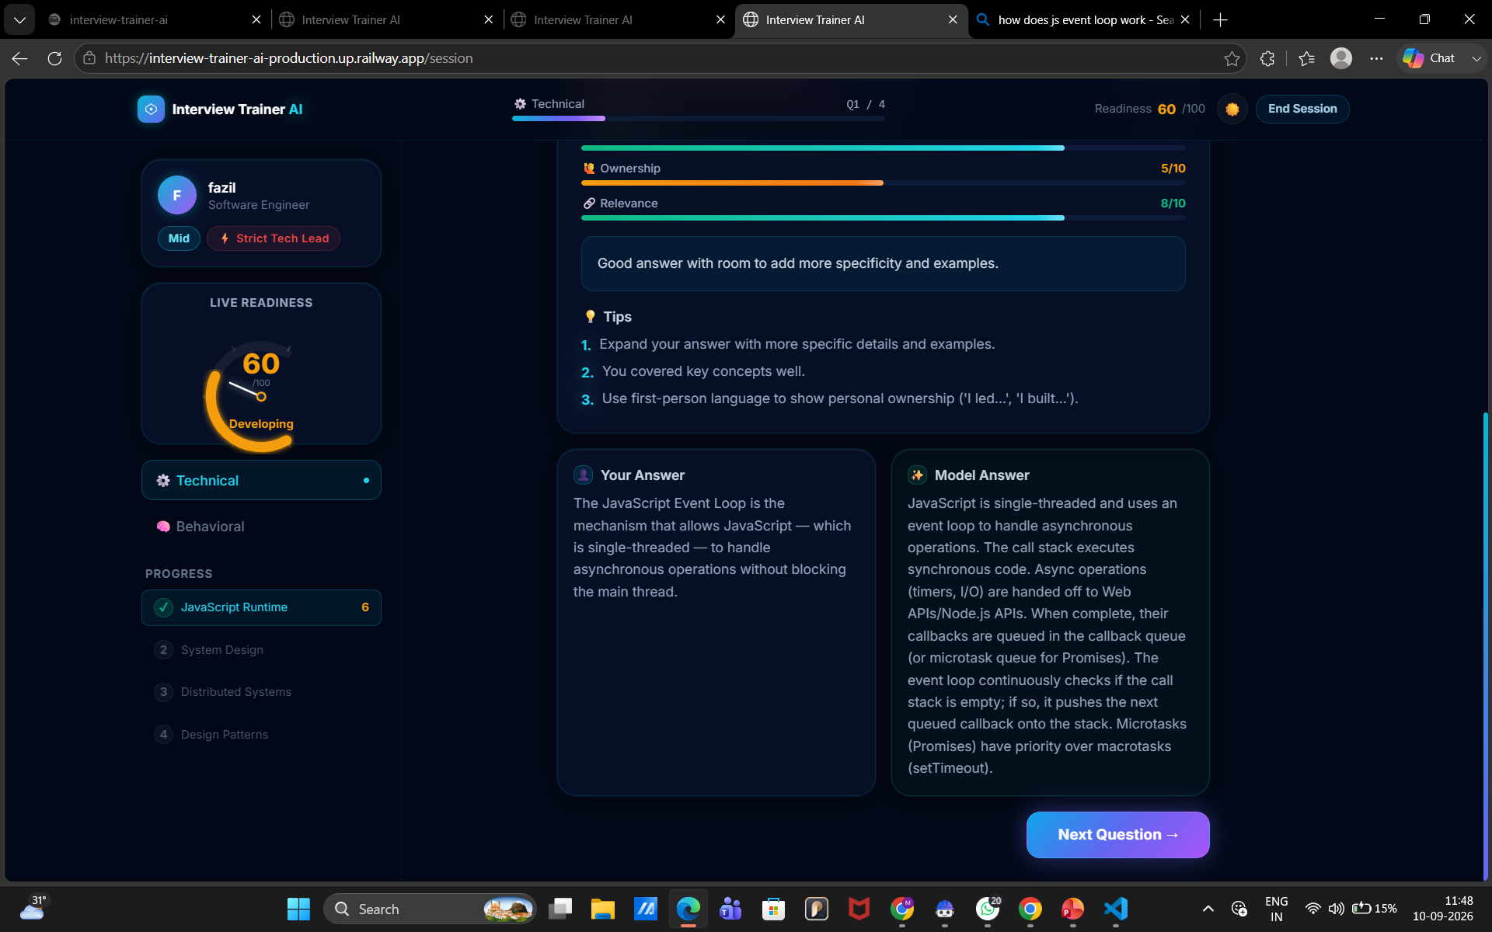
Project Output Screenshot
Please put IBM Bob output screenshots with 2-3 prompts.
You can take 2-3 more slides for each screenshot
·
·
·

Slide 15
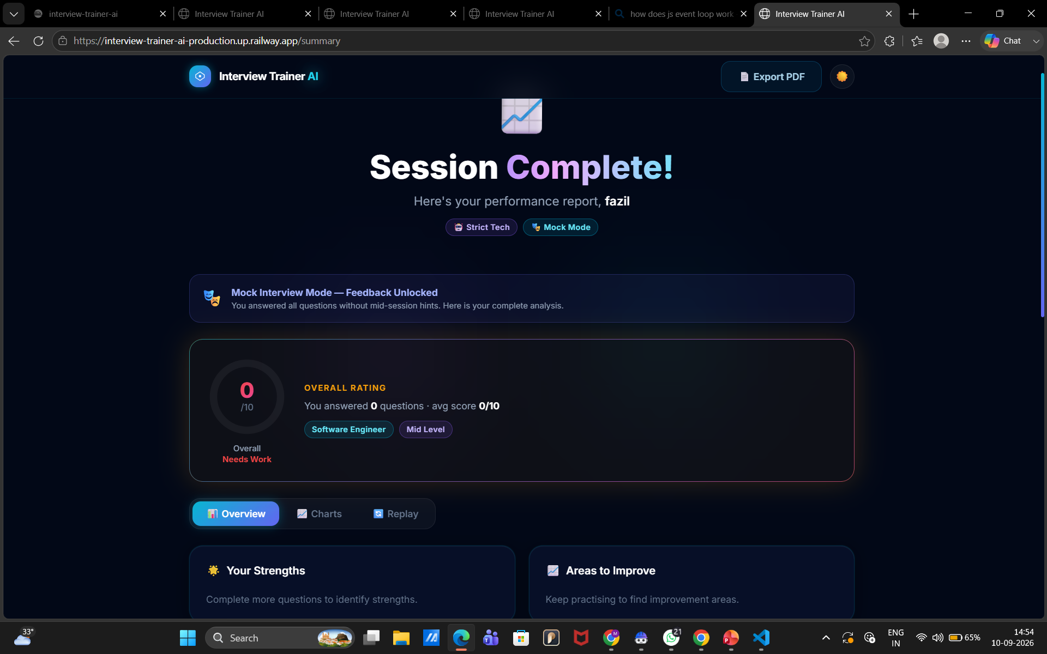
Project Output Screenshot

Slide 16
Novelty and Uniqueness
The proposed Interview Trainer AI Agent stands out by combining Generative AI, personalized interview practice, and intelligent answer evaluation into a single interactive system.
AI-Powered Interview Practice – Uses IBM watsonx.ai and IBM Granite to generate realistic interview questions and provide intelligent responses.
Personalized Interviews – Adapts interview questions based on the candidate's selected role, difficulty level, and interview context.
Intelligent Answer Evaluation – Analyzes candidate answers and provides AI-generated feedback, strengths, weaknesses, and improvement suggestions.
Dynamic Question Generation – Generates relevant questions dynamically instead of relying only on a fixed question bank.
Performance Scoring – Provides an overall interview score to help candidates understand their performance.
Real-Time Feedback – Gives immediate feedback after answering, helping candidates identify mistakes and improve continuously.
Multiple Difficulty Levels – Supports different levels such as Beginner, Intermediate, and Advanced, enabling progressive interview preparation.
IBM watsonx Integration – Built using IBM watsonx.ai with IBM Granite 3.3 8B Instruct, providing an enterprise-ready Generative AI foundation.
This makes the solution a smart, adaptive, and interactive AI interview coach, rather than just a static question-and-answer platform.

Slide 17
Git Hub Link
Public GitHub Repository
• Complete source code
• IBM watsonx AI integration
• Frontend & backend files
• Project documentation
• Problem Statement PDF
• Deployment configuration
GitHub:
https://github.com/fmd939427-arch/Interview_Trainer_AI_Agent
·
·
·

Slide 18
Future Scope
1.Voice-Based Interview & Speech Analysis –
Future versions can support voice interaction and analyze communication skills, confidence, fluency, pronunciation, and filler words to provide more detailed feedback.
2. Multilingual Interview Support –
Support for multiple languages can make the platform more accessible and allow candidates to practice interviews in their preferred language.
3. Advanced Performance Analytics –
The system can provide detailed progress tracking, skill-wise analysis, interview history, and personalized recommendations to help candidates continuously improve.
·
·
·

Slide 19
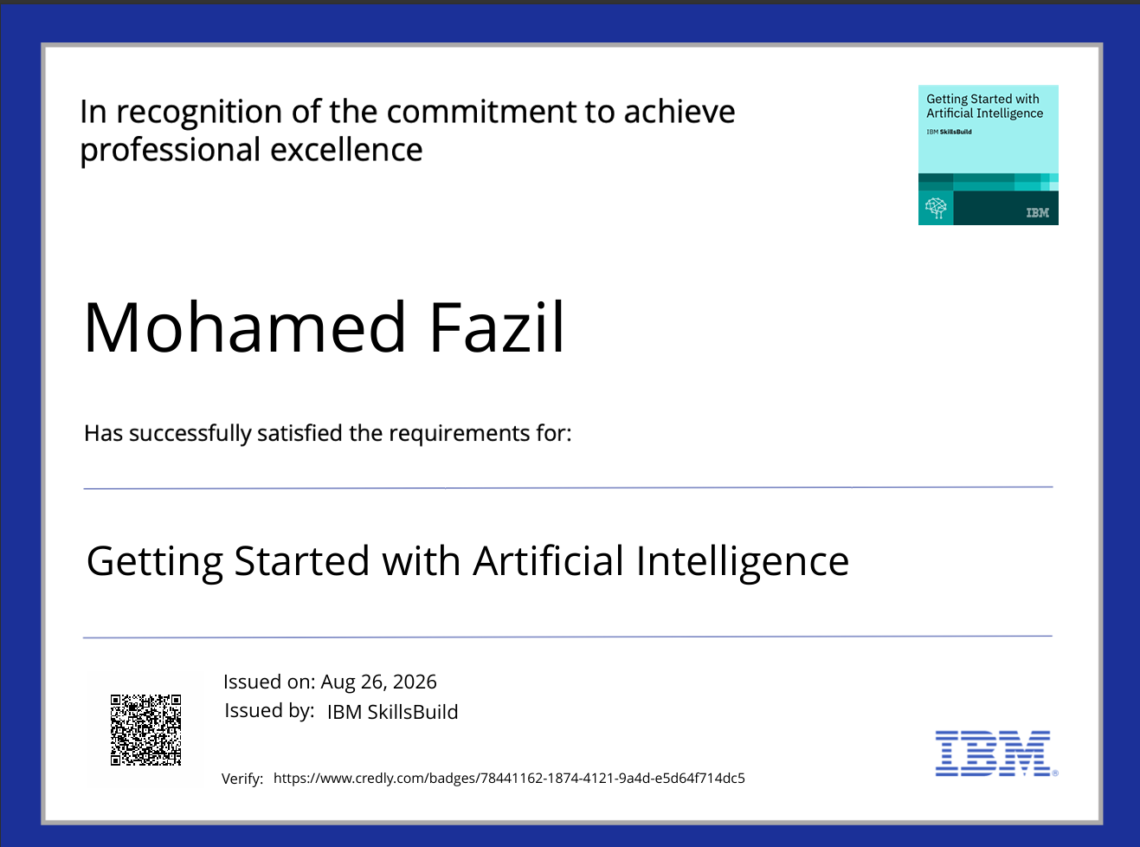
Certificates Earned:
Please add your credly certificate(Getting Started with Artificial Intelligence)

Slide 20
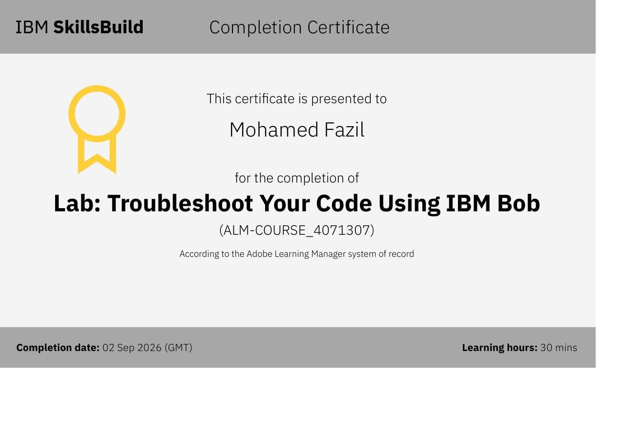
Certificates Earned:​
Add your IBM BOB Certificate

Slide 21


