Slide 1
MED412 Project
By:
Dev Anand (1510110117)
Harikrishnan A (1510110148)
S M Hasan Fayaz (1510110316)
Mohammed Azharudeen (1510110486)

Slide 2
ALGORITHM
The bot moves forward until it reaches the payload
Lifts the payload
Then proceeds forward until it encounters the first obstacle
It first does a right turn. The bot turns approximately 90*
If not, then small adjustments are made.
After the first right turn it has to take two more left turns to reach the end
The next two left turns are also 90* turns

Slide 3
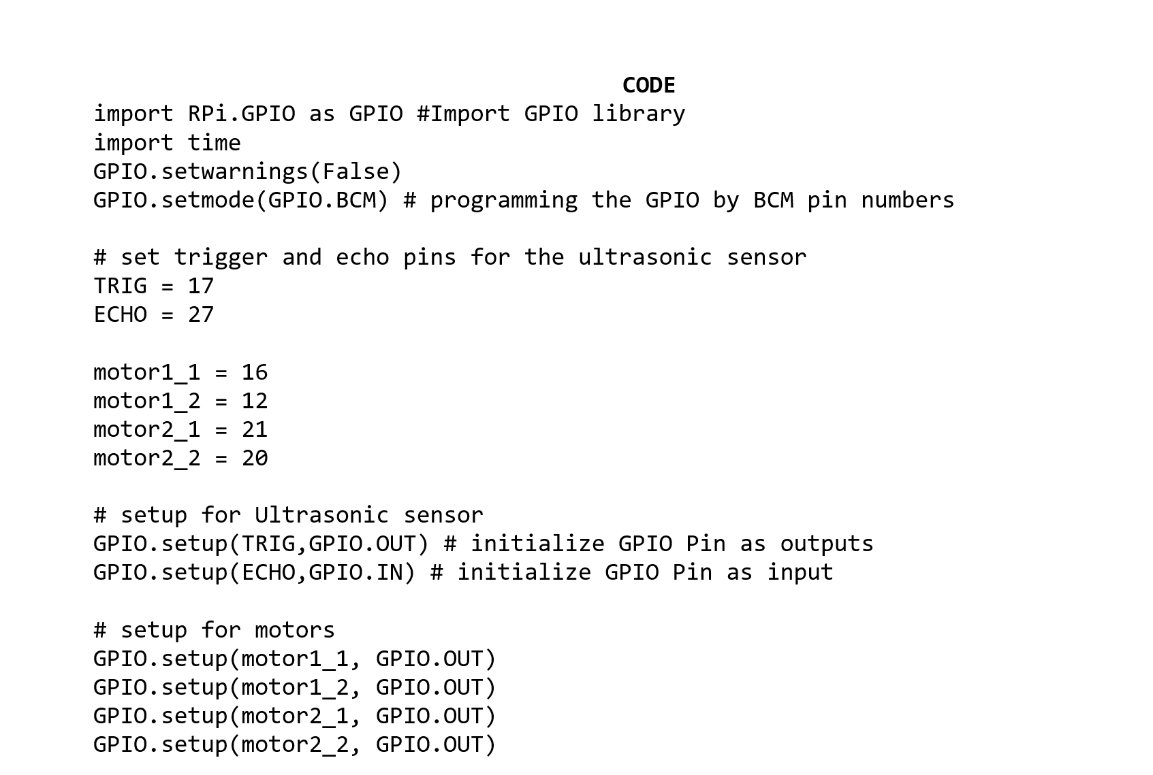

Slide 4
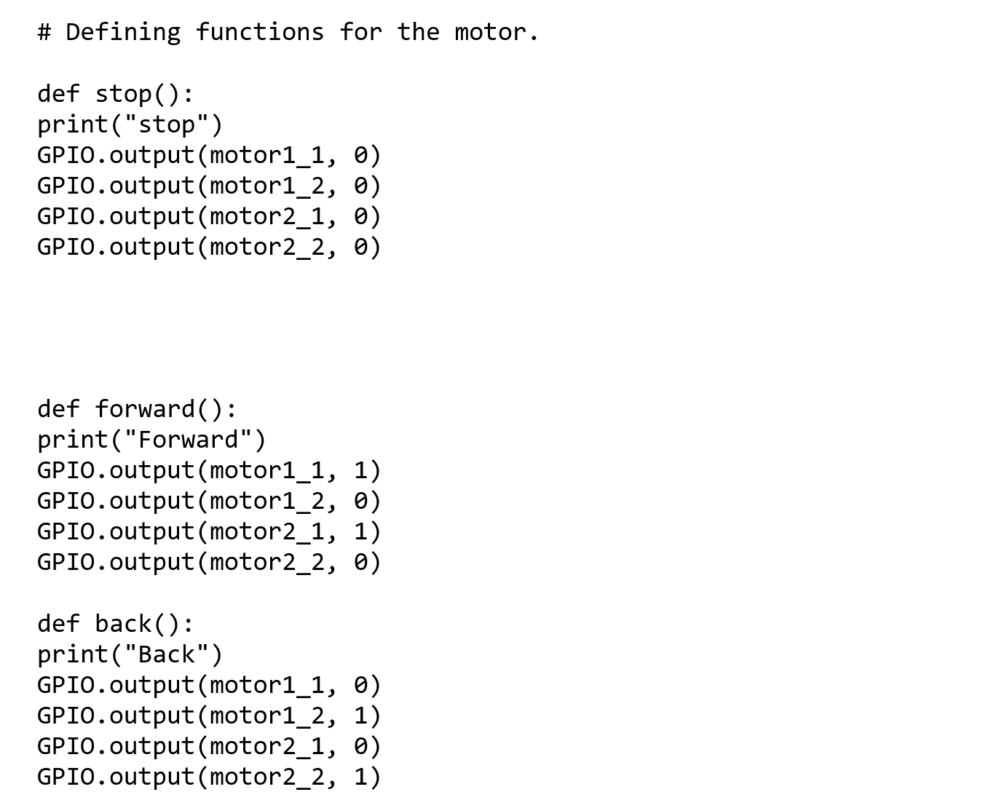

Slide 5
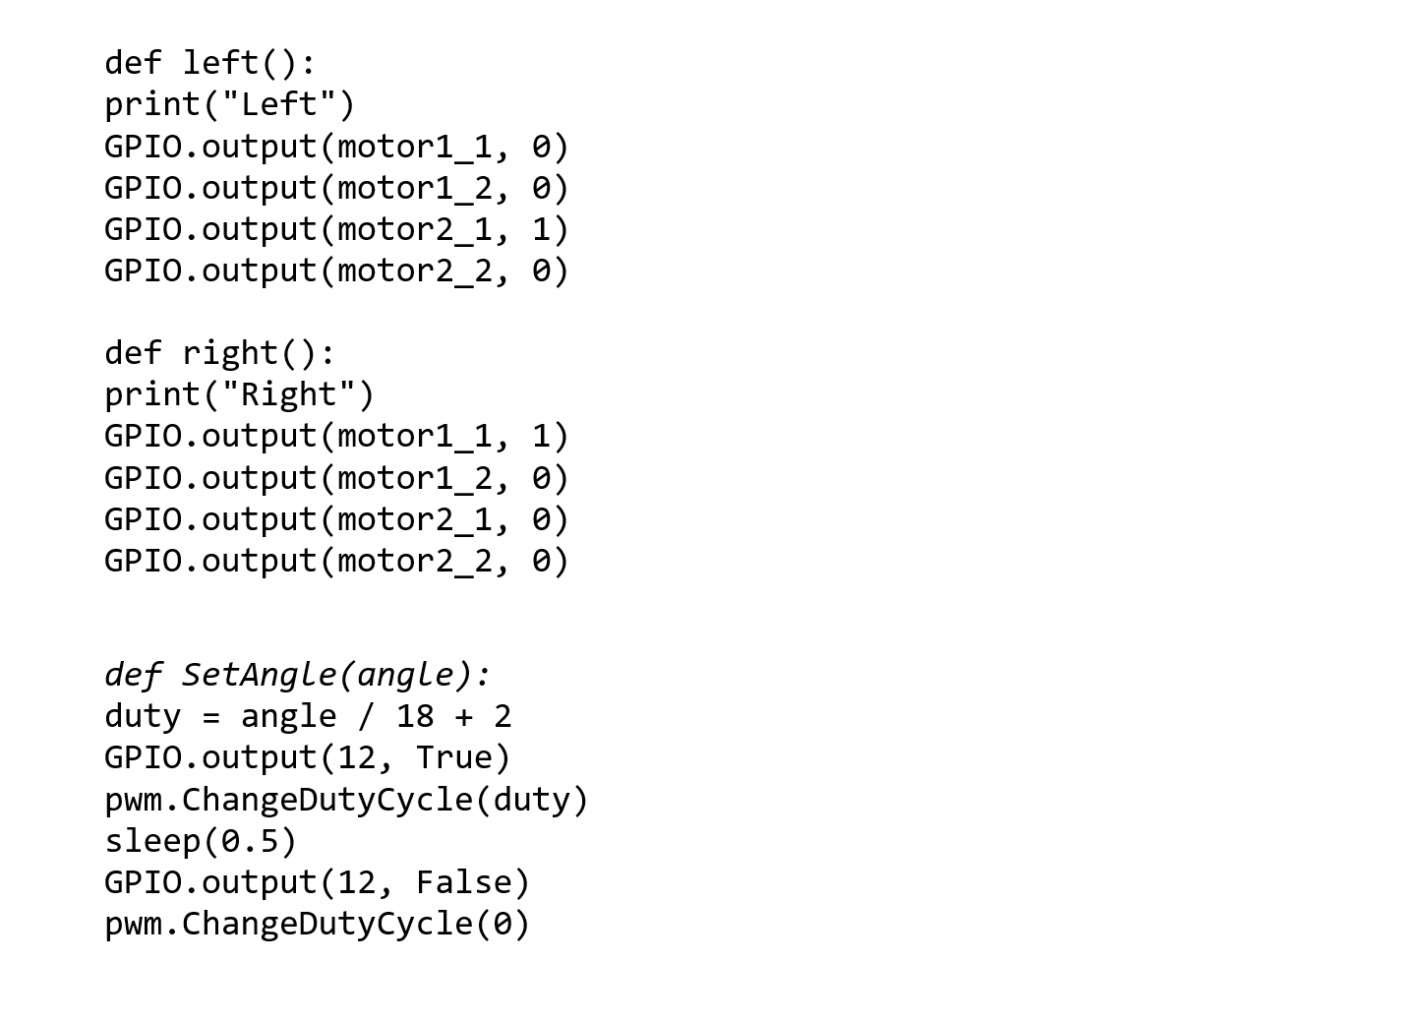

Slide 6
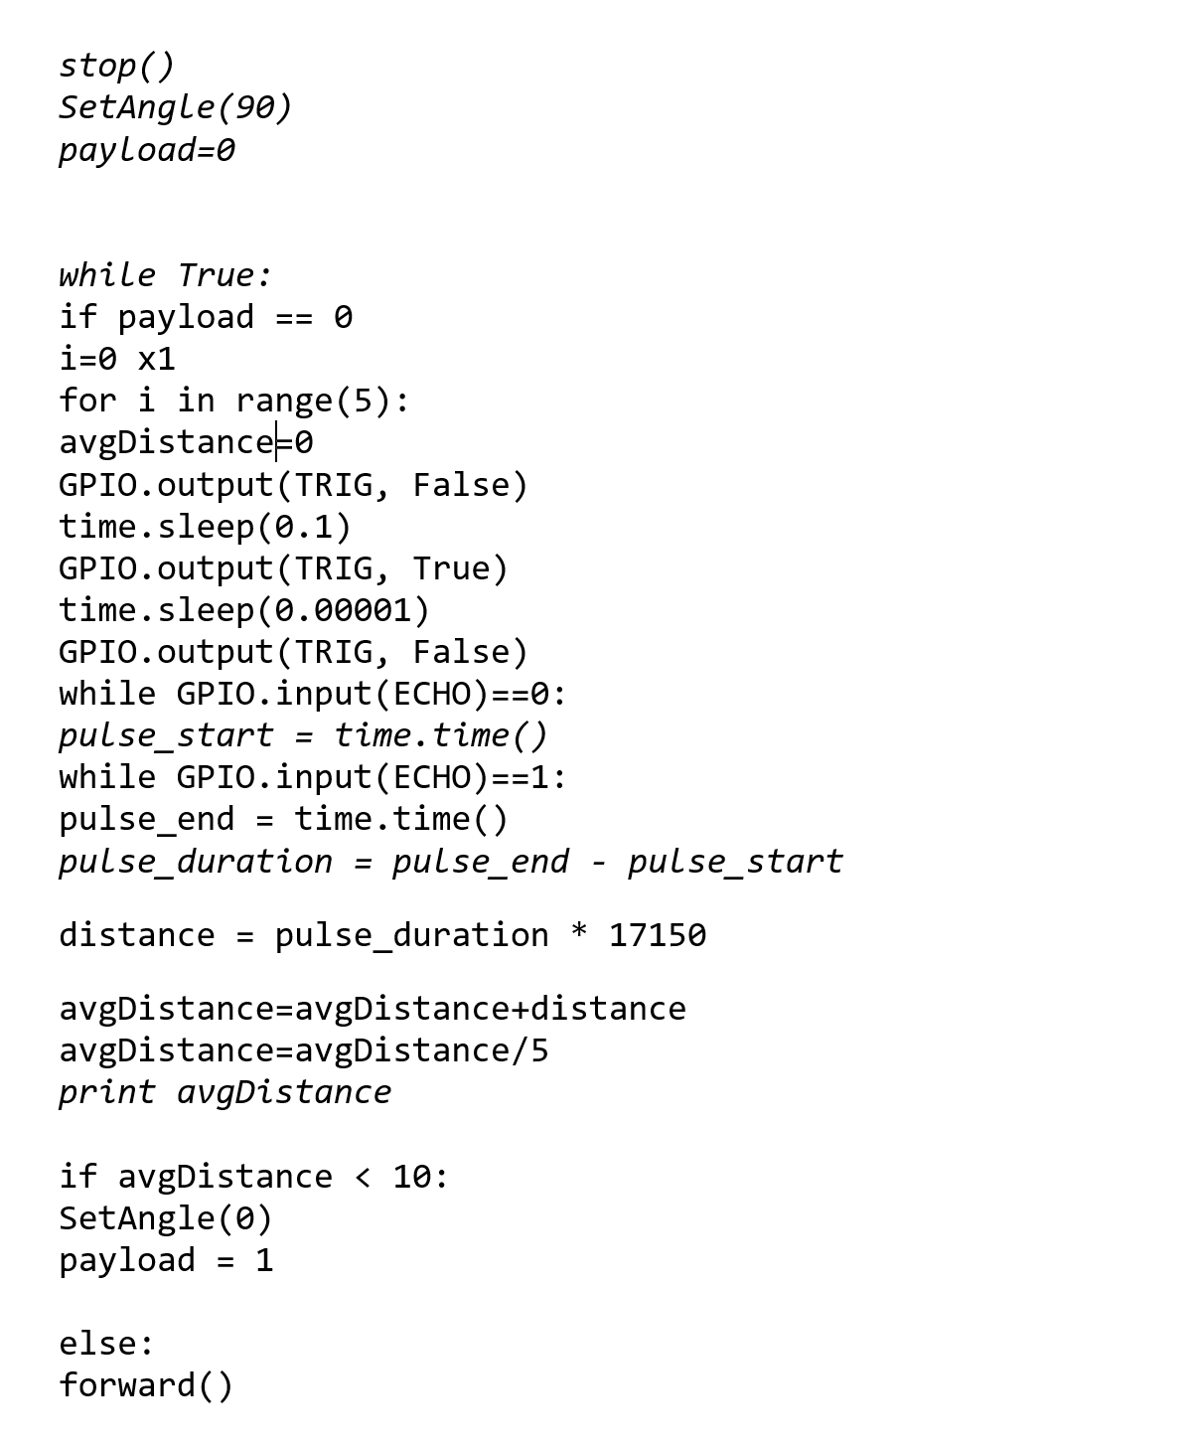

Slide 7
