Slide 1
MED412 Project
By:
Dev Anand (1510110117)
Harikrishnan A (1510110148)
S M Hasan Fayaz (1510110316)
Mohammed Azharudeen (1510110486)

Slide 2
Highlights of the Robot
Three wheeled robot
Forward wheel drive
Lifting mechanism
Method of differentiating Payload from obstacle
Obstacle avoidance using Ultrasonic sensor

Slide 3
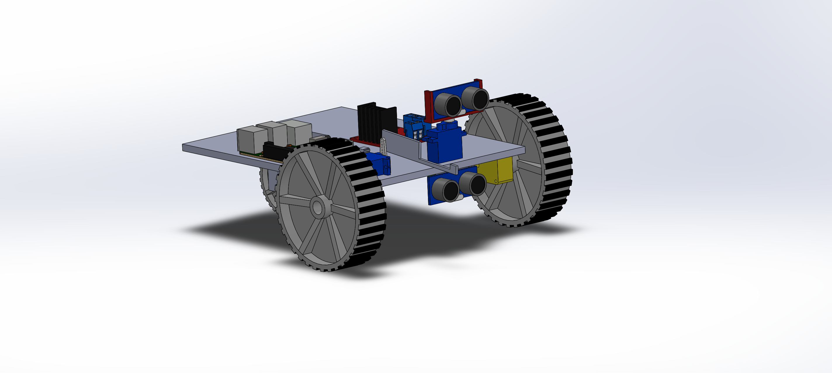
1. Why 3 Wheeled?
Three wheels eliminate the chances of sliding/drag as in the case of 4 wheeled robot while operating at low speeds. Hence this improves the stability of the robot.
Three wheel drive also improves the accuracy

Slide 4
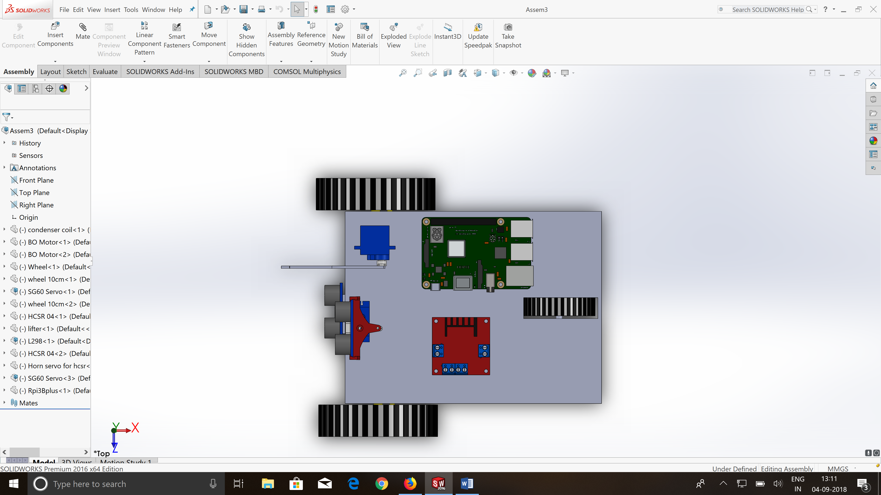
2. Why front wheel drive?
Stable while negotiating turns as compared to back wheel drive (which leads to sliding of front wheels).
Better to pull the back wheel instead of pushing the front wheel while negotiating steep climbs.

Slide 5
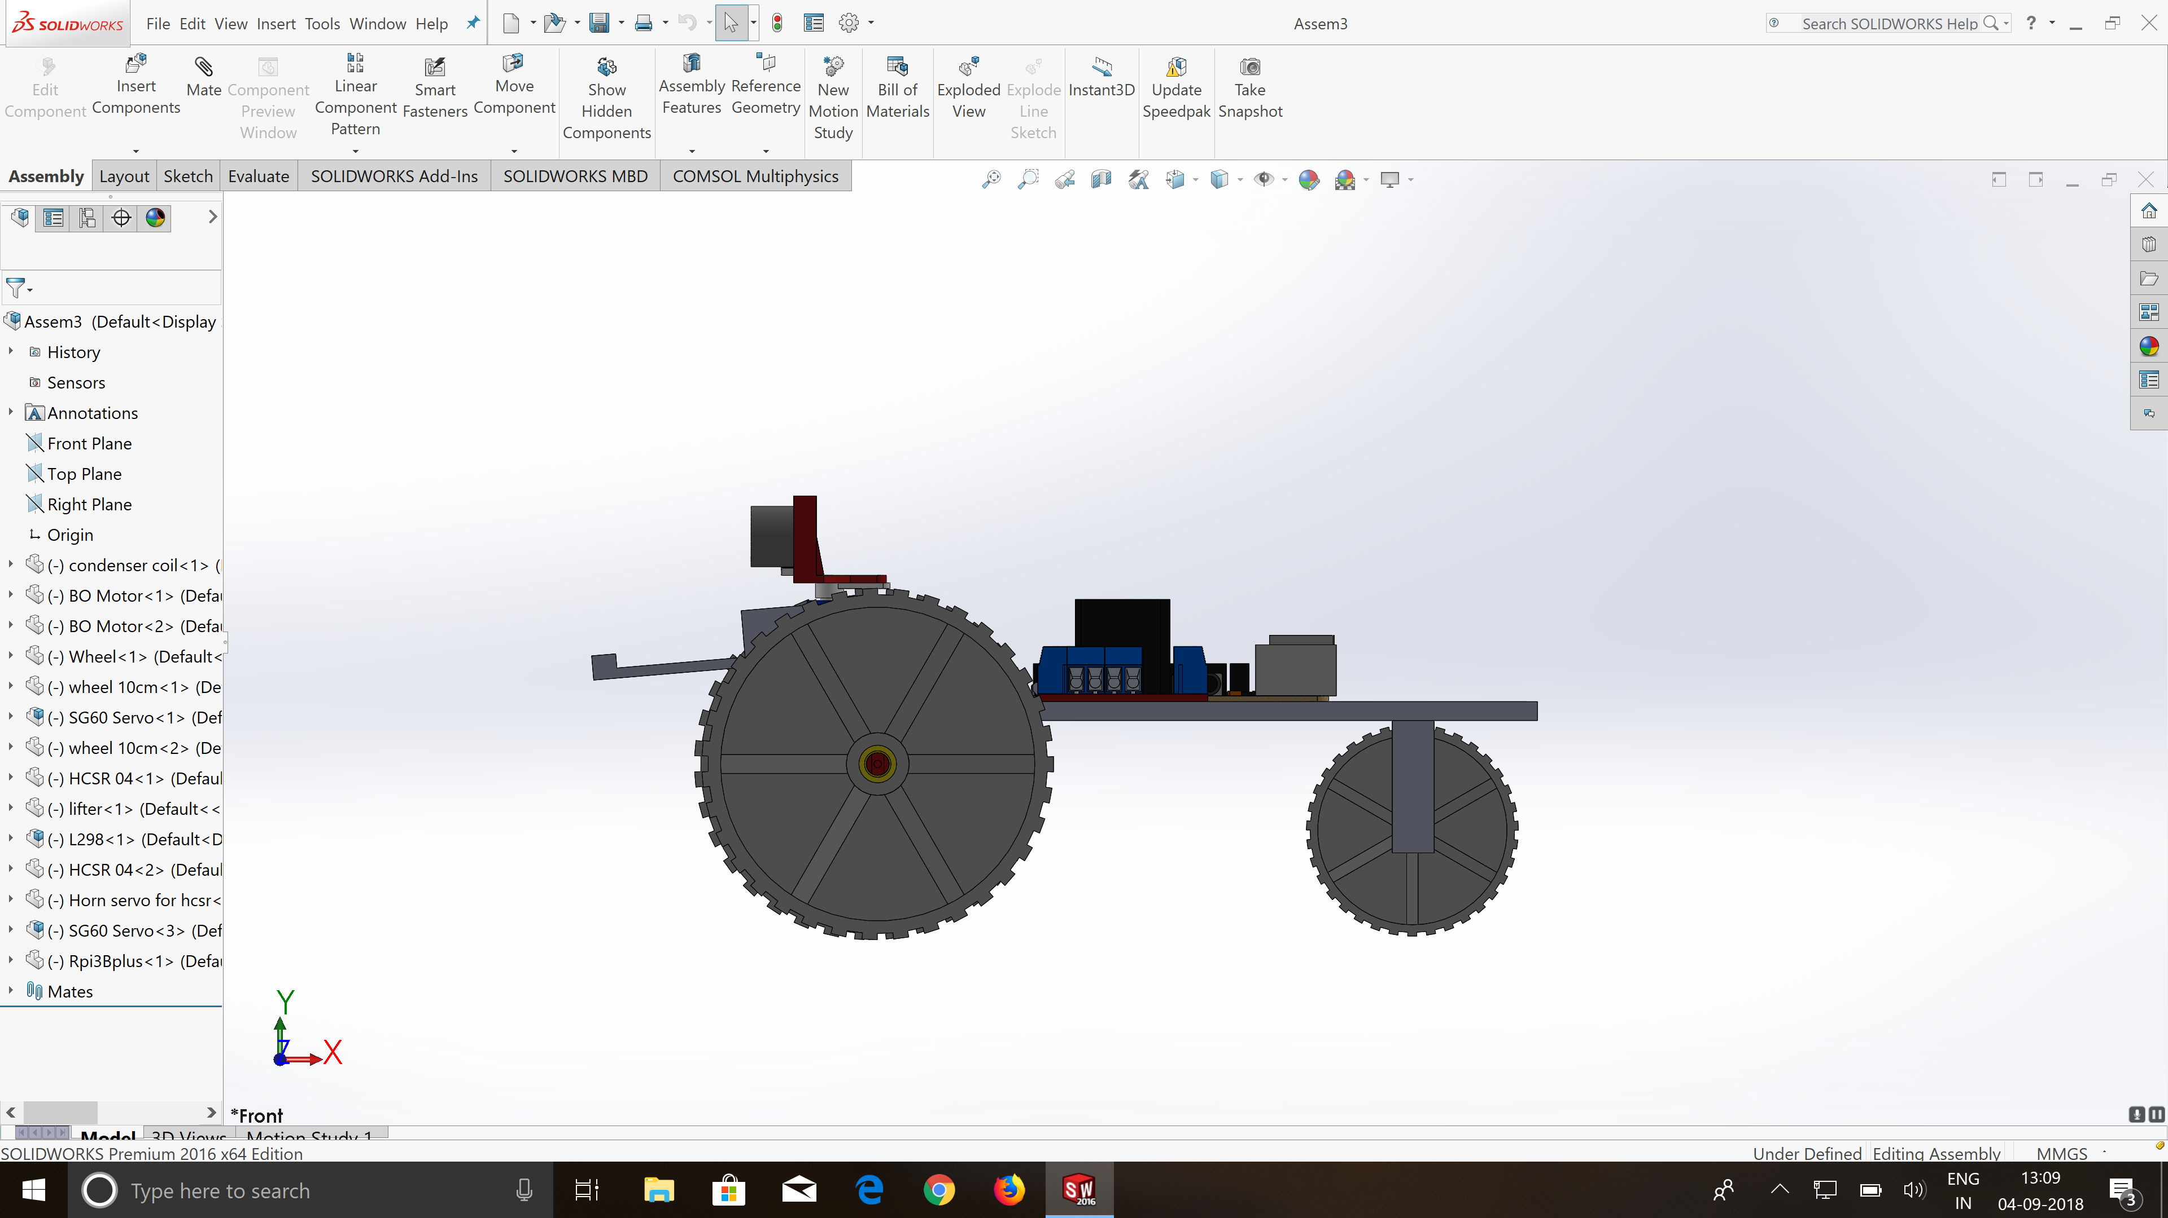
3. Lifting mechanism
Economical as compared to those involving forklift or magnets.
Simple and efficient design to lift small payloads.
One servo motor is dedicated for lifting the payload as per requirement. The servo motor actuates the Jib which in turn lifts the payload

Slide 6
4.Differentiating between Payload and obstacle
One sensor detects objects below 24 mm height and another detects objects above 26 mm. If both sensors or, the sensor detecting objects above 26mm, are active, the robot will go around the obstacle.
If the sensor detecting objects below 24 mm is activated alone and the payload has not been lifted, the robot will try lifting the object.
If the payload has been lifted and the robot senses an object of height less than 25 mm, it will go over the object.

Slide 7
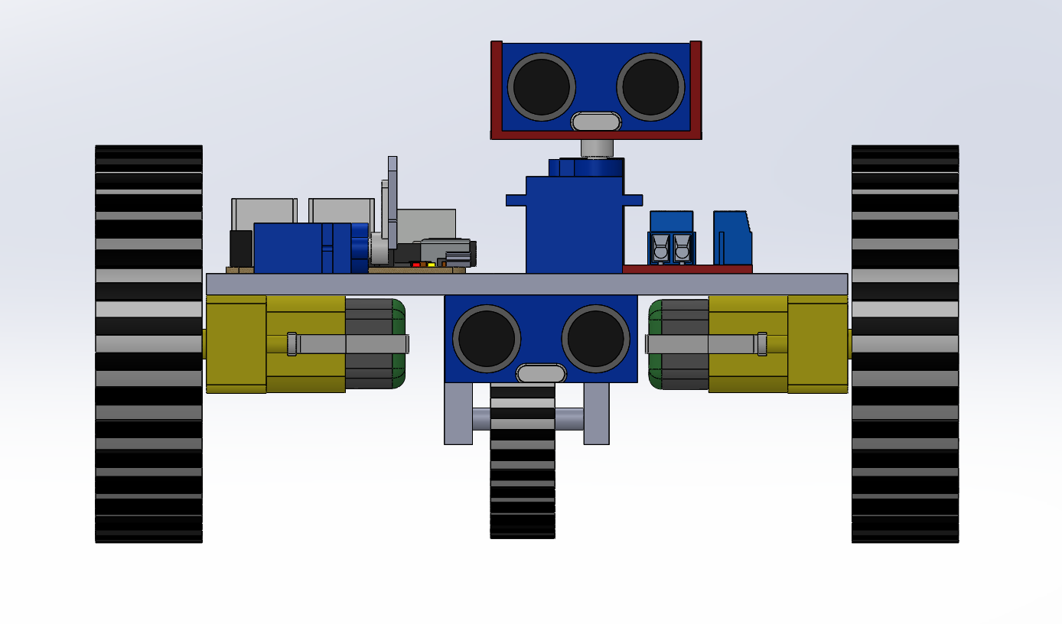
5.Obstacle avoiding algorithm
Once the sensor detects an obstacle, the robot stops. The ultrasonic sensor which is actuated using a servo motor, sweeps a certain angle and finds out the direction of unobstructed path. Wheels are then commanded to turn in that particular direction and to proceed until the next obstacle is spotted.

Slide 8
THANK YOU

